Slide 1

MAHAVEER INSTITUTE OF SCIENCE AND TECHNOLOGY
BANDLAGUDA, KESAVAGIRI,TELANGANA
Presentation On Image Steganography
PRESENTED BY :-
SURAJ VISHWAKARMA
SUBMITED TO :-
D.SRI LATHA REDDY(Asst. Prof)

Slide 2

IMAGE STEGANOGRAPHY

Slide 3
ABSTRACT
Steganography is the art of hiding the fact that communication is taking place, by hiding information in other information. Many different carrier file formats can be used, but digital images are the most popular because of their frequency on the internet. For hiding secret information in images, there exists a large variety of steganography techniques some are more complex than others and all of them have respective strong and weak points. Different applications may require absolute invisibility of the secret information, while others require a large secret message to be hidden. This project report intends to give an overview of image steganography, its uses and techniques. It also attempts to identify the requirements of a good steganography algorithm and briefly reflects on which steganographic techniques are more suitable for which applications.

Slide 4
Existing System
Information send through any network have chance to attack by hacker
Encryption provides an obvious approach to information security.
However encrypted information can be cracked by brutforcing hacks
Further more in many cases it is desirable to send information without anyone even noticing

Slide 5
Proposed System
In Steganography data is hidden inside a vessel or container that looks like it contains only something else.
Vessels can a digital image ,clip ,sound, even executable files
All of the traditional steganography techniques have limited information hiding capacity
They can hide only files or text message in an image

Slide 6
What is Steganography?
Steganography is the practice of hiding private or sensitive information within something that appears to be nothing out to the usual. Steganography is often confused with cryptology because the two are similar in the way that they both are used to protect important information. The difference between two is that steganography involves hiding information so it appears that no information is hidden at all. If a person or persons views the object that the information is hidden inside of he or she will have no idea that there is any hidden information, therefore the person will not attempt to decrypt the information.

Slide 7
Project Scope:
This project is developed for hiding information in any image file. The scope of the project is implementation of steganography tools for hiding information includes any type of information file and image files and the path where the user wants to save Image and extruded file.
Methodology:
User needs to run the application. The user has two tab options – encrypt and decrypt. If user select encrypt, application give the screen to select image file, information file and option to save the image file. If user select decrypt, application gives the screen to select only image file and ask path where user want to save the secrete file.
This project has two methods – Encrypt and Decrypt.
In encryption the secrete information is hiding in with any type of image file.
Decryption is getting the secrete information from image file.

Slide 8
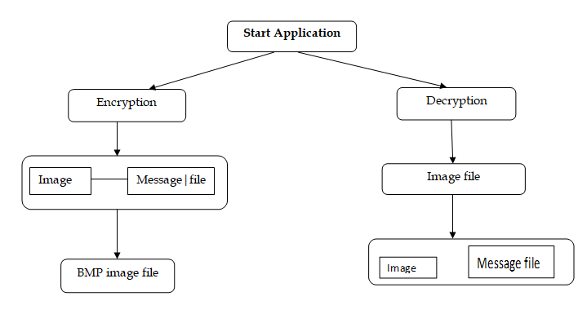
System Architecture

Slide 9
Software Requirements:
.NET Framework 4.0
Visual Studio 2010
OS Windows 7
Hardware Requirements:
Processor: Preferably 1.0 GHz or Greater.
RAM : 512 MB or Greater.

Slide 10
Summary
Steganography is a really interesting subject and outside of the mainstream cryptography and system administration that most of us deal with day after day.
Steganography can be used for hidden communication. We have explored the limits of steganography theory and practice. We printed out the enhancement of the image steganography system using LSB approach to provide a means of secure communication. A stego-key has been applied to the system during embedment of the message into the cover image.
This steganography application software provided for the purpose to how to use any type of image formats to hiding any type of files inside their. The master work of this application is in supporting any type of pictures without need to convert to bitmap, and lower limitation on file size to hide, because of using maximum memory space in pictures to hide the file.

Slide 11
Limitations of the Software:
This project has an assumption that is both the sender and receiver must have shared some secret information before imprisonment. Pure steganography means that there is none prior information shared by two communication parties.

Slide 12
Bibliography
Websites
Following websites are referring to create this project reports.
http://www.google.com
http://www.microsoft.com
http://www.programmer2programmer.net
http://www.codeproject.com
http://www.asp.net
http://www.asp123.com
Books
Following books and ebook are used to complete this project reports.
Mastering C# (Paperback)
SQL Server Bible (Paperback)
.NET Black Book (Paperback)
Professional C#, 2nd Edition (Paperback)
Professional ASP.NET (Paperback)
Source Code
Github https://github.com/topics/image-steganography

Slide 13
Thank You

