Slide 1


Hotel Booking Demand Prediction
IBM AI-Project
Student Name: SURAJ KUMAR
Enrollment No:A35404825103
Course : BCA
Institution: AMITY UNIVERSITY JHARKHAND RANCHI
Notes:
1

Slide 2
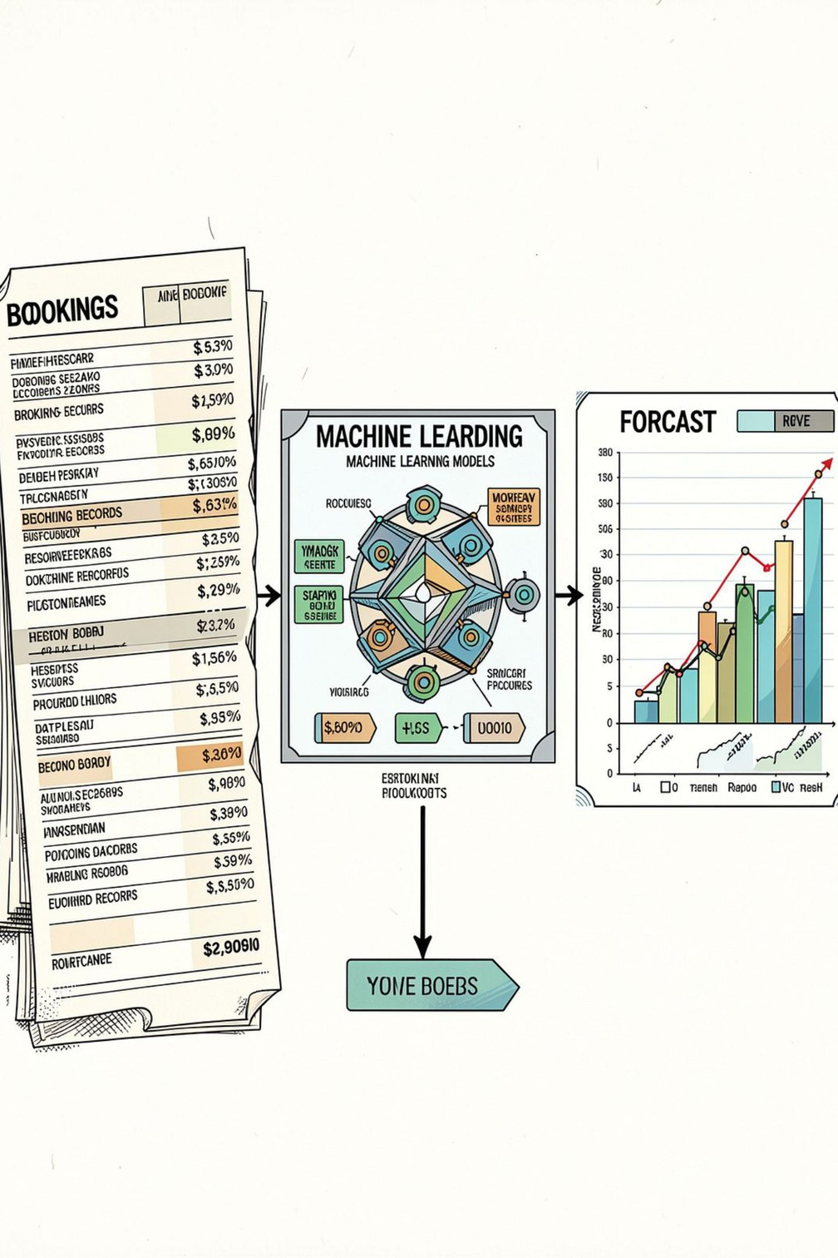
Problem Statement
Hotels require reliable daily demand estimates for staffing, inventory, and pricing.
Daily booking demand exhibits temporal variation (weekly, seasonal, yearly).
Historical booking patterns can inform predictive models.
This project applies machine-learning regression to predict daily hotel demand.
Historical Booking Data → Machine Learning → Demand Prediction
Notes:
2

Slide 3
Project Objective
Primary Goal
Analysis
Feature Work
Predict daily hotel booking demand from historical records.
Explore temporal patterns and feature relationships.
Create calendar, lag, and rolling features.
Modeling
Prediction Demo
Train & compare four regression models; evaluate with MAE, RMSE, R².
Predict on unseen input to demonstrate usage.
Notes:
3

Slide 4
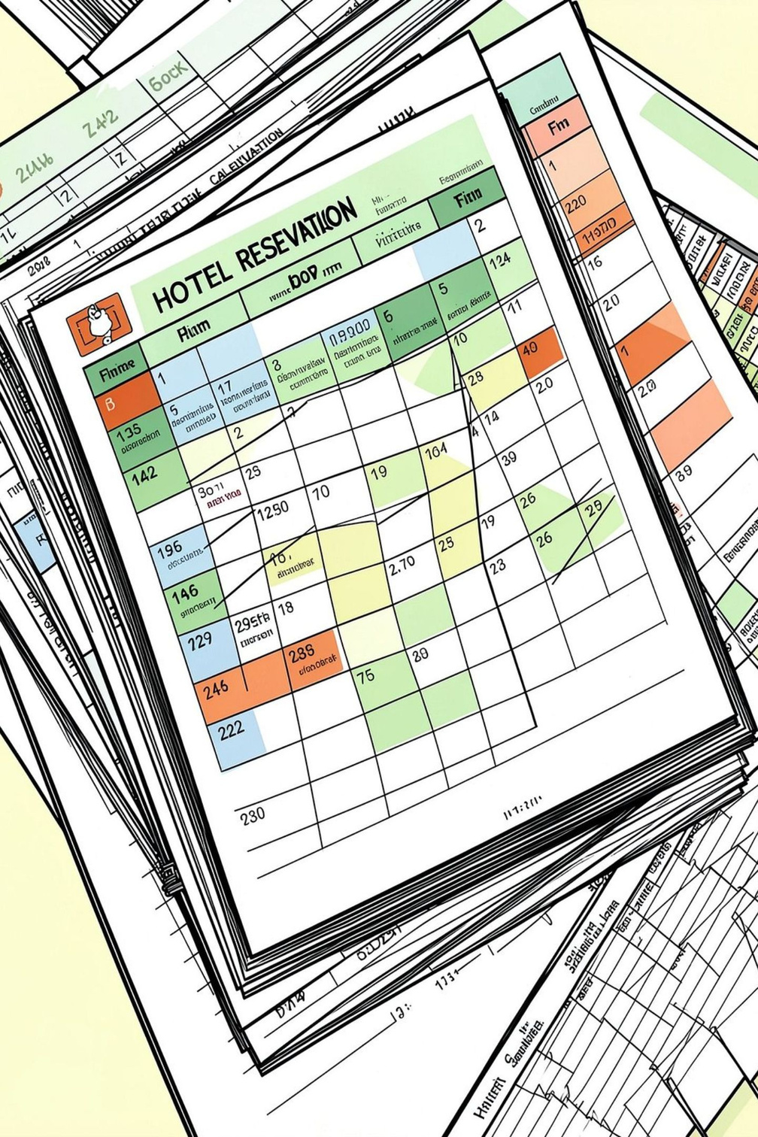
Dataset Description
Source: Historical hotel booking data aggregated to daily records.
Prepared dataset size: 793 daily observations.
Target variable: daily hotel booking demand (demand).
Key features
day_of_week, month, year, week_of_year, is_weekend
lag_1, lag_7, rolling_7
Daily booking records were aggregated to create the daily demand prediction dataset.
Notes:
4

Slide 5
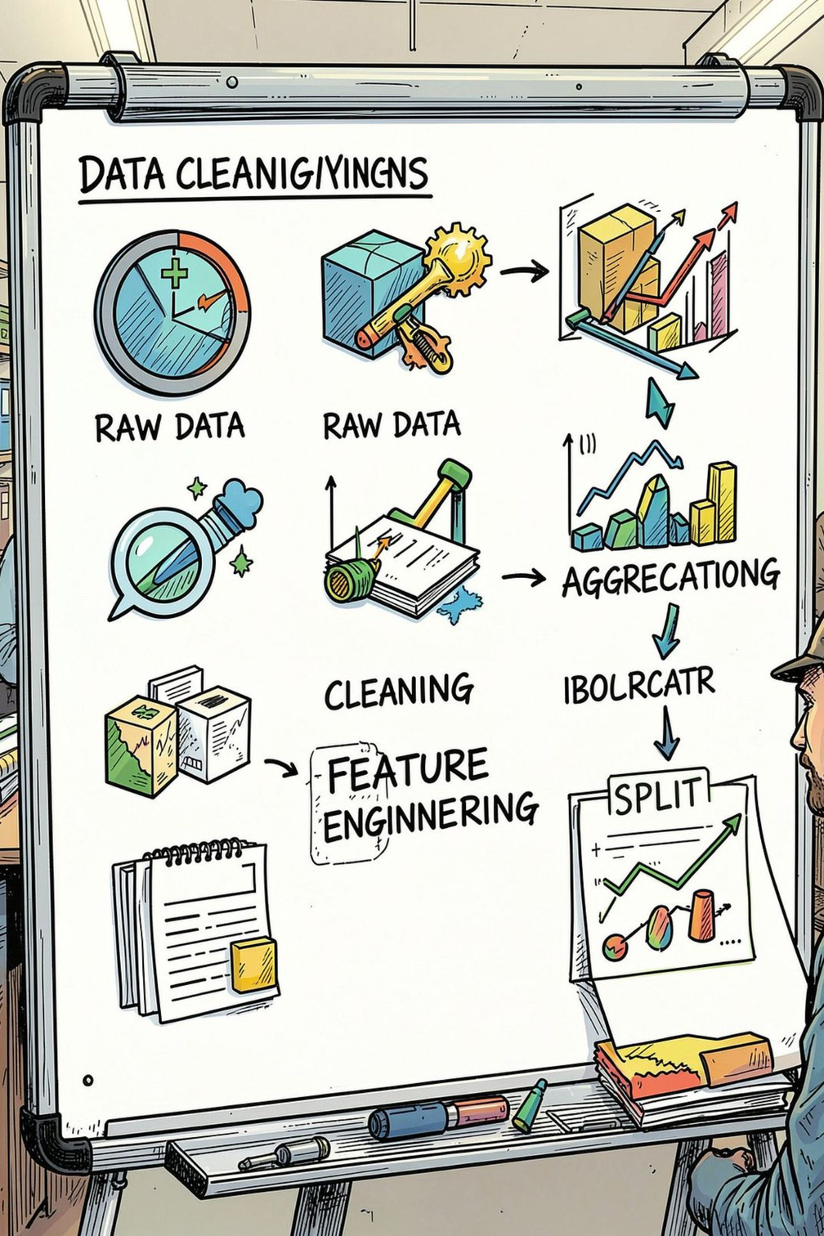
Data Preprocessing
Checked structure, missing values, and duplicates.
Processed arrival dates and aggregated bookings to daily demand.
Created calendar (time-based) features and lag / rolling features.
Used time-based train/test split to avoid leakage.
Train/Test Split
Training: 628 observations
Testing: 158 observations
Workflow: Raw Data → Cleaning → Daily Demand → Feature Engineering → Train/Test Split
Notes:
5

Slide 6
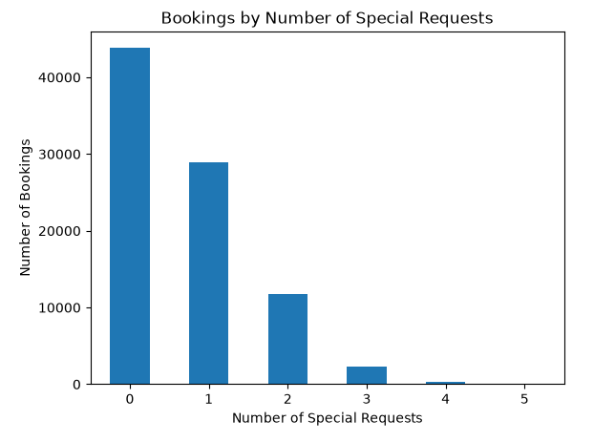
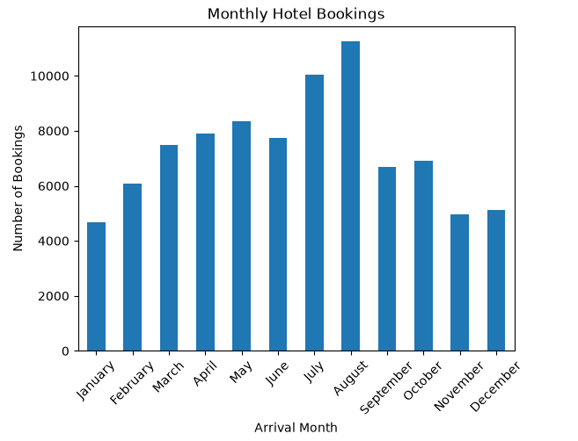
Exploratory Data Analysis (EDA)
The cleaned dataset contains 87,229 booking records and 32 columns.
City Hotel has more bookings (53,274) than Resort Hotel (33,955).
24,009 bookings were canceled, while 63,220 were not canceled.
The overall cancellation rate is approximately 27.52%.
August has the highest number of bookings with 11,242 bookings, while January has the lowest with 4,685 bookings.
2016 has the highest number of bookings with 42,313 records.
Notes:
6

Slide 7
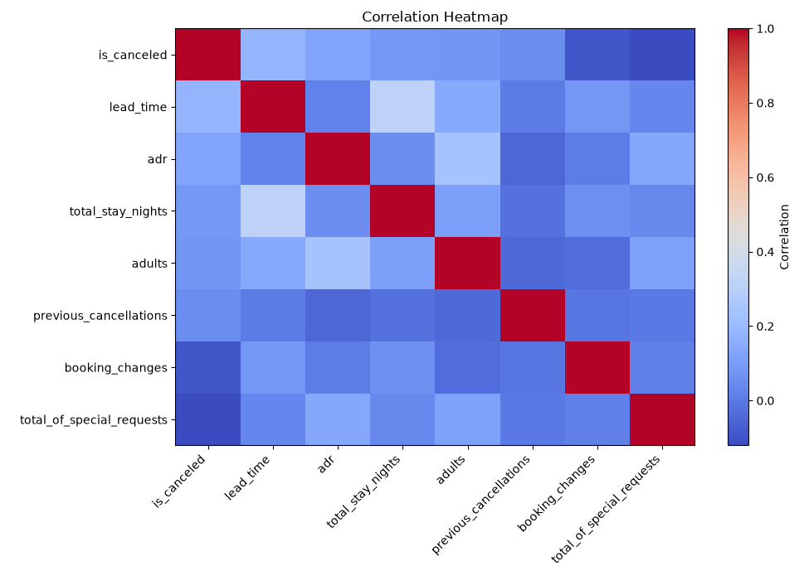
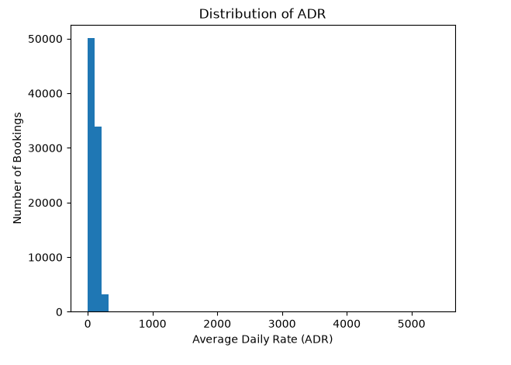
EDA
Transient customers form the largest customer segment with 71,862 bookings.
Room Type A is the most frequently reserved room type with 56,435 bookings.
The average total stay is approximately 3.63 nights, with a median of 3 nights.
Most bookings have relatively short stays, mainly around 1 to 5 nights.
The lead time distribution is right-skewed, with a median of 49 days and an average of approximately 79.97 days.
Most bookings have no special requests.
The ADR distribution is right-skewed, with most bookings concentrated at lower ADR values.
Correlation analysis shows mostly weak relationships among the selected numerical variables.
The strongest observed relationship is between lead_time and total_stay_nights, with a correlation of approximately 0.321.
No very strong correlation was observed among the selected numerical features.

Slide 8
Feature Engineering
Calendar Features
Historical Demand Features
day_of_week — day index (Mon–Sun)
month — calendar month
year — arrival year
week_of_year — ISO week number
is_weekend — boolean for weekend
lag_1 — previous day's demand
lag_7 — demand seven days earlier
rolling_7 — 7-day rolling average of demand
Feature importance (Random Forest)
rolling_7
lag_7
0.504157
0.166339
lag_1
day_of_week
0.134810
0.079032
week_of_year
month
0.070081
0.028281
year
is_weekend
0.011875
0.005426
Note: rolling_7 is the most important feature in the Random Forest model.
Notes:
7

Slide 9





ML Methodology & Models
Selection & Prediction
Model Development
Data Preparation
Linear Regression
Random Forest Regressor
Baseline linear model for relationship estimation.
Ensemble of trees to capture non-linearities and interactions.
Gradient Boosting Regressor
Artificial Neural Network (ANN)
Sequential tree boosting to reduce bias.
Feed-forward network; inputs scaled with StandardScaler.
Notes:
8

Slide 10
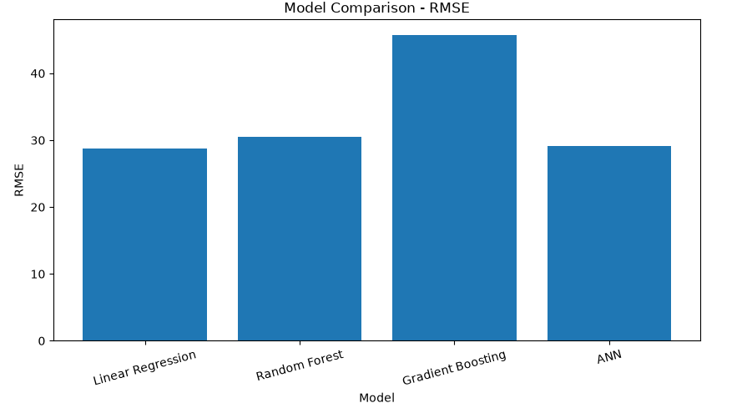
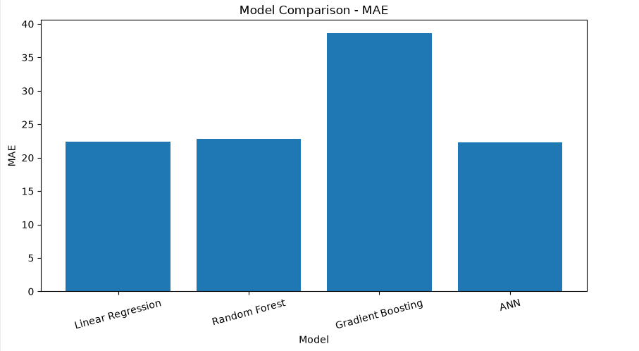
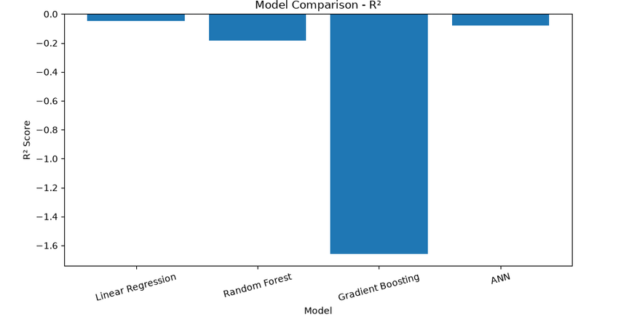
Model Evaluation & Comparison
Metrics on test set — lower MAE/RMSE is better; higher R² is better.
Key observations
Interpretation
MAE: ANN lowest (22.254582).
RMSE: Linear Regression lowest (28.747222).
R²: Linear Regression highest (-0.049421) — note negative values indicate low explanatory power vs baseline.
All models show limited explanatory power on the test set (negative R²).
ANN minimizes absolute error; Linear Regression minimizes squared error and yields best R².
Notes:
9

Slide 11
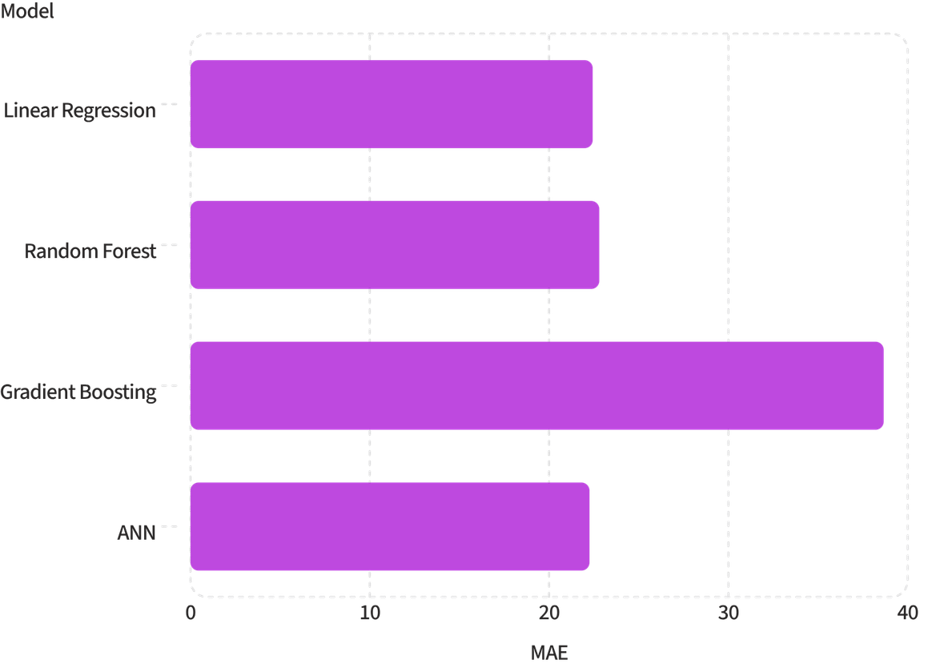
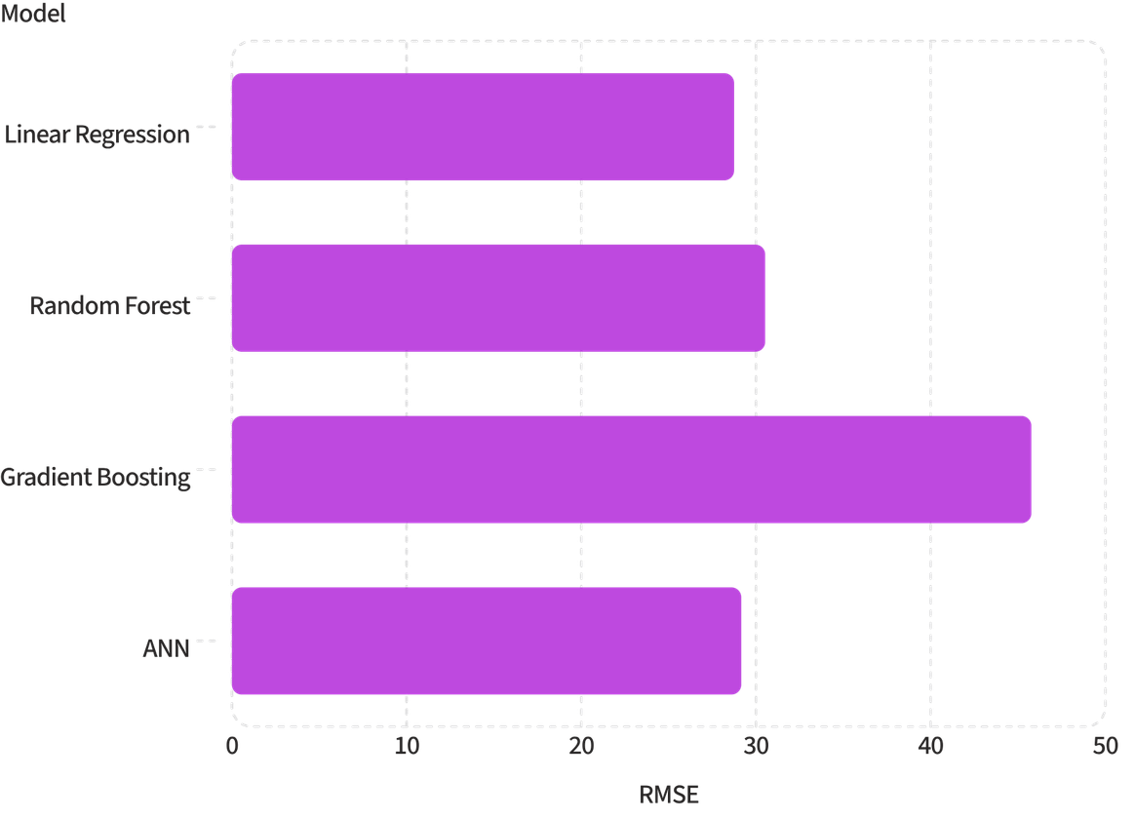
Model Evaluation & Comparison
Comparison uses the exact test-set metrics from the project.
Model | MAE | RMSE | R²
Linear Regression | 22.432493 | 28.747222 | -0.049421
Random Forest | 22.797975 | 30.523246 | -0.183094
Gradient Boosting | 38.659776 | 45.759936 | -1.659063
ANN | 22.254582 | 29.156207 | -0.079493
Interpretation: Lower MAE/RMSE indicate better predictive accuracy; higher R² indicates better explanatory power. ANN achieved the lowest MAE. Linear Regression produced the lowest RMSE and the highest (least negative) R². All models show negative R² on the test set, indicating performance worse than the baseline mean predictor on held-out data.

Slide 12
Prediction
Example single-point prediction performed in the notebook using the final Linear Regression model on manually provided unseen input.
Predicted Hotel Demand = 124.7425 ≈ 124.74
Final Prediction (Linear Regression)
This prediction was generated by the final Linear Regression model on a manually supplied unseen feature vector (details available in the notebook). Use the notebook screenshot as proof of the exact inference step.

Slide 13
Results, Conclusion & Limitations
Results
Final Model
Limitations
- ANN achieved the lowest MAE: 22.2546.
- Linear Regression achieved the lowest RMSE: 28.7472.
- Linear Regression achieved the highest R²: -0.0494.
- Gradient Boosting showed the weakest performance.
Linear Regression selected as the overall final model due to best RMSE and highest R² among evaluated models on the test set.
All models produced negative R² values on the test set — limited explanatory power vs baseline.
Important external drivers (events, weather, promotions) were not included.
Temporal non-stationarity and data sparsity can reduce generalisation.
Further data collection and modelling refinements are needed.

Slide 14
Future Scope & GitHub
Improve forecasting with more historical and external variables.
Tune model hyperparameters and evaluate additional approaches.
Explore stronger time-series forecasting methods.
GitHub Repository: https://github.com/suraj116k-code/IBM-Hotel-booking-demand-prediction-project
Thank You

