Slide 1

Movie Recommendation System
Group Members -
1- Suraj Shetty
2-Akshay Rathod
3-Akshay Udeg
Guide – Ms. Sukhada aloni

Slide 2
Keywords
Recommendation System
Content Based Filtering
Netflix Shows recommendation
Data Mining
DataSet

Slide 3
Introduction
With the development of mobile Internet, the TV industry is facing threats and challenges. This is because Big Data is changing the industry. The primary task of TV industry like Netflix is how to take the advantage of Big Data technology.
For Netflix programs, audience rating is the metrics whether the program is good or not. The more time the audience is watching the particular show ,the more popular the show is for the Audience.

Slide 4
This paper proposes a movie program recommendation system. The system is based on Big Data technology and content based recommendation which can automatically push programs to audience according to their interests.
This movie recommendation system is designed to suggest similar movies which is user is currently watching, and catch the attention of audiences. The system is based on massive user data, and data mining algorithms to analyze the user's interests.

Slide 5
Technology Stack
Google Colab(machine learning)
Python
Python Flask

Slide 6
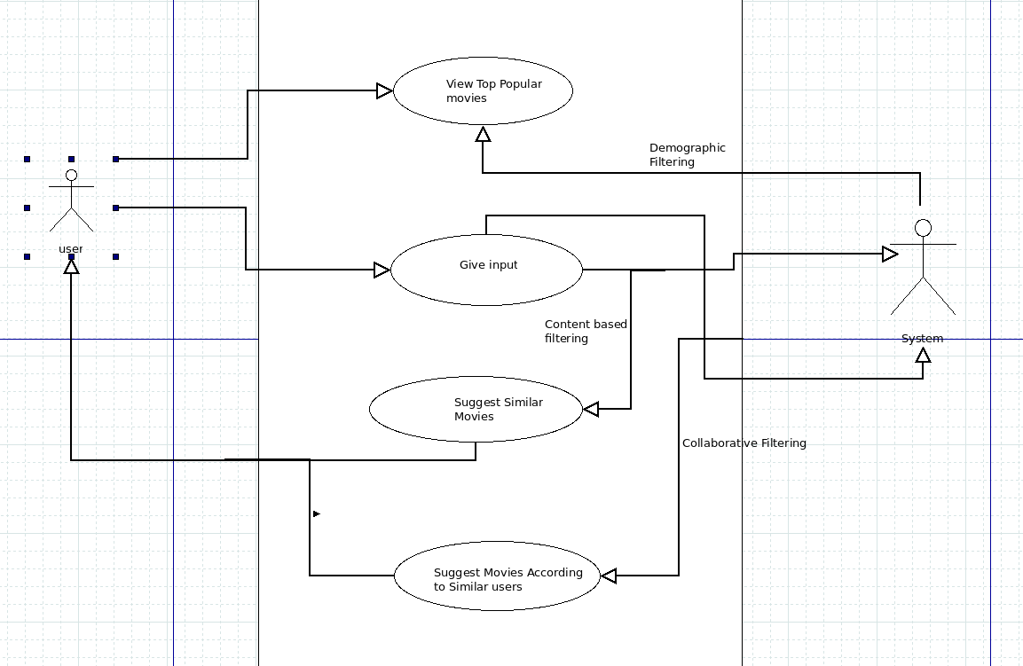

Slide 7
Benefits For Society
By using this recommendation system the cable operators having there default channel which are free to the users can start showing them the popular movies on that channel .By this way the cable operators will get the money which will be generated by the advertisement and the end users will not have to pay extra money for getting the channels which are showing similar movies.

Slide 8
Applications
Netflix uses this technology to recommend the users the similar shows which the user is watching so that the more the time the user spends on the applications and makes the subscriptions the more will be the revenue generated. By using Content based Filtering and Collaborative based Filtering the system can display similar movies which the user is currently watching.
Youtube also uses this technique to recommend the users the similar videos by analyzing the users behaviour and as per that recommend the similar videos on there channel.

Slide 9
Literature Review
1.Tv program recommendation system based on big data:
DOI: 10.1109/ICIS.2016.7550923 :
There are errors of program ratings recommendation system, and the program list is affected by human emotion as well. Our Program Recommended system based on Big Data reasonably gives solution to those drawbacks.
2. Through Data Analytics the watch time of particular Human-Machine can be used to determine the type of shows user like to watch.

Slide 10
Conclusion
According to the mass data collected and multi-dimensional analysis, we can find the most beneficial shows broadcast playbill, and discover the similar movies with respect to the users interest and can efficiently use the data available.

