Slide 1
Introduction to OneM2M
Suraj and Lavanya
3rd April, 2019
IIIT-H

Slide 2
Today’s topics
Case study : Existing IoT Solutions
Introduction to OneM2M
Why OneM2M
Ontology
Using OneM2M
Intro to the upcoming lab experiment

Slide 3
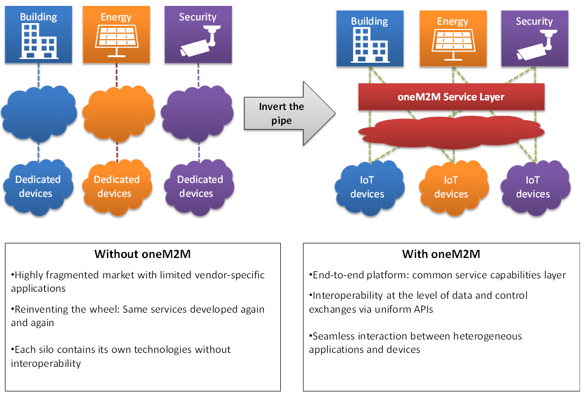
A simple case
Highly fragmented market with limited vendor-specific applications
Re-inventing the wheel : Same services developed again and again
Each silo contains its own technologies without interoperability
Source : http://www.onem2m.org/images/app_dev_guide/tr-0057/sillos.png

Slide 4
The challenges
Interoperability
Scalability
Device management
Notes:
And then we say OneM2M eliminates these issues and proceed to introduce the framework

Slide 5
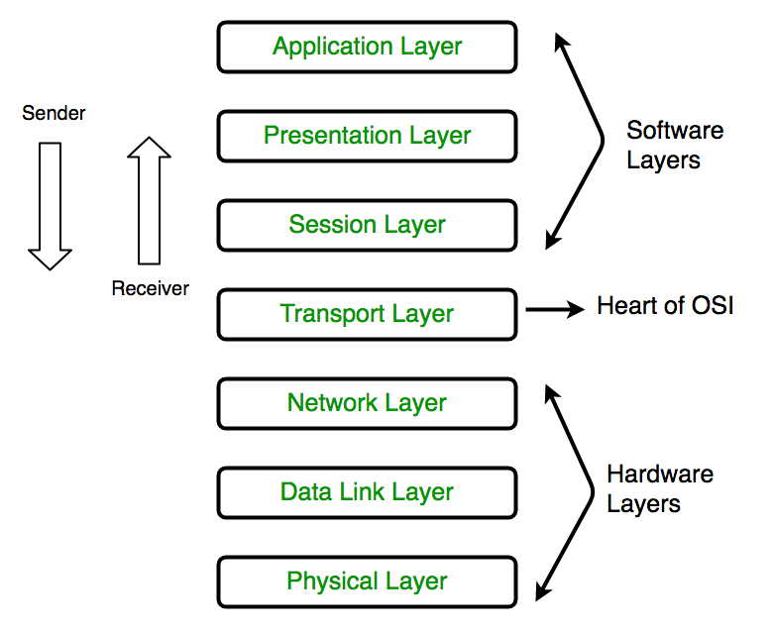
Network Layer
The oneM2M Service layer
https://cdncontribute.geeksforgeeks.org/wp-content/uploads/computer-network-osi-model-layers.png

Slide 6
What is oneM2M
Global standardization for M2M and IoT
Not across all the layers of the networking stack
Provides a software framework by creating a horizontal layer across domains.
This service layer is located between applications and hardware infrastructure
Enables reusability
Members consist of various standard bodies, ICTs and companies.
Work was initiated in 2008
Notes:
Horizontal - across various application domains
Service layer - middleware(sitting between processing / communication hardware and IoT applications)

Slide 7
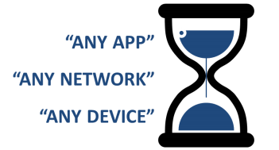
What oneM2M IS NOT
Standardize interfaces, not entire environment across networks
Device interoperable but is not network agnostic
Only IP (Internet Protocol) is supported
Notes:
top of IP. However, non-IP transports are also supported via interworking proxies.

Slide 8
Need for standardization
To provide scalability and flexibility
Improves functionality-cost-quality trade off
Set of APIs communicating with the service layer reduces:
Time-to-market
Development and on-boarding costs
Management of devices and applications

Slide 9
With oneM2M
End-to-end platform : common service capabilities layer
Interoperability at the level of data and control exchanges via uniform APIs
Seamless interaction between heterogeneous applications and devices
Source : http://www.onem2m.org/images/app_dev_guide/tr-0057/sillos.png
Notes:
Example : a security application detects that when noboby is in the building, it triggers the switching off of the light and it stops the air conditioning.

Slide 10
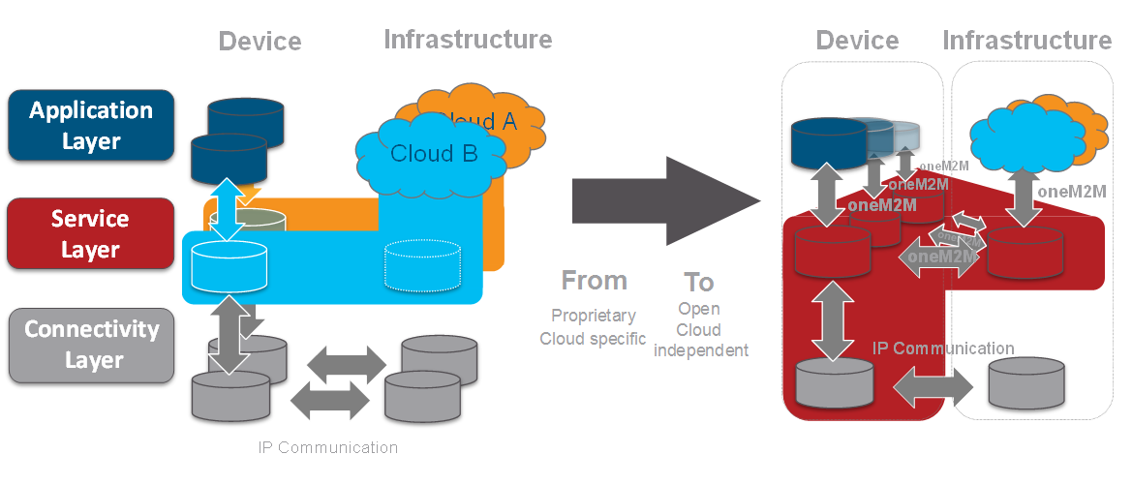
Cloud Interoperability
Source : http://www.onem2m.org/images/app_dev_guide/tr-0057/cloud_provider.png

Slide 11
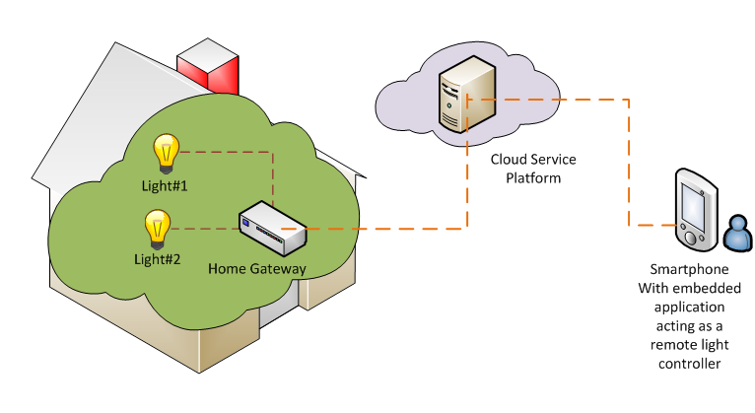
Ontology
http://www.onem2m.org/images/app_dev_guide/UseCase.png
Notes:
Explain what infrastructure nodes and middle nodes are

Slide 12
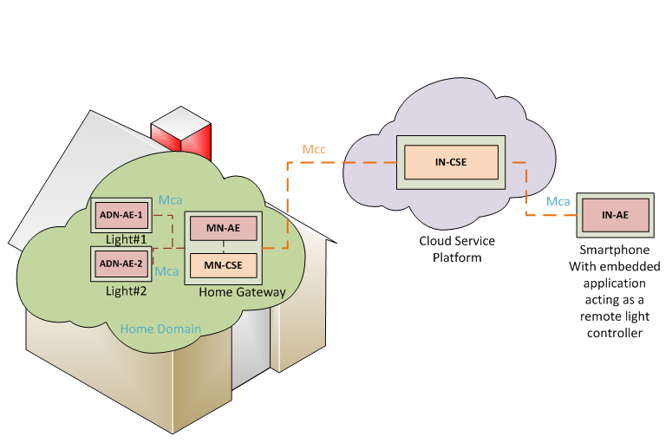
IN : Infrastructure Node
MN : Middle Node
CSE : Common service entity
AE : Application Entity
ADN : Application Device Node
http://www.onem2m.org/images/app_dev_guide/UseCase.png
Notes:
Onem2m defines

Slide 13
Steps to use OneM2M
Registration
Initial Resource Creation
Discovery of Container Resource
Discovery and Retrieval of Light states
Controlling the lights
Notes:
Show the tree structure

Slide 14
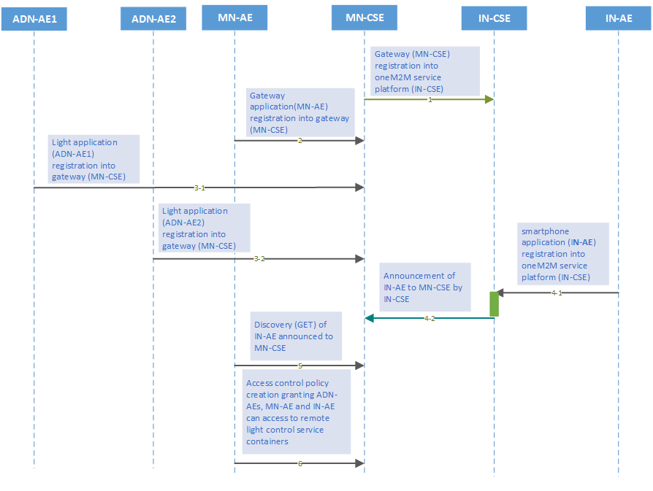
Registration Call Flow
Lights Home Gateway Cloud Mobile
http://www.onem2m.org/images/app_dev_guide/RegistrationCallflow.png
Notes:
Why shud we register?

Slide 15
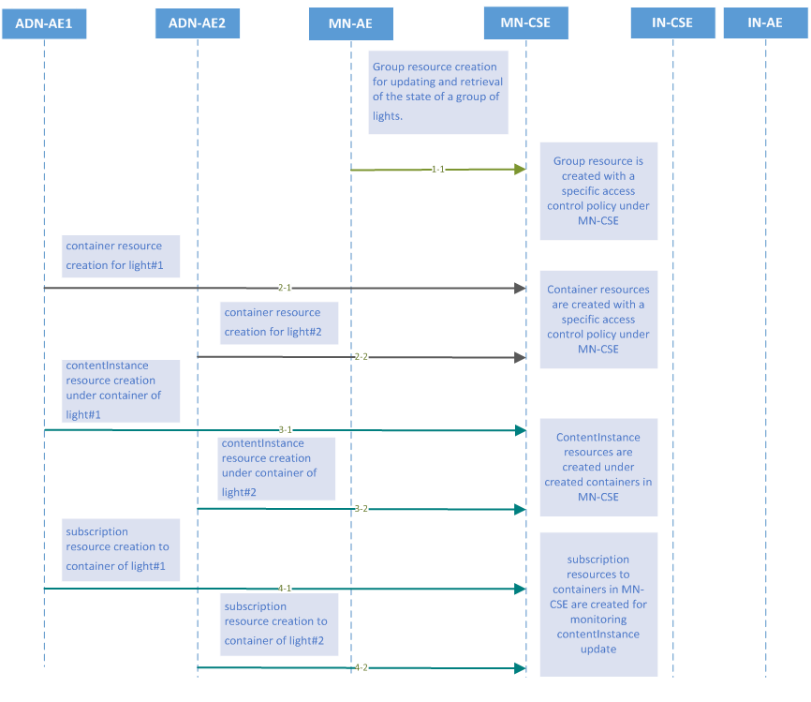
Resource Creation
http://www.onem2m.org/images/app_dev_guide/InitResourceCreation.png

Slide 16
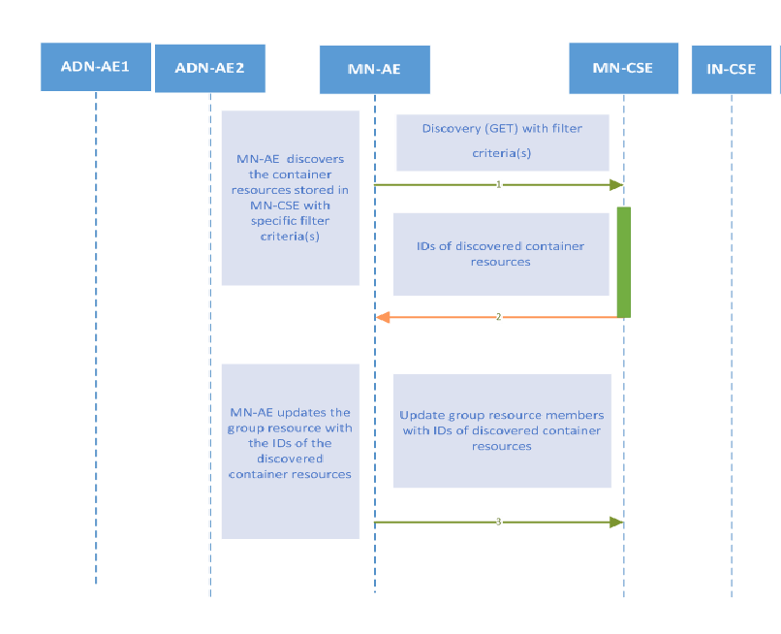
Container Discovery
http://www.onem2m.org/images/app_dev_guide/DiscCont.png

Slide 17
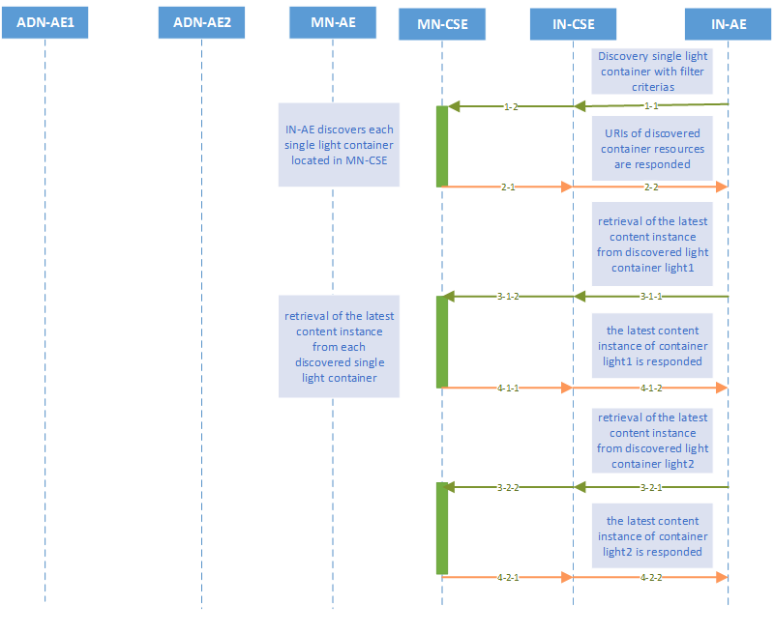
Discovery & Content Instance Retrieval
http://www.onem2m.org/images/app_dev_guide/DiscoveryRetrieval.png

Slide 18
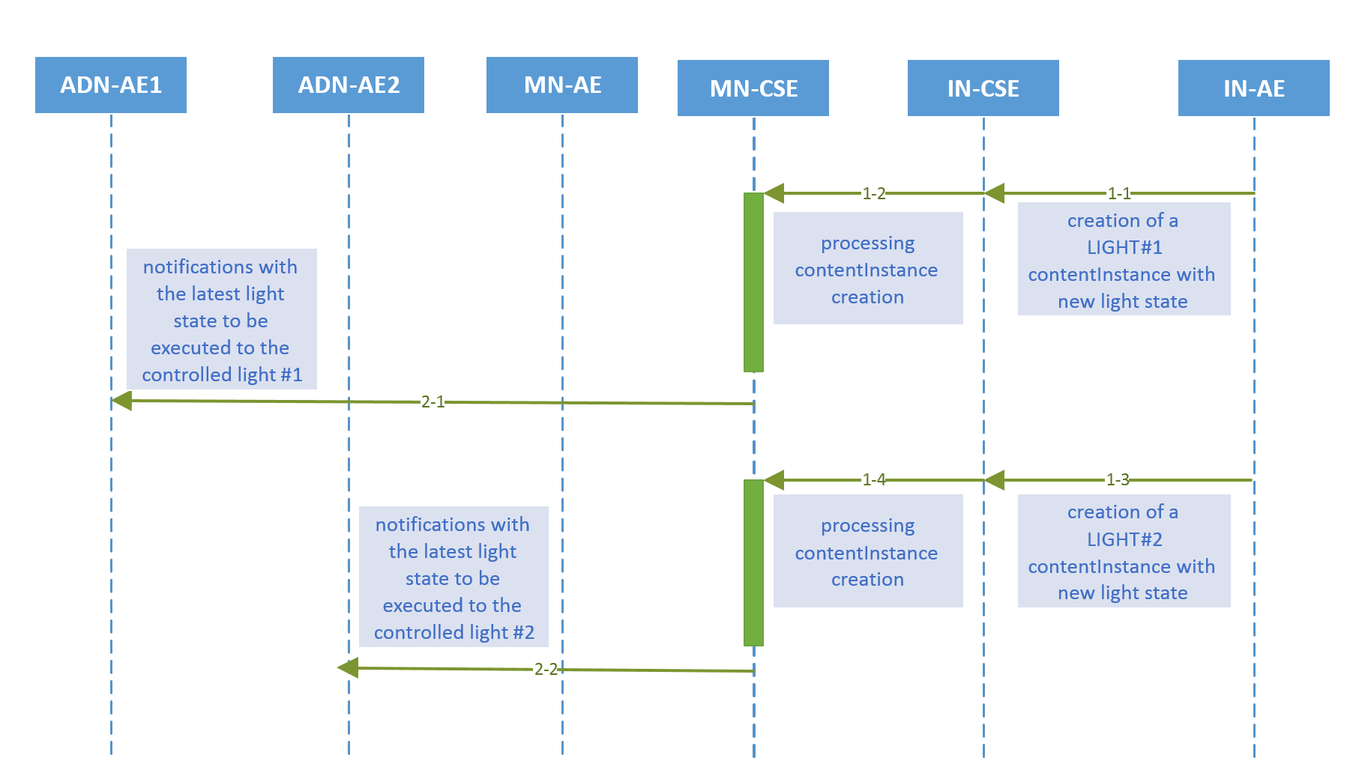
Light Control
http://www.onem2m.org/images/app_dev_guide/LightControl.png

Slide 19
Features of OneM2M
authentication, authorization, encryption
remote provisioning & activation
connectivity setup
buffering
scheduling
synchronization
aggregation
group communication
device management

Slide 20
Summary
OneM2M facilitates interoperability
Simple procedures allow developers to
build scalable systems
Focus on the idea/business rather than rewriting code
IoT products Easily maintainable

Slide 21
Upcoming Lab Session
What will you be doing?
Focus on the basics
Semi-Building OM2M methods on your own
Establishing Communication with sensors and actuators
Here is the “Requirements” document: (link)

Slide 22
References
Smart Cities with OneM2M
REST APIs
OneM2M Developer Guide
Node-RED : A Dashboard for visualizing data

