Slide 1
Welcome To
Digital Book
Presenting Name
Suraj Laxman Jadhav

Slide 2
Digital Book -
Digital Books Application which takes traditional books a step further. Traditionally Reader has to go to the store to buy book and publisher also need to print that book copies multiple times which is difficult. So I have developed Digital Book Application where Authors can upload their books content using this application on single click and Readers can read book very easily.

Slide 3
Application UI Components
Signup
Login
Home Page
Search Book
Buy Book
Add Book
Update Book

Slide 4
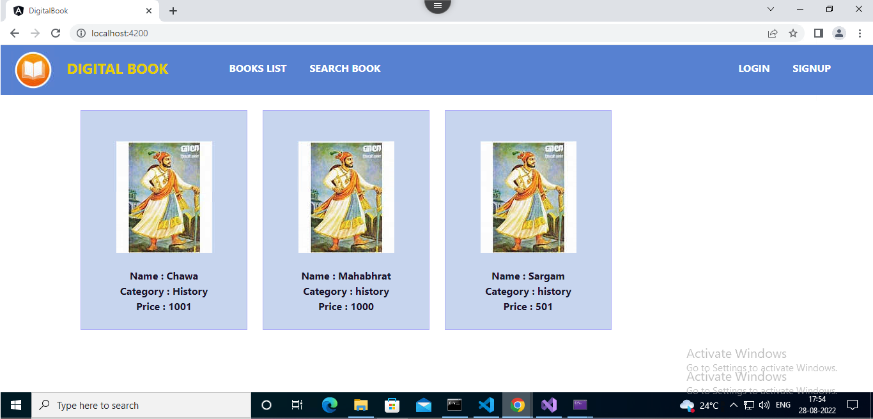
Home Page – Displays All the list of available books.

Slide 5
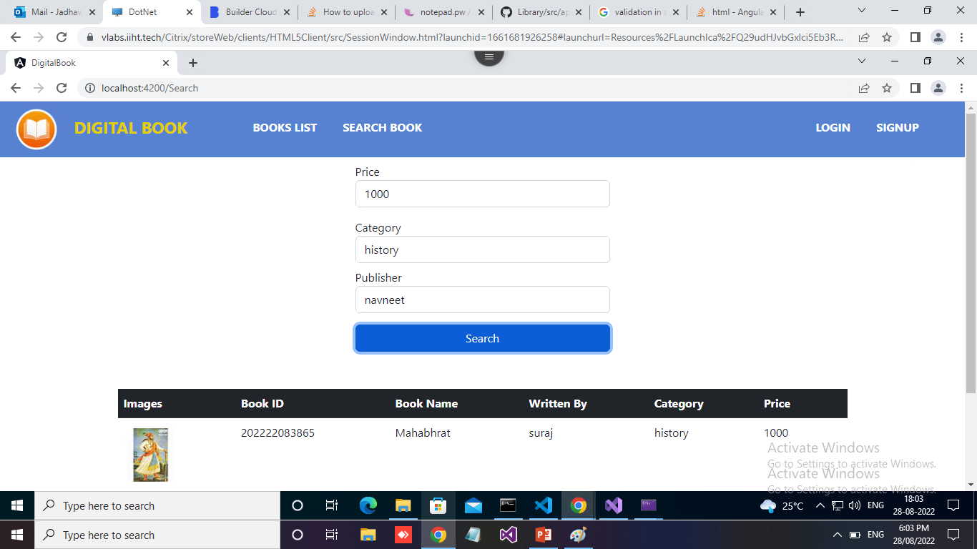
Search Book – Search for book by given price, category, publisher and shows list of Books.

Slide 6
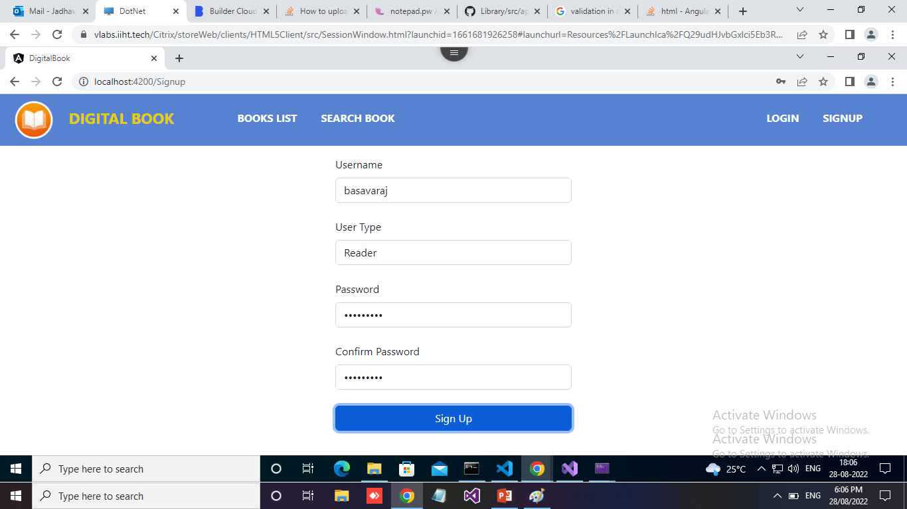
Sign Up – Reader or Author can create his account.

Slide 7
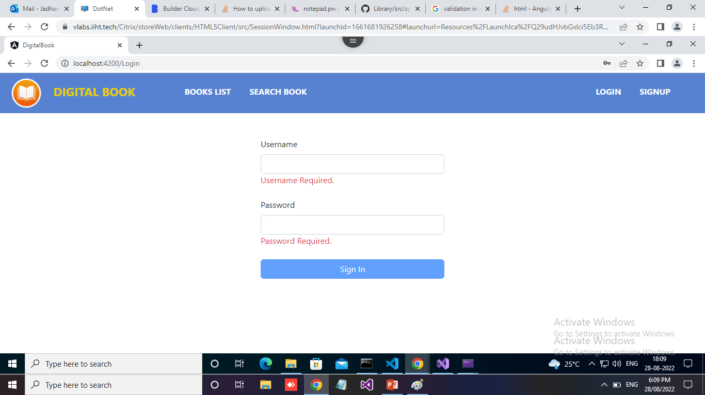
Login – After creating account Reader or Author can sign in using credentials.

Slide 8
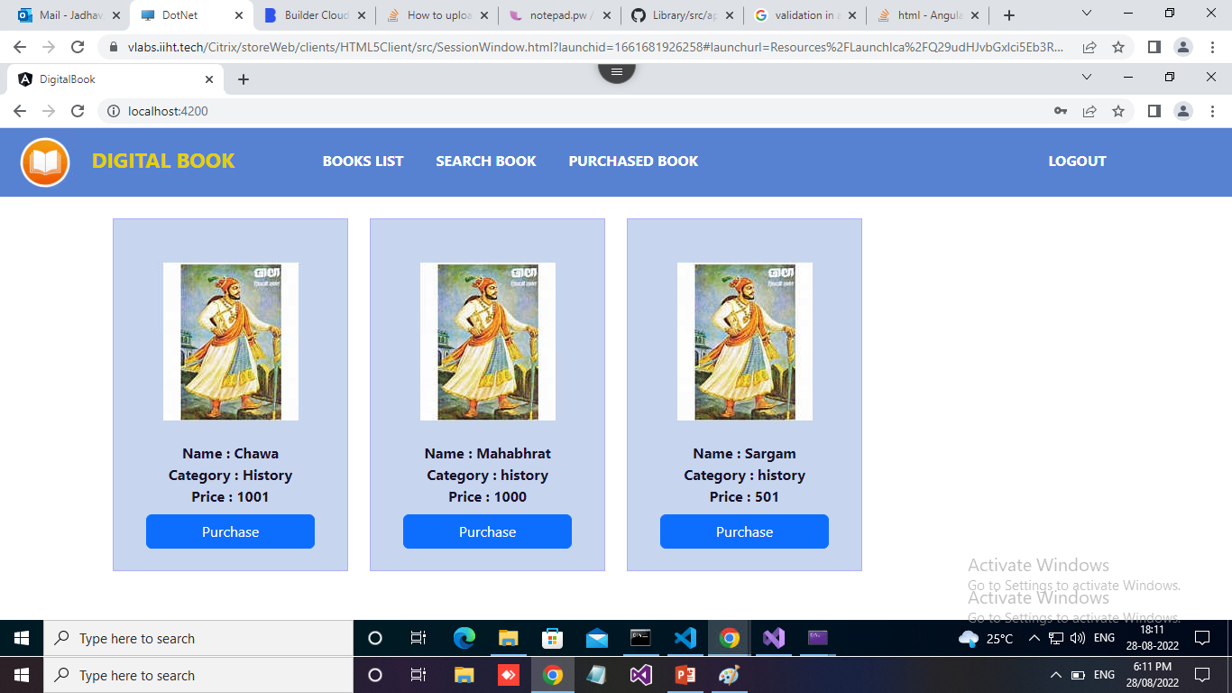

Slide 9
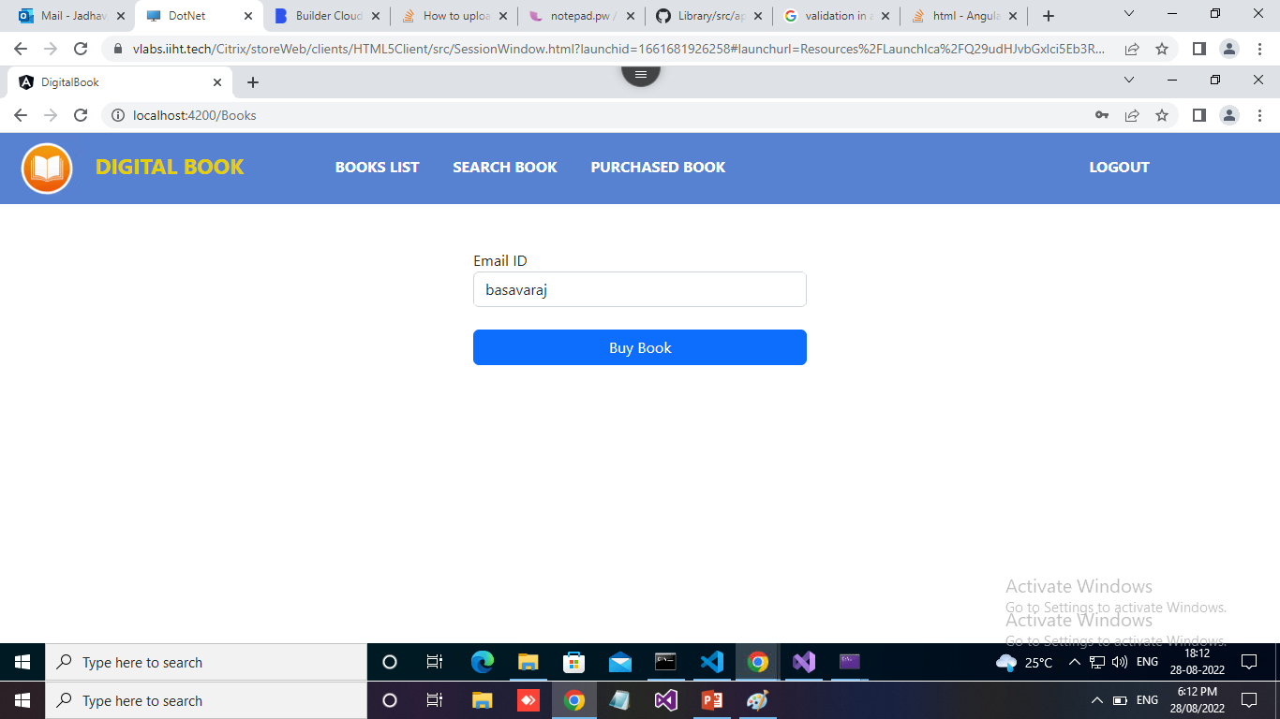
Purchase Book – User can buy book by providing email ID.

Slide 10
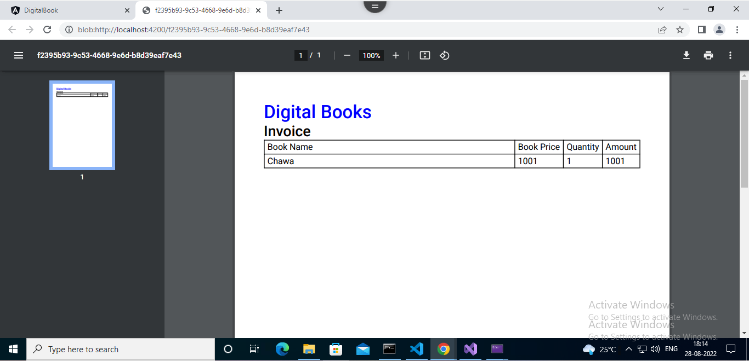
Invoice – After purchasing Book user can download purchase receipt.

Slide 11
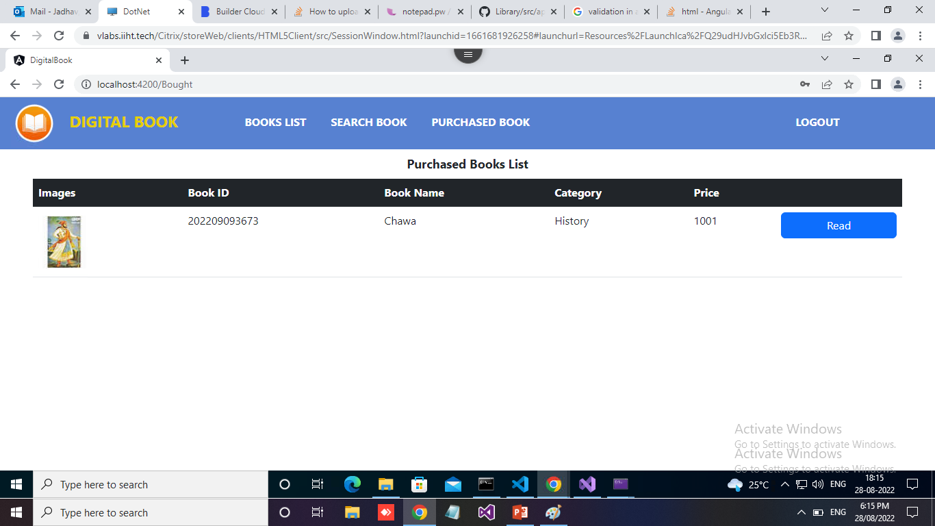
Purchased Books – After purchasing book user can see list of purchased book and read it.

Slide 12
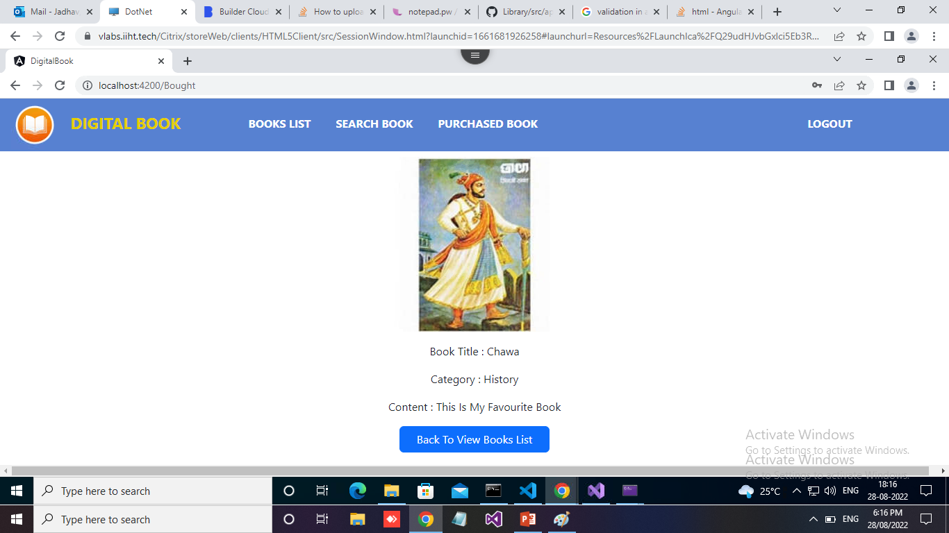

Slide 13
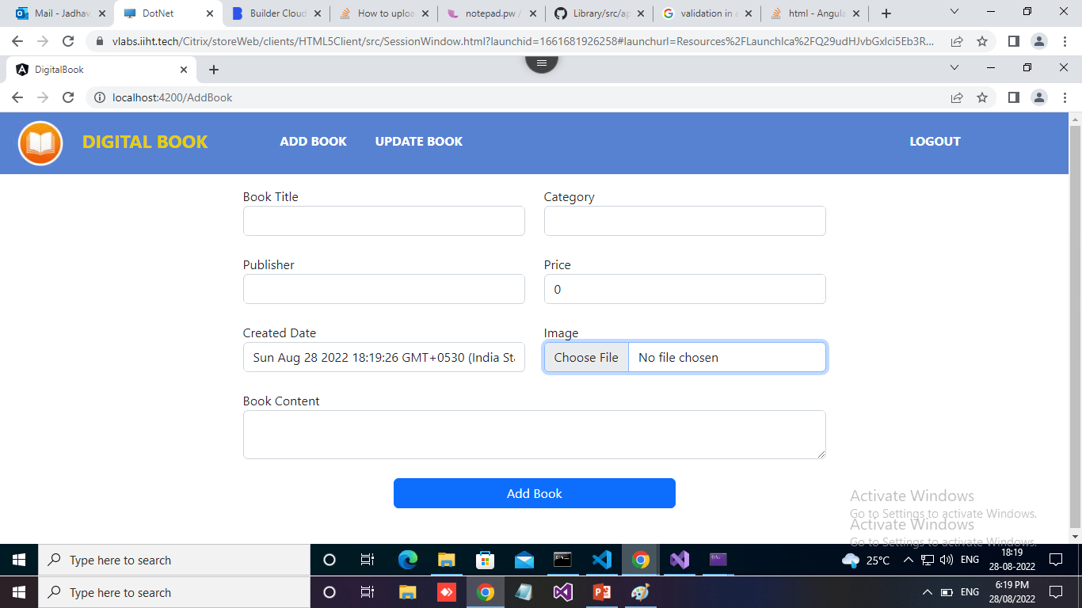
Add Book – Author can add book.

Slide 14
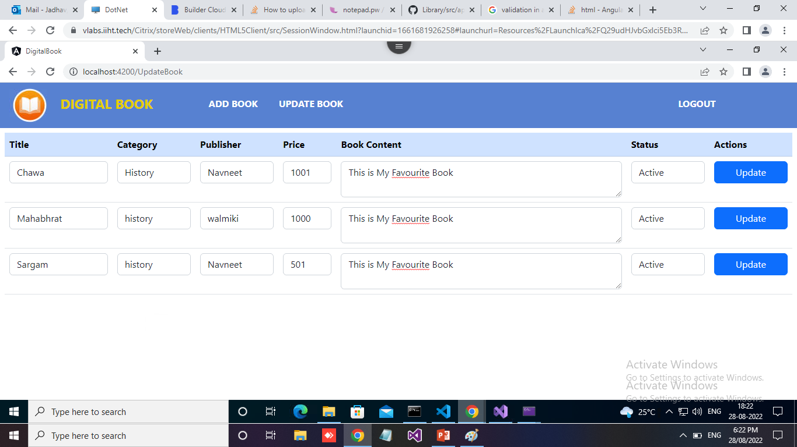
Update Book – Author can update Book Information.

Slide 15
Microsoft Azure -
Resource Groups
SQL Database
App Service
Azure Functions
Virtual Machines
Storage Accounts

Slide 16
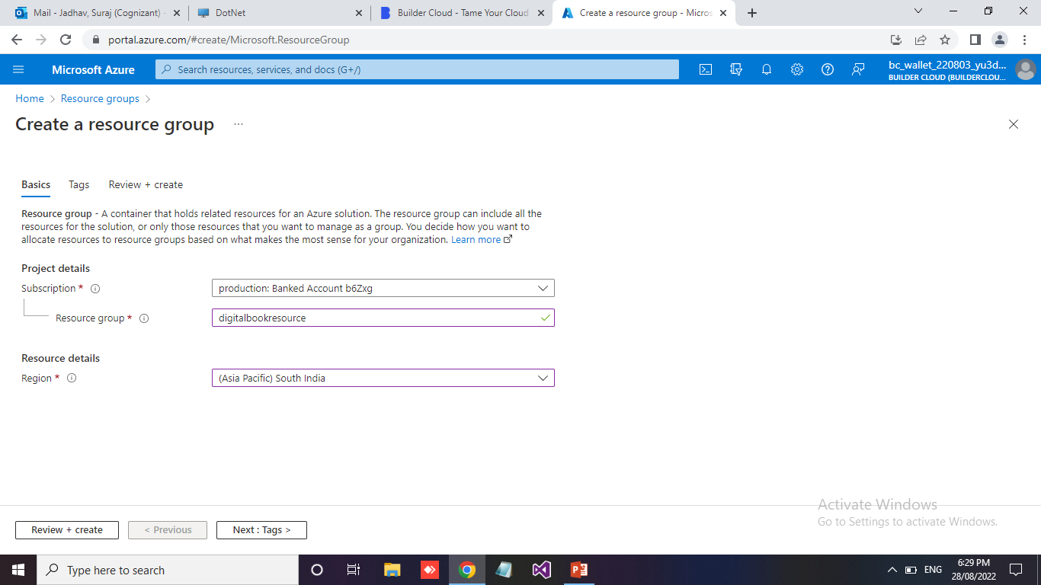
Resource Group –
A resource group is a container that holds related resources for an Azure solution like SQL Database, Application Deployment Services, VM’s etc.

Slide 17
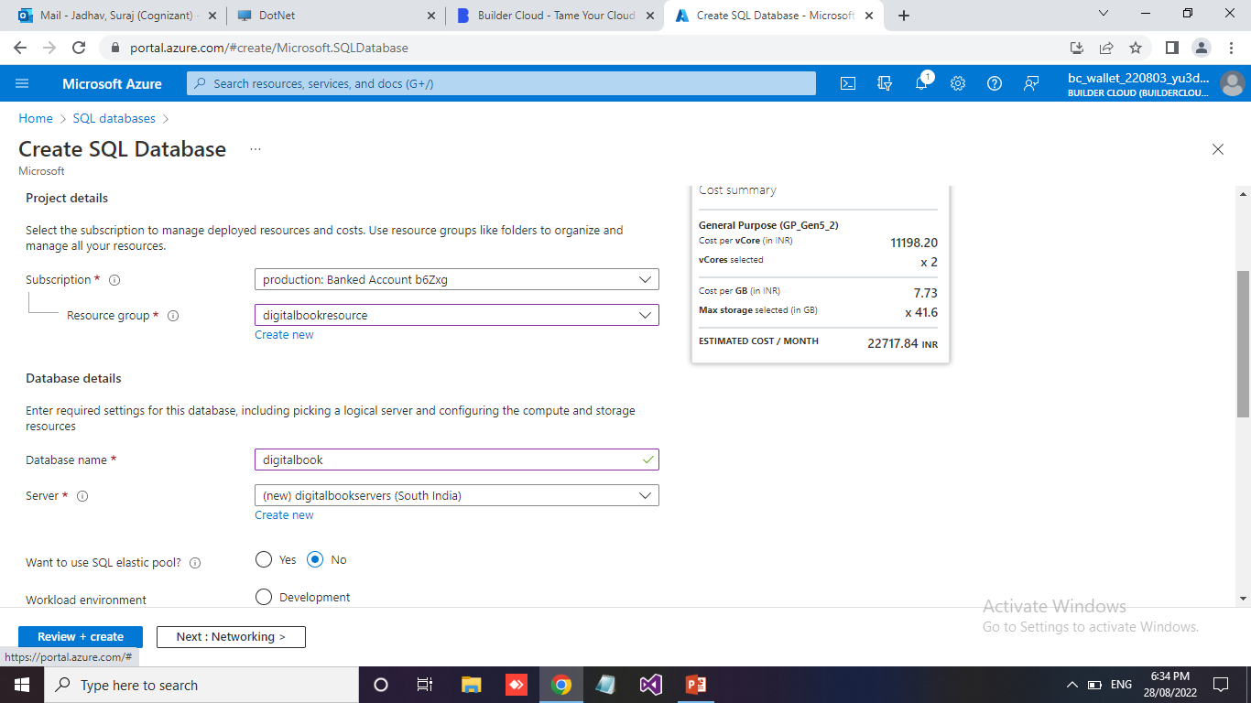
SQL Database - Microsoft Azure Database services take care of backup and high availability of the database.

Slide 18
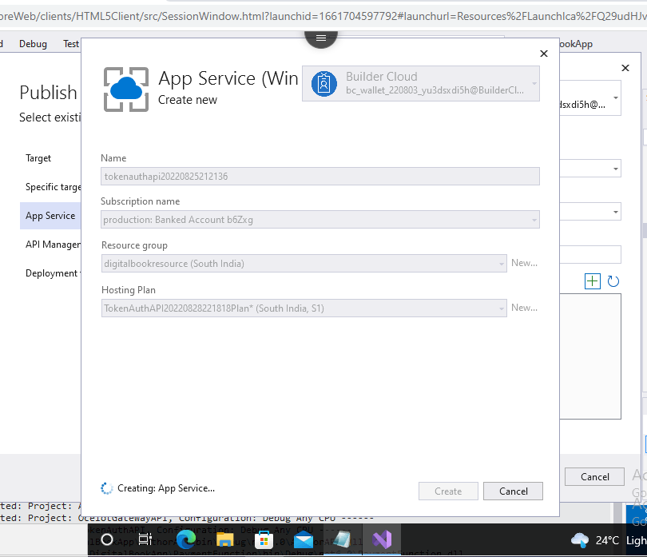
App Service – We can easily deploy our services on azure using app service.

Slide 19
Thank You…

