Slide 1

Introduction To JSON
JSON stands for JavaScript Object Notation
JSON is a text format for storing and transporting data
JSON is "self-describing" and easy to understand
JSON is mainly used to transfer data between server or web application.
1

Slide 2
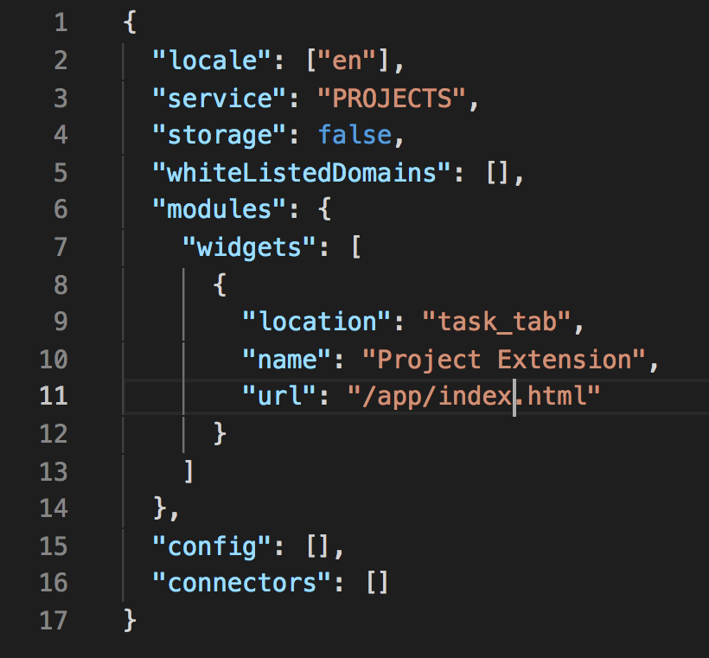
Example Of JSON
2

Slide 3
JSON Function in PHP
Json_encode and decode are two function available in php.
→Json_encode takes array as argument .
→json_decodes takes two file as argaumnet one is json file and another is optional ,it return false when no optional value is given and return object if true value given it return associative array
json_encodes → array into json file
Json_decodes → json into array
3

Slide 4
json_encode Example
// basic example json encode
$arr=array('a'=>1,'b'=>2,'c'=>3,'d'=>4);
echo json_encode($arr);
4

Slide 5
json_decode Example
// basic json decode
$jsondata = '{
"a": 1,
"b": 2,
"c": 3,
"d": 4
}';
$result = json_decode($jsondata);
echo"<pre>";
print_r($result);
echo"</pre>";
5

Slide 6
This much for now
6

