Slide 1
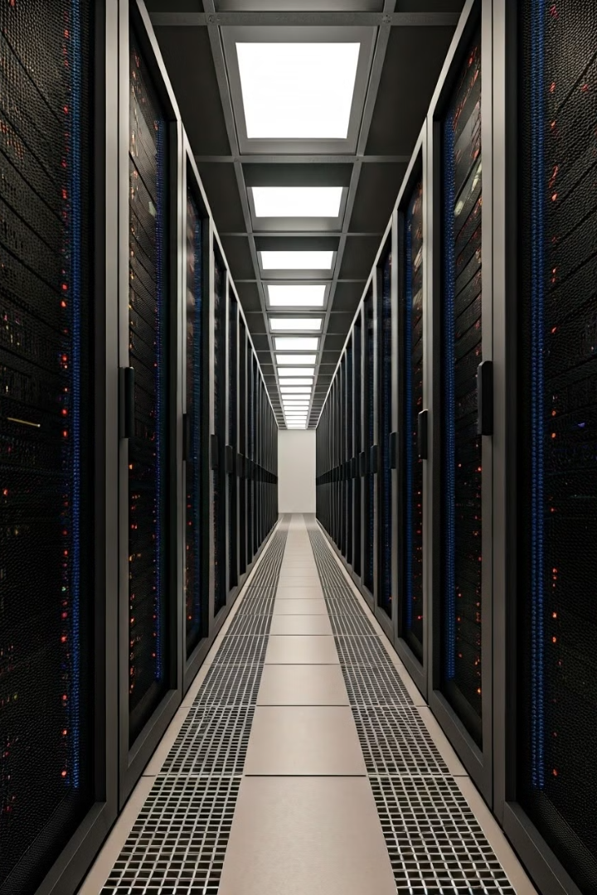
Advancements in Distributed Computing
Distributed computing allows multiple computers to collaborate in solving complex problems by breaking tasks into smaller pieces and distributing them across a network of machines. This approach harnesses the collective power of these systems, enabling more efficient and scalable processing than a single computer could achieve.

Slide 2
The Rise of Distributed Computing
1
2004: The Rise of MapReduce
Introduced by Dean and Ghemawat.
MapReduce is a Java-based, distributed execution framework within the Apache Hadoop Ecosystem.
Enabled scalable computation over large datasets; adopted by companies like Google for indexing web pages.
2
2010: The Introduction of Apache Spark
Developed by Zaharia et al.
Addressed MapReduce's limitations with in-memory processing for faster data access.
Ideal for iterative machine learning tasks.
Supports batch processing, stream processing, and graph analytics.
3
2015: Distributed Machine Learning with TensorFlow
Introduced by Abadi et al.
Supports distributed training of deep learning models across GPUs and clusters.
Enables scalable AI tasks in natural language processing, computer vision, and more.
Includes TensorFlow Serving for scalable model deployment in production environments.
4
2016: Evolution of Distributed Frameworks with PyTorch
Developed by Facebook’s AI Research Lab.
Dynamic computation graph, making it more flexible for research.
PyTorch Distributed introduced in 2019, enabling scalable training across multiple GPUs and machines.
5
Recent Years: Kubernetes and Distributed AI
Kubernetes automates the deployment and scaling of containerized AI applications.
When combined with TensorFlow and PyTorch, it efficiently orchestrates distributed workloads.
Kubeflow integrates machine learning pipelines into Kubernetes, streamlining the deployment of AI models in production environments.

Slide 3
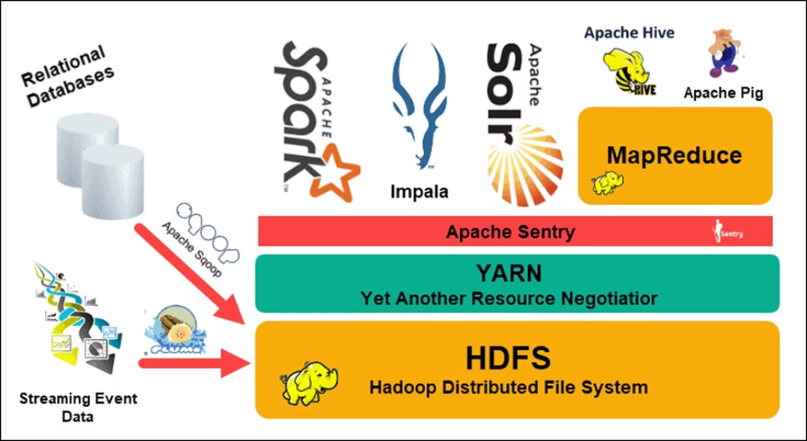
Hadoop
Apache Hadoop is an open-source software framework that enables the distributed storage and processing of large datasets across clusters of computers.
It is designed to scale from a single machine to thousands, efficiently handling big data through parallel processing using the MapReduce programming model.
Hadoop allows organizations to store and analyze vast amounts of data in a cost-effective, scalable manner.

Slide 4
Hadoop Ecosystem.
Hadoop Distributed File System (HDFS)
YARN (Yet Another Resource Negotiator)
MapReduce
MapReduce is the programming model and software framework at the core of Hadoop, enabling the distributed processing of large datasets.
HDFS is the primary storage component of the Hadoop ecosystem, providing distributed and fault-tolerant storage for large datasets.
YARN is the resource management and job scheduling system in Hadoop, responsible for allocating resources and executing applications across the cluster.
Ecosystem Tools
The Hadoop ecosystem includes a wide range of tools and applications, such as Pig, Hive, HBase, Spark, and Zeppelin, to support various data processing and analytics tasks.

Slide 5




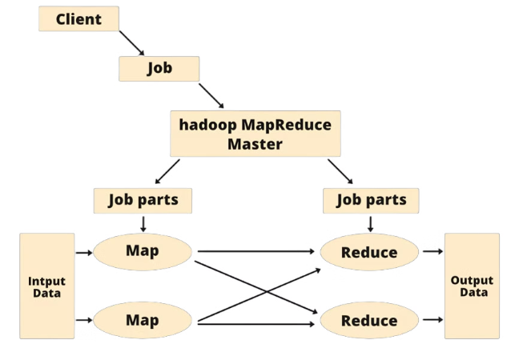
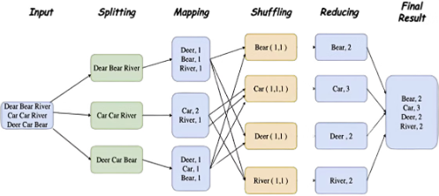
Understanding MapReduce
Input Data
Map Phase
Shuffle and Sort
Reduce Phase
The MapReduce process begins with the input data, which is divided into smaller chunks and distributed across the cluster.
In the Map phase, each node processes its assigned data chunk, generating intermediate key-value pairs as output.
The intermediate key-value pairs are then shuffled and sorted, preparing them for the Reduce phase.
The Reduce phase aggregates the sorted data, producing the final output that is stored in the distributed file system.

Slide 6




Apache Spark: A Unified Engine
In-Memory Processing
Unified Engine
Ease of Use
Spark's ability to perform in-memory computations drastically increases the speed of iterative tasks, such as machine learning algorithms, compared to disk-based frameworks like Hadoop MapReduce.
Spark supports multiple types of data processing tasks, such as batch processing, stream processing, and interactive queries, all within a unified platform, providing flexibility and versatility.
Spark's simple and expressive API allows users to perform complex operations with fewer lines of code, making it accessible to a wide range of developers.

Slide 7

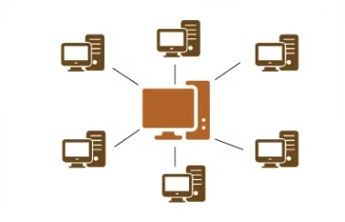
Distributed Computing and Data Science
1
Handling Large Datasets
Example: Hadoop allows companies like Facebook to store and process massive datasets across servers.
2
Enhancing Machine Learning and AI Workflows
Example: TensorFlow distributes deep learning model training across multiple GPUs for faster results.
3
Real-Time Data Processing
Example: Apache Kafka processes live streaming data for real-time analytics, used by companies like Netflix.
4
Scalability and Flexibility
Example: Kubernetes scales AI models across cloud environments, adjusting resources as demand grows.

Slide 8

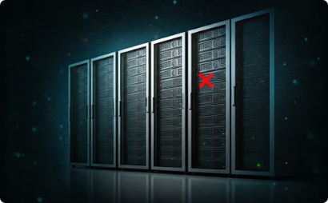



Limitations of Distributed Computing:
Network Latency and Bandwidth
Fault Tolerance and Reliability
Data Consistency and Synchronization
High network latency and limited bandwidth can slow down data transfers and reduce system efficiency, especially in large-scale machine-learning tasks.
Distributed systems are complex and prone to hardware failures, network issues, and software bugs, requiring additional overhead for fault tolerance like data replication and task retries.
Ensuring real-time consistency across nodes is challenging, particularly in applications like financial transactions or real-time analytics, where frequent data synchronization is required.
Scalability Challenges
Data Security and Privacy
Adding more nodes increases system complexity and communication overhead, and not all tasks, such as iterative machine learning algorithms, scale efficiently.
Ensuring secure data transmission and compliance with regional data privacy laws (e.g., GDPR) becomes more difficult as data is distributed across nodes in different locations.

Slide 9



New Trends in Distributed AI
Federated Learning
Distributed Reinforcement Learning
Edge Computing
AI models are trained on data distributed across devices, protecting privacy, especially in sensitive fields like healthcare and finance.
Edge computing brings AI models closer to data sources, reducing latency and enabling real-time decisions for applications such as autonomous vehicles and smart cities.
Frameworks like Ray and RLlib enhance AI learning by allowing agents to interact with multiple simulated environments concurrently, improving performance in robotics and autonomous systems.

