Slide 1
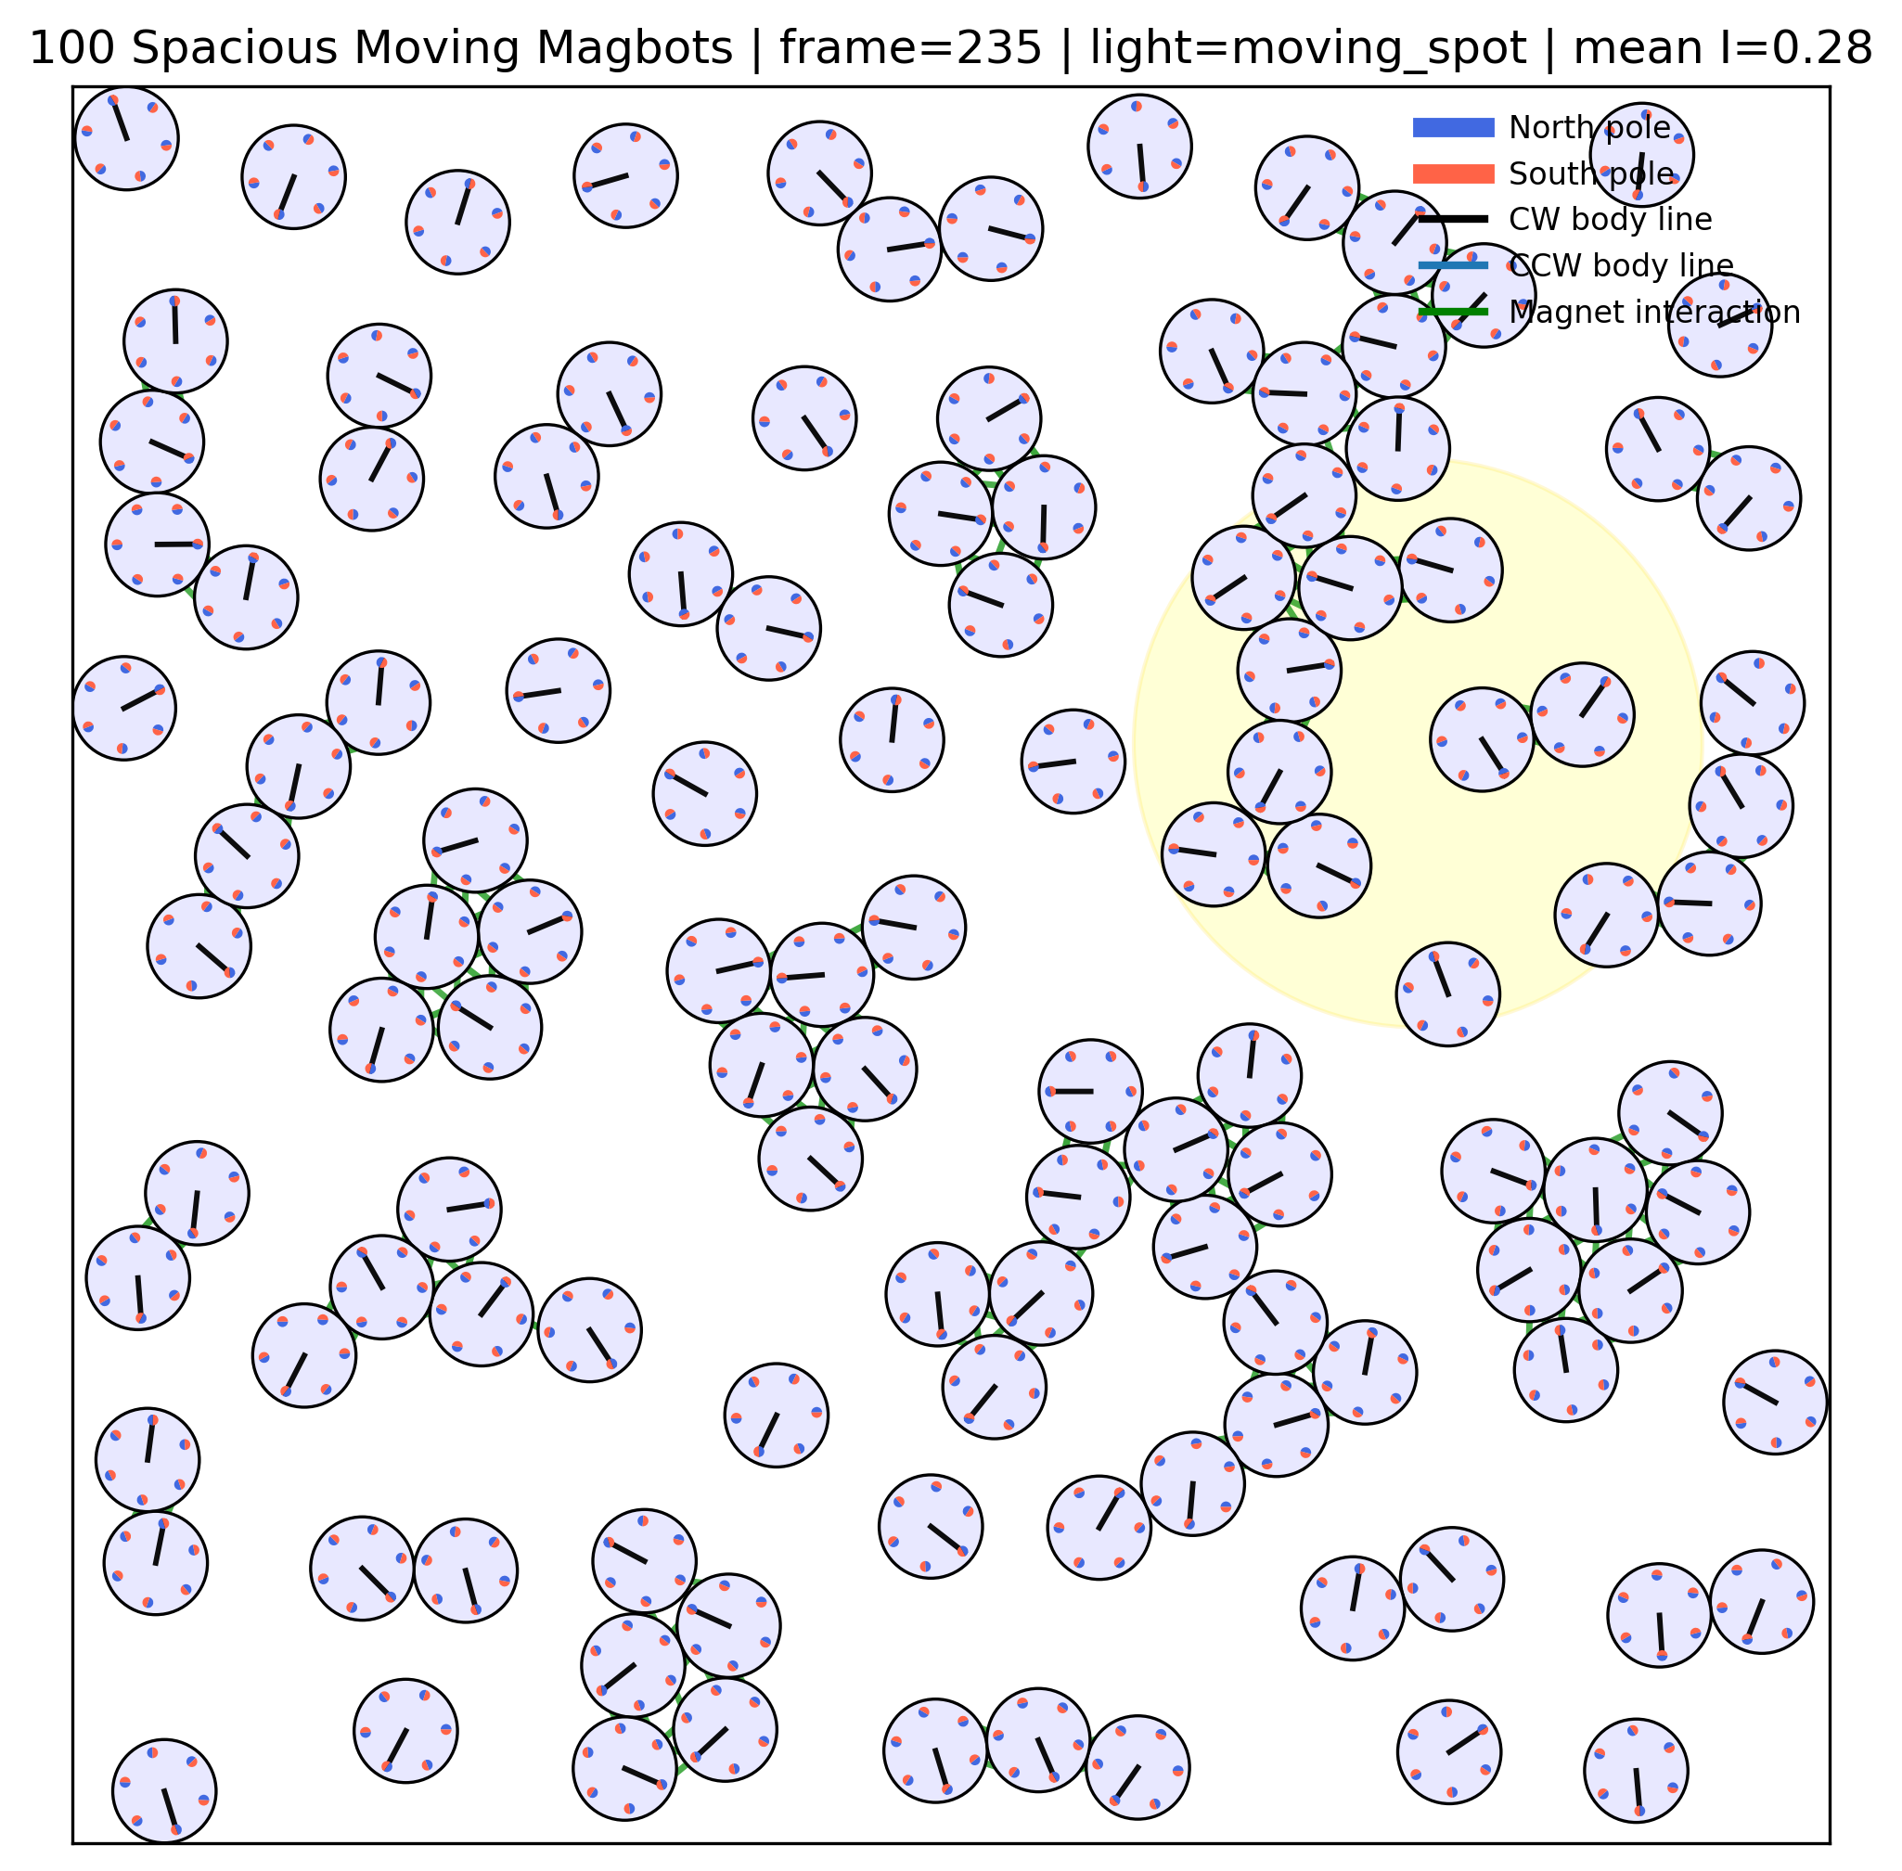
BTP-2 Defense Presentation
Simulation and Analysis of Robo-Matter
Active magnetic Magbots with chiral dynamics, light-field control, structural order metrics, MSD analysis, and simulation videos
Active crystal
Suraj | Roll No. 22PH23011
Prof. Pintu Patra | Spring Semester 2026
BTP-2 GitHub: Robo_matter_duality/tree/main/BTP-2
Active glass-like
Liquid-like
Gas-like
Includes: 4 simulation videos, 12 phase figures, repeated-seed MSD, equations and interpretation

Slide 2
RESEARCH MOTIVATION
The project asks how simple active magnetic units become material-like
The novelty is a transparent physics-based simulation that connects Robo-Matter mechanisms to measurable phase diagnostics.
Research area
Robo-Matter gap
BTP contribution
Active matter studies units that consume energy locally and self-organize far from equilibrium.
Magbot experiments show active crystals, glass-like arrest, liquid-like flow, and gas-like dispersion; simulation helps isolate why.
A two-dimensional six-site Magbot model links activity, chirality, light response, magnetic binding, and phase metrics.
collective state ~ magnetic binding and ordering / active agitation and noise
Central claim: the same local rules can generate ordered, arrested, flowing, and dispersed regimes when the activity-binding balance changes.
Suraj BTP-2 | Simulation and Analysis of Robo-Matter | project-generated plots and videos
02

Slide 3
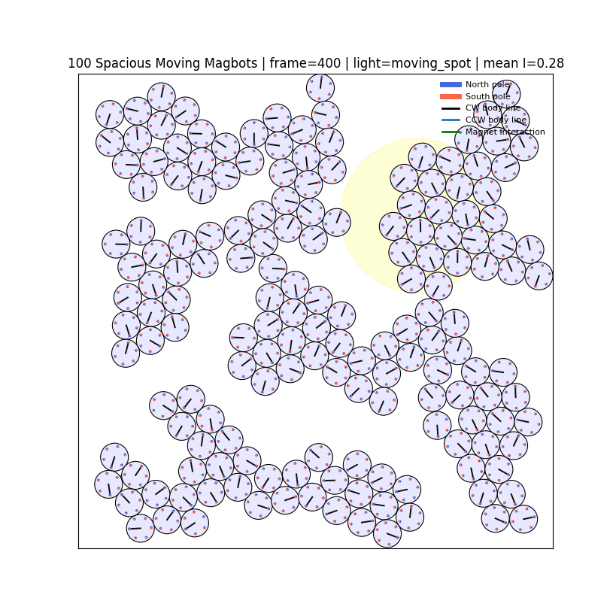
MODEL FORMULATION
Each Magbot is a rigid active disk with six magnetic sites
The model keeps the experimental ingredients that matter for phase behavior while staying computationally transparent.
State variables
Interaction ingredients
x_i(t): body-center position
theta_i(t): body orientation
phi_ik(t): internal magnet phase
I(x,t): local light intensity
Mechanisms
self-propulsion, chiral rotation, Gaussian light drift, steric repulsion, magnetic attraction, body torque, and internal magnet torque
Project-generated active crystal snapshot: local interaction creates collective structure
Suraj BTP-2 | Simulation and Analysis of Robo-Matter | project-generated plots and videos
03

Slide 4
EQUATIONS OF MOTION
The update rule separates activity, light response, force, torque, and noise
These equations make the model interpretable: every term has a physical role.
x_i(t+dt) = x_i(t) + [mu_t F_i + F_light + v0(I_i) n_i] dt + sqrt(2 D_t dt) eta_i
theta_i(t+dt) = theta_i(t) + [omega_i(I_i) + mu_r tau_i] dt + sqrt(2 D_r dt) xi_i
phi_ik(t+dt) = phi_ik(t) + mu_phi tau_phi,ik dt + sqrt(2 D_phi dt) zeta_ik
Interpretation
v0 and omega increase with local light; F_i contains magnetic and steric interactions; tau_i rotates the body; tau_phi evolves each magnetic site. Reflecting boundaries and cell-list neighbor search make long simulations practical.
Suraj BTP-2 | Simulation and Analysis of Robo-Matter | project-generated plots and videos
04

Slide 5
ANALYSIS METRICS
Three diagnostics separate order, rearrangement, and mobility
This is why the report does not rely only on final snapshots.
N_i(t_m) = { j != i : |x_j(t_m) - x_i(t_m)| <= r_nn }, r_nn = 2.35
psi_6^(i)(t_m) = (1/N_i) sum_{j in N_i} exp[6 i alpha_ij(t_m)]
r_6(t_m) = (1/N) sum_i |psi_6^(i)(t_m)|
C_i(t_m) = | N_i(t_m) triangle N_i(t_{m-1}) |
n_c(t_m) = (1/(N Delta t_m)) sum_i C_i(t_m)
MSD(tau) = < |x_i(t+tau) - x_i(t)|^2 >_{i,t}
Why both r6 and nc are needed
High r6 can mean active crystal or trapped glass. High nc can mean useful liquid flow or uncoordinated gas-like collisions. Classification comes from reading r6, nc, snapshots, videos, and MSD together.
Suraj BTP-2 | Simulation and Analysis of Robo-Matter | project-generated plots and videos
05

Slide 6
PHASE LOGIC
Changing the activity-binding balance moves the system across four regimes
The transition is qualitative, but it provides a useful organizing principle for the results.
Lambda = k_m / (v_base + omega_base + epsilon)
Activity is not just noise: at moderate strength it helps Magbots search and anneal defects; at high strength it melts cohesion.
Strong binding + low activity
local order but kinetic arrest
Active glass-like
Strong binding + moderate activity
defect annealing and active crystal
Active crystal
Comparable binding and activity
persistent bond exchange and flow
Liquid-like
Weak binding + high activity
dispersed active gas
Gas-like
Suraj BTP-2 | Simulation and Analysis of Robo-Matter | project-generated plots and videos
06

Slide 7
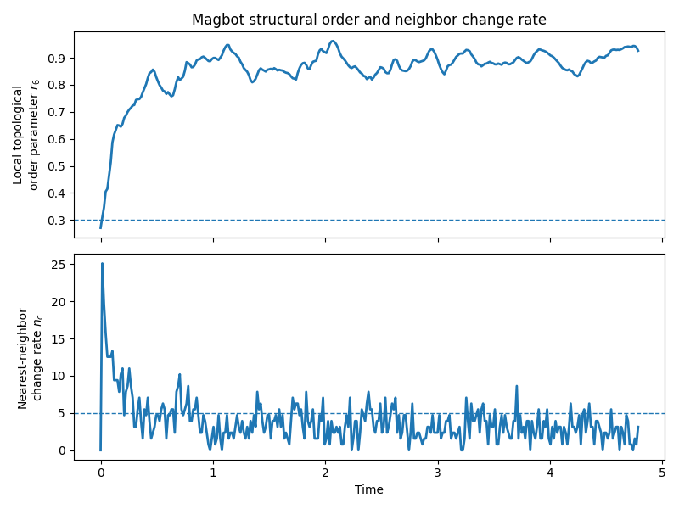
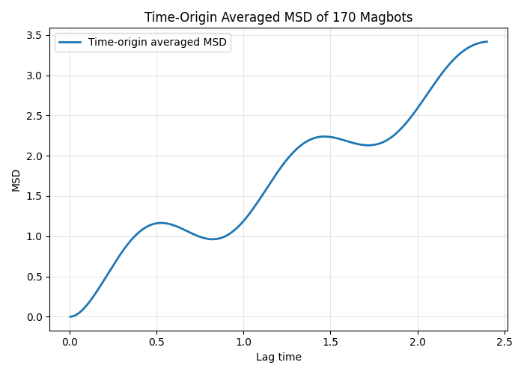
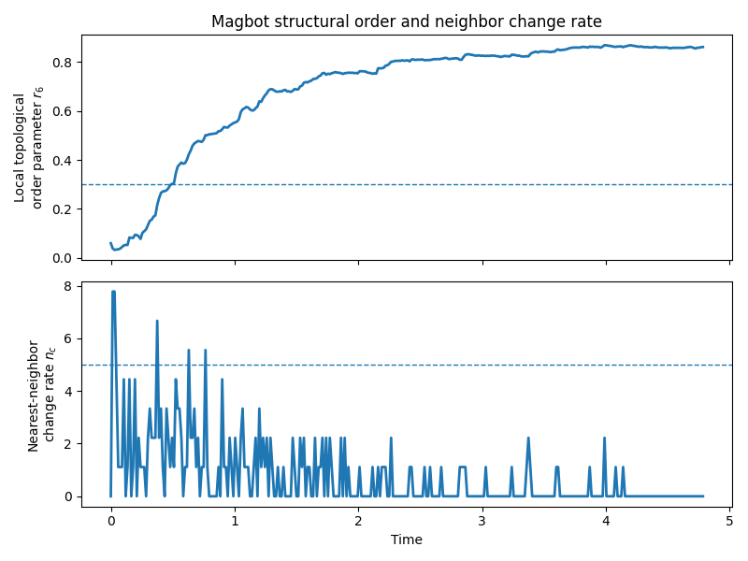
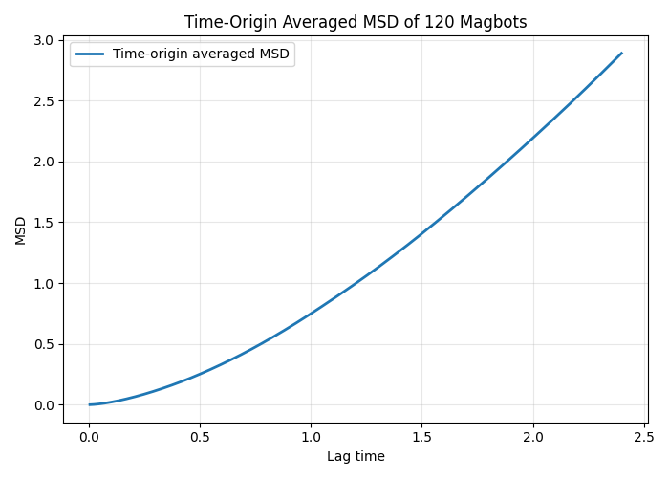
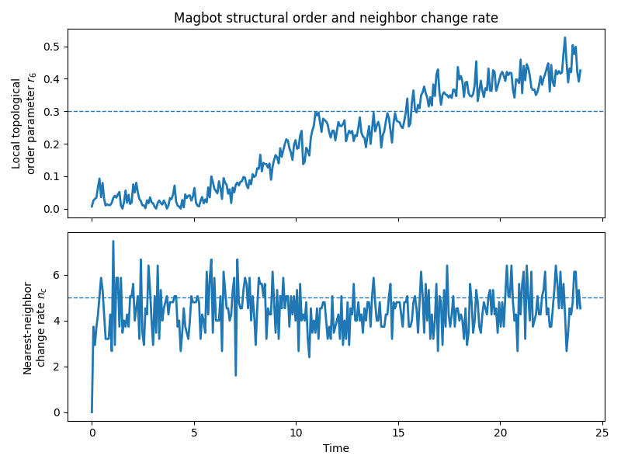
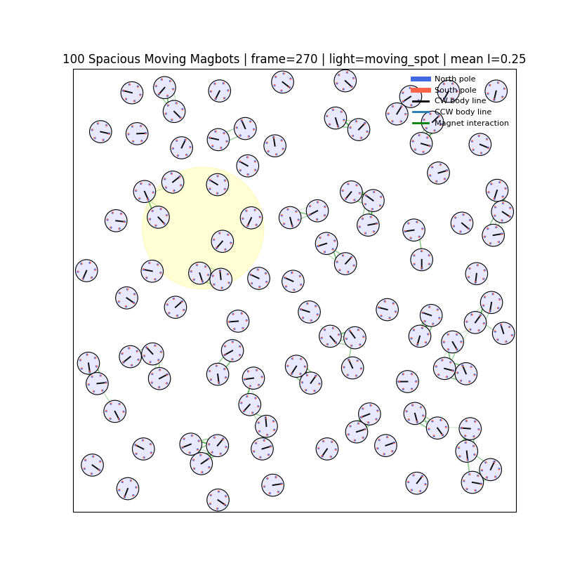
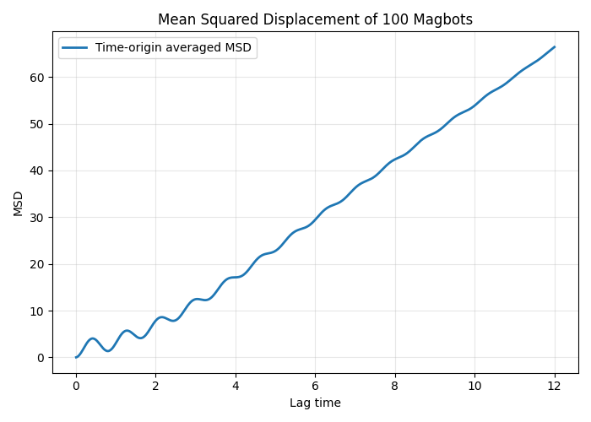
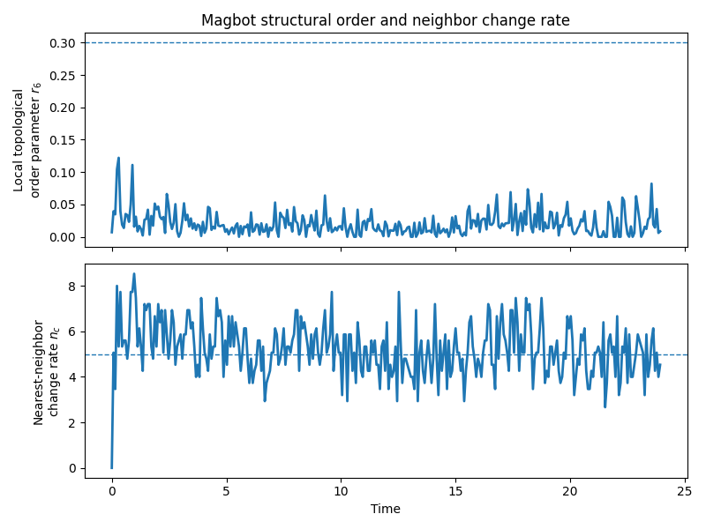
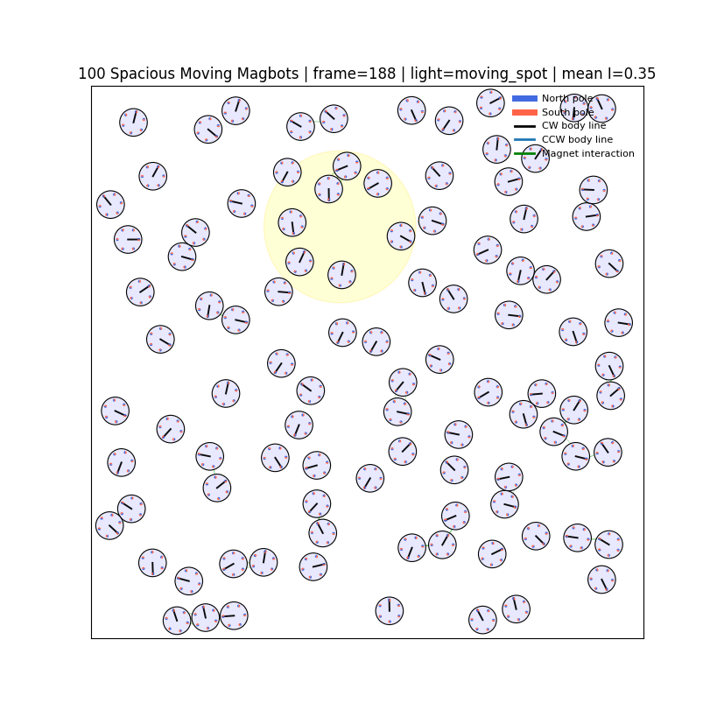
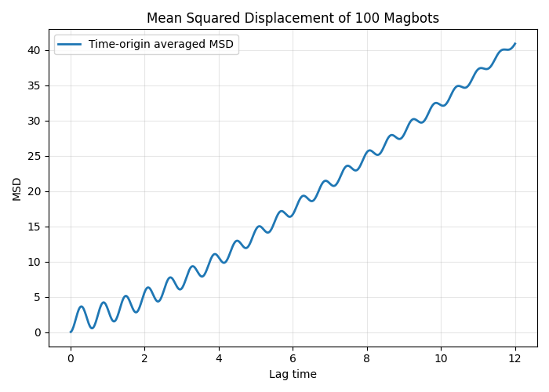
EVIDENCE SET
Each phase is supported by parameter plots, snapshots, MSD curves, and videos
The deck keeps every major proof object from the report visible.
Phase
Parameter plot
Snapshot / video
MSD curve
Active crystal
active_crystal_like.mp4
Active glass-like
active_glass.mp4
Liquid-like
liquid_like.mp4
Gas-like
gas_like.mp4
Suraj BTP-2 | Simulation and Analysis of Robo-Matter | project-generated plots and videos
07

Slide 8
ORDERED ACTIVE STATE
Active crystal: parameter trace separates structure from rearrangement
Moderate activity anneals defects while strong magnetic binding preserves local order.
Simulation video: active_crystal_like.mp4
Local: BTP-2/states/simulation/active_crystal_like.mp4
GitHub: https://github.com/suraj4556kumar-sketch/Robo_matter_duality/blob/main/BTP-2/states/simulation/active_crystal_like.mp4
Order parameter r6 and nearest-neighbor change rate nc
Interpretation
r6 rises close to 0.9; neighbor exchange falls after the early search stage.
Suraj BTP-2 | Simulation and Analysis of Robo-Matter | project-generated plots and videos
08

Slide 9
ACTIVE CRYSTAL MSD
Active crystal: MSD shows the mobility scale behind the snapshot
The MSD curve is read together with r6 and nc so that visual order is not confused with dynamical freedom.
r6 high / nc low / MSD ~3.59
MSD(tau) = < |x_i(t+tau) - x_i(t)|^2 >_{i,t}
Physical reading
Final repeated-seed MSD mean is about 3.59 on the short-lag window, so the state is active but spatially constrained.
Classification cue
Mean squared displacement versus lag time
Low MSD with high r6 indicates constrained order; high MSD with persistent nc indicates reconfiguration; high MSD with low r6 indicates dispersal.
Suraj BTP-2 | Simulation and Analysis of Robo-Matter | project-generated plots and videos
09

Slide 10
ARRESTED LOCAL ORDER
Active glass-like: parameter trace separates structure from rearrangement
Strong binding forms local clusters, but low rearrangement traps the system kinetically.
Simulation video: active_glass.mp4
Local: BTP-2/states/simulation/active_glass.mp4
GitHub: https://github.com/suraj4556kumar-sketch/Robo_matter_duality/blob/main/BTP-2/states/simulation/active_glass.mp4
Order parameter r6 and nearest-neighbor change rate nc
Interpretation
r6 grows, but nc collapses toward zero; order appears without healthy reorganization.
Suraj BTP-2 | Simulation and Analysis of Robo-Matter | project-generated plots and videos
10

Slide 11
ACTIVE GLASS-LIKE MSD
Active glass-like: MSD shows the mobility scale behind the snapshot
The MSD curve is read together with r6 and nc so that visual order is not confused with dynamical freedom.
r6 high / nc very low / MSD ~2.62
MSD(tau) = < |x_i(t+tau) - x_i(t)|^2 >_{i,t}
Physical reading
Final repeated-seed MSD mean is about 2.62, the most restricted mobility among the tested regimes.
Classification cue
Mean squared displacement versus lag time
Low MSD with high r6 indicates constrained order; high MSD with persistent nc indicates reconfiguration; high MSD with low r6 indicates dispersal.
Suraj BTP-2 | Simulation and Analysis of Robo-Matter | project-generated plots and videos
11

Slide 12
FLOWING RECONFIGURATION
Liquid-like: parameter trace separates structure from rearrangement
Comparable activity and binding maintain transient contacts while allowing continuous flow.
Simulation video: liquid_like.mp4
Local: BTP-2/states/simulation/liquid_like.mp4
GitHub: https://github.com/suraj4556kumar-sketch/Robo_matter_duality/blob/main/BTP-2/states/simulation/liquid_like.mp4
Order parameter r6 and nearest-neighbor change rate nc
Interpretation
r6 increases slowly, while nc remains high and fluctuating; bonds form and break persistently.
Suraj BTP-2 | Simulation and Analysis of Robo-Matter | project-generated plots and videos
12

Slide 13
LIQUID-LIKE MSD
Liquid-like: MSD shows the mobility scale behind the snapshot
The MSD curve is read together with r6 and nc so that visual order is not confused with dynamical freedom.
r6 medium / nc high / MSD ~71.37
MSD(tau) = < |x_i(t+tau) - x_i(t)|^2 >_{i,t}
Physical reading
Final repeated-seed MSD mean is about 71.37, making this the strongest controlled mobility regime.
Classification cue
Mean squared displacement versus lag time
Low MSD with high r6 indicates constrained order; high MSD with persistent nc indicates reconfiguration; high MSD with low r6 indicates dispersal.
Suraj BTP-2 | Simulation and Analysis of Robo-Matter | project-generated plots and videos
13

Slide 14
MOBILE DISORDER
Gas-like: parameter trace separates structure from rearrangement
High activity with weak binding disperses particles faster than stable contacts can form.
Simulation video: gas_like.mp4
Local: BTP-2/states/simulation/gas_like.mp4
GitHub: https://github.com/suraj4556kumar-sketch/Robo_matter_duality/blob/main/BTP-2/states/simulation/gas_like.mp4
Order parameter r6 and nearest-neighbor change rate nc
Interpretation
r6 stays low; nc remains active because collisions occur, but they do not build cohesion.
Suraj BTP-2 | Simulation and Analysis of Robo-Matter | project-generated plots and videos
14

Slide 15
GAS-LIKE MSD
Gas-like: MSD shows the mobility scale behind the snapshot
The MSD curve is read together with r6 and nc so that visual order is not confused with dynamical freedom.
r6 low / nc active / MSD ~27.21
MSD(tau) = < |x_i(t+tau) - x_i(t)|^2 >_{i,t}
Physical reading
Final repeated-seed MSD mean is about 27.21 with large seed variation, indicating active dispersal rather than controlled flow.
Classification cue
Mean squared displacement versus lag time
Low MSD with high r6 indicates constrained order; high MSD with persistent nc indicates reconfiguration; high MSD with low r6 indicates dispersal.
Suraj BTP-2 | Simulation and Analysis of Robo-Matter | project-generated plots and videos
15

Slide 16
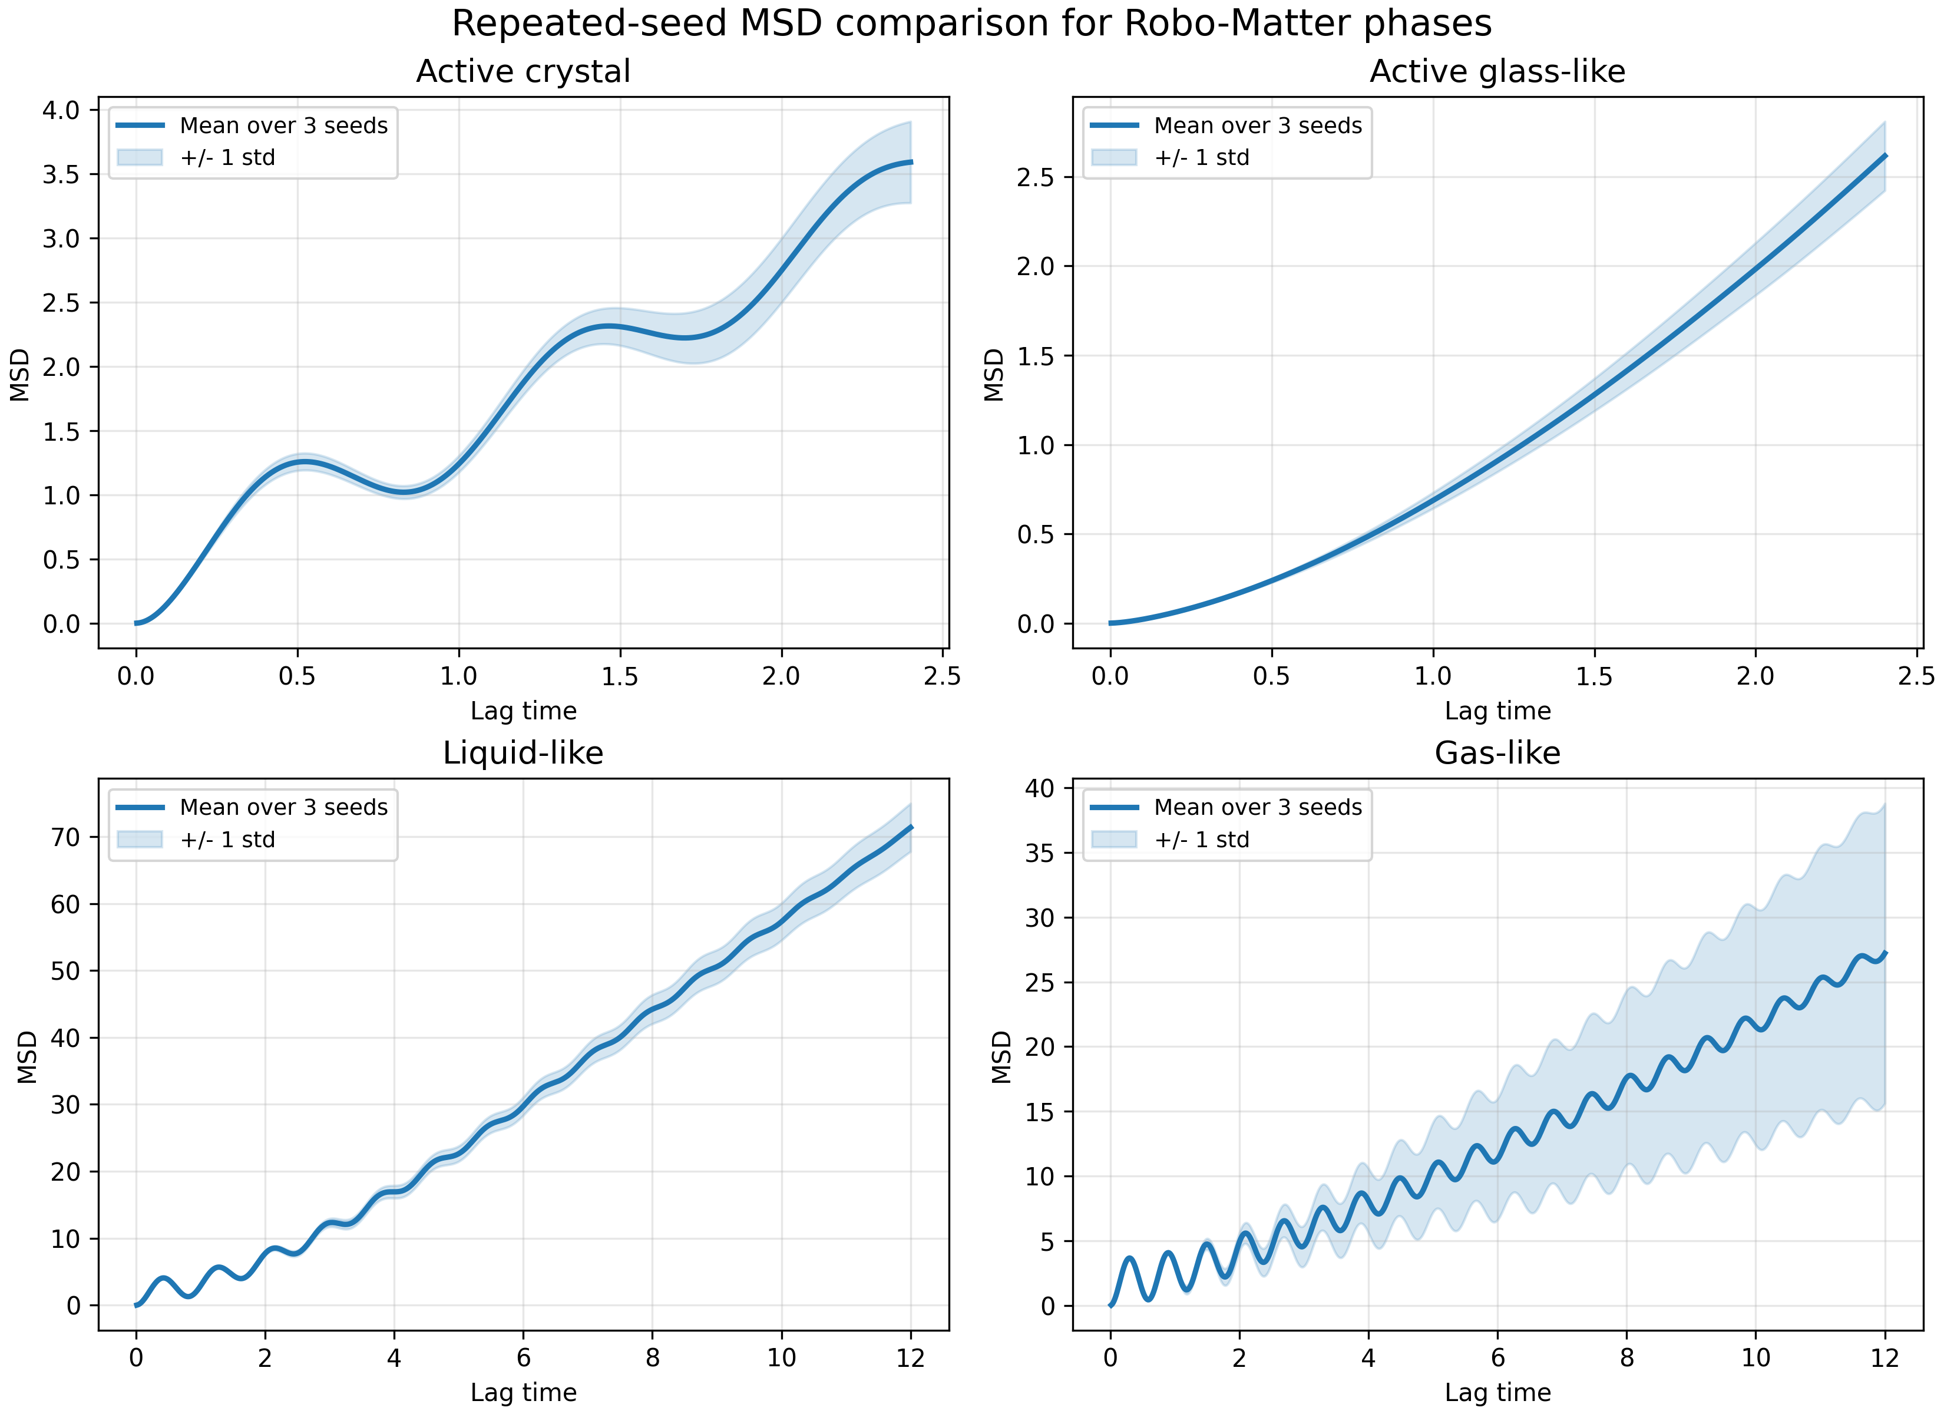
REPEATED-SEED CHECK
Repeated MSD confirms the mobility ranking is not a single-run accident
Each phase was repeated for seeds 7, 17, and 29 in the report analysis.
Final MSD mean
Active crystal
3.59
constrained ordered motion
Active glass-like
2.62
most dynamically restricted
Liquid-like
71.37
largest controlled mobility
Gas-like
27.21
mobile but seed-sensitive
Mean MSD with one-standard-deviation envelope
Takeaway
Liquid-like Robo-Matter is not merely disordered: it combines mobility with persistent interaction. Gas-like motion is mobile too, but less controlled and less cohesive.
Suraj BTP-2 | Simulation and Analysis of Robo-Matter | project-generated plots and videos
16

Slide 17
CROSS-PHASE INTERPRETATION
The useful adaptive regime lies between rigid arrest and complete dispersion
The same model produces four states by changing activity, attraction, density, and interaction range.
Metric pair
Physical meaning
Likely regime
high r6, low nc
stable local structure
active crystal / arrested glass
medium-high r6, high nc
structured but flowing network
liquid-like
low r6, high nc
mobile disorder
gas-like
low r6, low nc
frozen disorder
deep glass limit
glass-like -> active crystal -> liquid-like -> gas-like
increase activity / weaken binding
Suraj BTP-2 | Simulation and Analysis of Robo-Matter | project-generated plots and videos
17

Slide 18
CONCLUSION
Robo-Matter behavior emerges from local active magnetic rules
Main result
Video index
A single six-site active Magbot model reproduces active-crystal, active-glass-like, liquid-like, and gas-like regimes using interpretable dynamics and multiple diagnostics.
Active crystal
BTP-2/states/simulation/active_crystal_like.mp4
https://github.com/suraj4556kumar-sketch/Robo_matter_duality/blob/main/BTP-2/states/simulation/active_crystal_like.mp4
Active glass-like
BTP-2/states/simulation/active_glass.mp4
https://github.com/suraj4556kumar-sketch/Robo_matter_duality/blob/main/BTP-2/states/simulation/active_glass.mp4
Limitations
The magnetic interaction is simplified, light response is phenomenological, and broader parameter sweeps with more seeds are needed for quantitative phase boundaries.
Liquid-like
BTP-2/states/simulation/liquid_like.mp4
https://github.com/suraj4556kumar-sketch/Robo_matter_duality/blob/main/BTP-2/states/simulation/liquid_like.mp4
Future work
Gas-like
BTP-2/states/simulation/gas_like.mp4
https://github.com/suraj4556kumar-sketch/Robo_matter_duality/blob/main/BTP-2/states/simulation/gas_like.mp4
Extend repeated-seed statistics, compute radial distribution and cluster-size metrics, test feedback control, and compare against experimental Robo-Matter phase boundaries.
Report and code: https://github.com/suraj4556kumar-sketch/Robo_matter_duality/blob/main/BTP-2

