Slide 1

Eccomerce_eda by sql
This project analyzes an e-commerce dataset to uncover business insights, optimize operations, and improve customer experience. The data includes orders, customers, products, payments, sellers, and geolocation information.

Slide 2
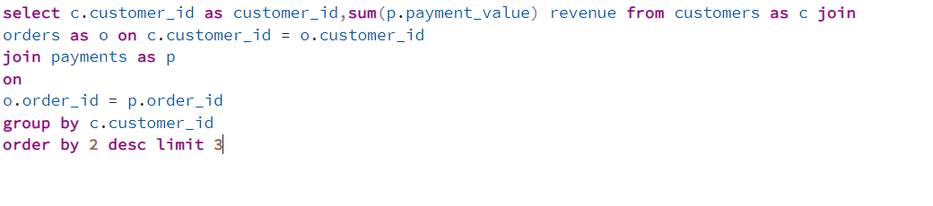
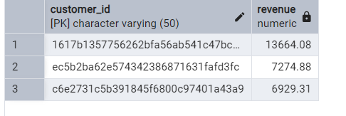
Find the top 3 cities with the highest total sales revenue.

Slide 3

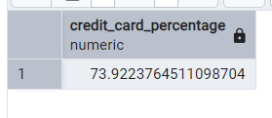
calculate the percentage of orders paid via credit card.

Slide 4
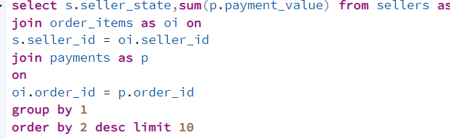
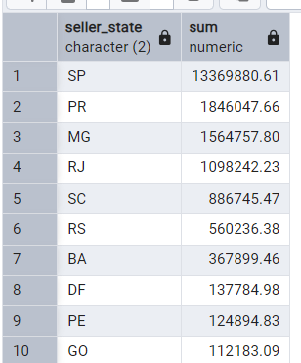
Calculate the average order value (payment amount) for each customer state.

Slide 5
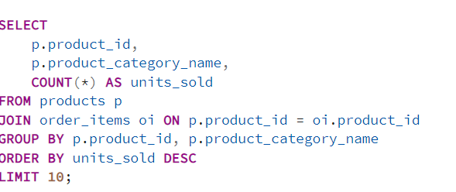
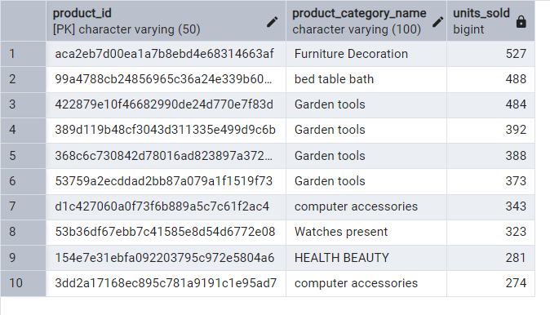
Show the top 10 best-selling products by quantity sold.

Slide 6
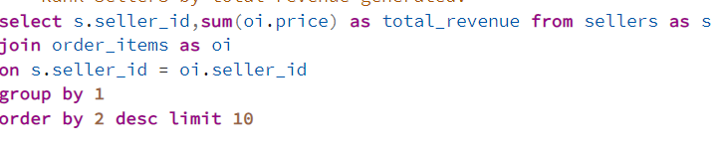
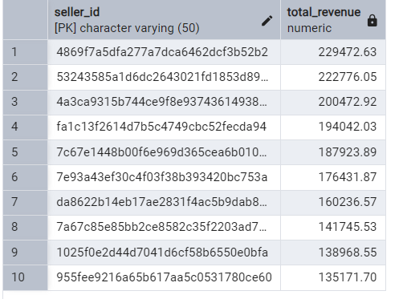
Top Rank sellers by total revenue generated.

Slide 7
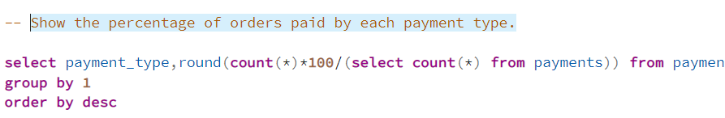
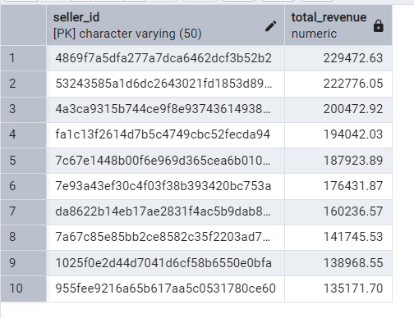
Show the percentage of orders paid by each payment type.

Slide 8
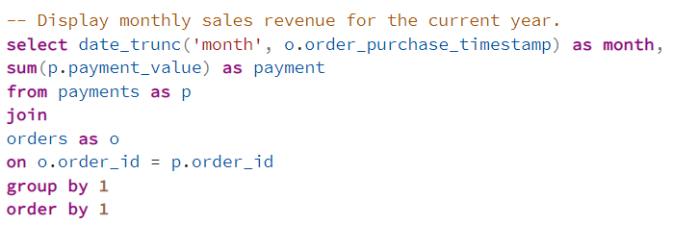
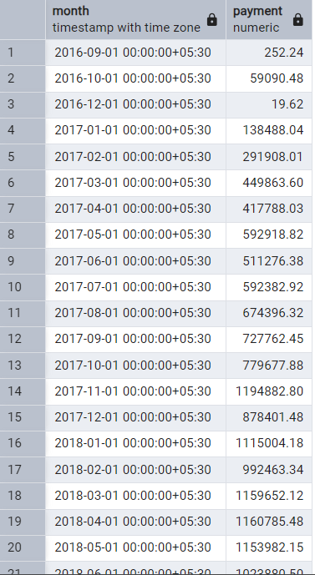
Display monthly sales revenue for the current year.

