Slide 1
Superstore
Task eight

Slide 2
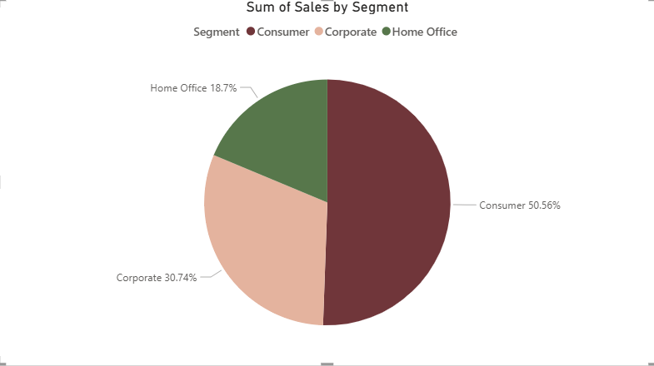
Which customer segments contribute the most revenue and profit?
consumer segment dominate with 50.56% of sales are coming from consumer segment
corporate contribute is corporate its 30.74%
home office is 18.7%

Slide 3
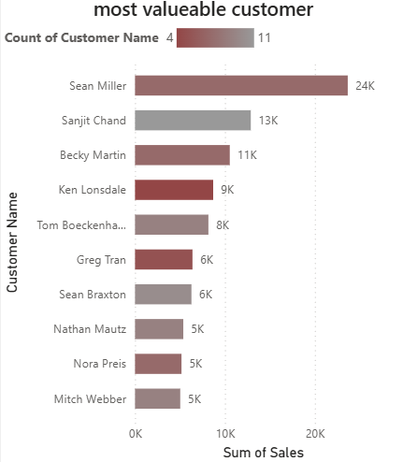
Who are the top 10 most valuable customers by total sales and profit?
Sean Miller is by far the most valuable customer with 24K sales, nearly double the next customer.
Sanjit Chand (13K) and Becky Martin (11K) follow, but there’s a steep drop after Sean Miller.
The rest (Ken Lonsdale, Tom Boecken, Greg Tran, etc.) contribute between 5K–9K, showing a long tail of smaller but steady customers.
Customer concentration is high: a single customer (Sean Miller) accounts for a large share of sales, which creates dependency risk.

Slide 4
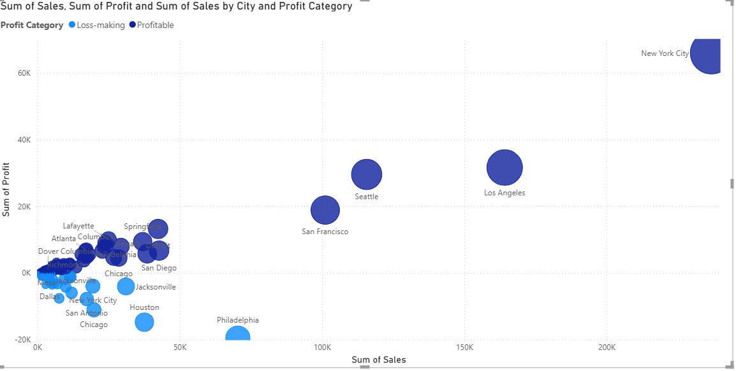
Which cities show the highest demand but lowest profitability?
New York ,los angeles,seattle city have high sale and high profitable
Philadelphia ,Houston,Chicago have most sales but less profit and some are nealy 0

Slide 5
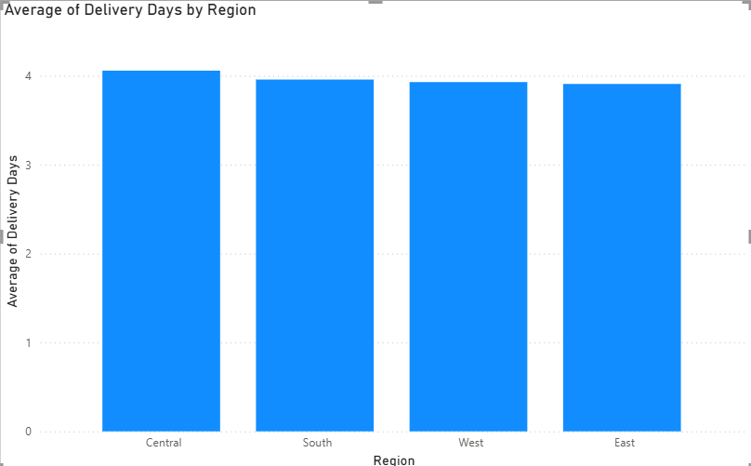
Which regions have the longest delivery times?
The difference is very small but the long time take in central region like 4.1 days

Slide 6
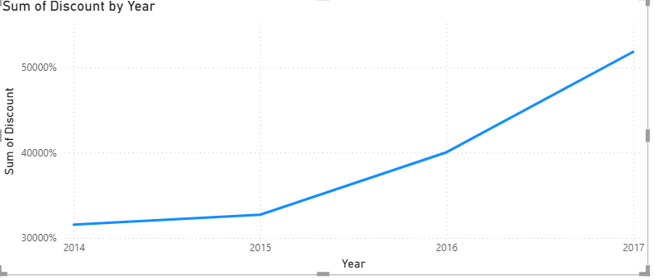
Has discount usage increased or decreased over time?
The useage of discount increase over time
The steepest increase happened between 2016 to 2017

