Slide 1
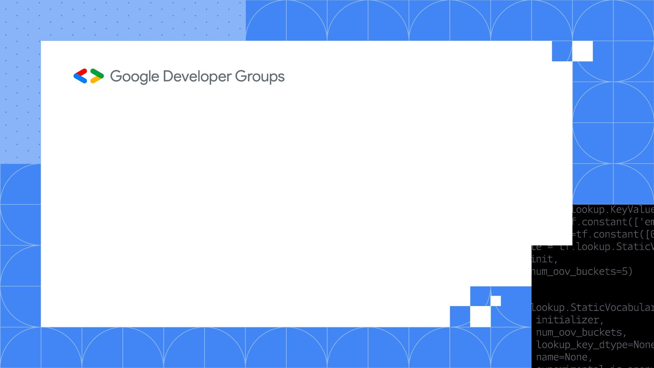
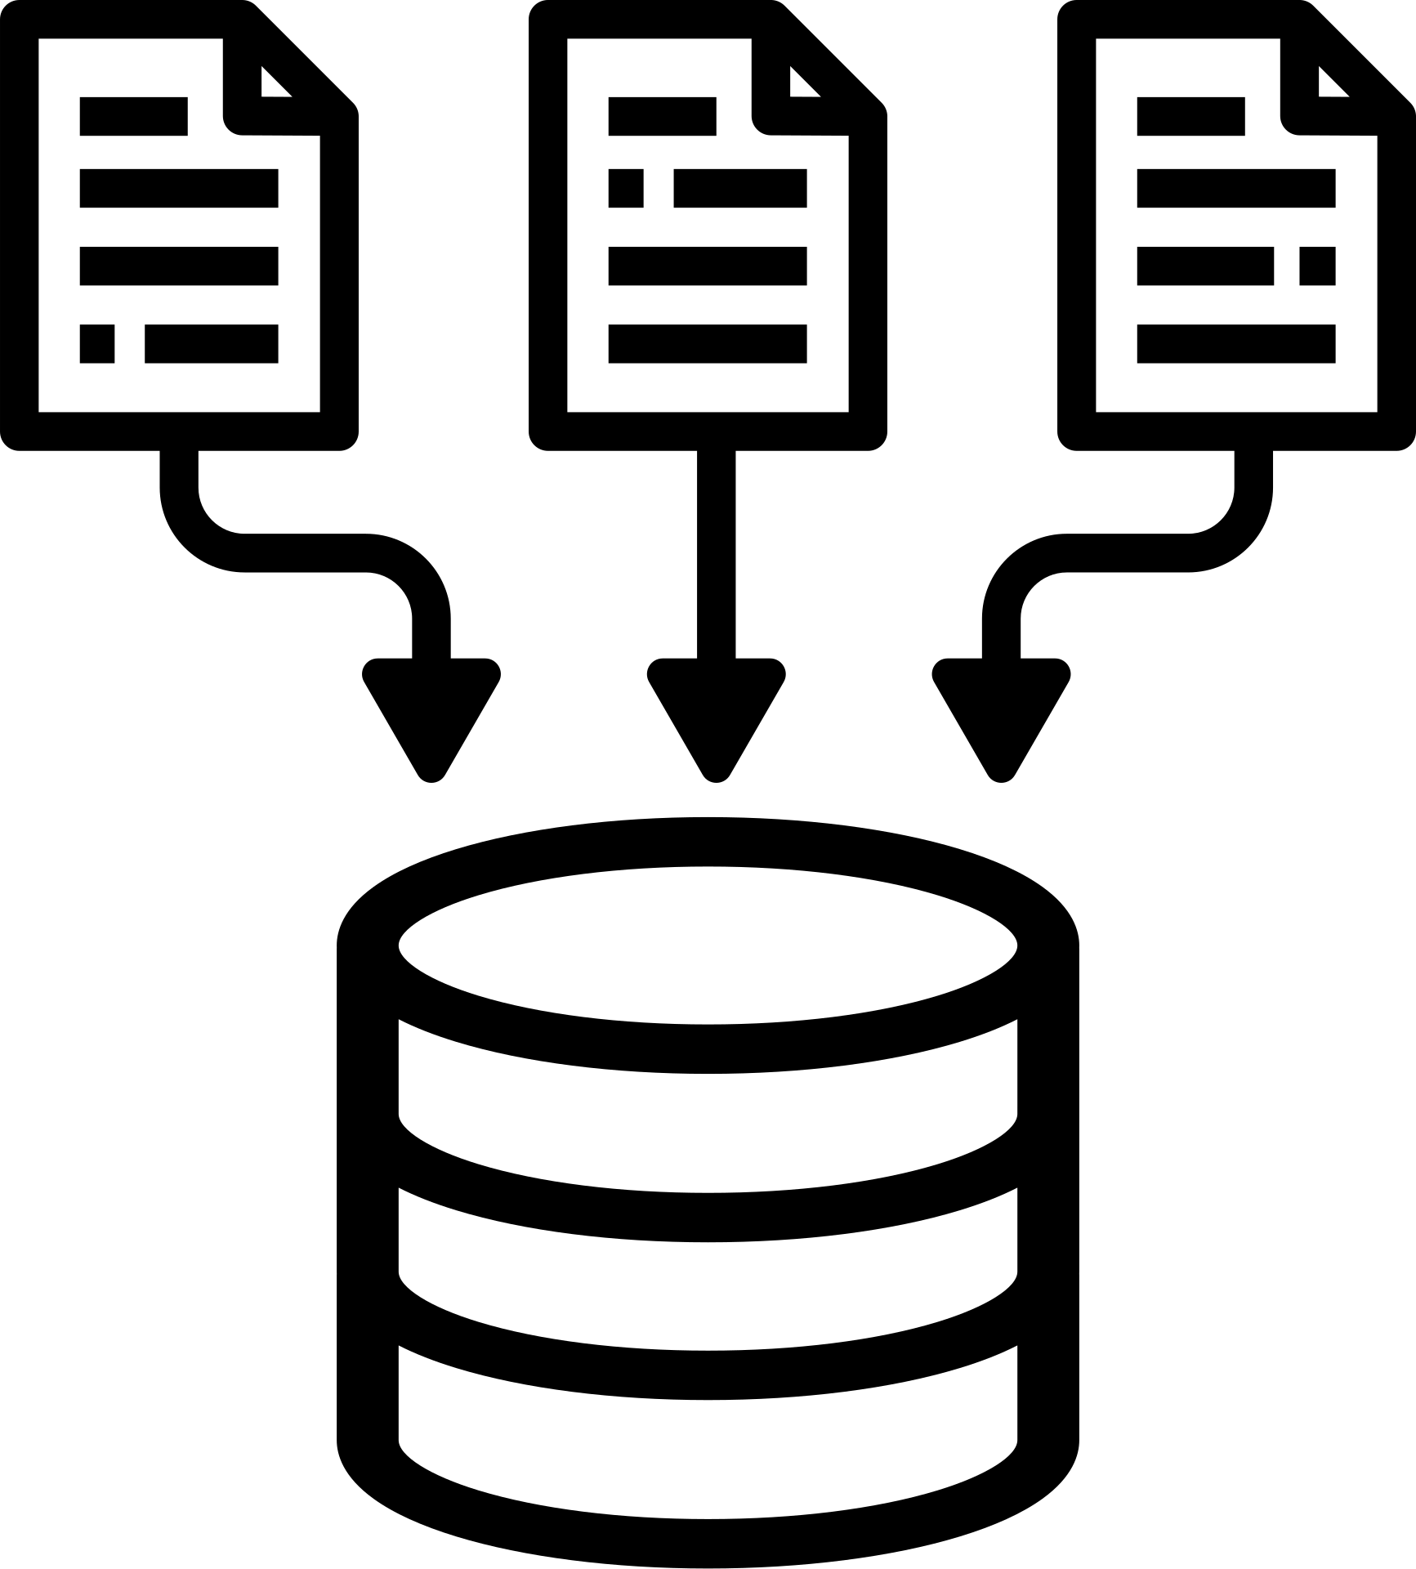
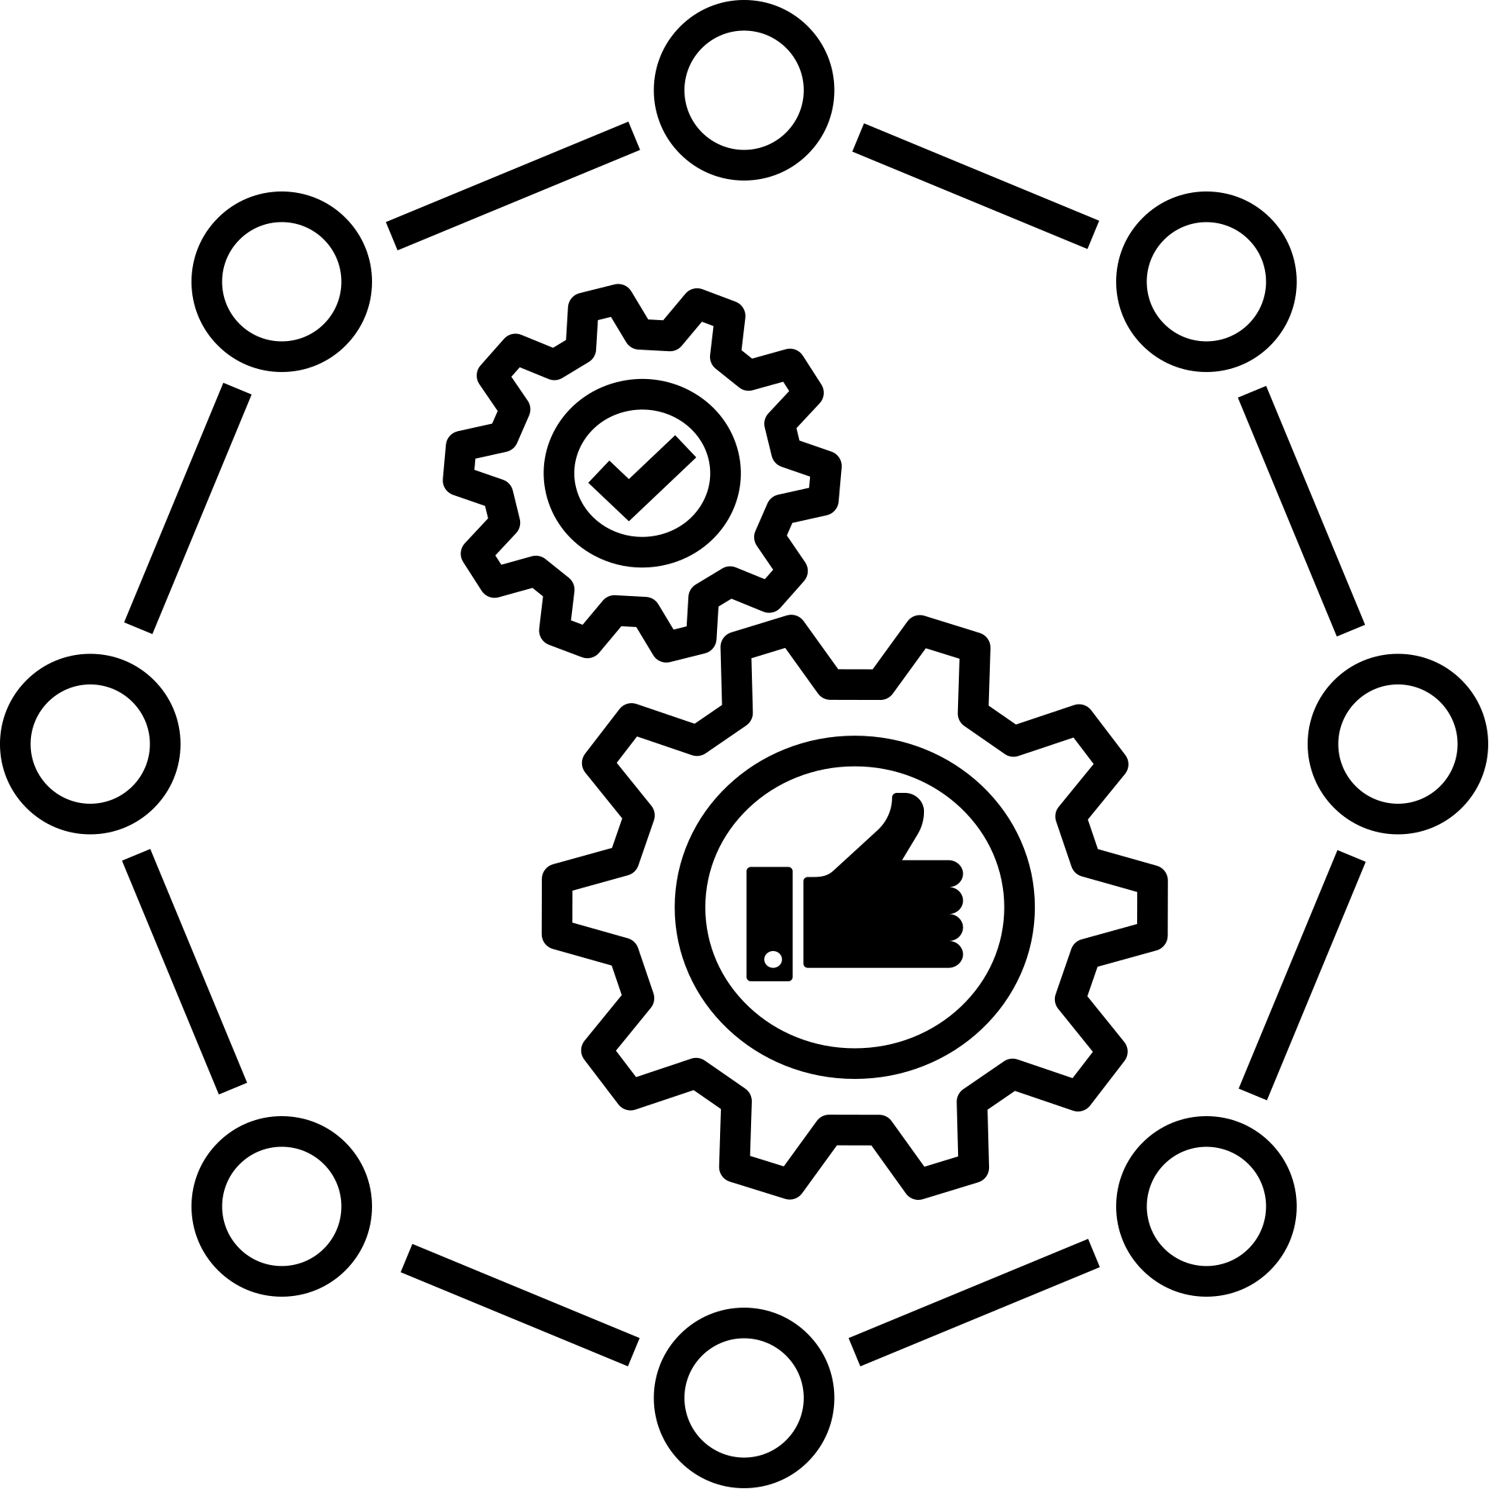

on campus CVR
WEB OFFLINE SESSIONS
Week-2

Slide 2
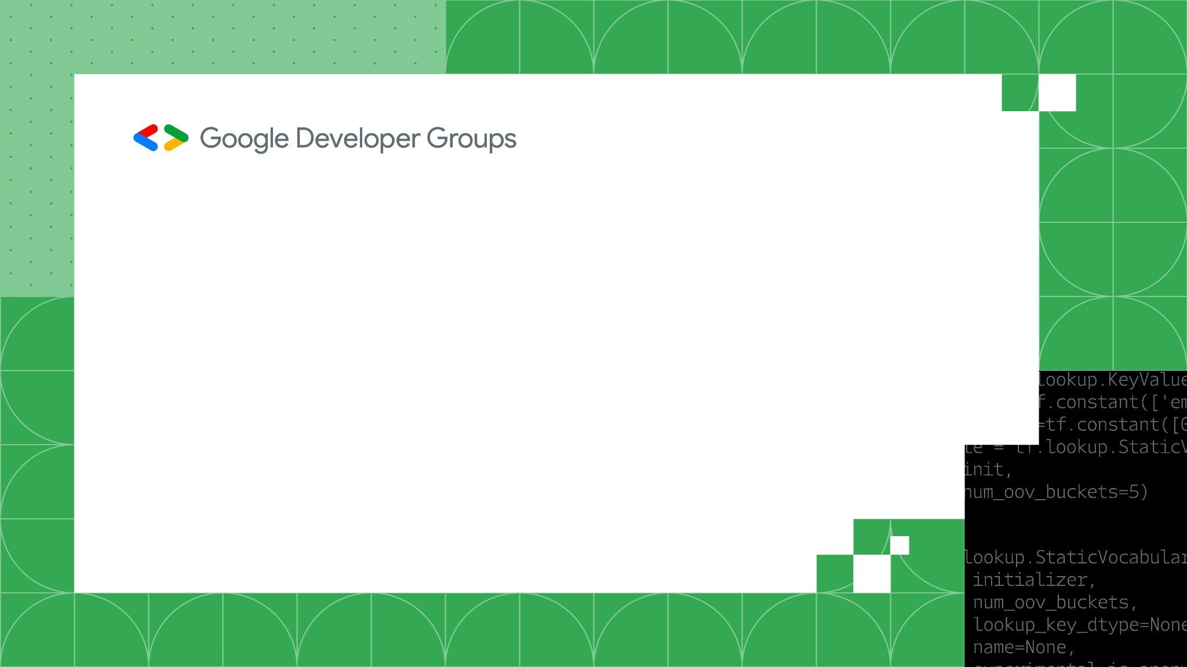
How are banches in github used?
In GitHub, branches are used to manage parallel development and isolate changes within a repository. They allow you to work on features, bug fixes, or experiments independently without affecting the main codebase. This helps developers maintain a clean and stable main branch (often main or master) while testing and refining new ideas.
Branches also enable collaboration by letting team members work on separate tasks simultaneously. Changes made in a branch can be reviewed and discussed through pull requests before being merged into the main branch. This ensures code quality and reduces the risk of introducing bugs into the main project.

Slide 3
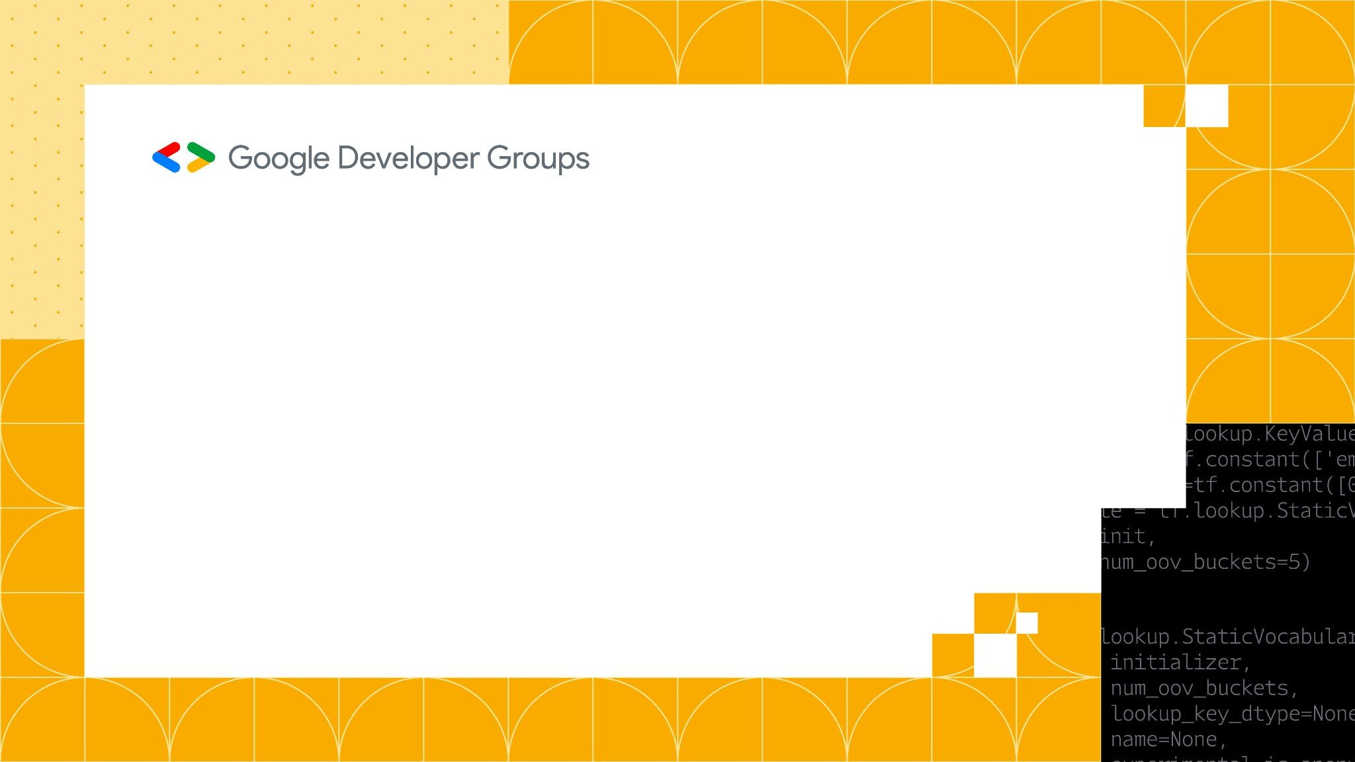
What is a pull request?
A pull request in GitHub is a feature used to propose and collaborate on changes before they are merged into the main branch or another target branch. When you create a pull request, you’re asking others to review your changes, which are usually made in a separate branch, and decide whether they should be merged. It’s a key tool for collaboration, as it allows team members to discuss and refine code before integrating it into the main project.
Pull requests often include features like code comments, automated testing, and approval requirements, ensuring that changes meet quality standards. They provide a centralized space for discussion, making it easy to address feedback and resolve conflicts. Once the pull request is approved and tests pass, it can be merged, updating the target branch with the proposed changes.

Slide 4
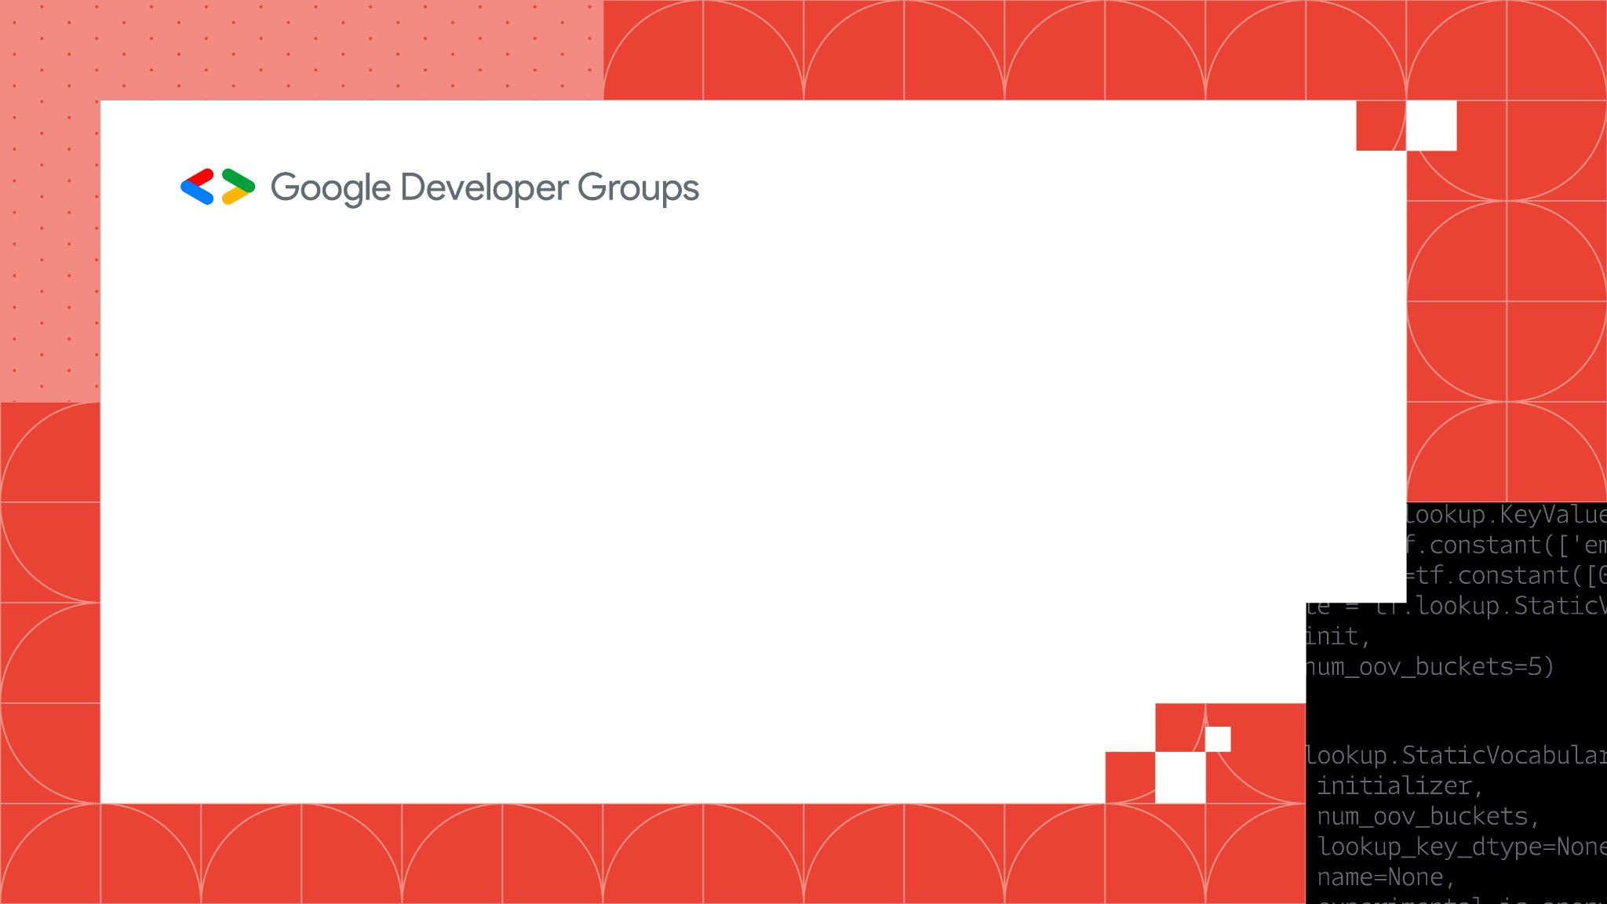
Creating a react app
> npx create-react-app appname
> Delete “reportWebVitals.js” and remove imports related to this from “index.js” in src directory
> npm start
> access your app at http://localhost:3000

Slide 5
Why should we use react.js?
1. Component-Based Architecture
2. Virtual DOM for Performance
3. Declarative Syntax
4. Strong Community and Support
https://www.geeksforgeeks.org/what-are-the-advantages-of-react-js/

Slide 6
What is useState hook?
The useState hook in React is used to manage state in functional components. It allows you to declare a state variable and provides a way to update its value, enabling dynamic behavior in your components.
Key Uses of useState:
State Management:
useState is used to store and manage values that can change over time, such as user input, UI toggles, counters, or fetched data.

Slide 7
Reactiveness:
When the state changes, React automatically re-renders the component to reflect the updated value, ensuring the UI stays in sync with the data.
Refer:
https://react.dev/reference/react/useState

Slide 8
Example:
import React, { useState } from "react";
function Counter() {
const [count, setCount] = useState(0);
return (
<div>
<p>Count: {count}</p>
<button onClick={() => setCount(count + 1)}>Increase</button>
</div>
);
}

