Slide 1
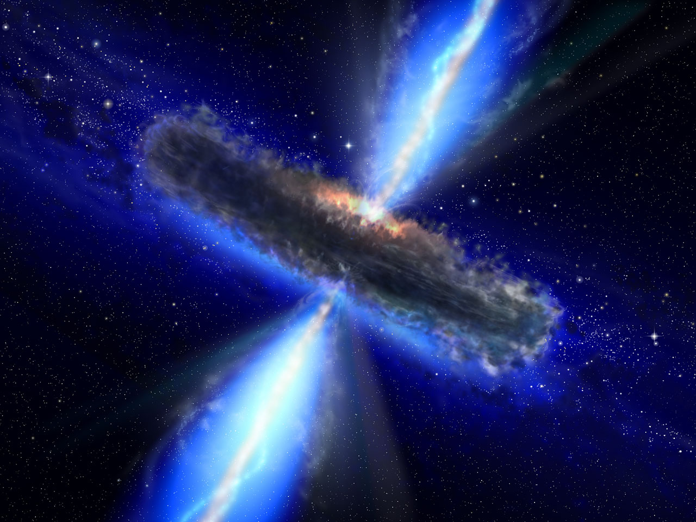
Throwing Light on Black Holes
S.R. Manikandasriram Sri Sankara Sen. Sec. School
Tanmay Shankar Bala Vidya Mandir
Our Guru: Prof. Prasanta Kumar Tripathy
Research Science Initiative Chennai, Summer Programme 2010
IIT Madras

Slide 2
Abstract
In this project, we study Black Holes and their properties, by interpreting the solutions of the equations that govern them.

Slide 3
What are Black Holes?
Why are they attractive?
How does one study them?

Slide 4
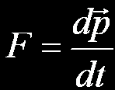
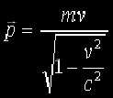
Coordinate Transformations
Under coordinate transformations the line element remains unchanged.
( Valid for v<<c )
This is invariant under Galilean transformations.
When v is comparable to c, this breaks down, and Special relativity steps in.
where
This is invariant under Lorentz transformation.

Slide 5
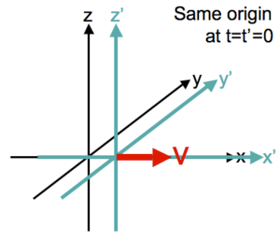

Lorentz Transformation
The Line Element is:
Standard Linear Transformation:
General Linear Transformations can also be performed.

Slide 6


Matrix Representation
The necessary condition for a Lorentz Transformation is:
It has a 6 parameter family of solutions.
η → Flat Metric. Λ → Transformation Matrix

Slide 7
Special Relativity
The Principle of Relativity.
The Principle of Invariant Light Speed.

Slide 8
General Relativity
Incorporating gravity into Special Relativity, we get General Relativity.
Equivalence Principle.
Einstein’s Field Equations.

Slide 9

Einstein’s Field Equations
Requires:
Second order derivatives of the dynamic variable.
Invariant under general coordinate transformation.
A Tensor of rank-2 is the perfect object that satisfies these conditions.
This is an object that transforms as:
It is invariant under linear coordinate transformations.

Slide 10
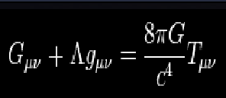
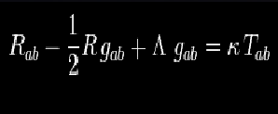

Slide 11
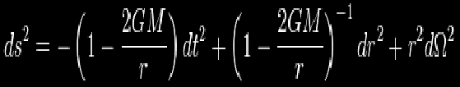
Schwarzschild matrix
This is the first non trivial solution of Einstein’s field equation, and represents the space-time of a black hole.
Suggests apparent singularity, at r=2GM , but this can be resolved with proper coordinate system.

Slide 12
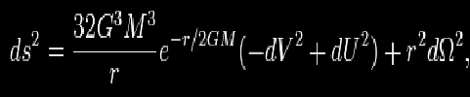
Here the anomaly is removed.

Slide 13
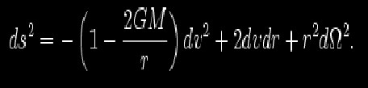

v=t+r*

