Slide 1


Project Presentation
S-NaV
Smart Navigation
Karthik.M (ME11B153)
S.R.Manikandasriram (EE11B127)

Slide 2
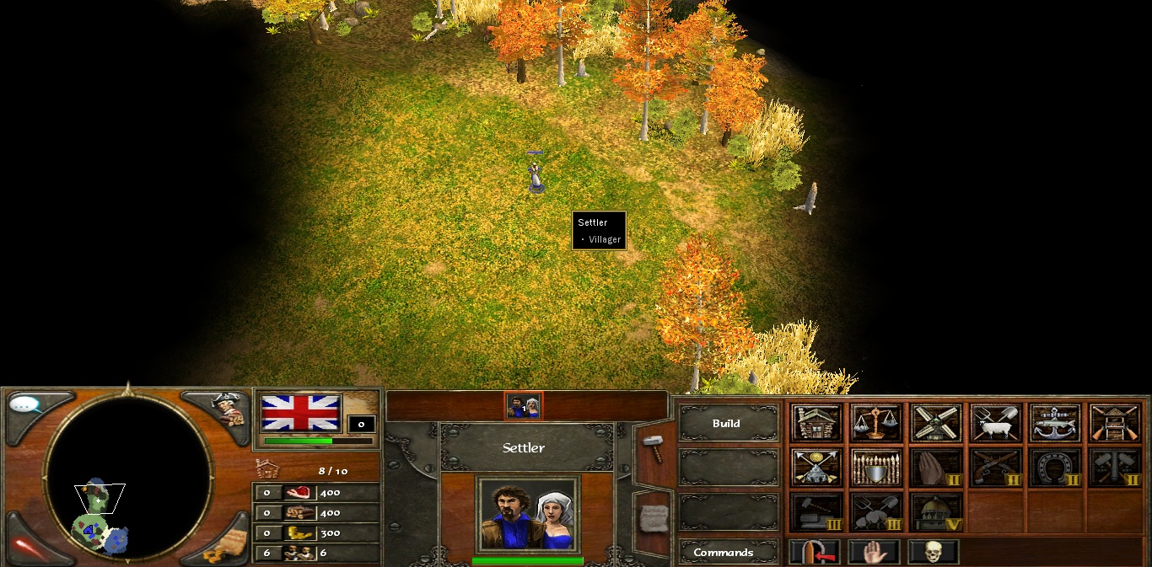
The Concept

Slide 3
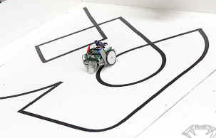
The Target
Independent of Support System
Adaptability & Portability
Unrestricted work area
Notes:
For example, a line follower requires a predefined path. Bots guided by a transceiver system require external units. However, what we would effective and convenient is a bot which is standalone. That is what we are aiming at. By virtue of the absence of any external support, on a larger scale, we can also achieve better terrain independence.

Slide 4

The Solution
Ability to remember paths
Ability to decipher the shortest route

Slide 5
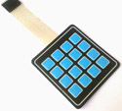
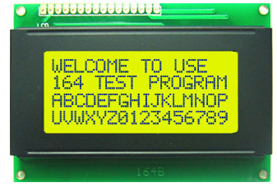
Echo
4x4 Matrix Keypads
Atmega16 Micro
JHD204 LCD

Slide 6
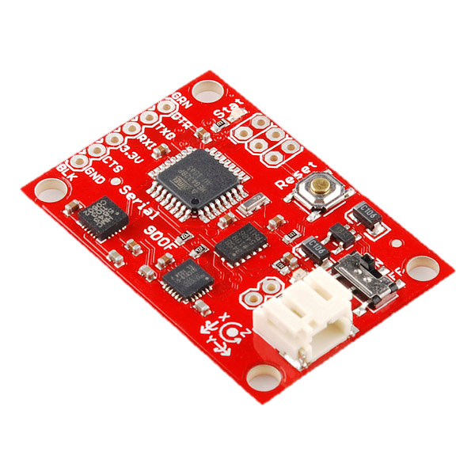
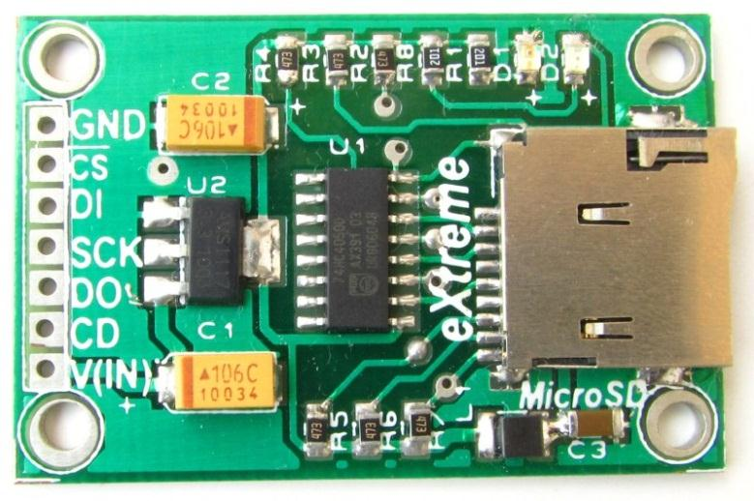

The Hardware
9 DOF Razor IMU
Wheel Encoder Set
MicroSD Card (TF) module
433 MHz RF module

Slide 7
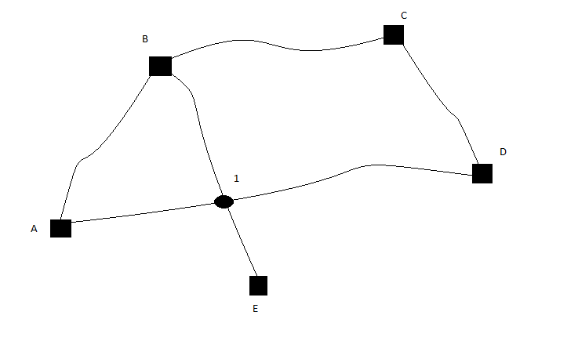
The Algorithm
Initial | Final | Length
A | B | 15
B | C | 24
C | D | 32
D | A | 2
B | E | 9
B | 1 | 36
1 | E | 14
A | 1 | 33
1 | D | 78
Encoder Left | Encoder Right
0 | 0
1 | 0
2 | 1
3 | 2
… | …
Notes:
Further data from 9 DOF module could be used to produce a 3D map

Slide 8
Single-Pair Shortest Path Problem
Dijkstra’s Algorithm
Bidirectional Search
In case of heavy computation, it can be outsourced to a Laptop/Mob App and the final results stored in a Table!

Slide 9
The Cost Factor
Component Name | Cost (approx.)
9DOF Razor IMU
Echo: Atmega16 + JHD204A + 4x4Matrix KeyPad+ trivial | Rs.1000 (300+420+180+100)
Bot: 2 DC Gear Motors + Chasis + etc… | Rs. (290+
RF Module: 433MHz | Rs.315
microSD (TF) Module +1GB SD card | Rs. 665 (480+185)
Wheel Encoder Set | Rs. 2060
Total:

Slide 10
Primitive AI
Bot’s “map” to be partitioned into domains and a probabilistic attempt to reach the master based on past ‘experiences’ which can be overridden

Slide 11

Avenues for Expansion
Improving robustness of the bot and enabling it to lift and carry small objects.
Making it an All-Terrain Vehicle.
Voice Recognition.
Packaging the S-Nav system into a module that can be fitted into any bot.
Notes:
Mention AI is primitive

Slide 12
References
URL:
http://www.sparkfun.com/products/9623
http://en.wikipedia.org/wiki/Dijkstra%27s_algorithm
http://www.dharmanitech.com/2009/01/sd-card-interfacing-with-atmega8-fat32.html
http://extremeelectronics.co.in/category/rf/
http://extremeelectronics.co.in/avr-tutorials/4x3-matrix-keypad-interface-avr-tutorial/
http://extremeelectronics.co.in/avr-tutorials/using-lcd-module-with-avrs/

Slide 13
THANK YOU

