Slide 1


Project Presentation
S-NaV
Smart Navigation
Karthik.M (ME11B153)
S.R.Manikandasriram (EE11B127)

Slide 2
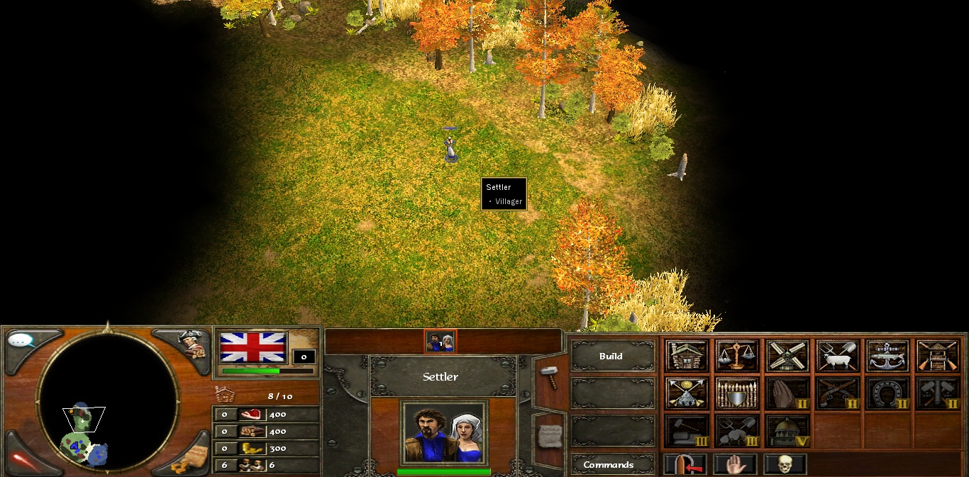
The Concept

Slide 3
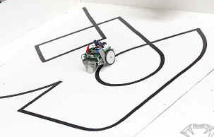
The Target
Independent of Support System
Adaptability & Portability
Unrestricted work area
Notes:
For example, a line follower requires a predefined path. Bots guided by a transceiver system require external units. However, what we would effective and convenient is a bot which is standalone. That is what we are aiming at. By virtue of the absence of any external support, on a larger scale, we can also achieve better terrain independence.

Slide 4

The Solution
Ability to remember paths
Ability to decipher the shortest route

Slide 5
The Hardware
4 wheeled bot incorporating Ackermans Steering.
Wirelessly called and controlled by a handheld.
Encoders
External Memory

Slide 6
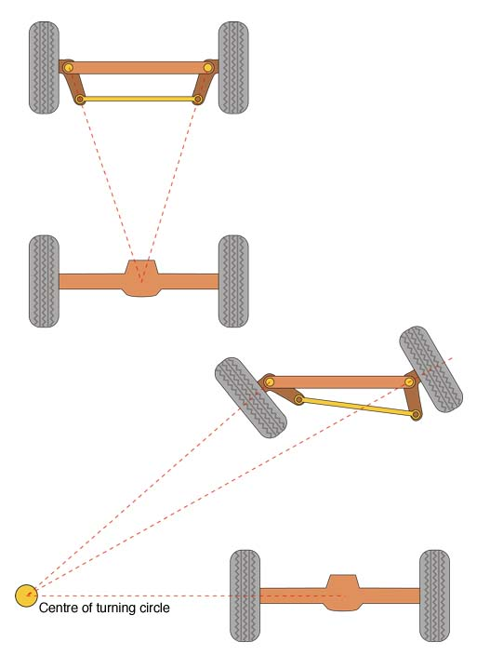
4 Wheeled Bot
Ackerman Steering
Servo
Rack and Pinion
Chasis

Slide 7
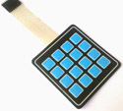
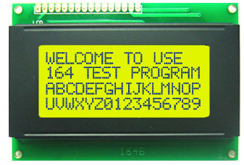

Control
4x4 Matrix Keypads
Atmega16 Micro
JHD164 LCD
The Transmitter

Slide 8
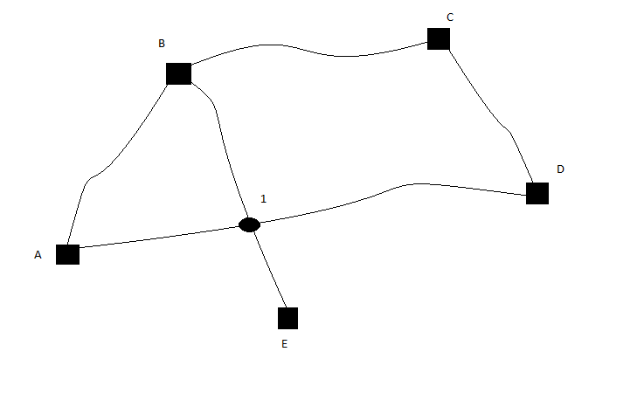
The Algorithm
Initial | Final
A | B
B | C
C | D
D | A
B | E
B | 1
1 | E
A | 1
1 | D
Encoder Value | Servo Angle
0 | 0
1 | 0
2 | 1
3 | 2
… | …
Notes:
Mani/1.5mins

Slide 9

Avenues for Expansion
Artificial Intelligence
Improving robustness of the bot and enabling it to lift and carry small objects.
Incorporating a magnetic-compass.
Making it an All-Terrain Vehicle.
Voice Recognition.
Packaging the S-Nav system into a module that can be fitted into any bot.
Notes:
Mention AI is primitive

Slide 10
THANK YOU

