Slide 1
Accelerating Predictive Analytics on Large Datasets through Embarrassingly Parallel Computing
Name: Suraj Basavaraj Rajolad
ID:02131154

Slide 2
Balancing Time and Data Size
The amount of time it takes to process the data we use grows proportionally as its size does as well.
When the model is put into use, it will be fed a lot of data, which could make it take longer to process and get results.

Slide 3
Importing data and Preprocessing
We are importing the data in CSV format, with 100,000 rows and 10 columns.
We filtered the columns and selected four features: 'num_pages', 'book_rating,' 'book_price', and 'text_lang'. The target variable is 'book_genre'.
To ensure that no single column has too much influence on the model, we used a standard scaler procedure to adjust the data. This helps to standardise the values in each column so that they are all on the same scale.

Slide 4
Model
GradientBoostingClassifier is an ensemble learning method for classification and regression tasks that combines multiple weak prediction models to form a strong predictive model.
To train the model, we used the GradientBoostingClassifier algorithm with a setting of n_estimators=100 and learning_rate=0.1.
The algorithm works by building decision trees in a sequential manner, with each new tree aiming to correct the errors of the previous tree.
The output of the GradientBoostingClassifier for classification tasks is the class selected by the model with the highest predicted probability.

Slide 5
Use of Parallel Processing
Serial: Type of processing in which one task is completed at a time and all the tasks are executed by the processor in a sequence. Workload of the processor higher.
Parallel: Type of processing in which multiple tasks are completed at a time by different processors Requires less time to complete the task. Workload per a processor is lower.

Slide 6
Steps
The data was imported in CSV format.
The data was preprocessed, including filtering columns and using a standard scaler procedure.
A Gradient Boosting Classifier model is created.
The same data was fed to the model using multiprocessing, with different settings for the number of cores and the size of the data.
The time taken to process the data, the speedup, and the efficiency was calculated for each combination of cores and data size.

Slide 7
Methods
The implementation of parallel computing in this study was done using the Python programming language.
The Python library multiprocessing was used to implement both serial and parallel programming in this study.
The use of multiple cores in parallel computing can significantly speed up computations and improve performance.
To implement parallelization in this study, we used the Pool() module from the multiprocessing library in Python.
The Pool() module allows us to parallelize a function by distributing its tasks among multiple processes, with each process running on a separate core.

Slide 8
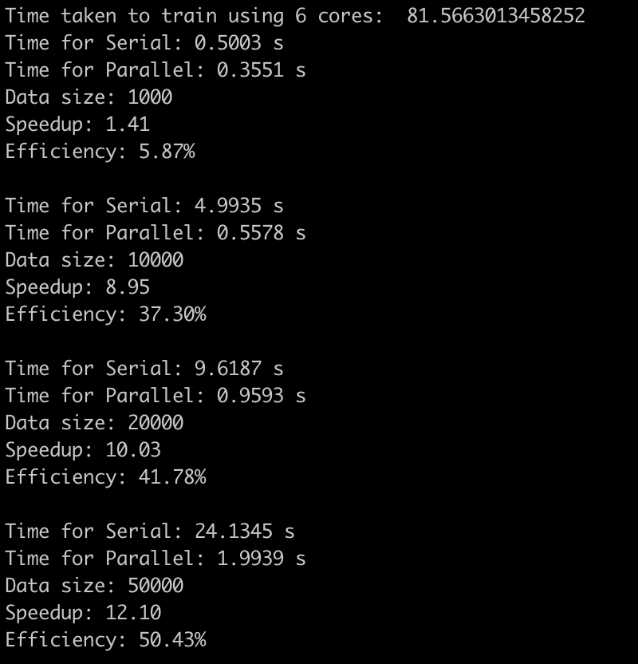
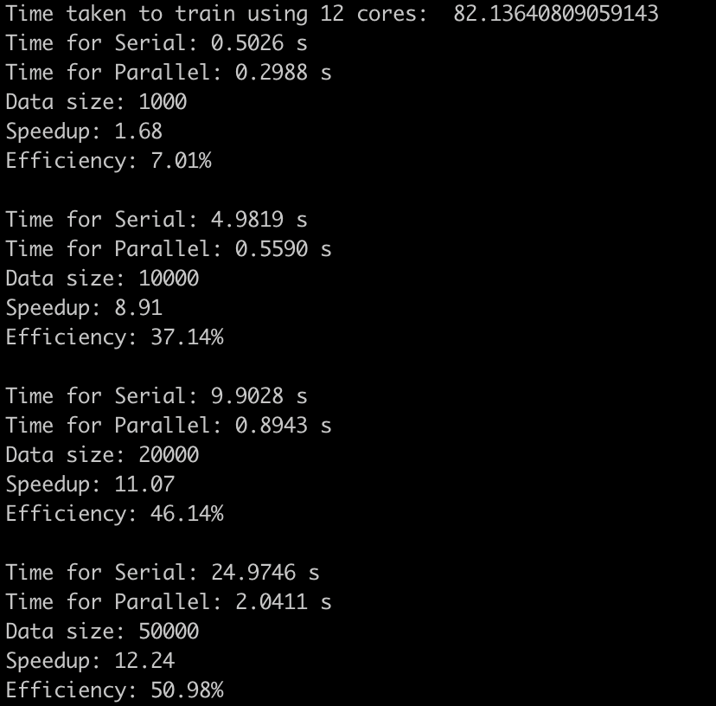
Serial and Parallel time for diff data size

Slide 9
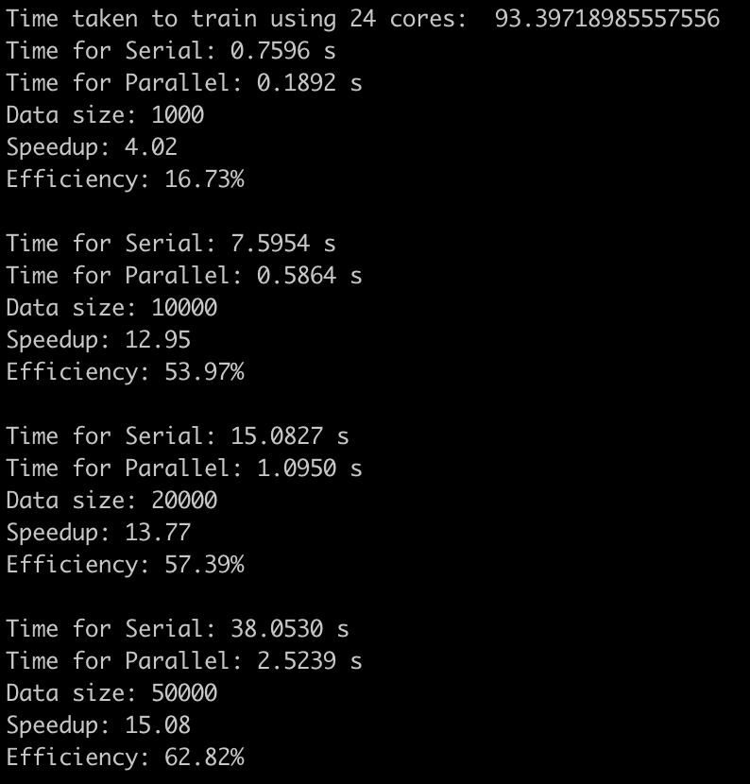
Contd..

Slide 10
Conclusion
In conclusion, making predictions quickly for huge datasets can be greatly accelerated by using embarrassingly parallel computation. In this method, the workload is divided into smaller tasks that can run in parallel on a laptop's multiple cores. The total amount of time required for prediction can be decreased by using a supercomputer to access additional cores. Overall, this method can be a useful tool for more quickly producing predictions on large datasets.

Slide 11
References
Multiprocessing :https://docs.python.org/3/library/multiprocessing.html
Pandas:https://pandas.pydata.org/
Parallelization with MultiProcessing: https://towardsdatascience.com/parallelization-w-multiprocessing-in-python-bd2fc234f516
Seaborn: https://seaborn.pydata.org/
Matplotlib: https://matplotlib.org/

Slide 12
THANK YOU

