Slide 1
Chemical Reaction Neural Networks for Biomass Pyrolysis Kinetics
By: Suraj Adhikari

Slide 2
Experiment List
Exp | Reference | m₀ (mg) | β (K/min) | [KCL] (%) | Lid (Yes/No)
1 | Exp | 5 | 2.5 | 0 | No
2 | Exp | 5 | 10 | 0 | No
3 | Exp | 5 | 2.5 | 0.1 | No
4 | Exp | 5 | 2.5 | 1 | No
5 | Exp | 5 | 10 | 0.1 | No
6 | Exp | 5 | 10 | 1 | No
7 | Exp | 5 | 2.5 | 0 | Yes
8 | Exp | 5 | 2.5 | 0.1 | Yes
9 | Exp | 5 | 2.5 | 1 | Yes
10 | Exp | 20 | 2.5 | 0 | No
Seite 2

Slide 3
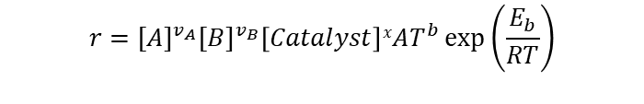
Incorporating Catalyst Species
Assumptions
Output matrix weights for Catalyst species= 0 (Does not participate in reaction)
Catalyst species concentration is Initialized for each experiment (i.e. 1% or 0.1%)
Catalyst species does not change during an experiment.
Reaction Equation
Law of Mass Action and Arrhenius Law
$$v_{A}A+ v_{B}B +x Catalyst→v_{C}C+ v_{D}D+x Catalyst$$
$$r={[A]}^{v_{A}}{[B]}^{v_{B}}\left[Catalyst\right]xAT^{b}\exp\left(\frac{E_{b}}{RT}\right)$$
$r=exp⁡(v_{A}ln⁡[A]$ + $v_{B}\ln\left[B\right]$ + 0 $\ln\left[C\right]$ + 0 $\ln\left[D\right]+x ln⁡[Catalyst]+lnA+b lnT− \frac{E_{A}}{RT})$
Seite 3

Slide 4
Training Case Example
5 species, 8 Reaction, 1 Catalyst species
Train Loss = 0.052
Validation Loss = 0.047
 | Cellu | S2 | S3 | S4 | Cat. | E_{a} | b | lnA | Cellu | S2 | S3 | S4 | Vola.
R1 | 2.0 | 0. | 0. | 0. | 0. | 122.33 | 0.33 | 14.19 | -2.0 | 0. | 0.12 | 1.88 | 0.
R2 | 0. | 0.13 | 0. | 0. | 0. | 112.07 | 0.01 | 8.44 | 0. | -0.13 | 0. | 0.13 | 0.
R3 | 0. | 0. | 1.21 | 0. | 0. | 100.55 | 0.18 | 10.98 | 0. | 0.65 | -1.21 | 0.29 | 0.28
R4 | 0.89 | 0.25 | 0.13 | 0. | 0. | 88.96 | 0.21 | 13.68 | -0.89 | -0.25 | -0.13 | 0.85 | 0.41
R5 | 0. | 0. | 0. | 0.63 | 0.06 | 58.69 | 0.0 | 9.58 | 0. | 0. | 0.37 | -0.63 | 0.27
R6 | 0. | 0. | 0. | 0.96 | 0.9 | 69.75 | 0.41 | 15.51 | 0. | 0.34 | 0.49 | -0.96 | 0.13
R7 | 0. | 0. | 0. | 1.30 | 0.09 | 67.52 | 0.39 | 12.9 | 0. | 0.29 | 0. | -1.30 | 1.01
R8 | 0. | 0. | 0. | 0.81 | 0. | 112.75 | 0.51 | 16.87 | 0. | 0.59 | 0. | -0.81 | 0.22
Seite 4

Slide 5
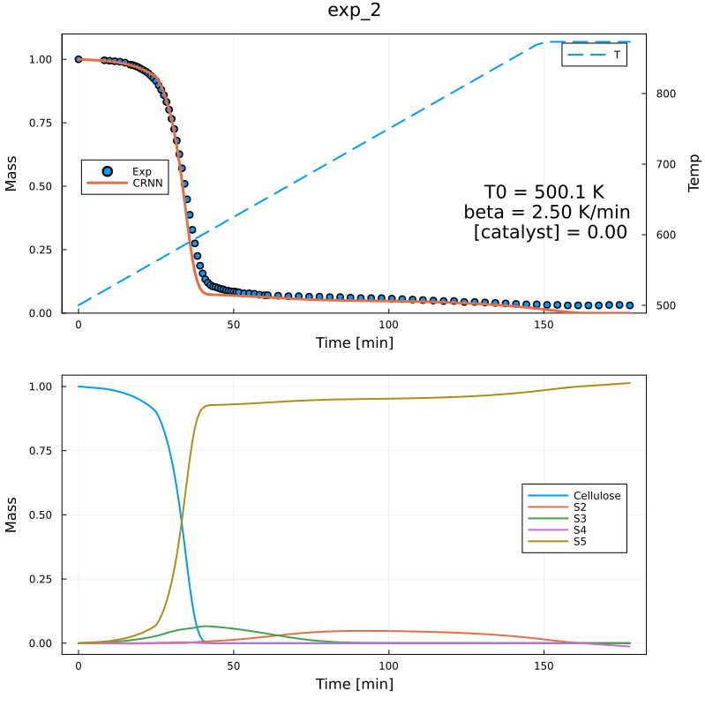
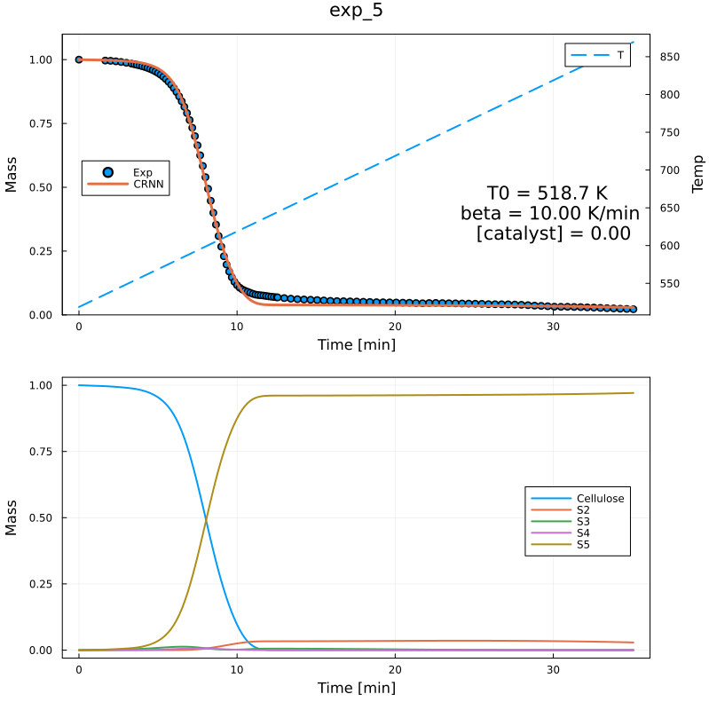
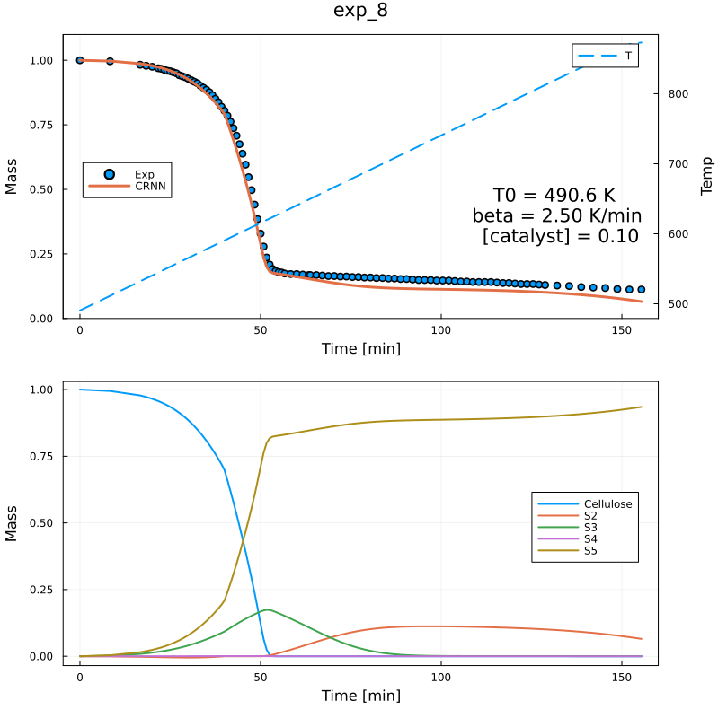
Predicted Residual Mass and Species Profiles
Seite 5

Slide 6
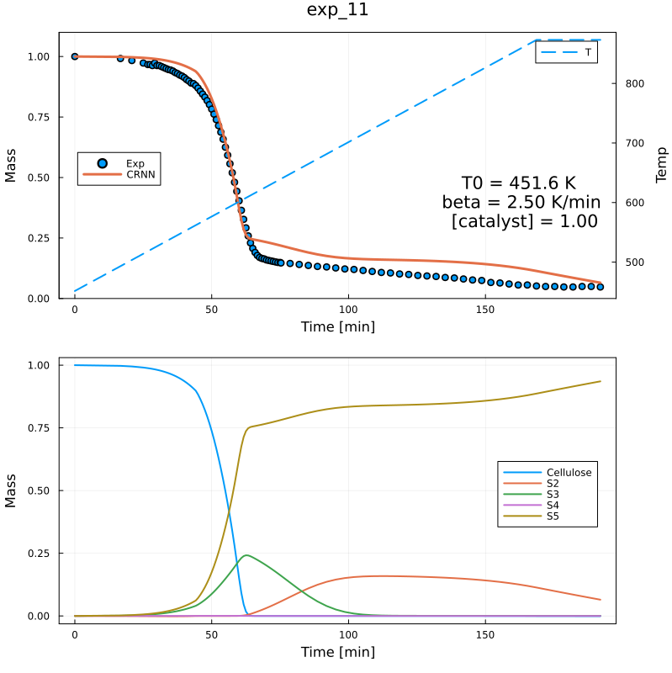
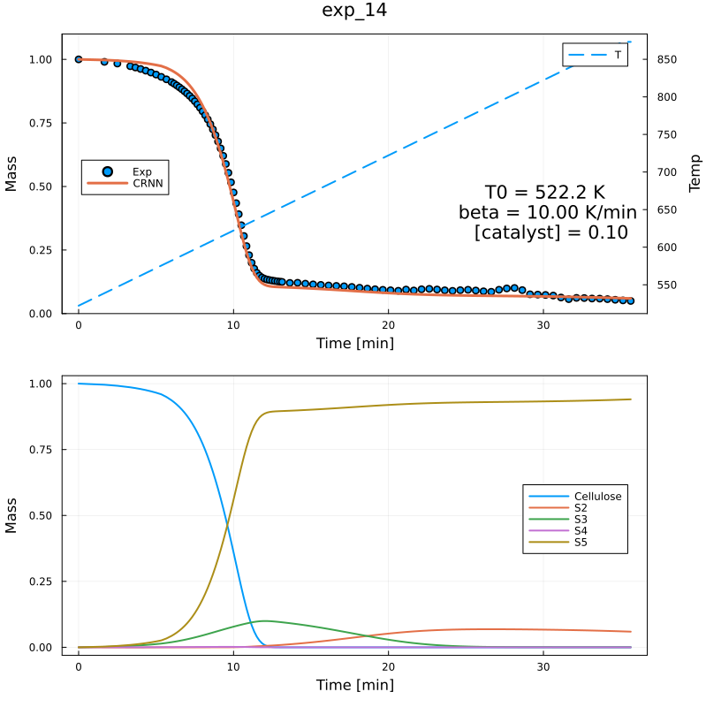
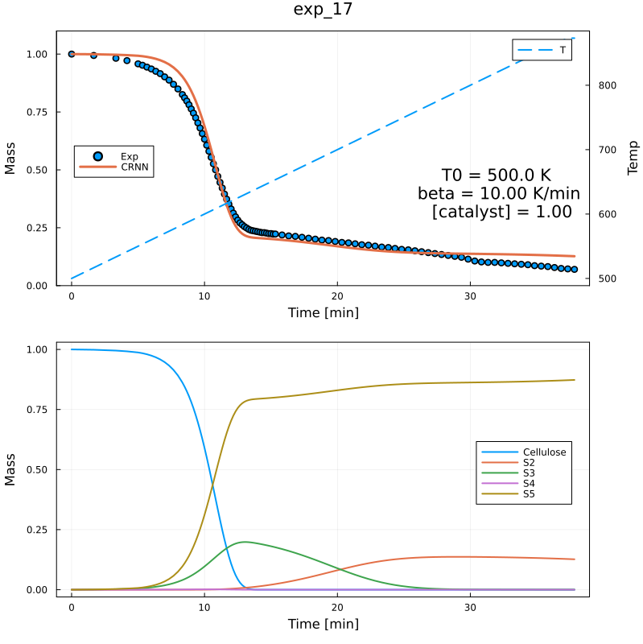
Predicted Residual Mass and Species Profiles
Seite 6

Slide 7
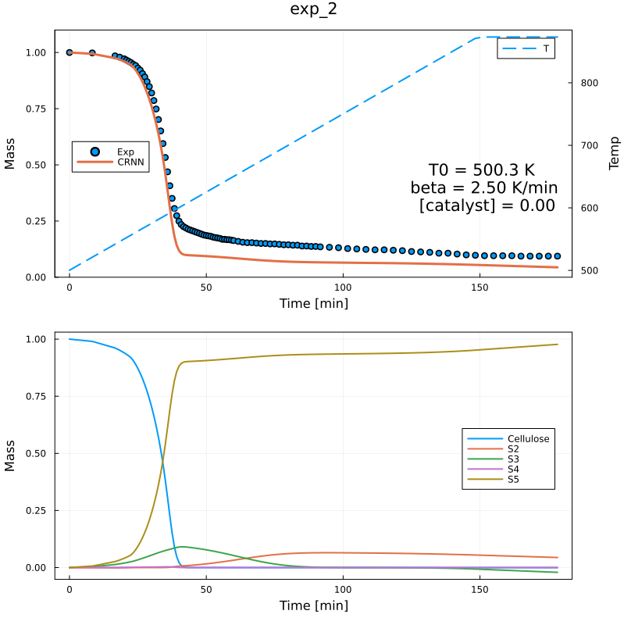
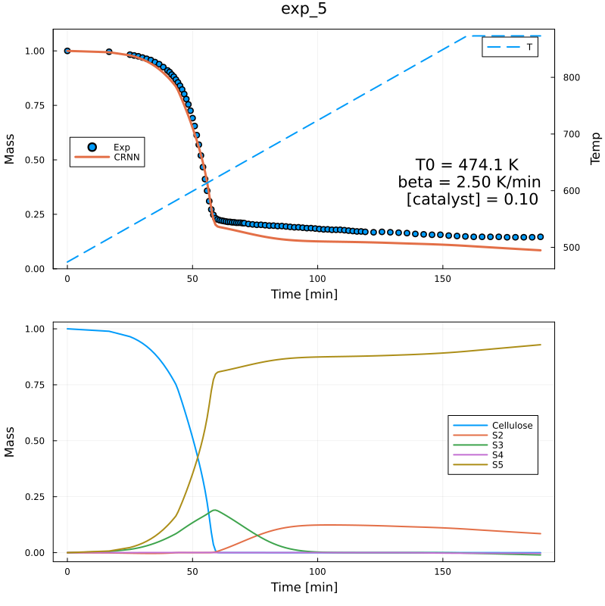
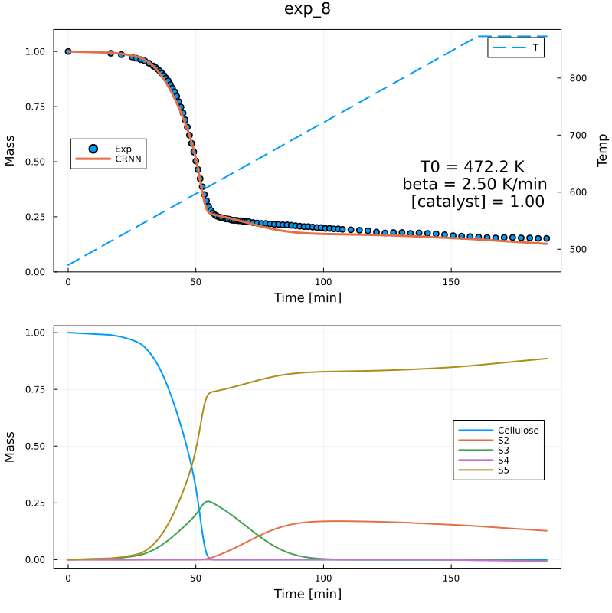
Lid Experiments Results
With 5 species, 8 reactions, 1 Catalyst species
Seite 7

Slide 8
Lid Experiments Results with Extra Reactions
With 5 species, 9 reactions, 1 Catalyst species
Train Loss = 0.040
Validation Loss = 0.029
 | Cellu | S2 | S3 | S4 | Cat. | E_{a} | b | lnA | Cellu | S2 | S3 | S4 | Vola.
R1 | 2.0 | 0. | 0. | 0. | 0. | 122.33 | 0.33 | 14.19 | -2.0 | 0. | 0.12 | 1.88 | 0.
R2 | 0. | 0.13 | 0. | 0. | 0. | 112.07 | 0.01 | 8.44 | 0. | -0.13 | 0. | 0.13 | 0.
R3 | 0. | 0. | 1.21 | 0. | 0. | 100.55 | 0.18 | 10.98 | 0. | 0.65 | -1.21 | 0.29 | 0.28
R4 | 0.89 | 0.25 | 0.13 | 0. | 0. | 88.96 | 0.21 | 13.68 | -0.89 | -0.25 | -0.13 | 0.85 | 0.41
R5 | 0. | 0. | 0. | 0.63 | 0.06 | 58.69 | 0.0 | 9.58 | 0. | 0. | 0.37 | -0.63 | 0.27
R6 | 0. | 0. | 0. | 0.96 | 0.9 | 69.75 | 0.41 | 15.51 | 0. | 0.34 | 0.49 | -0.96 | 0.13
R7 | 0. | 0. | 0. | 1.30 | 0.09 | 67.52 | 0.39 | 12.9 | 0. | 0.29 | 0. | -1.30 | 1.01
R8 | 0. | 0. | 0. | 0.81 | 0. | 112.75 | 0.51 | 16.87 | 0. | 0.59 | 0. | -0.81 | 0.22
R9 | 0. | 0. | 0. | 0.51 | 0. | 48.44 | 0.09 | 5.02 | 0. | 0.1 | 0.33 | -0.51 | 0.08
Seite 8

Slide 9
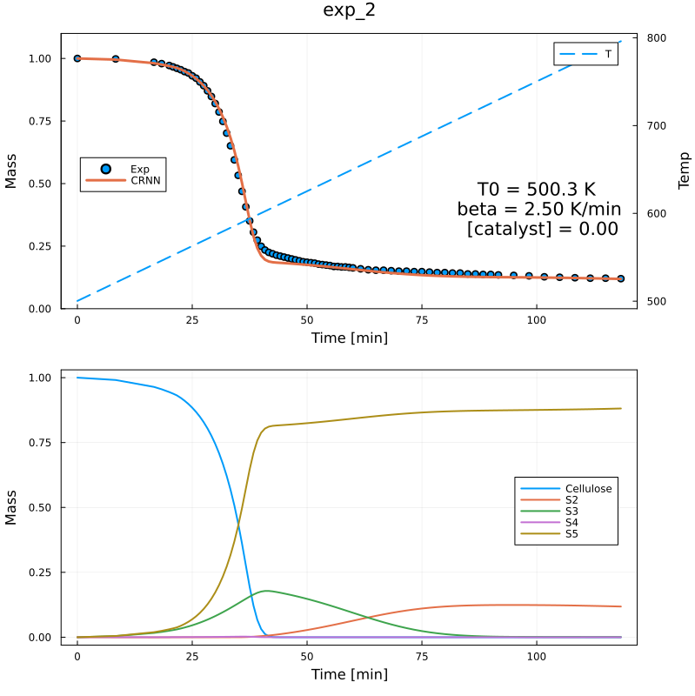
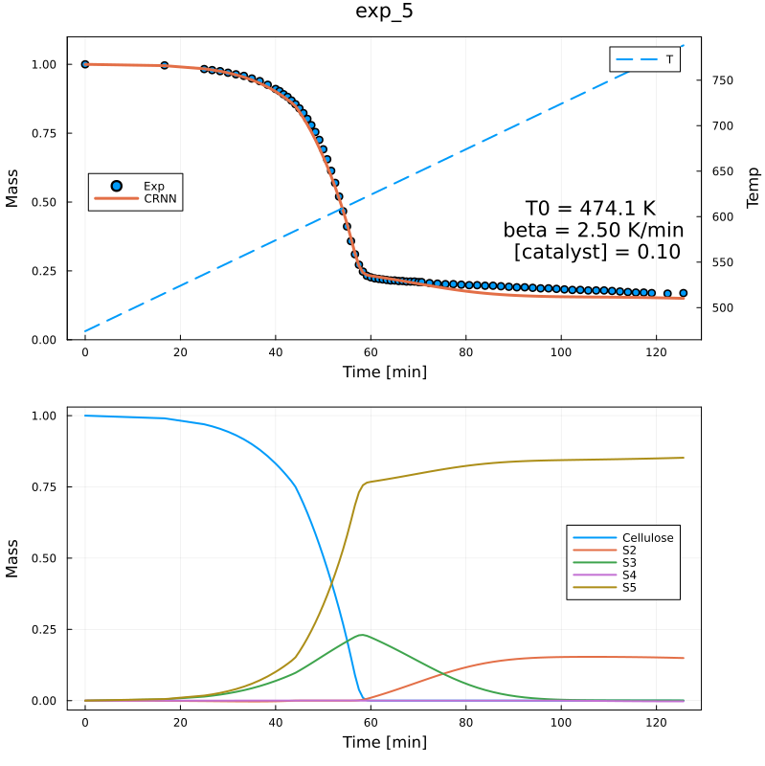
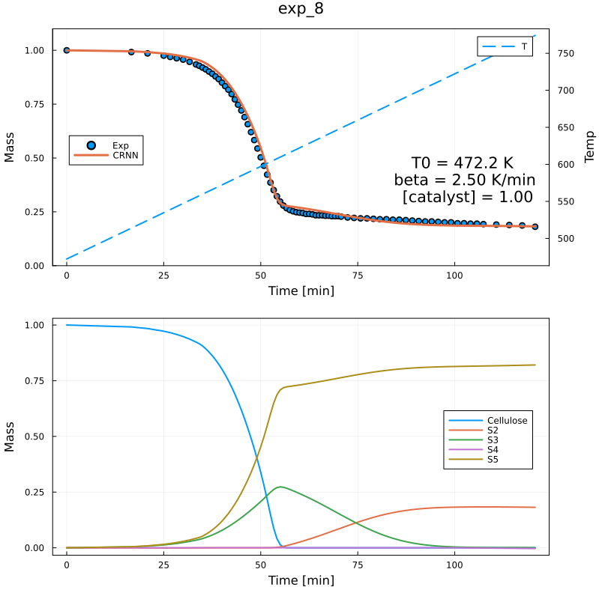
Predicted Residual Mass and Species Profiles
Seite 9

Slide 10
Lid Experiments Results with Extra Reactions
With 5 species, 10 reactions, 1 Catalyst species
Training Loss = 0.028, Validation Loss = 0. 030
 | Cellu | S2 | S3 | S4 | Cat. | E_{a} | b | lnA | Cellu | S2 | S3 | S4 | Vola.
R1 | 2.0 | 0. | 0. | 0. | 0. | 122.33 | 0.33 | 14.19 | -2.0 | 0. | 0.12 | 1.88 | 0.
R2 | 0. | 0.13 | 0. | 0. | 0. | 112.07 | 0.01 | 8.44 | 0. | -0.13 | 0. | 0.13 | 0.
R3 | 0. | 0. | 1.21 | 0. | 0. | 100.55 | 0.18 | 10.98 | 0. | 0.65 | -1.21 | 0.29 | 0.28
R4 | 0.89 | 0.25 | 0.13 | 0. | 0. | 88.96 | 0.21 | 13.68 | -0.89 | -0.25 | -0.13 | 0.85 | 0.41
R5 | 0. | 0. | 0. | 0.63 | 0.06 | 58.69 | 0.0 | 9.58 | 0. | 0. | 0.37 | -0.63 | 0.27
R6 | 0. | 0. | 0. | 0.96 | 0.9 | 69.75 | 0.41 | 15.51 | 0. | 0.34 | 0.49 | -0.96 | 0.13
R7 | 0. | 0. | 0. | 1.30 | 0.09 | 67.52 | 0.39 | 12.9 | 0. | 0.29 | 0. | -1.30 | 1.01
R8 | 0. | 0. | 0. | 0.81 | 0. | 112.75 | 0.51 | 16.87 | 0. | 0.59 | 0. | -0.81 | 0.22
R9 | 0. | 0. | 0. | 0.30 | 0.14 | 61.07 | 0. | 5.86 | 0. | 0.12 | 0. | -0.30 | 0.18
R10 | 0. | 0. | 0. | 0.52 | 0. | 49.45 | 0. | 5.97 | 0. | 0.11 | 0.37 | -0.52 | 0.04
Seite 10

Slide 11
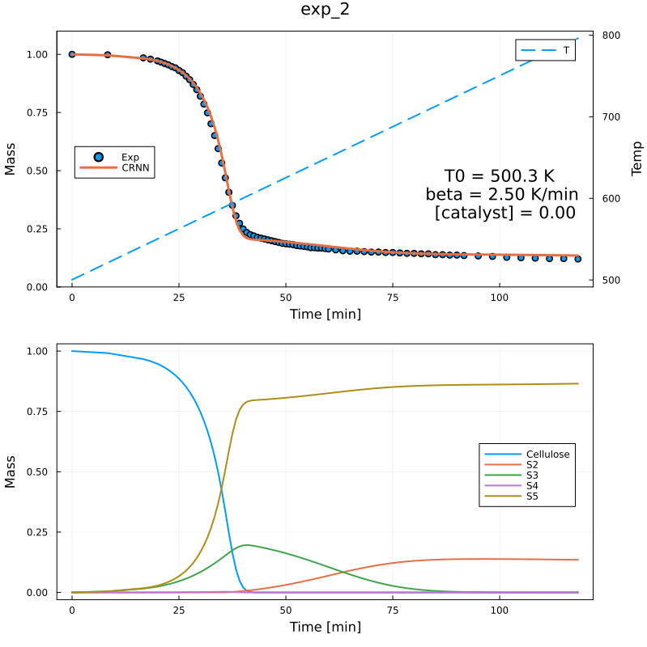
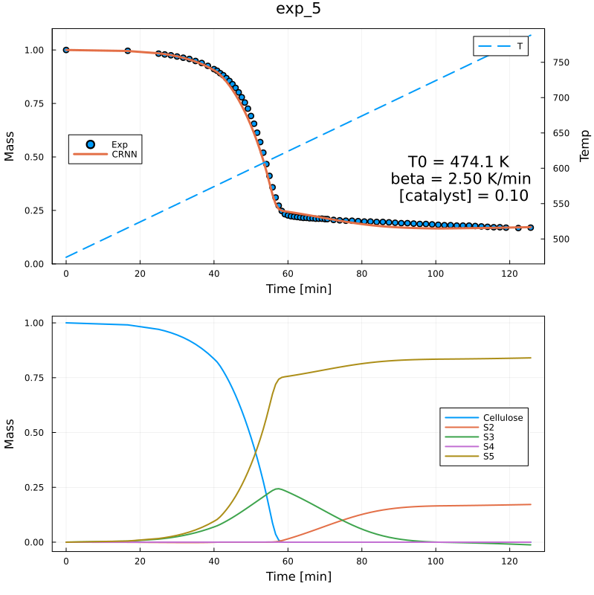
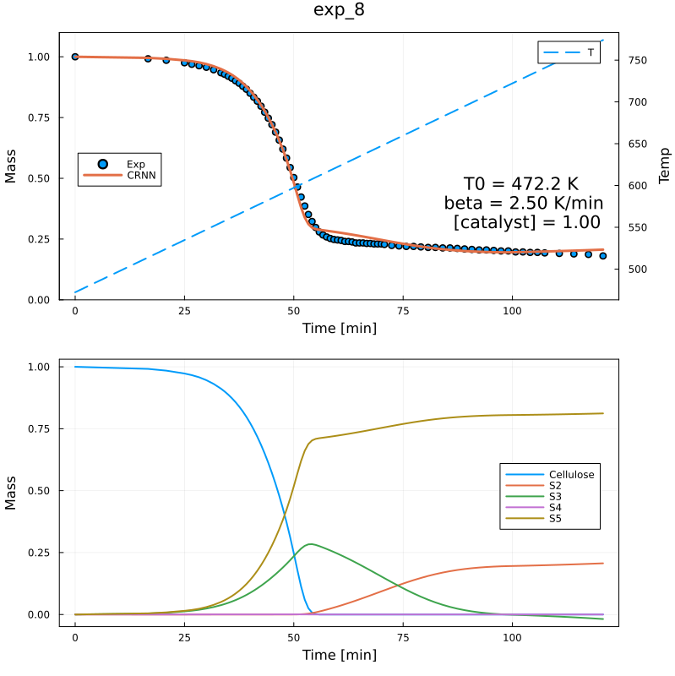
Predicted Residual Mass and Species Profiles
Seite 11

Slide 12
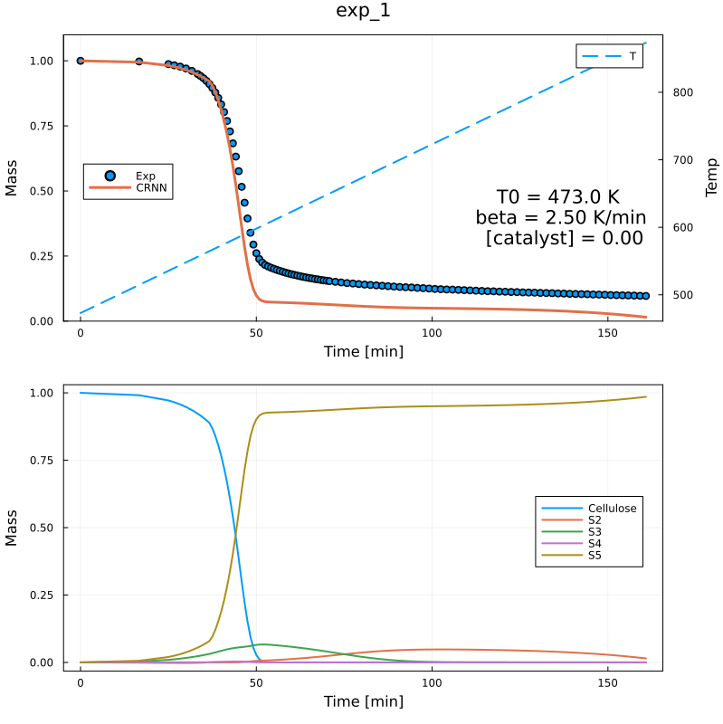
20 mg Experiments Results
With 5 species, 8 reactions, 1 Catalyst species
Seite 12

Slide 13
20 mg Experiments Results with Extra Reaction
With 5 species, 9 reactions, 1 Catalyst species
Train Loss = 0.020
Validation Loss = 0.017
 | Cellu | S2 | S3 | S4 | Cat. | E_{a} | b | lnA | Cellu | S2 | S3 | S4 | Vola.
R1 | 2.0 | 0. | 0. | 0. | 0. | 122.33 | 0.33 | 14.19 | -2.0 | 0. | 0.12 | 1.88 | 0.
R2 | 0. | 0.13 | 0. | 0. | 0. | 112.07 | 0.01 | 8.44 | 0. | -0.13 | 0. | 0.13 | 0.
R3 | 0. | 0. | 1.21 | 0. | 0. | 100.55 | 0.18 | 10.98 | 0. | 0.65 | -1.21 | 0.29 | 0.28
R4 | 0.89 | 0.25 | 0.13 | 0. | 0. | 88.96 | 0.21 | 13.68 | -0.89 | -0.25 | -0.13 | 0.85 | 0.41
R5 | 0. | 0. | 0. | 0.63 | 0.06 | 58.69 | 0.0 | 9.58 | 0. | 0. | 0.37 | -0.63 | 0.27
R6 | 0. | 0. | 0. | 0.96 | 0.9 | 69.75 | 0.41 | 15.51 | 0. | 0.34 | 0.49 | -0.96 | 0.13
R7 | 0. | 0. | 0. | 1.30 | 0.09 | 67.52 | 0.39 | 12.9 | 0. | 0.29 | 0. | -1.30 | 1.01
R8 | 0. | 0. | 0. | 0.81 | 0. | 112.75 | 0.51 | 16.87 | 0. | 0.59 | 0. | -0.81 | 0.22
R9 | 0. | 0. | 0. | 0.57 | 0. | 46.41 | 0.1 | 4.96 | 0. | 0.13 | 0.36 | -0.57 | 0.09
Seite 13

Slide 14
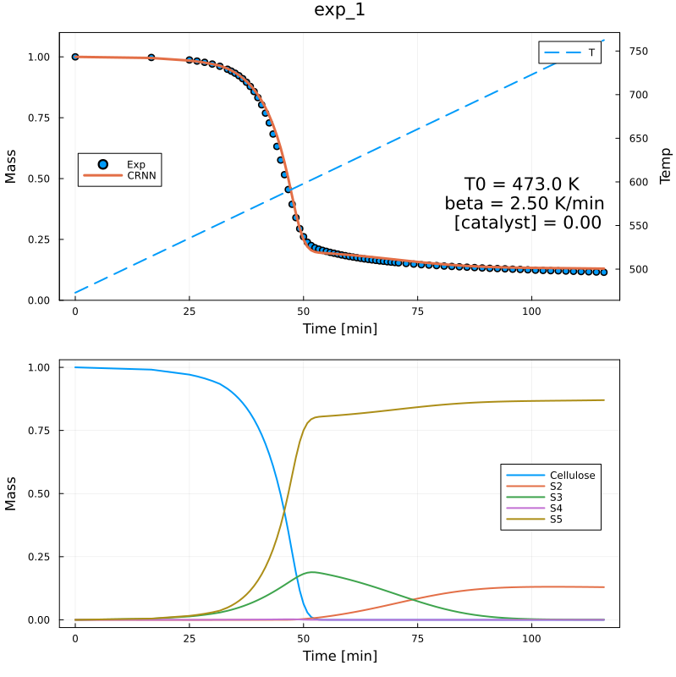
Predicted Residual Mass and Species Profiles
Seite 14

Slide 15
Lid Experiments Results with Extra Reactions
With 5 species, 10 reactions, 1 Catalyst species
Training Loss = 0.013, Validation Loss = 0. 013
 | Cellu | S2 | S3 | S4 | Cat. | E_{a} | b | lnA | Cellu | S2 | S3 | S4 | Vola.
R1 | 2.0 | 0. | 0. | 0. | 0. | 122.33 | 0.33 | 14.19 | -2.0 | 0. | 0.12 | 1.88 | 0.
R2 | 0. | 0.13 | 0. | 0. | 0. | 112.07 | 0.01 | 8.44 | 0. | -0.13 | 0. | 0.13 | 0.
R3 | 0. | 0. | 1.21 | 0. | 0. | 100.55 | 0.18 | 10.98 | 0. | 0.65 | -1.21 | 0.29 | 0.28
R4 | 0.89 | 0.25 | 0.13 | 0. | 0. | 88.96 | 0.21 | 13.68 | -0.89 | -0.25 | -0.13 | 0.85 | 0.41
R5 | 0. | 0. | 0. | 0.63 | 0.06 | 58.69 | 0.0 | 9.58 | 0. | 0. | 0.37 | -0.63 | 0.27
R6 | 0. | 0. | 0. | 0.96 | 0.9 | 69.75 | 0.41 | 15.51 | 0. | 0.34 | 0.49 | -0.96 | 0.13
R7 | 0. | 0. | 0. | 1.30 | 0.09 | 67.52 | 0.39 | 12.9 | 0. | 0.29 | 0. | -1.30 | 1.01
R8 | 0. | 0. | 0. | 0.81 | 0. | 112.75 | 0.51 | 16.87 | 0. | 0.59 | 0. | -0.81 | 0.22
R9 | 0. | 0.09 | 0. | 0.28 | 0.11 | 44.24 | 0.01 | 3.54 | 0. | -0.09 | 0.08 | -0.28 | 0.28
R10 | 0. | 0. | 0. | 0.51 | 0.05 | 37.14 | 0.02 | 4.06 | 0. | 0.13 | 0.36 | -0.51 | 0.03
Seite 15

Slide 16
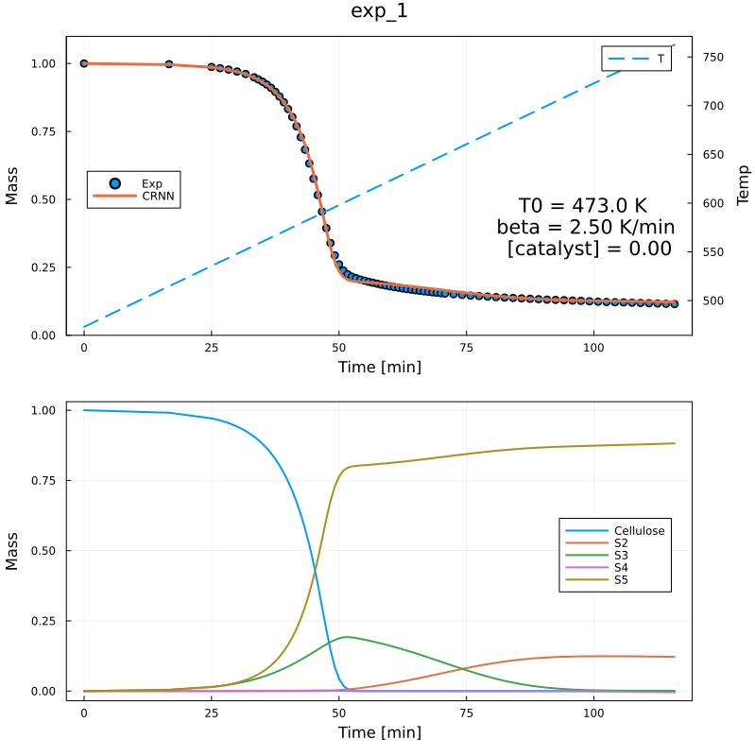
Predicted Residual Mass and Species Profiles
Seite 16

Slide 17
Training Case Example – 5s8r1c
5 species, 8 Reaction, 1 Catalyst species
Train Loss = 0.052
Validation Loss = 0.047
 | Cellu | S2 | S3 | S4 | Cat. | E_{a} | b | lnA | Cellu | S2 | S3 | S4 | Vola.
R1 | 2.0 | 0. | 0. | 0. | 0. | 122.33 | 0.33 | 14.19 | -2.0 | 0. | 0.12 | 1.88 | 0.
R2 | 0. | 0.13 | 0. | 0. | 0. | 112.07 | 0.01 | 8.44 | 0. | -0.13 | 0. | 0.13 | 0.
R3 | 0. | 0. | 1.21 | 0. | 0. | 100.55 | 0.18 | 10.98 | 0. | 0.65 | -1.21 | 0.29 | 0.28
R4 | 0.89 | 0.25 | 0.13 | 0. | 0. | 88.96 | 0.21 | 13.68 | -0.89 | -0.25 | -0.13 | 0.85 | 0.41
R5 | 0. | 0. | 0. | 0.63 | 0.06 | 58.69 | 0.0 | 9.58 | 0. | 0. | 0.37 | -0.63 | 0.27
R6 | 0. | 0. | 0. | 0.96 | 0.9 | 69.75 | 0.41 | 15.51 | 0. | 0.34 | 0.49 | -0.96 | 0.13
R7 | 0. | 0. | 0. | 1.30 | 0.09 | 67.52 | 0.39 | 12.9 | 0. | 0.29 | 0. | -1.30 | 1.01
R8 | 0. | 0. | 0. | 0.81 | 0. | 112.75 | 0.51 | 16.87 | 0. | 0.59 | 0. | -0.81 | 0.22
Seite 17

Slide 18
Reaction Mechanism
R1 | 2.0 Cell | → | 0.12 S3 + 1.88 S4
R2 | 0.13 S2 | → | 0.13 S4
R3 | 1.21 S3 | → | 0.65 S2 + 0.28 Vol + 0.29 S4
R4 | 0.89 Cell + 0.25 S2 + 0.13 S3 | → | 0.85 S4 + 0.41 Vol
R5 | 0.63 S4 | → | 0.37 S3 + 0.27 Vol
R6 | 0.96 S4 | → | 0.34 S2 + 0.13 Vol + 0.49 S3
R7 | 1.30 S4 | → | 0.29 S2 + 1.01 Vol
R8 | 0.81 S4 | → | 0.59 S2 + 0.22 Vol
Seite 18

Slide 19
Training Case Example – 5s8r1c -02
5 species, 8 Reaction, 1 Catalyst species
Train Loss = 0.062
Validation Loss = 0.103
 | Cellu | S2 | S3 | S4 | Cat. | E_{a} | b | lnA | Cellu | S2 | S3 | S4 | Vola.
R1 | 0 | 0.04 | 0 | 0.04 | 0.15 | 192.53 | 0.09 | 23.67 | 0 | -0.04 | 0.09 | -0.04 | 0.
R2 | 0 | 0.16 | 0.71 | 0 | 0.39 | 185.75 | 0.37 | 32.8 | 0 | -0.16 | -0.71 | 0.85 | 0.01
R3 | 0.2 | 0.01 | 0.09 | 0 | 0.02 | 235.51 | 0.03 | 20.89 | -0.2 | -0.01 | -0.09 | 0.26 | 0.03
R4 | 0 | 0 | 0 | 0.2 | 0.1 | 242.33 | 0.01 | 19.8 | 0 | 0.06 | 0.09 | -0.2 | 0.06
R5 | 0 | 0 | 0.08 | 0.83 | 0 | 192.39 | 0.43 | 33.5 | 0 | 0.04 | -0.08 | -0.83 | 0.87
R6 | 0 | 0 | 0 | 0.84 | 0.37 | 113.35 | 0.12 | 23.94 | 0 | 0.17 | 0.6 | -0.84 | 0.07
R7 | 0.97 | 0 | 0 | 0 | 0.03 | 193.76 | 0.37 | 32.28 | -0.97 | 0 | 0.02 | 0.77 | 0.18
R8 | 0.2 | 0 | 0.1 | 0 | 0.03 | 230.57 | 0.06 | 20.87 | -0.2 | 0.01 | -0.1 | 0.26 | 0.03
Seite 19

Slide 20
Reaction Mechanism
R1 | 0.04 S2 + 0.04 S4 | → | 0.09 S3
R2 | 0.16 S2 + 0.71 S3 | → | 0.85 S4 + 0.01Vol
R3 | 0.2 Cell + 0.01 S2 + 0.09 S3 | → | 0.26 S4 + 0.03 Vol
R4 | 0.2 S4 | → | 0.06 S2 + 0.09 S3 + 0.06 Vol
R5 | 0.08 S3 + 0.83 S4 | → | 0.04 S2 + 0.87 Vol
R6 | 0.84 S4 | → | 0.17 S2 + 0.6 S3 + 0.07 Vol
R7 | 0.97 Cell | → | 0.02 S3 + 0.77 S4 + 0.18 Vol
R8 | 0.2 Cell + 0.1 S3 | → | 0.01 S2 + 0.26 S4 + 0.03 Vol
Seite 20

Slide 21
Training Case Example – 5s8r1c - 09
5 species, 8 Reaction, 1 Catalyst species
Train Loss = 0.044
Validation Loss = 0.103
 | Cellu | S2 | S3 | S4 | Cat. | E_{a} | b | lnA | Cellu | S2 | S3 | S4 | Vola.
R1 | 0.19 | 0 | 0 | 0.98 | 0.01 | 87.65 | 0.01 | 19.62 | -0.19 | 0.35 | 0.03 | -0.98 | 0.79
R2 | 0 | 0.83 | 0 | 0 | 0.41 | 74.54 | 0.01 | 19.51 | 0 | -0.83 | 0.15 | 0.57 | 0.11
R3 | 1.08 | 0.3 | 0 | 0 | 0.01 | 208.53 | 0.5 | 35.5 | -1.08 | -0.3 | 0 | 1.29 | 0.09
R4 | 0.05 | 0.12 | 0.16 | 0 | 0.11 | 225.42 | 0 | 18.79 | -0.05 | -0.12 | -0.16 | 0.32 | 0.01
R5 | 0.17 | 0 | 0.04 | 0.38 | 0.01 | 217.46 | 0.07 | 21.79 | -0.17 | 0.26 | -0.04 | -0.38 | 0.33
R6 | 0 | 0 | 0.14 | 0.85 | 1.34 | 123.34 | 0.39 | 30.51 | 0 | 0.95 | -0.14 | -0.85 | 0.04
R7 | 0 | 0.05 | 2.17 | 0 | 0.14 | 171.08 | 0.05 | 20.81 | 0 | -0.05 | -2.17 | 2.21 | 0.01
R8 | 2.01 | 0.01 | 0 | 0 | 0.67 | 175.62 | 0.34 | 30.52 | -2.01 | -0.01 | 0.5 | 0.3 | 1.22
Seite 21

Slide 22
Reaction Mechanism
R1 | 0.19 Cell + 0.98 S4 | → | 0.35 S2 + 0.03 S3 + 0.79 Vol
R2 | 0.13 S2 | → | 0.15 S3 + 0.57 S4 + 0.11 Vol
R3 | 1.08 Cell + 0.3 S2 | → | 1.29 S4 + 0.09 Vol
R4 | 0.05 Cell + 0.12 S2 + 0.16 S3 | → | 0.32 S4 + 0.01 Vol
R5 | 0.17 Cell + 0.04 S3 + 0.38 S4 | → | 0.26 S2 + 0.33 Vol
R6 | 0.14 S3 + 0.85 S4 | → | 0.95 S2 + 0.04 Vol
R7 | 0.05 S2 + 2.17 S3 | → | 2.21 S4 + 0.01 Vol
R8 | 2.01 Cell + 0.01 S2 | → | 0.5 S3 + 0.3 S4 + 1.22 Vol
Seite 22

Slide 23
Vielen Dank für Ihre Aufmerksamkeit!
www.ovgu.de

