Slide 1
Chemical Reaction Neural Networks for Biomass Pyrolysis Kinetics
By: Suraj Adhikari

Slide 2
Experiment List
Exp | Reference | m₀ (mg) | β (K/min) | [KCL] (%) | Lid (Yes/No)
1 | Exp | 5 | 2.5 | 0 | No
2 | Exp | 5 | 10 | 0 | No
3 | Exp | 5 | 2.5 | 0.1 | No
4 | Exp | 5 | 2.5 | 1 | No
5 | Exp | 5 | 10 | 0.1 | No
6 | Exp | 5 | 10 | 1 | No
7 | Exp | 5 | 2.5 | 0 | Yes
8 | Exp | 5 | 2.5 | 0.1 | Yes
9 | Exp | 5 | 2.5 | 1 | Yes
10 | Exp | 20 | 2.5 | 0 | No

Slide 3
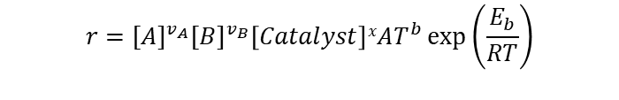
Incorporating Catalyst Species
Assumptions
Output matrix weights for Catalyst species= 0 (Does not participate in reaction)
Catalyst species concentration is Initialized for each experiment (i.e. 1% or 0.1%)
Catalyst species does not change during an experiment.
Reaction Equation
Law of Mass Action and Arrhenius Law
$$v_{A}A+ v_{B}B +x Catalyst→v_{C}C+ v_{D}D+x Catalyst$$
$$r={[A]}^{v_{A}}{[B]}^{v_{B}}\left[Catalyst\right]xAT^{b}\exp\left(\frac{E_{b}}{RT}\right)$$
$r=exp⁡(v_{A}ln⁡[A]$ + $v_{B}\ln\left[B\right]$ + 0 $\ln\left[C\right]$ + 0 $\ln\left[D\right]+x ln⁡[Catalyst]+lnA+b lnT− \frac{E_{A}}{RT})$

Slide 4
Training Case Example
5 species, 8 Reaction, 1 Catalyst species
Train Loss = 0.052
Validation Loss = 0.047
 | Cellu | S2 | S3 | S4 | Cat. | E_{a} | b | lnA | Cellu | S2 | S3 | S4 | Vola.
R1 | 2.0 | 0. | 0. | 0. | 0. | 122.33 | 0.33 | 14.19 | -2.0 | 0. | 0.12 | 1.88 | 0.
R2 | 0. | 0.13 | 0. | 0. | 0. | 112.07 | 0.01 | 8.44 | 0. | -0.13 | 0. | 0.13 | 0.
R3 | 0. | 0. | 1.21 | 0. | 0. | 100.55 | 0.18 | 10.98 | 0. | 0.65 | -1.21 | 0.29 | 0.28
R4 | 0.89 | 0.25 | 0.13 | 0. | 0. | 88.96 | 0.21 | 13.68 | -0.89 | -0.25 | -0.13 | 0.85 | 0.41
R5 | 0. | 0. | 0. | 0.63 | 0.06 | 58.69 | 0.0 | 9.58 | 0. | 0. | 0.37 | -0.63 | 0.27
R6 | 0. | 0. | 0. | 0.96 | 0.9 | 69.75 | 0.41 | 15.51 | 0. | 0.34 | 0.49 | -0.96 | 0.13
R7 | 0. | 0. | 0. | 1.30 | 0.09 | 67.52 | 0.39 | 12.9 | 0. | 0.29 | 0. | -1.30 | 1.01
R8 | 0. | 0. | 0. | 0.81 | 0. | 112.75 | 0.51 | 16.87 | 0. | 0.59 | 0. | -0.81 | 0.22

Slide 5
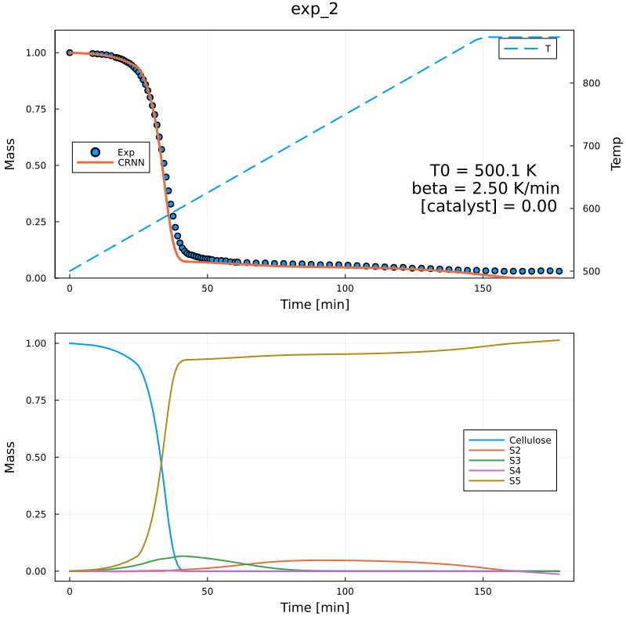
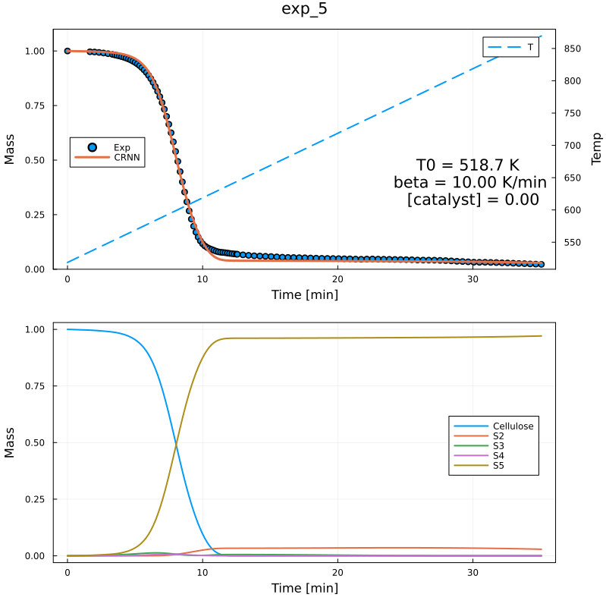
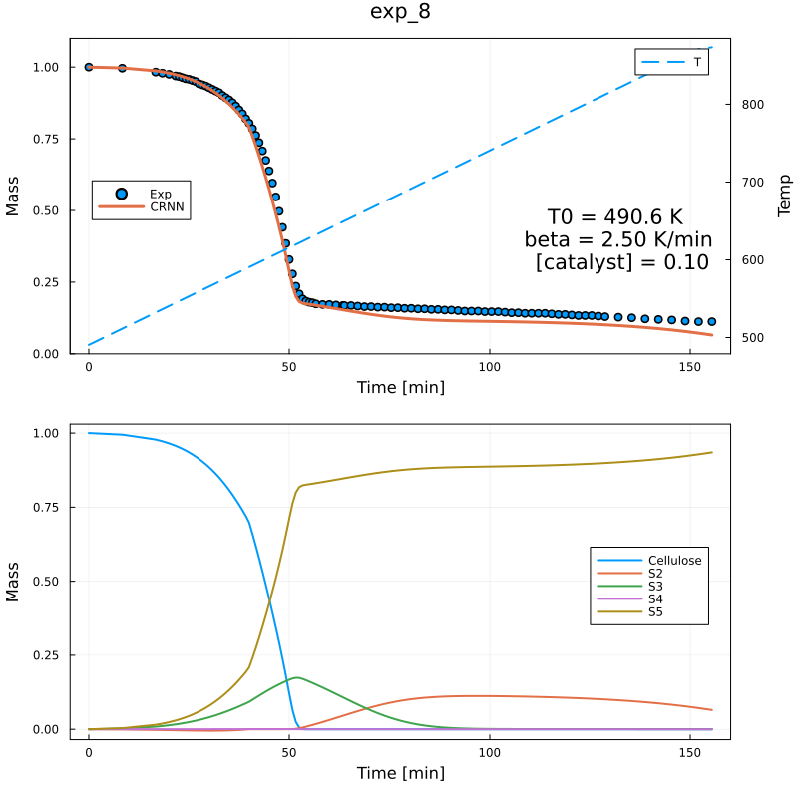
Predicted Residual Mass and Species Profiles

Slide 6
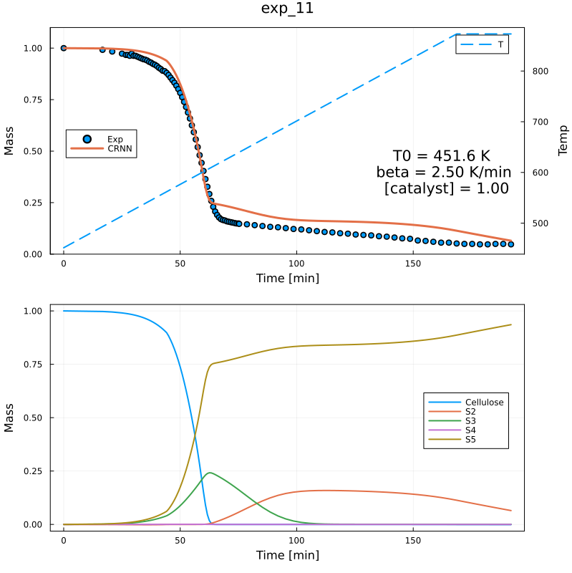
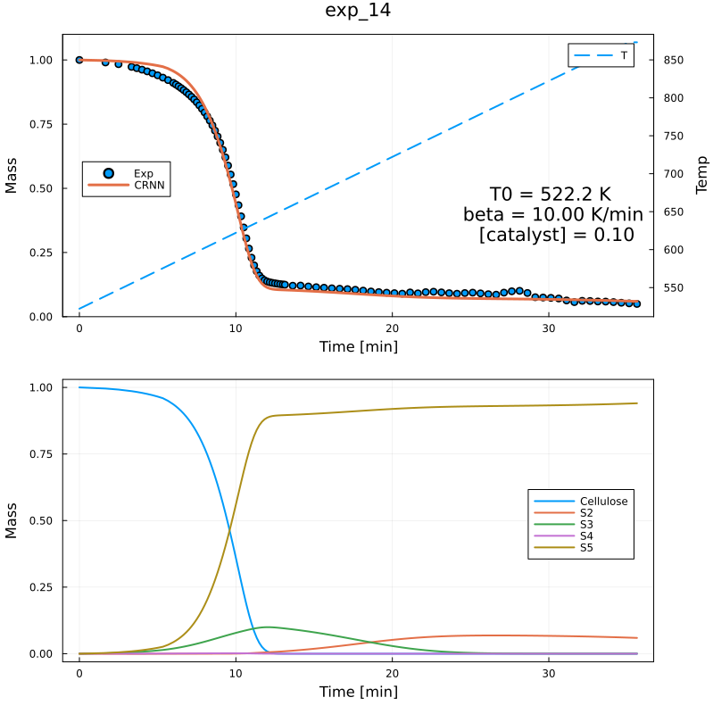
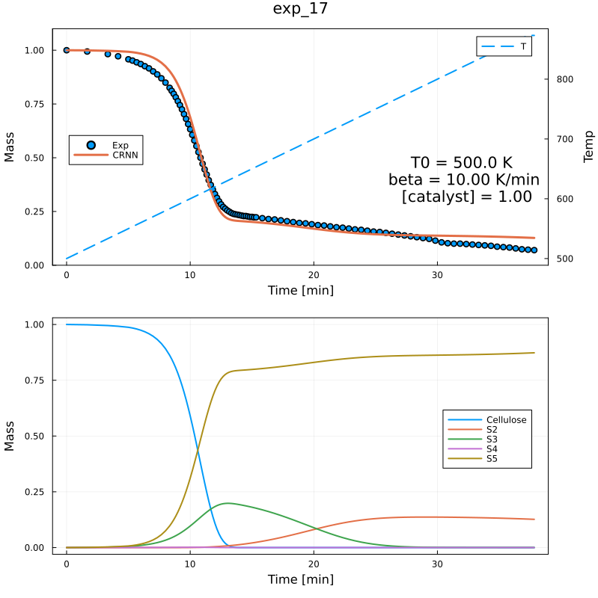
Predicted Residual Mass and Species Profiles

Slide 7
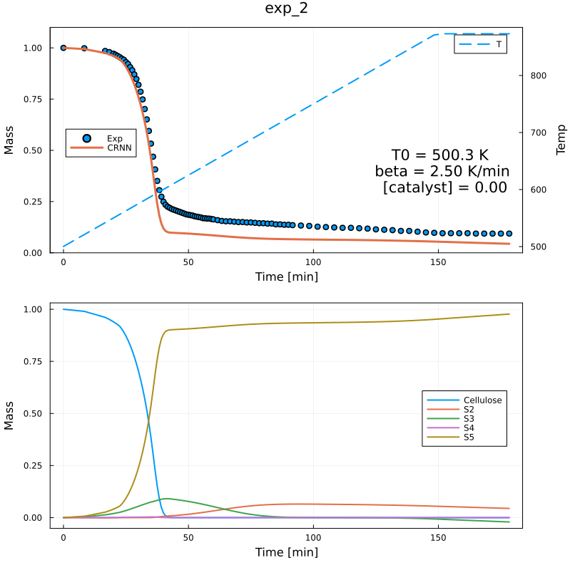
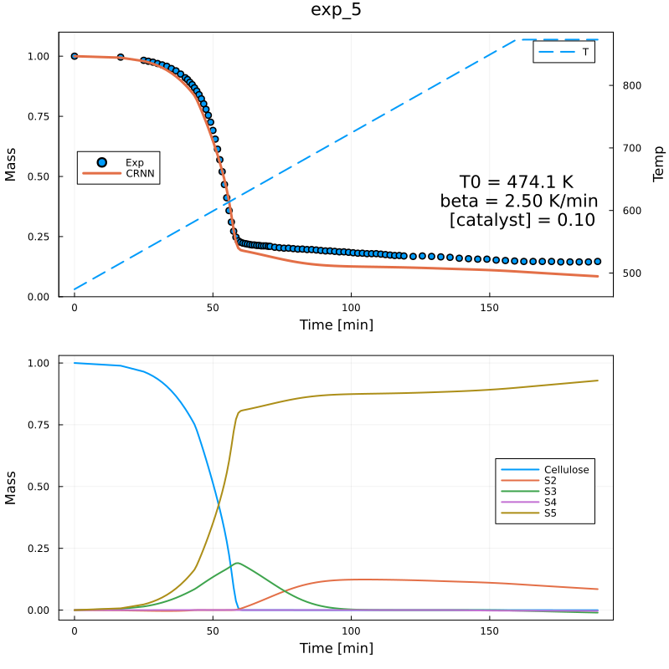
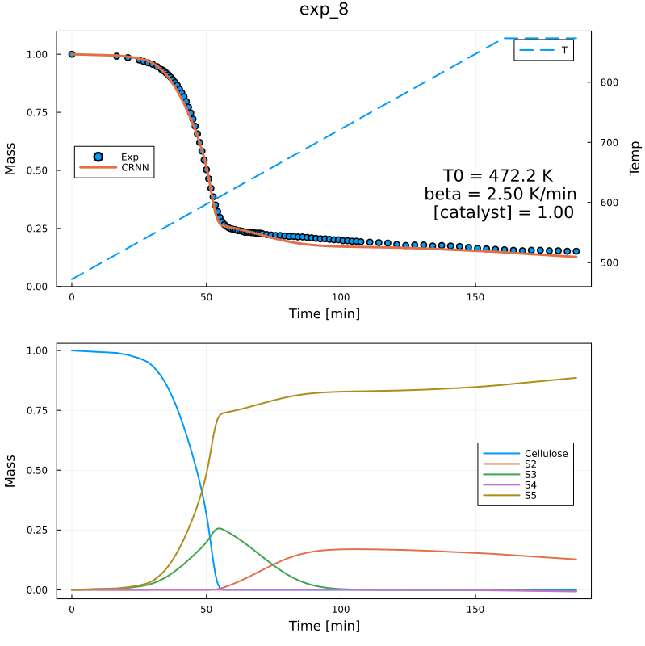
Lid Experiments Results
With 5 species, 8 reactions, 1 Catalyst species

Slide 8
Lid Experiments Results with Extra Reactions
With 5 species, 9 reactions, 1 Catalyst species
Train Loss = 0.040
Validation Loss = 0.029
 | Cellu | S2 | S3 | S4 | Cat. | E_{a} | b | lnA | Cellu | S2 | S3 | S4 | Vola.
R1 | 2.0 | 0. | 0. | 0. | 0. | 122.33 | 0.33 | 14.19 | -2.0 | 0. | 0.12 | 1.88 | 0.
R2 | 0. | 0.13 | 0. | 0. | 0. | 112.07 | 0.01 | 8.44 | 0. | -0.13 | 0. | 0.13 | 0.
R3 | 0. | 0. | 1.21 | 0. | 0. | 100.55 | 0.18 | 10.98 | 0. | 0.65 | -1.21 | 0.29 | 0.28
R4 | 0.89 | 0.25 | 0.13 | 0. | 0. | 88.96 | 0.21 | 13.68 | -0.89 | -0.25 | -0.13 | 0.85 | 0.41
R5 | 0. | 0. | 0. | 0.63 | 0.06 | 58.69 | 0.0 | 9.58 | 0. | 0. | 0.37 | -0.63 | 0.27
R6 | 0. | 0. | 0. | 0.96 | 0.9 | 69.75 | 0.41 | 15.51 | 0. | 0.34 | 0.49 | -0.96 | 0.13
R7 | 0. | 0. | 0. | 1.30 | 0.09 | 67.52 | 0.39 | 12.9 | 0. | 0.29 | 0. | -1.30 | 1.01
R8 | 0. | 0. | 0. | 0.81 | 0. | 112.75 | 0.51 | 16.87 | 0. | 0.59 | 0. | -0.81 | 0.22
R9 | 0. | 0. | 0. | 0.51 | 0. | 48.44 | 0.09 | 5.02 | 0. | 0.1 | 0.33 | -0.51 | 0.08

Slide 9
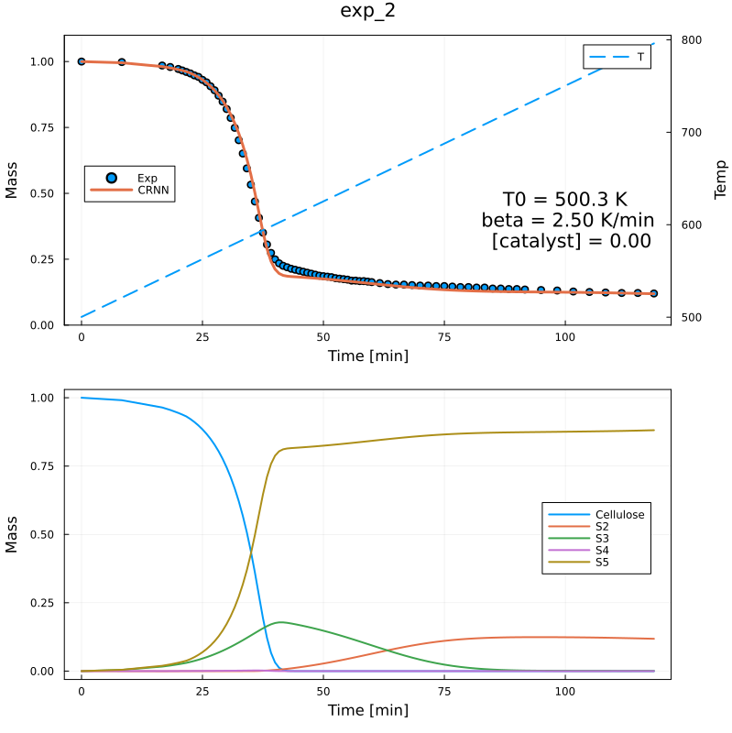
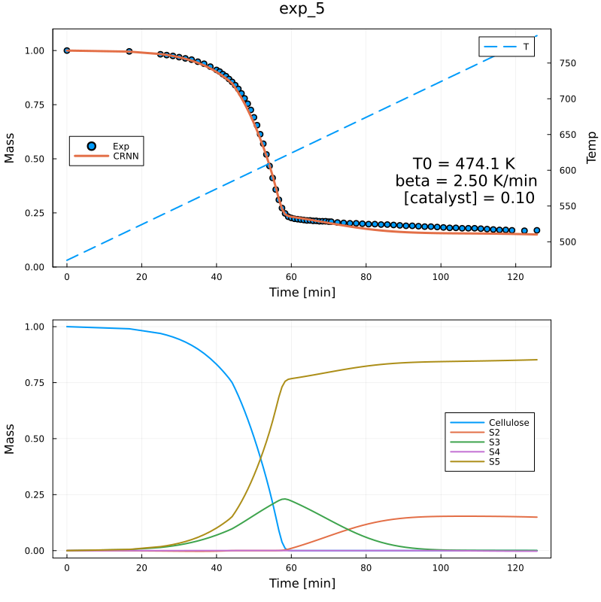
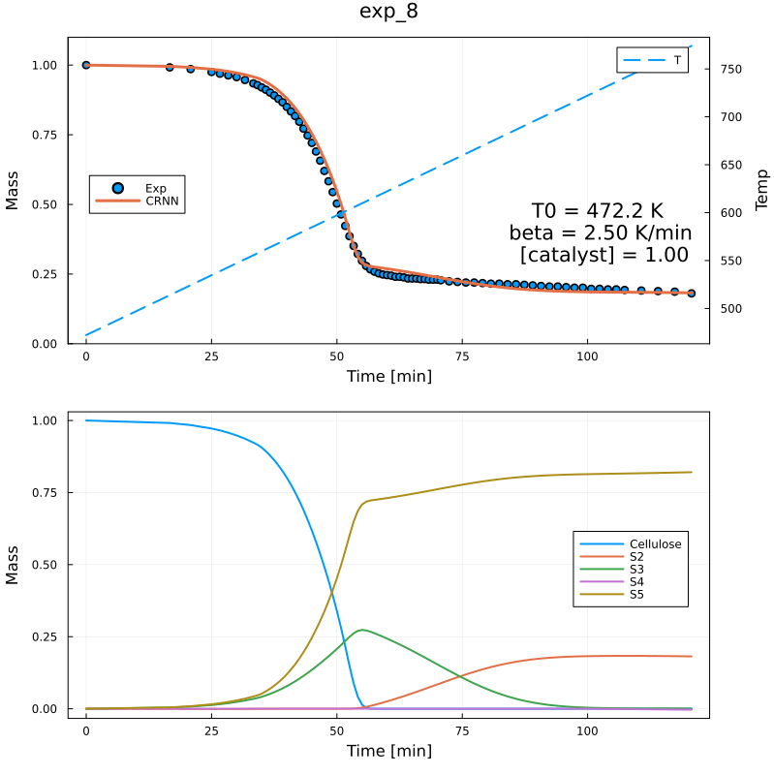
Predicted Residual Mass and Species Profiles

Slide 10
Lid Experiments Results with Extra Reactions
With 5 species, 10 reactions, 1 Catalyst species
Training Loss = 0.028, Validation Loss = 0. 030
 | Cellu | S2 | S3 | S4 | Cat. | E_{a} | b | lnA | Cellu | S2 | S3 | S4 | Vola.
R1 | 2.0 | 0. | 0. | 0. | 0. | 122.33 | 0.33 | 14.19 | -2.0 | 0. | 0.12 | 1.88 | 0.
R2 | 0. | 0.13 | 0. | 0. | 0. | 112.07 | 0.01 | 8.44 | 0. | -0.13 | 0. | 0.13 | 0.
R3 | 0. | 0. | 1.21 | 0. | 0. | 100.55 | 0.18 | 10.98 | 0. | 0.65 | -1.21 | 0.29 | 0.28
R4 | 0.89 | 0.25 | 0.13 | 0. | 0. | 88.96 | 0.21 | 13.68 | -0.89 | -0.25 | -0.13 | 0.85 | 0.41
R5 | 0. | 0. | 0. | 0.63 | 0.06 | 58.69 | 0.0 | 9.58 | 0. | 0. | 0.37 | -0.63 | 0.27
R6 | 0. | 0. | 0. | 0.96 | 0.9 | 69.75 | 0.41 | 15.51 | 0. | 0.34 | 0.49 | -0.96 | 0.13
R7 | 0. | 0. | 0. | 1.30 | 0.09 | 67.52 | 0.39 | 12.9 | 0. | 0.29 | 0. | -1.30 | 1.01
R8 | 0. | 0. | 0. | 0.81 | 0. | 112.75 | 0.51 | 16.87 | 0. | 0.59 | 0. | -0.81 | 0.22
R9 | 0. | 0. | 0. | 0.30 | 0.14 | 61.07 | 0. | 5.86 | 0. | 0.12 | 0. | -0.30 | 0.18
R10 | 0. | 0. | 0. | 0.52 | 0. | 49.45 | 0. | 5.97 | 0. | 0.11 | 0.37 | -0.52 | 0.04

Slide 11
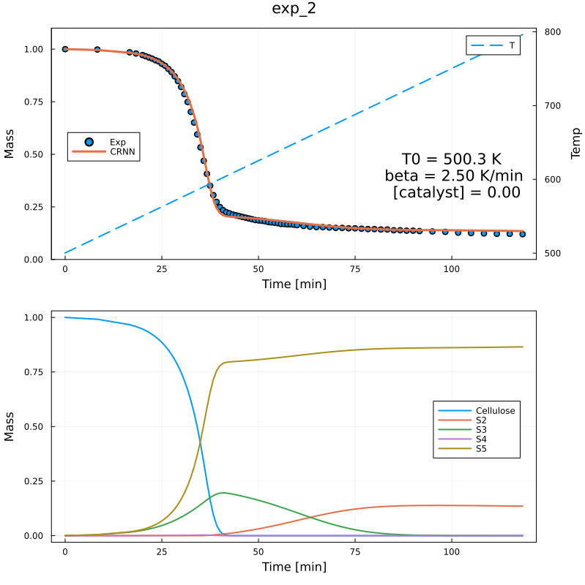
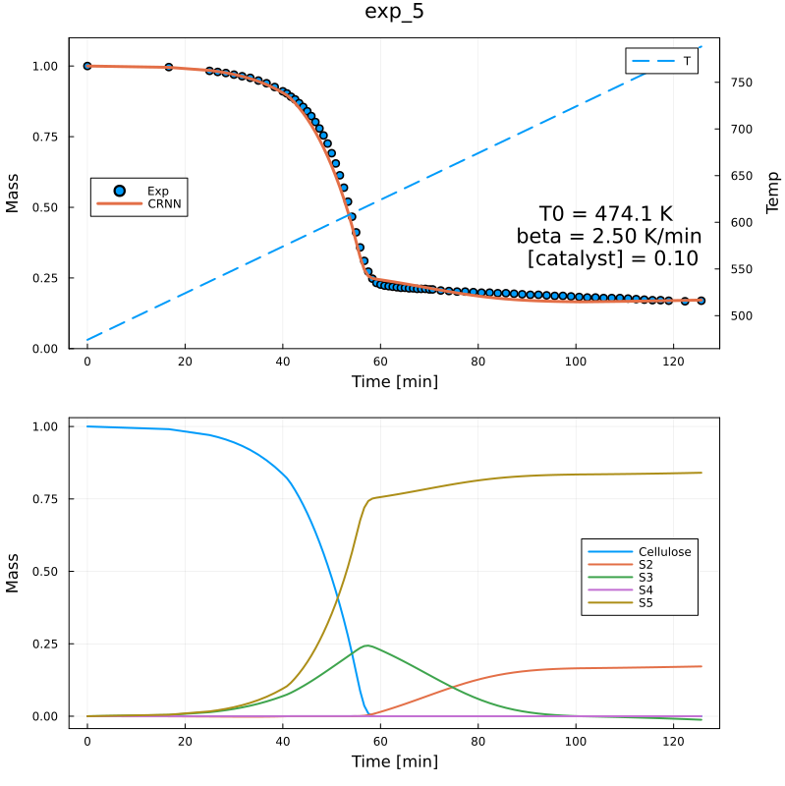
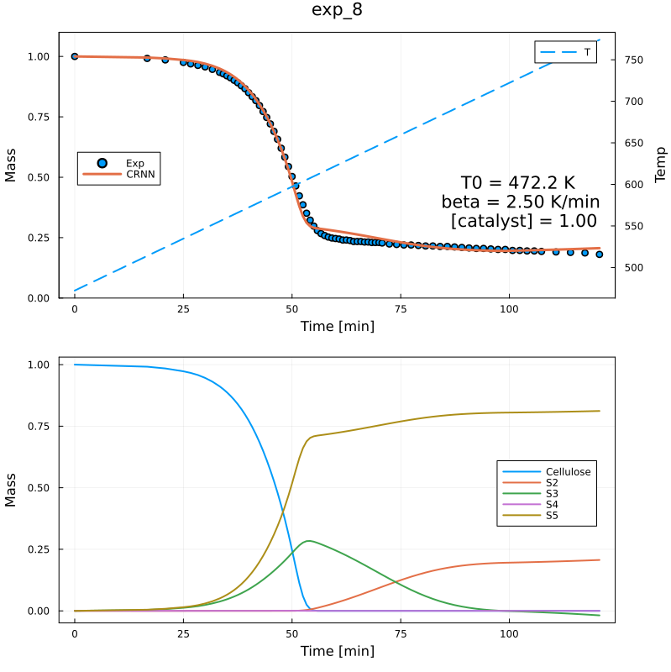
Predicted Residual Mass and Species Profiles

Slide 12
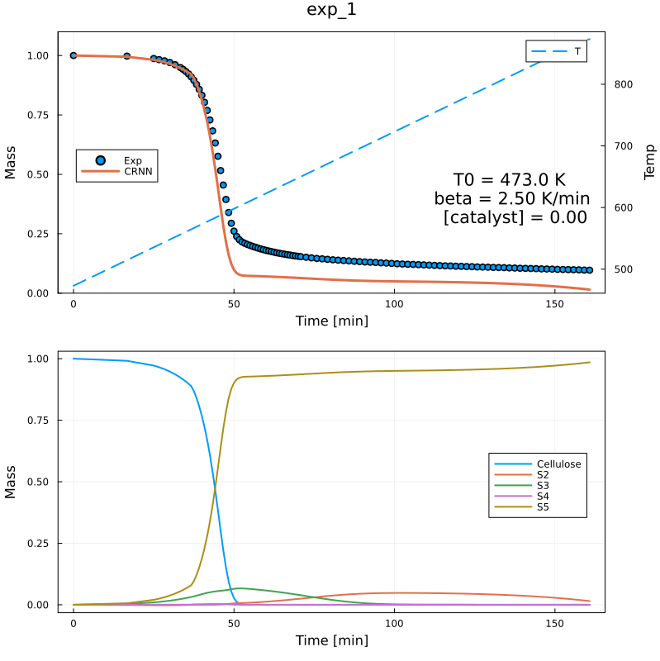
20 mg Experiments Results
With 5 species, 8 reactions, 1 Catalyst species

Slide 13
20 mg Experiments Results with Extra Reaction
With 5 species, 9 reactions, 1 Catalyst species
Train Loss = 0.020
Validation Loss = 0.017
 | Cellu | S2 | S3 | S4 | Cat. | E_{a} | b | lnA | Cellu | S2 | S3 | S4 | Vola.
R1 | 2.0 | 0. | 0. | 0. | 0. | 122.33 | 0.33 | 14.19 | -2.0 | 0. | 0.12 | 1.88 | 0.
R2 | 0. | 0.13 | 0. | 0. | 0. | 112.07 | 0.01 | 8.44 | 0. | -0.13 | 0. | 0.13 | 0.
R3 | 0. | 0. | 1.21 | 0. | 0. | 100.55 | 0.18 | 10.98 | 0. | 0.65 | -1.21 | 0.29 | 0.28
R4 | 0.89 | 0.25 | 0.13 | 0. | 0. | 88.96 | 0.21 | 13.68 | -0.89 | -0.25 | -0.13 | 0.85 | 0.41
R5 | 0. | 0. | 0. | 0.63 | 0.06 | 58.69 | 0.0 | 9.58 | 0. | 0. | 0.37 | -0.63 | 0.27
R6 | 0. | 0. | 0. | 0.96 | 0.9 | 69.75 | 0.41 | 15.51 | 0. | 0.34 | 0.49 | -0.96 | 0.13
R7 | 0. | 0. | 0. | 1.30 | 0.09 | 67.52 | 0.39 | 12.9 | 0. | 0.29 | 0. | -1.30 | 1.01
R8 | 0. | 0. | 0. | 0.81 | 0. | 112.75 | 0.51 | 16.87 | 0. | 0.59 | 0. | -0.81 | 0.22
R9 | 0. | 0. | 0. | 0.57 | 0. | 46.41 | 0.1 | 4.96 | 0. | 0.13 | 0.36 | -0.57 | 0.09

Slide 14
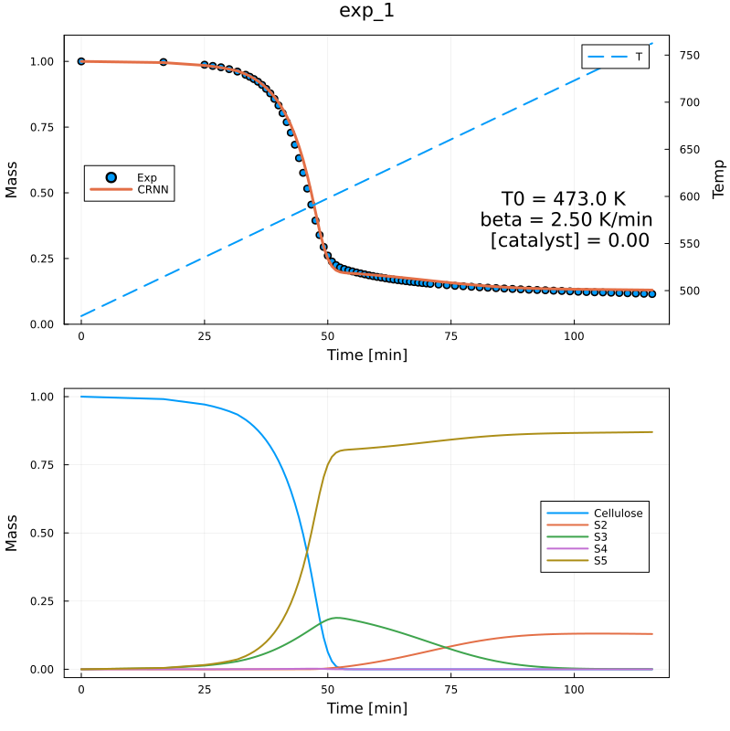
Predicted Residual Mass and Species Profiles

Slide 15
Lid Experiments Results with Extra Reactions
With 5 species, 10 reactions, 1 Catalyst species
Training Loss = 0.013, Validation Loss = 0. 013
 | Cellu | S2 | S3 | S4 | Cat. | E_{a} | b | lnA | Cellu | S2 | S3 | S4 | Vola.
R1 | 2.0 | 0. | 0. | 0. | 0. | 122.33 | 0.33 | 14.19 | -2.0 | 0. | 0.12 | 1.88 | 0.
R2 | 0. | 0.13 | 0. | 0. | 0. | 112.07 | 0.01 | 8.44 | 0. | -0.13 | 0. | 0.13 | 0.
R3 | 0. | 0. | 1.21 | 0. | 0. | 100.55 | 0.18 | 10.98 | 0. | 0.65 | -1.21 | 0.29 | 0.28
R4 | 0.89 | 0.25 | 0.13 | 0. | 0. | 88.96 | 0.21 | 13.68 | -0.89 | -0.25 | -0.13 | 0.85 | 0.41
R5 | 0. | 0. | 0. | 0.63 | 0.06 | 58.69 | 0.0 | 9.58 | 0. | 0. | 0.37 | -0.63 | 0.27
R6 | 0. | 0. | 0. | 0.96 | 0.9 | 69.75 | 0.41 | 15.51 | 0. | 0.34 | 0.49 | -0.96 | 0.13
R7 | 0. | 0. | 0. | 1.30 | 0.09 | 67.52 | 0.39 | 12.9 | 0. | 0.29 | 0. | -1.30 | 1.01
R8 | 0. | 0. | 0. | 0.81 | 0. | 112.75 | 0.51 | 16.87 | 0. | 0.59 | 0. | -0.81 | 0.22
R9 | 0. | 0.09 | 0. | 0.28 | 0.11 | 44.24 | 0.01 | 3.54 | 0. | -0.09 | 0.08 | -0.28 | 0.28
R10 | 0. | 0. | 0. | 0.51 | 0.05 | 37.14 | 0.02 | 4.06 | 0. | 0.13 | 0.36 | -0.51 | 0.03

Slide 16
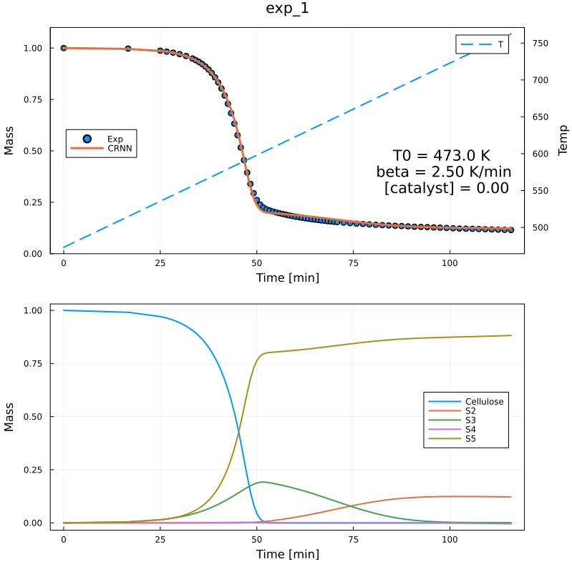
Predicted Residual Mass and Species Profiles

Slide 17
Vielen Dank für Ihre Aufmerksamkeit!
www.ovgu.de

