Slide 1


Artificial Tree
Team - Malak
Adarsh Kushwaha
Subash Poudel
Amar Kr. Yadav

Slide 2
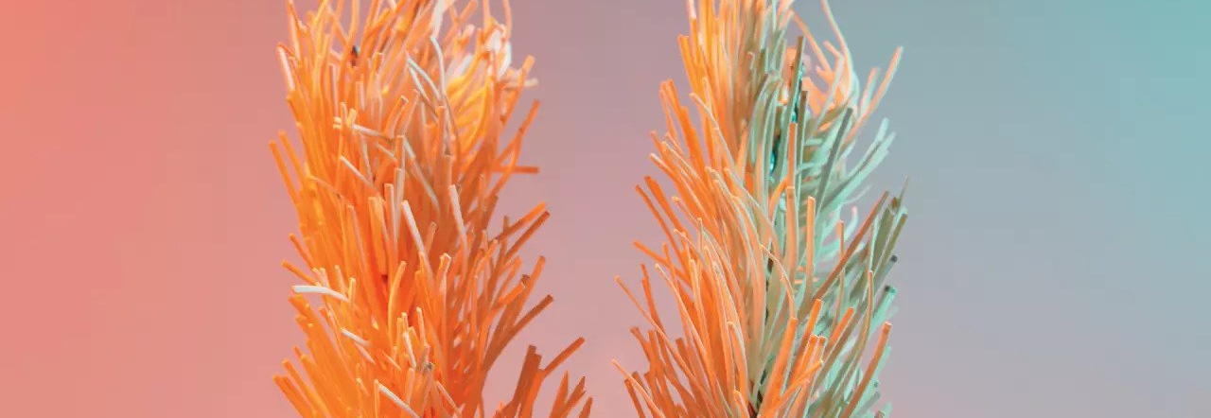

Introduction

Slide 3
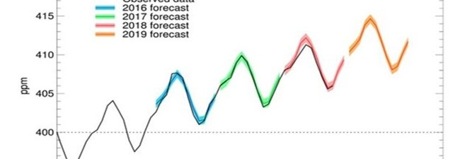
Challenges

