Slide 1
Music VP
A musical tour to NYC through MVP’s webpage
- an endeavor by Phillip, Rich, Suraj, Deepali

Slide 2
Elevator pitch
“Music brings people all over the world together .”
“Never before have I seen such a large group of people come together for something so important to them.”
- Source is Internet
Notes:
Deepali

Slide 3
Concept
Project Name
Music Venue Planner
Project Description
Search for the music events and concerts in the New York city and plan your event.
User Story
As a music lover I would like to see music events in New York and plan for the event I am going to attend.
Notes:
Deepali

Slide 4
Process
Technologies
(HTML, CSS framework, Jquery, AJAX, APIs, Bootstrap)
Challenges
(meeting virtually; merging codes)
Successes
(Knowing each other’s strengths; completing the project by our internal deadline; personal growth)
APIs used are
ticketmaster.com
bandsintown.com
openweathermap.com
Notes:
Rich
APIs used are
ticketmaster.com
bandsintown.com
openweathermap.com

Slide 5
Breakdown of Tasks and Role
Creating user interface
Researching APIs and getting keys
Coding and building
Testing
Creating demo presentation
Notes:
Rich
Every team member performed every single step mentioned on the screen.

Slide 6
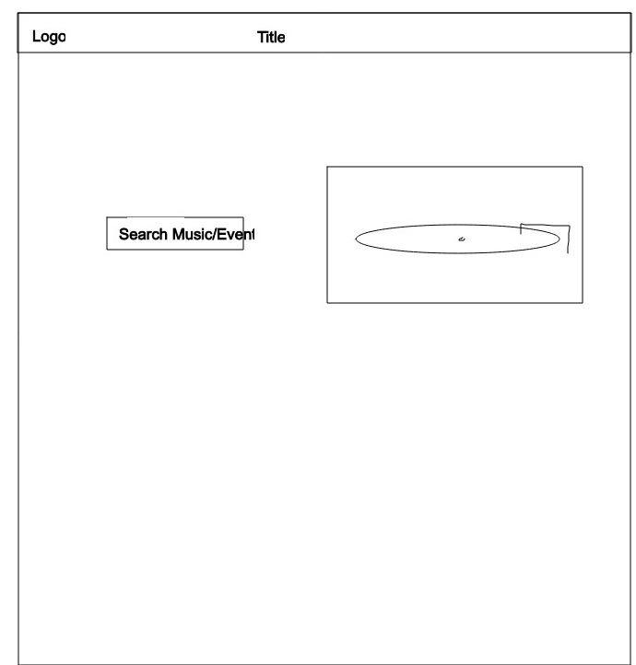

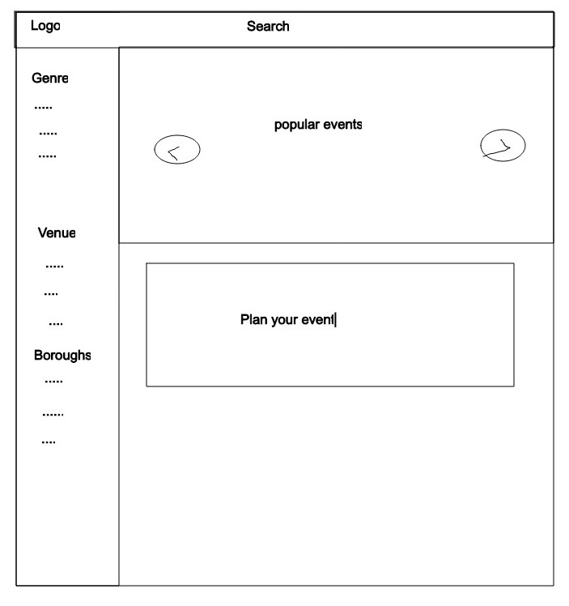
Wireframe
Notes:
Phillip

Slide 7
Demo
https://pmanapat.github.io/Music-VP/
Notes:
Phillip
https://pmanapat.github.io/Music-VP/

Slide 8
Directions for Future Development: Phase 2
Extend our services to outside of NY
Enhance the current features
Include hotel booking and flight booking – maybe who knows ☺
Notes:
Suraj

Slide 9

Links
Deployed
GitHub repo
Notes:
Suraj

Slide 10
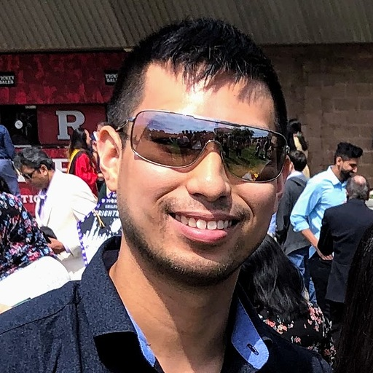
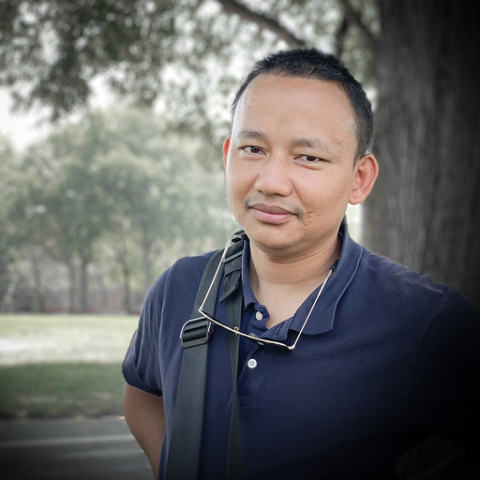
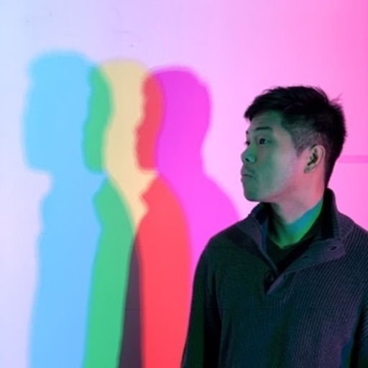
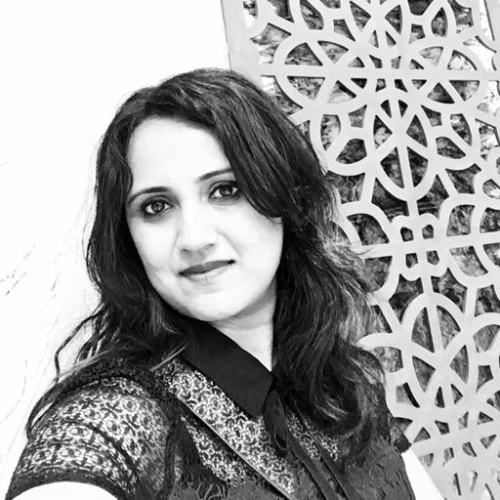
“Thank you!”
Notes:
Suraj
Opening the session for feedback and question you might have

