Slide 1
PIXELWISE SEMANTIC SEGMENTATION Using Deep Convolutional Encoder Decoder Network
Presented by:
Suraj Sanath Kumar Bharadwaj
Narayan Narvekar

Slide 2
Table of Contents
Architecture
Datasets
Training
Analysis
References

Slide 3
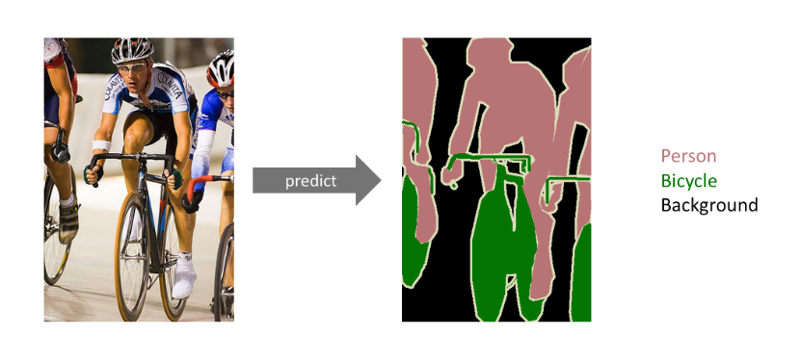
Architecture
The Deep Convolutional encoder decoder network, also known as SegNet, is used for pixelwise semantic segmentation.
This technique results in every pixel of the image being assigned a specific class (Figure 1).
The network is composed of a stack of encoders followed by a corresponding stack of decoders which is fed into a soft-max classification layer.
The decoders help in mapping low resolution feature maps at the output of the encoder stack to full input image size feature maps.
Figure 1: An example of semantic segmentation

Slide 4
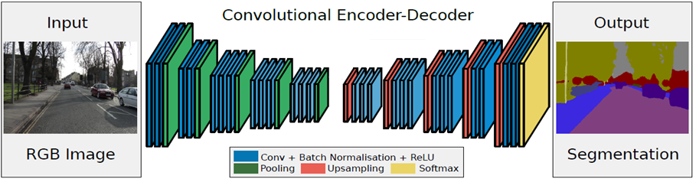
Architecture
Pooling Indices
Figure 2: Network Architecture

Slide 5
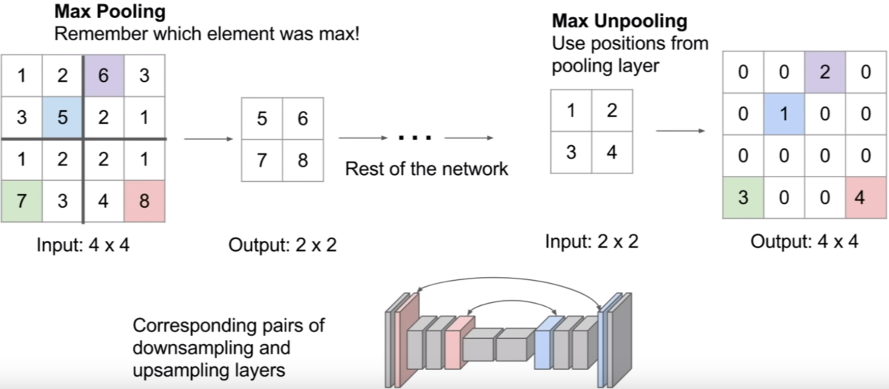
Architecture
Figure 3: Downsampling and Upsampling Operation

Slide 6
Architecture
Local Response Normalization: Local response normalization is performed as a pre-processing step to the input images. It assists in correcting the non-uniform scene illumination thus reducing the dynamic range,i.e., increases contrast in shadowed parts and highlighting the edges which allows the network to learn category shapes.
Batch Normalization: Batch normalization is a method by which the inputs of each layer can be normalized, in order to tackle the internal covariate shift problem. The batch normalization is applied after every convolutional layer.
Adam Optimizer: Adam Optimizer is a replacement optimization algorithm for stochastic gradient descent for training deep learning models. It combines the best properties of the AdaGrad and RMSProp algorithms to provide an optimization algorithm that can handle sparse gradients on noisy problems.
Median Frequency Balancing: Median frequency balancing is the process of assigning weight to a class in the loss function. This weight is calculated as the ratio of the median of class frequencies calculated on the entire training set divided by the class frequency.

Slide 7
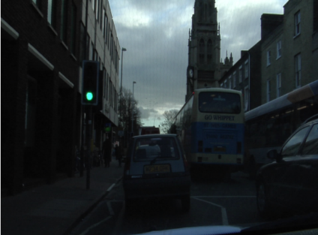

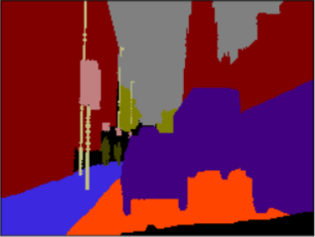
Datasets
The neural network uses the CamVid road scenes dataset. This dataset consists of 367 training, 233 testing images and 101 validation RGB images.
Figure 4(a) represents the original image whose pixels need to be classified.
Figure 4(b) is the labelled image that is generated from the input image. This image is used as the input image for the network. The pixel values of the labelled image are equal to the class indices, i.e. all the pixel values range from 0 to 11 for the labels. Refer Figure 5.
Figure 4(c) is the ground truth image(expected network output), which is generated by assigning a class specific color code to each pixel value of the original image.
0 - Sky
1 - Building
2 - Pole
3 - Road
4 - Pavement
5 - Tree
6 - SignSymbol
7 - Fence
8 - Car
9 - Pedestrian
10 - Bicyclist
11 - Unlabelled
Figure 4: (a) Input Image, (b) Labelled Image, (c) Ground Truth
Figure 5: Class Indices

Slide 8
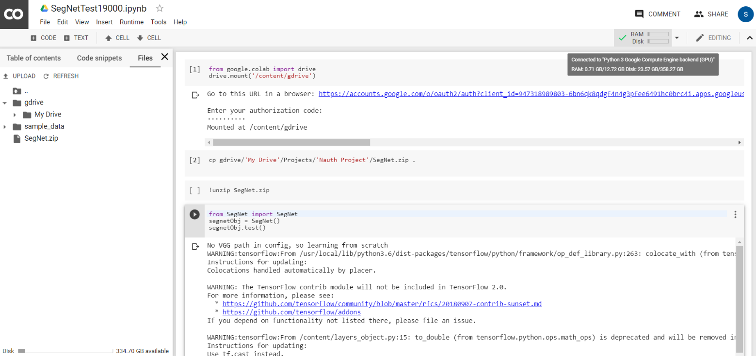
Training
In order to speed up training, Google Colaboratory was used, which is a free cloud service that provides the possibility of utilizing a free GPU for training the network.
Colaboratory works with our own google drive and it requires us to store all the project relevant files and datasets in our google drive.
Figure 6: Google Colaboratory snapshot

Slide 9
Analysis
To analyse the performance of our network, the global accuracy was considered which provides a measure of the percentage of pixels that were correctly classified in the dataset.
The network was trained for a total of 19000 iterations.
After every 1000 iterations, the network was deployed on the validation dataset which provides an indication whether the network is still learning or has saturated.
After 19000 iterations, no further improvement in the validation accuracy was observed. Hence the number of iterations were fixed to 19000.
The training and validation losses decrease over each iteration, which is a good indication that the network is being optimized at every iteration.
The trained model is then evaluated on a new dataset which the network has never seen before, i.e., the test dataset which contains a total of 233 images as specified earlier.
The final test accuracy that we obtain is 83.47%, which is calculated by averaging the individual accuracies of each of the test images.

Slide 10
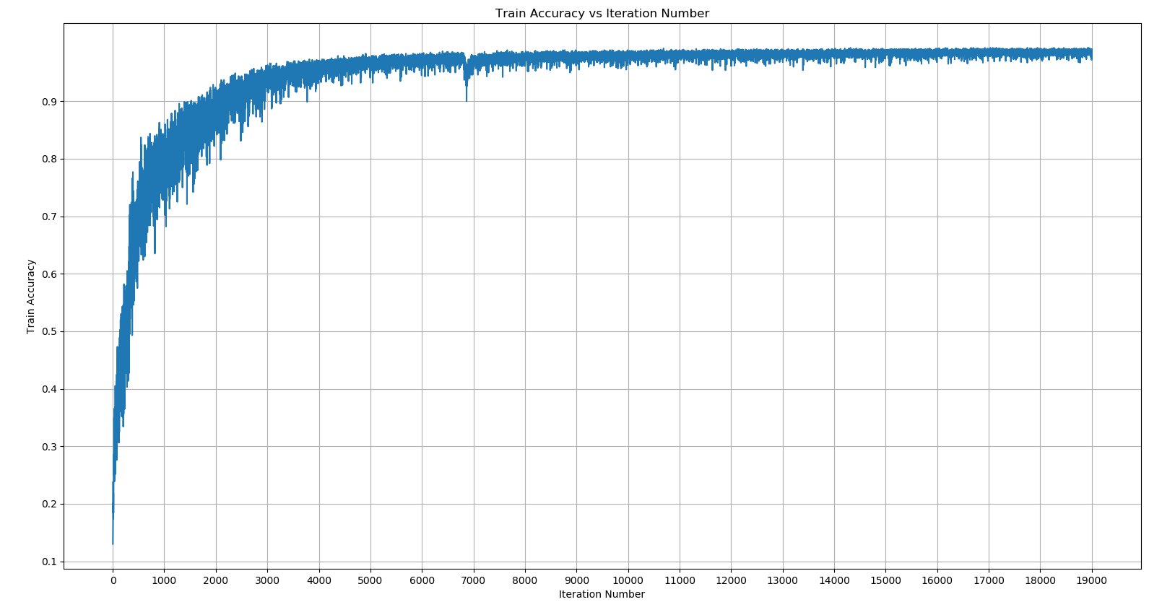
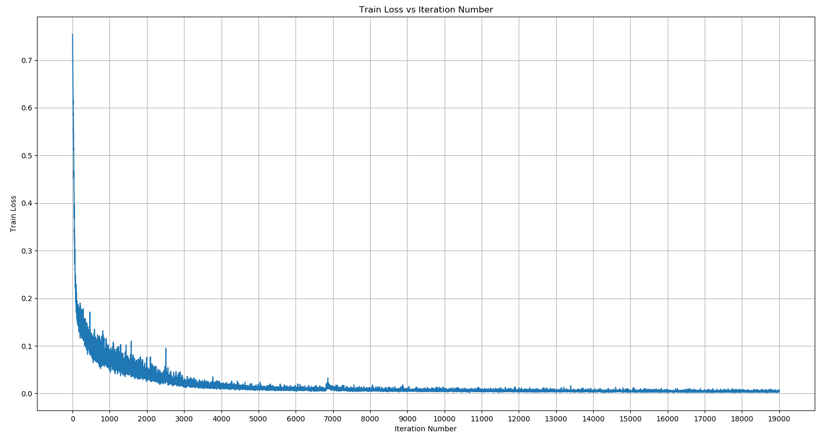
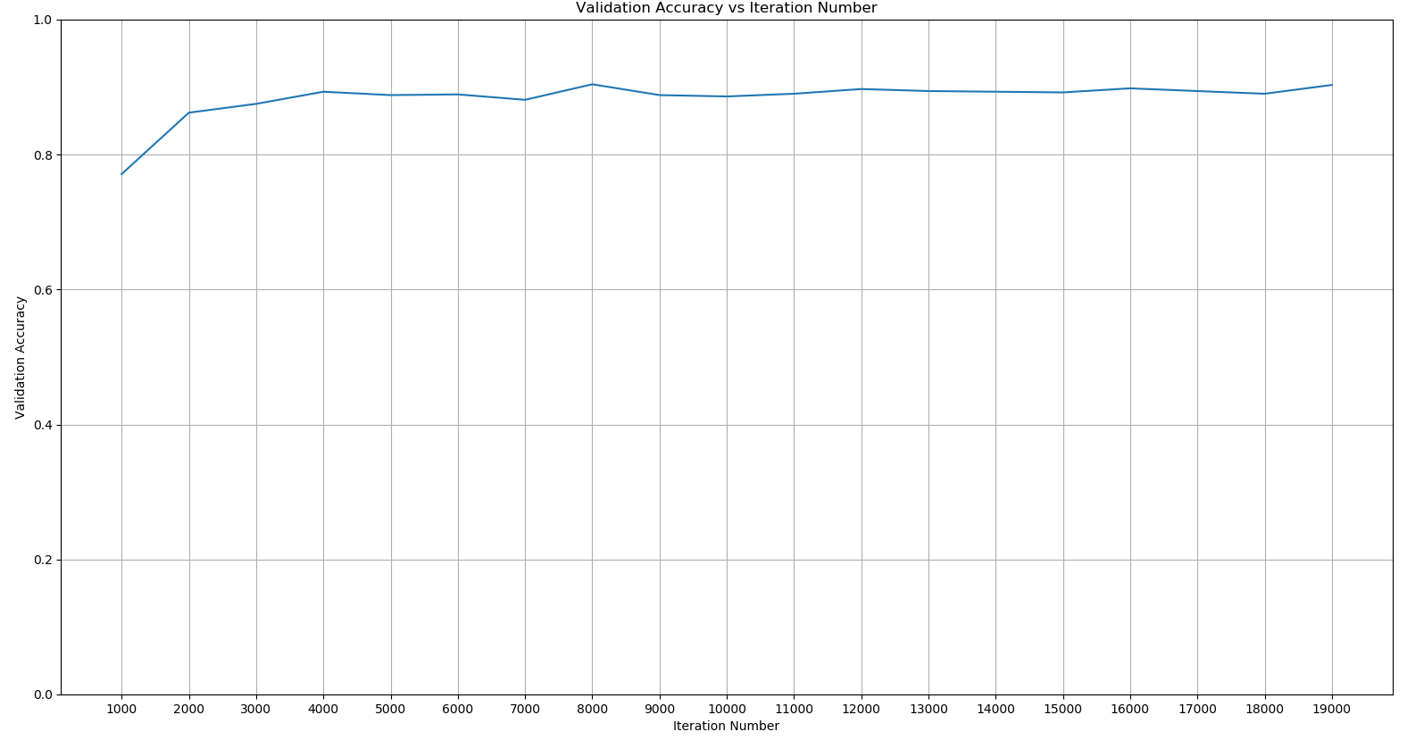
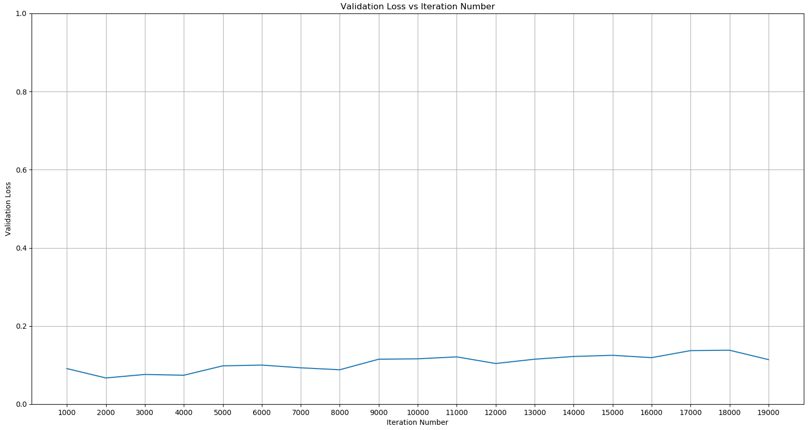
Analysis
Figure 7: Train Accuracy vs Iteration Number
Figure 8: Train Loss vs Iteration Number
Figure 9: Validation Accuracy vs Iteration Number
Figure 10: Validation Loss vs Iteration Number

Slide 11
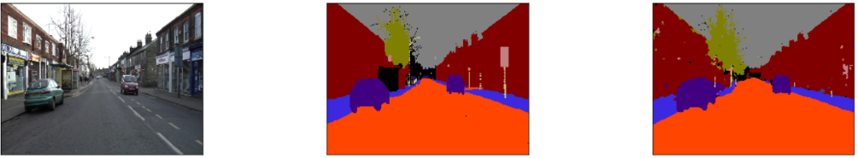
Analysis
The predicted class labels for an image from the test dataset is shown below.
The original image, its ground truth and the predicted output of our model, along with the color legends for the different classes are displayed below
Figure 11: Test dataset, (a) Input image, (b) Ground Truth, (c) Predicted Output

Slide 12
References
[1] J. Jordan, "An overview of semantic image segmentation.," 20 May 2018. [Online]. Available: https://www.jeremyjordan.me/semantic-segmentation/.
[2] M. R. L. J. H. Y-Lan Boureau, "Unsupervised Learning of Invariant Feature Hierarchies with Applications to Object Recognition," 2007 IEEE Conference on Computer Vision and Pattern Recognition, vol. 1, pp. 1-8, 2007.
[3] A. K. R. C. Vijay Badrinarayanan, "SegNet: A Deep Convolutional Encoder-Decoder Architecture for Image Segmentation," in IEEEE, 2016.
[4] K. Simonyan and A. Zisserman, "Very deep convolutional networks for large-scale image recognition," 2014.
[5] E. S. a. T. D. J. Long, "Fully convolutional networks for semantic segmentation," 2015.
[6] S. H. a. B. H. H. Noh, "Learning deconvolution network for semantic segmentation," 2015.
[7] M. u. Hassan, "VGG16 – Convolutional Network for Classification and Detection," 20 November 2018. [Online]. Available: https://neurohive.io/en/popular-networks/vgg16/.
[8] S. Ioffe and C. Szegedy, "Batch normalization: Accelerating deep S. Ioffe and C. Szegedy, “Batch normalization: Accelerating deep," vol. vol. abs/1502.03167, 2015.
[9] S. Ruder, "An overview of gradient descent optimization algorithms," 19 Jan 2016. [Online]. Available: http://ruder.io/optimizing-gradient-descent/index.html#fn14.
[10] D. P. &. B. J. L. Kingma, "Adam: a Method for Stochastic Optimization. International Conference on Learning Representations," pp. 1-13, 2015.
[11] D. E. a. R. Fergus, "Predicting depth, surface normals and semantic labels with a common multi-scale convolutional architecture," vol. 2650–2658, 2015.
[12] X. Z. S. R. a. J. S. K. He, "Delving deep into rectifiers: Surpassing human-level performance on imagenet classification,," ICCV, vol. 1026–1034, 2015.

