Slide 1
Project Overview - Digital Logic Design - Hardware design using Verilog - Hardware Design for Elevator Control
2018(June/July) – 1st Summer Break Intern Work
Suraj Bidnur (PES University, Bangalore)

Slide 2
Digital Logic Design
Basic Digital Design Elements / Function
Digital Design Fundamentals
Digital Chip Implementation

Slide 3
Basic Digital Design Elements / Function
Transfer resistor and transistor
Basic building block of any electronic circuit/device
2 major uses: As a switch and as an amplifier
Logic Gates
Eg: AND, OR, NOT, NAND, NOR, XOR, XNOR
NAND and NOR are universal gates
Any logic can be realised using either gate
Logic Optimisation Methods
K-Maps, Quine-McCluskey
Storage Elements
Flip-flops, Registers, Memory
Memory realised using basic flip-flops

Slide 4
Digital Design fundamentals
Threads
A thread of execution or a set of instructions for a particular program
Can be interlinked and can carry out data transfer
Finite State Machines
Moore and Mealy
Moore: Its output depends only on its current state
Mealy: Its output depends not only on its current state but also the inputs provided

Slide 5
Digital Chip Implementation
Full Custom
Circuit design done with transistor level
For high level performance, but cumbersome
Analog design usually custom design
Example: Intel – Processors, Memories
Semi Custom
Uses standard cell design (pre-defined logic cells)
Circuit design done using High level design language
Gate Array (transistor arrays)
Field Programmable Gate Array (FPGA)

Slide 6
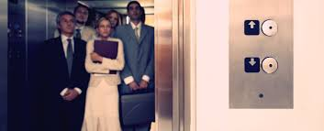
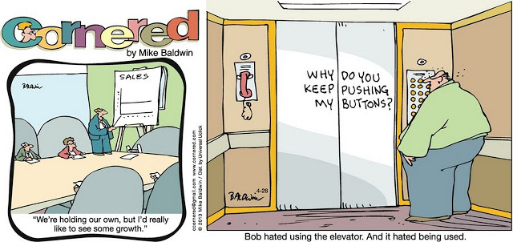
Elevator (Lift) Hardware control design
Requirement / Features
Assumptions / Limitations
Design Overview
Design verification
Hardware implementation using FPGA Platform (Altera DE2-70)
Results / Proto function

Slide 7
Requirements / Features
3 floor design (can be extended to more floors)
External switches to call the Lift (up or down)
Internal switches to select which floor
All inputs debounced
External and internal lift calls are indicated by LED’s
Direction display (Up/Down)on 2 Seven-Segment displays
Floor number display on 1 Seven-Segment display

Slide 8
Assumptions / Limitations
Due to less push buttons on the FPGA
UP and DOWN external requests are done using only one push button
One transition of the toggle switch is taken as one signal
To decide priority of the level calls, if the lift is moving up then it ignores the calls from the lower levels and vice versa

Slide 9
Design Overview
This simple lift control system controls a lift which moves for 3 floors which are ground, first and second
3 push buttons are used to decide the external call for the direction of the lift
For the 1st floor external call, 1 click-> UP, 2 clicks-> DOWN and 3 clicks-> BOTH
Ground floor button is for UP and 2nd floor click is for DOWN
1 push button used to reset the system (active low reset)
3 switches are used to select the floor number which is the internal panel of the lift
All the inputs (switch and push-buttons) are debounced to prevent the glitches that generally occur when manual switches are pressed/toggled

Slide 10
Design Overview
No derived clock is being used but instead a slow reference signal is used as an enable signal to all the logic elements
The external and internal lift calls are indicated with the help of LED’s which are activated on call and cleared by the lift
2 Seven-Segment displays are used to display the direction in which the lift is moving
UP for UP and dn for DOWN
1 Seven-Segment display is used to display on the floor number where the lift is currently at
The movement of the lift is all controlled by a state machine

Slide 11
Design Details
Start
All the inputs (push-button and switch) are debounced
After debouncing the inputs, a pulse is generated for each transition which is used to control the state machine
Each input is sensed by the state machine and the appropriate state movement occurs
The lift moves to the next floor after a short period of time with the help of a counter
After a state movement, the state machine sends the output details to the output processing modules
These output processing modules take the signals from the state machine and produce the necessary outputs
Processing inputs
State machine movement
Output and display
Stop

Slide 12
State Machine Diagram
INITIAL
Reset active
Legend:
int-> internal
ext-> external
Reset Withdrawn
If reset
If reset
LEVEL-0
If reset
Lvl-0/2 int call
No action
Lvl-1/0 int call
Lvl-0/2 ext call
Lvl-1/0 ext call
LEVEL-2
LEVEL-1
Lvl-2/1 ext call
No action
Lvl-2/1 int call
No action

Slide 13
Design Verification
The final design DUT (Device Under Test) verification was done through a verilog simulator
The testbench required for the simulation consists of all the instances of the required modules for the DUT
In the testbech, different input signals are passed and the outputs are observed for proper behaviour

Slide 14
Design Verification
Test cases
Reset- Test :
When reset input is active the lift is at Level-0
When Lift is at any other level, if reset is active lift will come to level-0
No inputs are sensed when in reset
External Up/Down Test
If Lift is in other level, on Up/Down pushing Lift will come to the level where signal is sensed,
Tested at each level’s Up/Down
Lift Internal level Test
Pushing the switches internal to the lift, will take to the level required based on switch pushed (Level 0/1/2)
Tested at each level to go to any other level

Slide 15
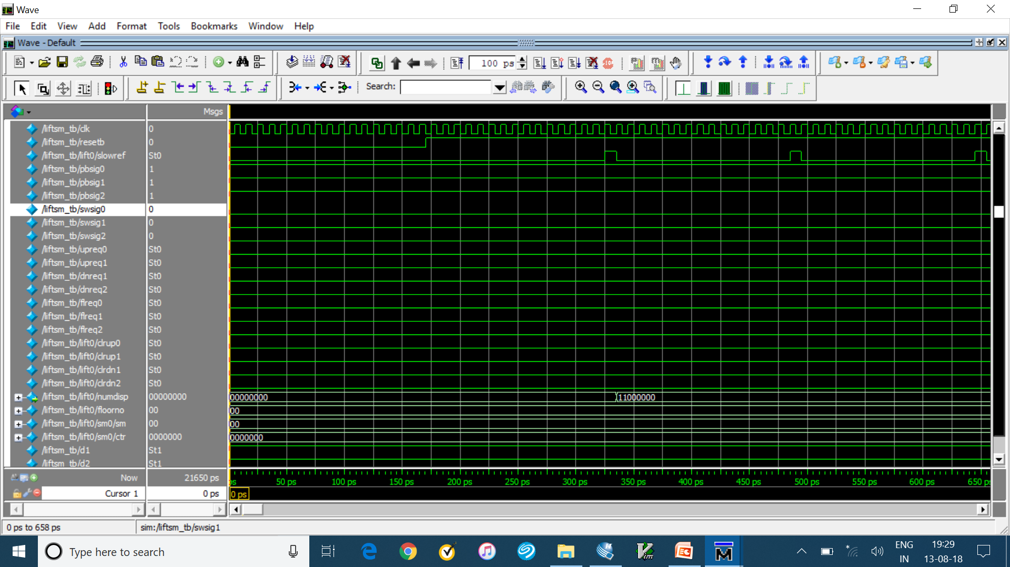
Design Verification
Reset Test

Slide 16
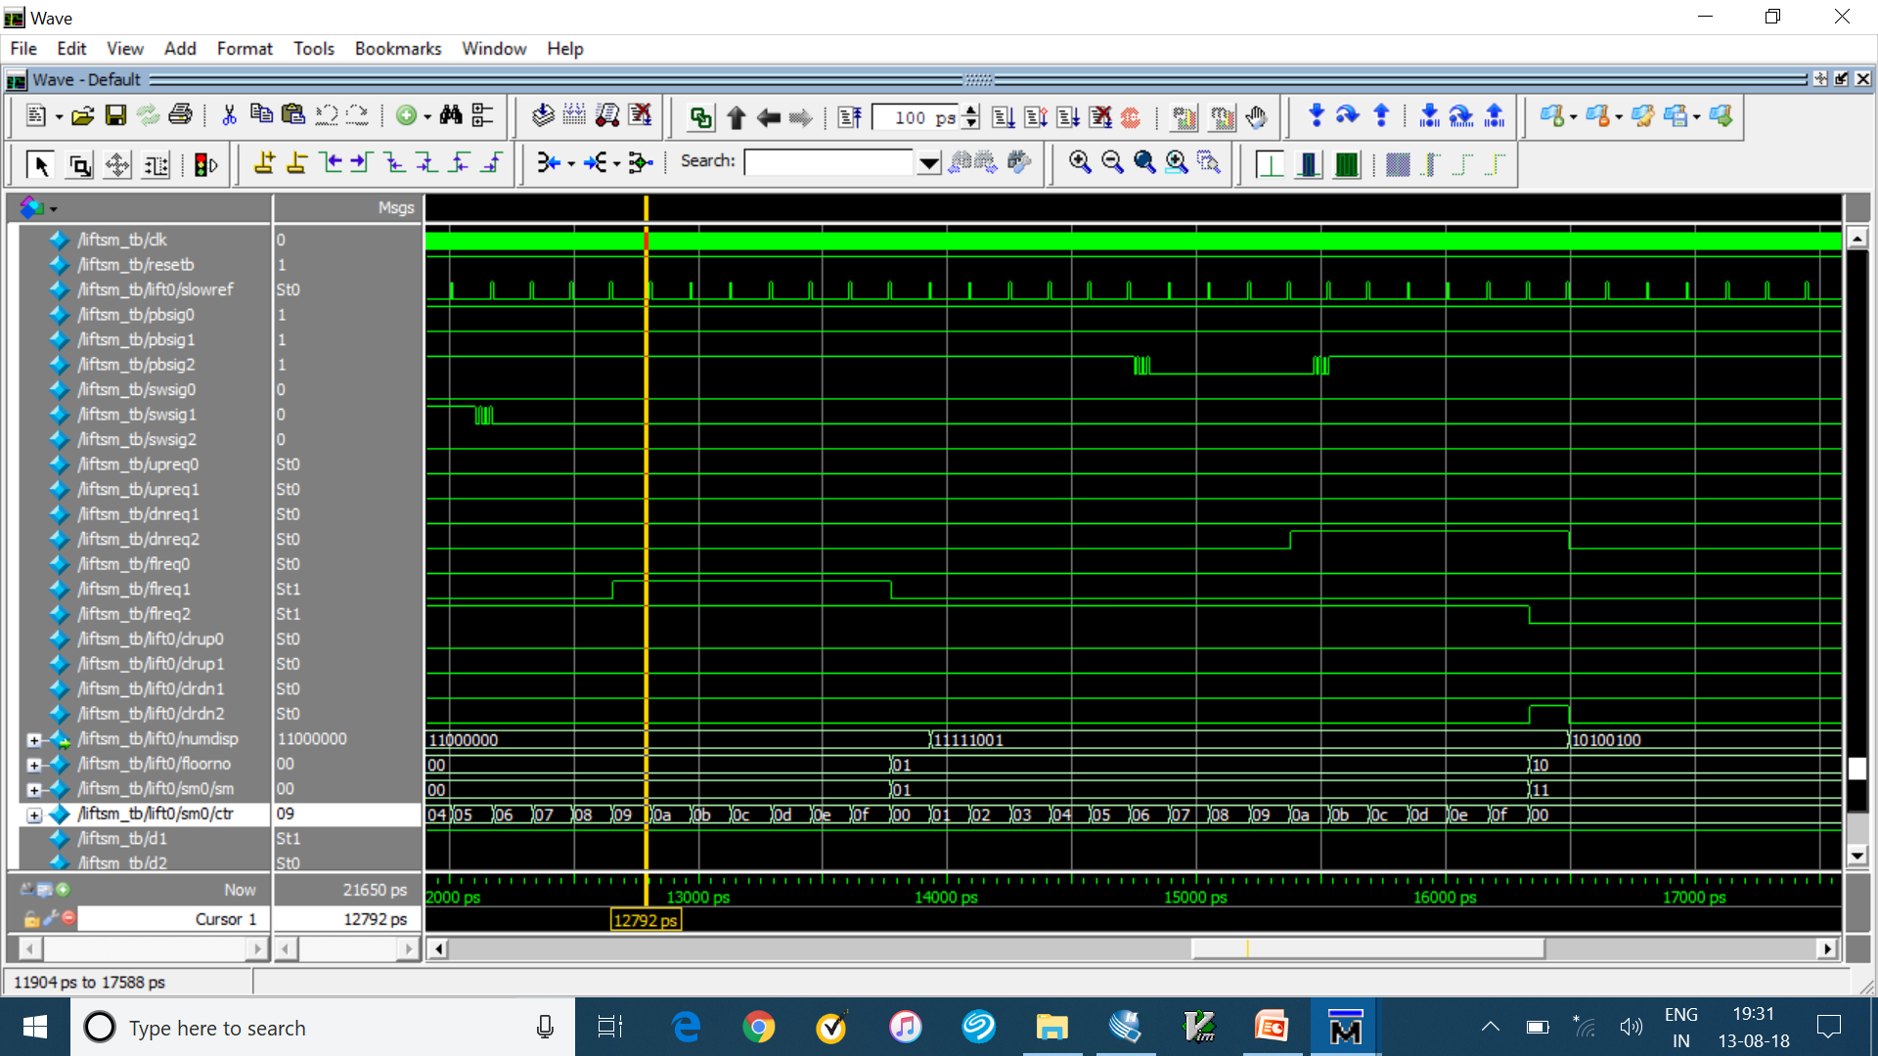
Design Verification
External UP/DOWN Test

Slide 17
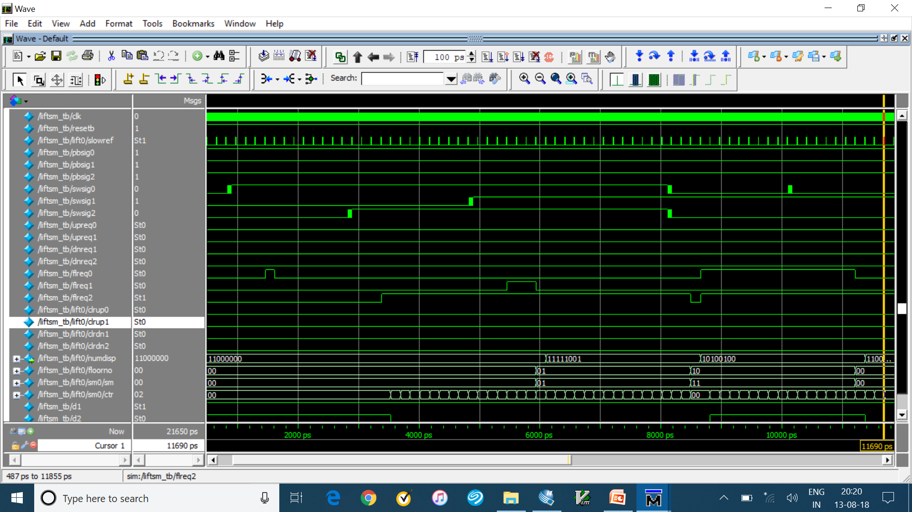
Design Verification
Internal Level Test

Slide 18
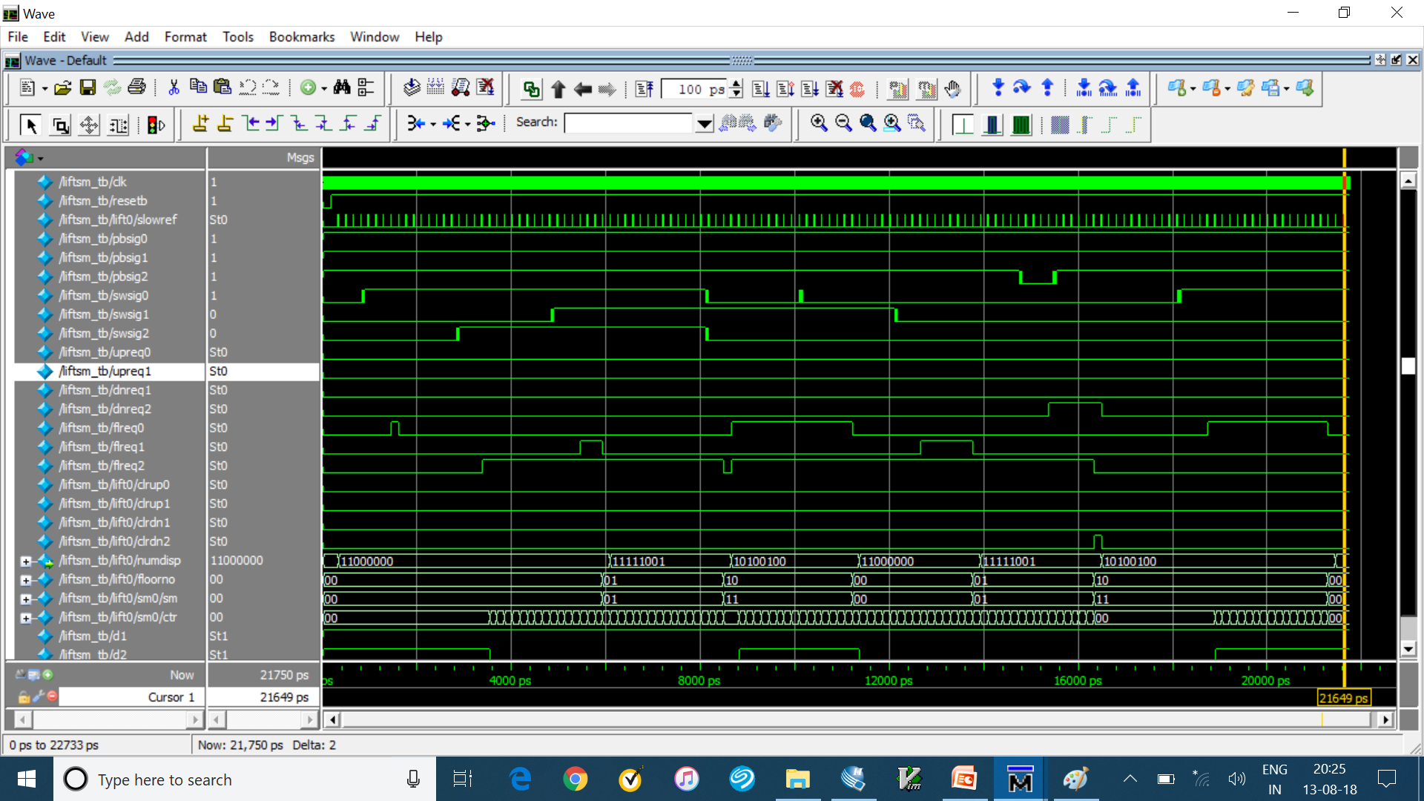
Design Verification
All Test Cases

Slide 19
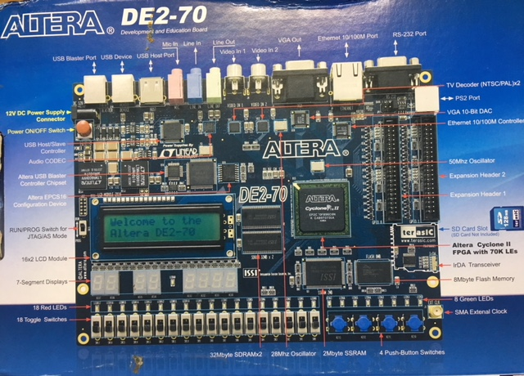
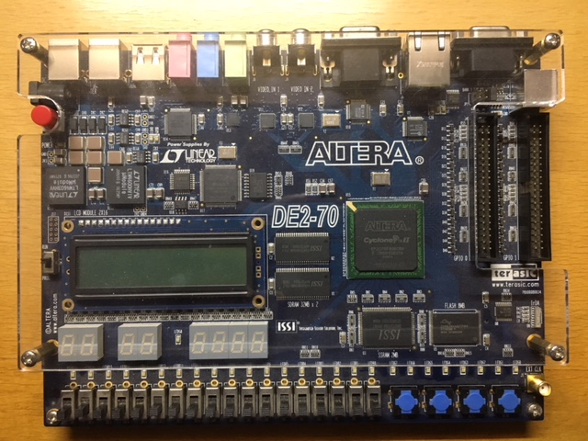
Hardware Implementation using FPGA Platform (Altera DE2-70 board)
DE2-70 FPGA Platform Overview
Altera Cyclone II FPGA \w 70K Les
Various input & output i/f to develop specific function
Refer to following picture for features

Slide 20
Hardware Implementation using FPGA Platform (Altera DE2-70 board)
Design was compiled and mapped to FPGA (Cyclone-II) on DE2-70 board
After code compilation, the required pin assignments are made using the board datasheet
Pin assignment for push button, Toggle, LED & 7-Segment LED
After pin assignment is complete, the device is programmed. This causes the design to be burned on the FPGA so it can be implemented
When the programming is complete, the design can be tested using actual inputs from the board

Slide 21
Hardware Implementation using FPGA Platform (Altera DE2-70 board)
Elevator (Lift) functioning (Add Picture & Video of possible)

Slide 22
Result
I learnt the basics of digital electronics which includes logic gates, optimisation and finite state machines
Basics of digital logic design, implementation and testing using Verilog-HDL
And finally, demonstrated the learnings through a mini project with actual specific design function (Elevator Control Logic)
Understanding the requirements of a specific design
Designing the Logic for the specific function
Testing the design in simulator and on FPGA platform

Slide 23
Acknowledgement
I am very much thankful to Anuj Ramanujan Valmiki for imparting the knowledge on Basics of Digital design concepts, Hardware porting on FPGA and assisting me through out this process.

