Slide 1
Parallel and Distributed Computing UE17EC413
Parallel Merge-Sort
Suraj Bidnur – PES1201700145
7th Sem, ECE, PES University

Slide 2
Contents
Merge Sort (Serial)
Merge Sort (Parallel)
System Details
Performance Comparison – Table
Performance Comparison – Graph
Observations
Thank You

Slide 3
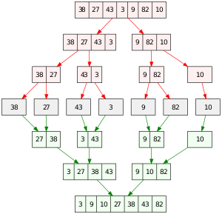
Merge Sort (Serial)
Divide and Conquer algorithm
Time complexity O(n*logn)
Can be coded using recursion

Slide 4
Merge Sort (Parallel)
Implemented using C++ and OpenMP
The splitting of the input array is done in parallel
The input array is shared by all threads as it is passed by reference
Threads are synchronised with the “taskwait” OpenMP pragma
If the array size is less than 10,000, then serial merge-sort will run

Slide 5
System Details
4GB RAM
Max array size used – 100M elements
All array elements randomly generated
Dual Core Intel i3 processor
Max number of threads - 2
Using Windows Subsystem for Linux (WSL) and g++ compiler
“Perf stat” command to get program runtime for documentation

Slide 6
Performance Comparison - Table
Array Size | Parallel Run Time (Seconds) | Serial Run Time (Seconds)
10,000 | 0.0103699 | 0.0066009
50,000 | 0.0209726 | 0.0215755
100,000 | 0.0352869 | 0.0297682
500,000 | 0.0755455 | 0.116892
1,000,000 | 0.1737931 | 0.4038189
5,000,000 | 1.3185083 | 1.538552
10,000,000 | 2.1365496 | 4.1017829
50,000,000 | 8.0732246 | 18.7065625
100,000,000 | 27.5570044 | 36.7649461

Slide 7
Performance Comparison - Graph

Slide 8
Observations
For array sizes up to 100,000 we see that the times for both the serial and parallel execution are comparable
For these the overhead involved in parallel computing is hindering the speed up
For sizes of 500,00 and above the parallel algorithm runs faster than the serial algorithm
Now the overhead is significantly less, so there is speedup achieved

Slide 9
Observations (cont.)
Time complexity of the parallel algorithm is now O(nlogn / p)
P is the number of threads available
Since I have only 2 threads, p is 2 and the speedup is 2x

Slide 10
Thank You

