Slide 1

A Project Presentation
on
Sentinel-X: AI-Based Network Attack Forecasting
from Network Traffic Data
Presentation by :
Shristi Jaiswal — Roll No. 2405250100153
Suraj Prakash Chaudhary — Roll No. 2405250100156
Suraj Upadhyay — Roll No. 2405250100158
Udai Kumar Srivastava — Roll No. 2405250100160
Under the guidance of :
Mr. Akash Gupta
(Assistant Professor)
Department of Computer Science and Engineering
Buddha Institute of Technology, GIDA, Gorakhpur
Session 2026-27

Slide 2

Project Content
S.No. | Content Module | Key Focus / Deliverable
01 | Introduction & Shift | Reactive NIDS vs Predictive Forecasting (SIH26153)
02 | Literature Review | Survey of 7 benchmark papers & research gaps
03 | Project Objectives | 4 Core engineering & defense targets
04 | System Architecture | 7-stage closed-loop data & neural pipeline
05 | 16 State Features | 10s aggregation capturing attack kinetics
06 | Sequence Windowing | Leak-free chronological 70/15/15 partitioning
07 | LSTM World Model | 2-layer recurrent backbone with 3 multi-task heads
S.No. | Content Module | Key Focus / Deliverable
08 | Autoregressive Rollout | Multi-step rollout (T+1..T+3) & joint loss
09 | MITRE ATT&CK Lifecycle | 5-stage conservative behavioral progression
10 | Explainable AI (SHAP) | Signed risk drivers, inhibitors & temporal saliency
11 | Empirical Benchmarks | 100% Recall, 75% FPR reduction & decay curves
12 | SOC Command Dashboard | 5 interactive operational views running offline
13 | Future Scope & Roadmap | Automated SDN, Temporal GNNs & Edge Quantization
14 | References & Bibliography | 7 Academic citations matching Literature Review
• Structured Academic Agenda: Comprehensive coverage spanning foundations, leak-free sequence modeling, dual XAI, and live SOC deployment.

Slide 3
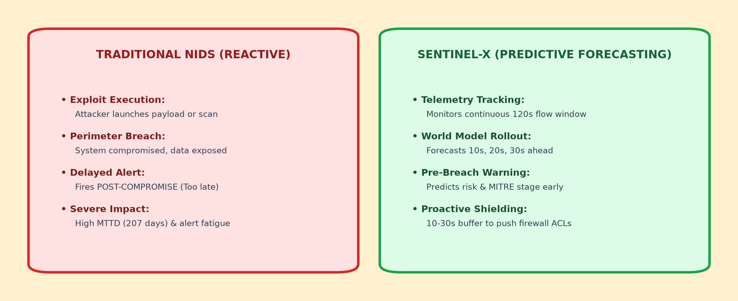
Problem Statement: Shift to Predictive Defense
• The Reactive Bottleneck: Traditional NIDS alerts post-compromise with a 207-day average MTTD, overwhelming analysts with alert fatigue.
• The Predictive Paradigm: Sentinel-X forecasts risk 10–30 seconds into the future, enabling automated firewall ACL isolation before breaches execute.

Slide 4
Literature Review: Comparative Analysis
Ref | Author & Year | Benchmark / Domain | Key Methodology | Identified Gap (Addressed by Sentinel-X)
[1] | Moustafa & Slay (2015) | UNSW-NB15 Benchmark | Static flow extraction, Decision Trees & Association Rule Mining | Evaluates static isolated flows; lacks temporal sequencing and future trajectory forecasting.
[2] | Sharafaldin et al. (2018) | CIC-IDS2017 Dataset | Systematic attack profiling; evaluated Random Forest, KNN & SVM | Exclusively post-breach detection; alerts fire after compromise with severe alert fatigue.
[3] | Vinayakumar et al. (2019) | Deep Recurrent NIDS | Multi-layer RNN and LSTM architectures for flow classification | Classifies single historical windows; lacks auxiliary state reconstruction and multi-step rollout.
[4] | Lundberg & Lee (2017) | Explainable AI (SHAP) | Unified game-theoretic Shapley values for model feature impact | Targets static tabular data; lacks temporal saliency mapping across sequence time-steps.
[5] | Haider et al. (2020) | Predictive Intrusion Models | Deep Reinforcement Learning & state projection in virtual sandboxes | Agent policy focus; does not learn continuous 16-D physics of real enterprise network telemetry.
[6] | MITRE Corporation (2020) | MITRE ATT&CK Matrix | Enterprise knowledge base of adversarial tactics and techniques | Used for retrospective incident response; lacks automated behavioral stage triage from live flows.
[7] | Hafeez et al. (2020) | Distributed Intrusion Systems | Ensemble deep learning for high-throughput network monitoring | High cloud compute latency; lacks sub-20ms local CPU execution and automated SDN orchestration.
• Research Gap Synthesis: Existing literature is predominantly reactive, static, and cloud-heavy. Sentinel-X bridges these gaps via 3-step autoregressive rollout, dual XAI, and sub-20ms local CPU execution.

Slide 5
Objectives & Engineering Scope
01. Predictive World Model
Develop an autoregressive 2-layer LSTM that ingests rolling 120s windows (T-11..T) to forecast risk across multi-step future horizons (T+1, T+2, T+3).
02. MITRE Stage Classification
Concurrently classify the attack progression into 5 conservative behavioral stages (Benign, Recon, Initial Access, Lateral Move, C2) for SOC triage.
03. Dual-Tier Explainable AI
Implement signed SHAP feature attribution (drivers vs inhibitors) and temporal sequence saliency to eliminate the neural 'black box' for SOC analysts.
04. Interactive SOC Simulation
Deliver a production-ready Streamlit dashboard with executive gauges, confidence interval bands, and local offline execution (<20ms latency).
• Target Success Metrics: Zero missed intrusions at T+1 (100% Recall), >75% reduction in false alarms, and sub-20ms inference latency.

Slide 6
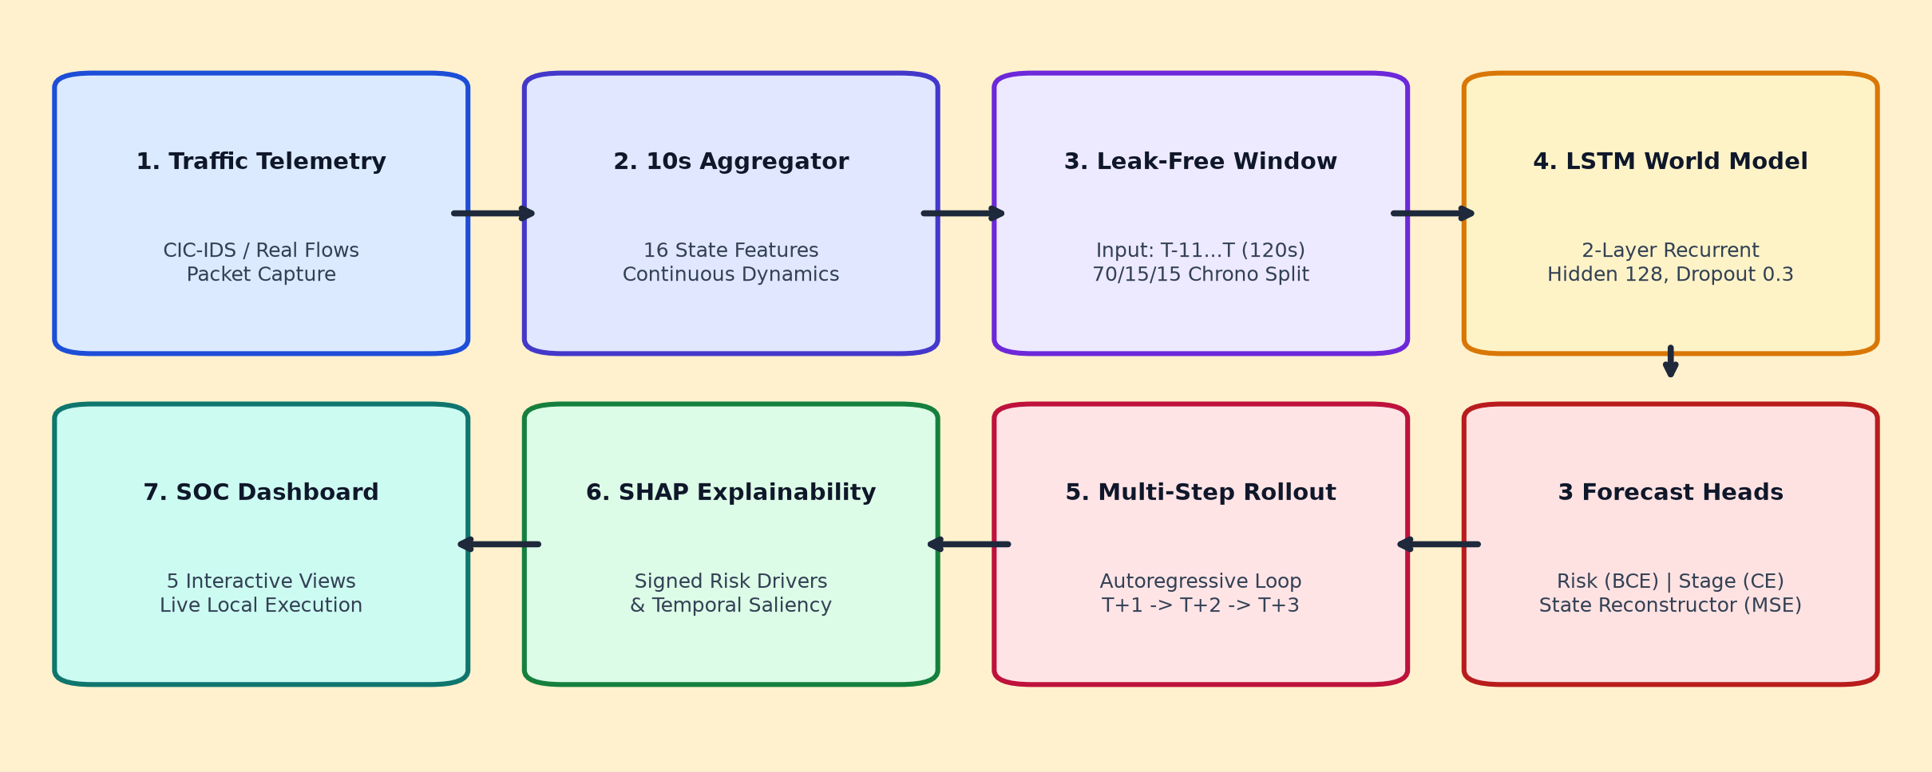
End-to-End System Pipeline
• Closed-Loop Data & Neural Pipeline: Raw PCAP Flows → 10s Window Aggregator → 2-Layer LSTM → 3 Forecast Heads → Autoregressive Rollout → SOC Dashboard.
• Localized Defensive Execution: Operates entirely offline on standard student hardware without recurring cloud costs or telemetry data leakage.

Slide 7
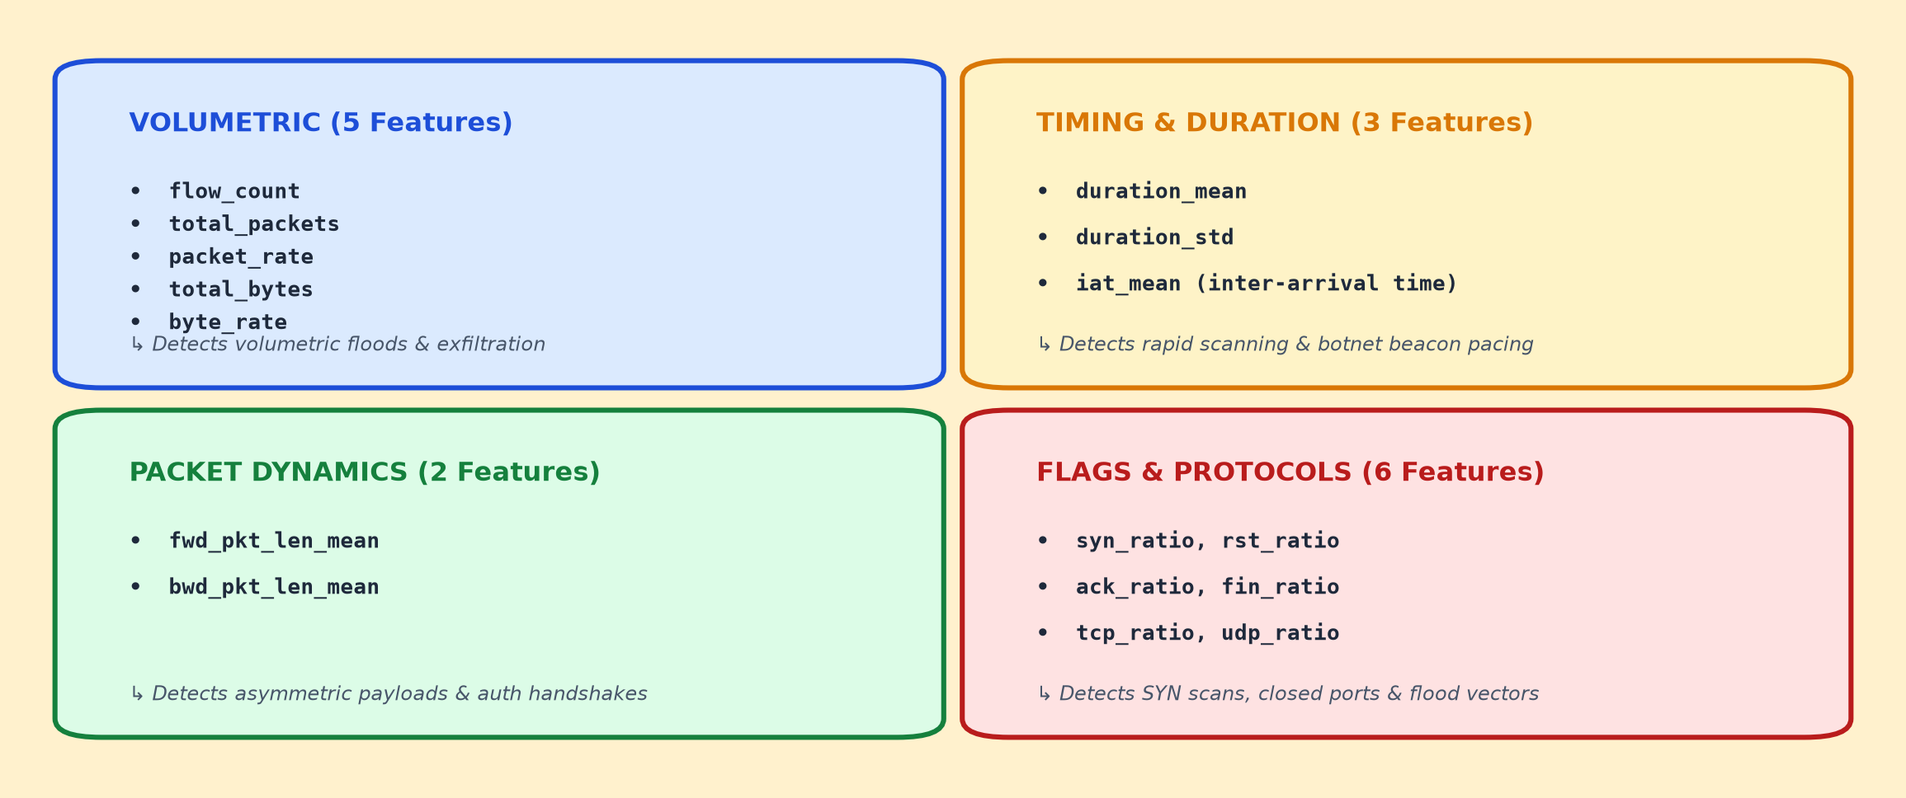
16-Dimensional Network State Representation
• Why 10-Second Windows? Packet-by-packet sniffing overflows memory on gigabit links; statistical windowing captures attack kinetics.
• Comprehensive Profiling: Combines volumetric rates, packet length asymmetry, inter-arrival timing, and TCP flag ratios into a unified 16-D state vector.

Slide 8
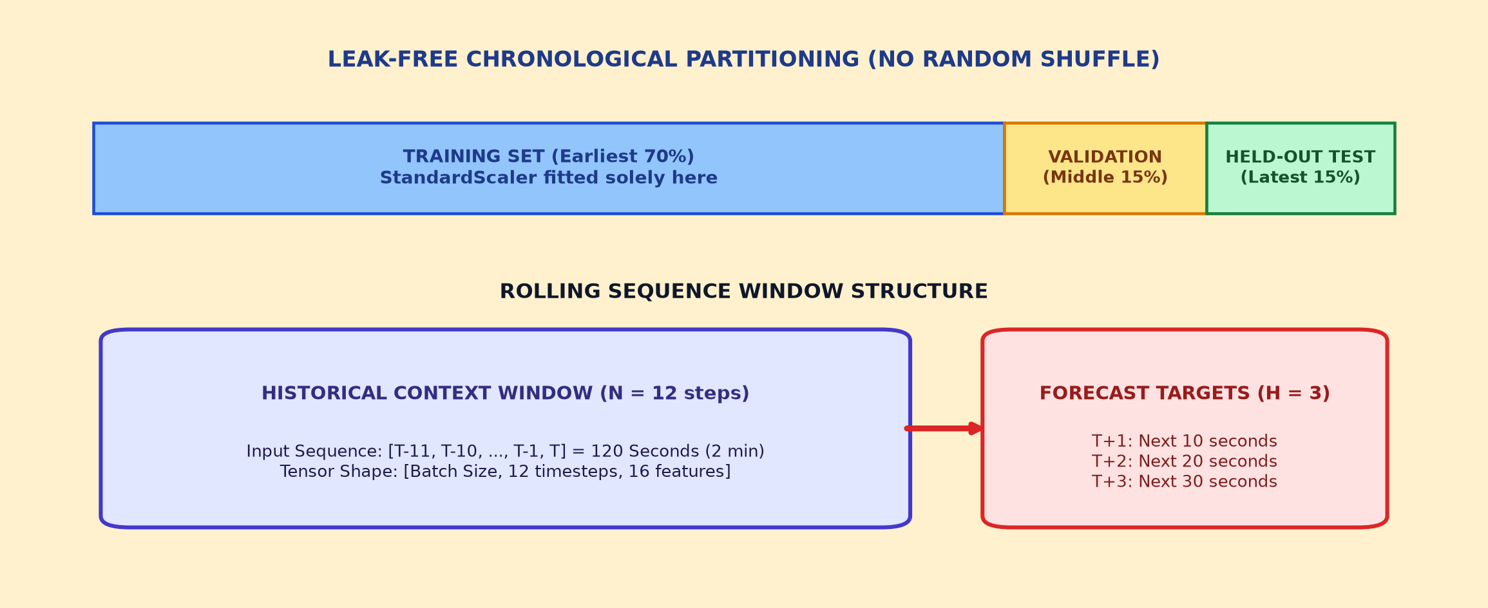
Leak-Free Chronological Windowing
• Guaranteed Zero Data Leakage: Standard train_test_split(shuffle=True) causes temporal leakage in time series. We enforce a strict 70/15/15 chronological partition.
• Strict Scaler Isolation: StandardScaler is fitted strictly on the earliest 70% training split and applied transformationally to validation and test sets.

Slide 9
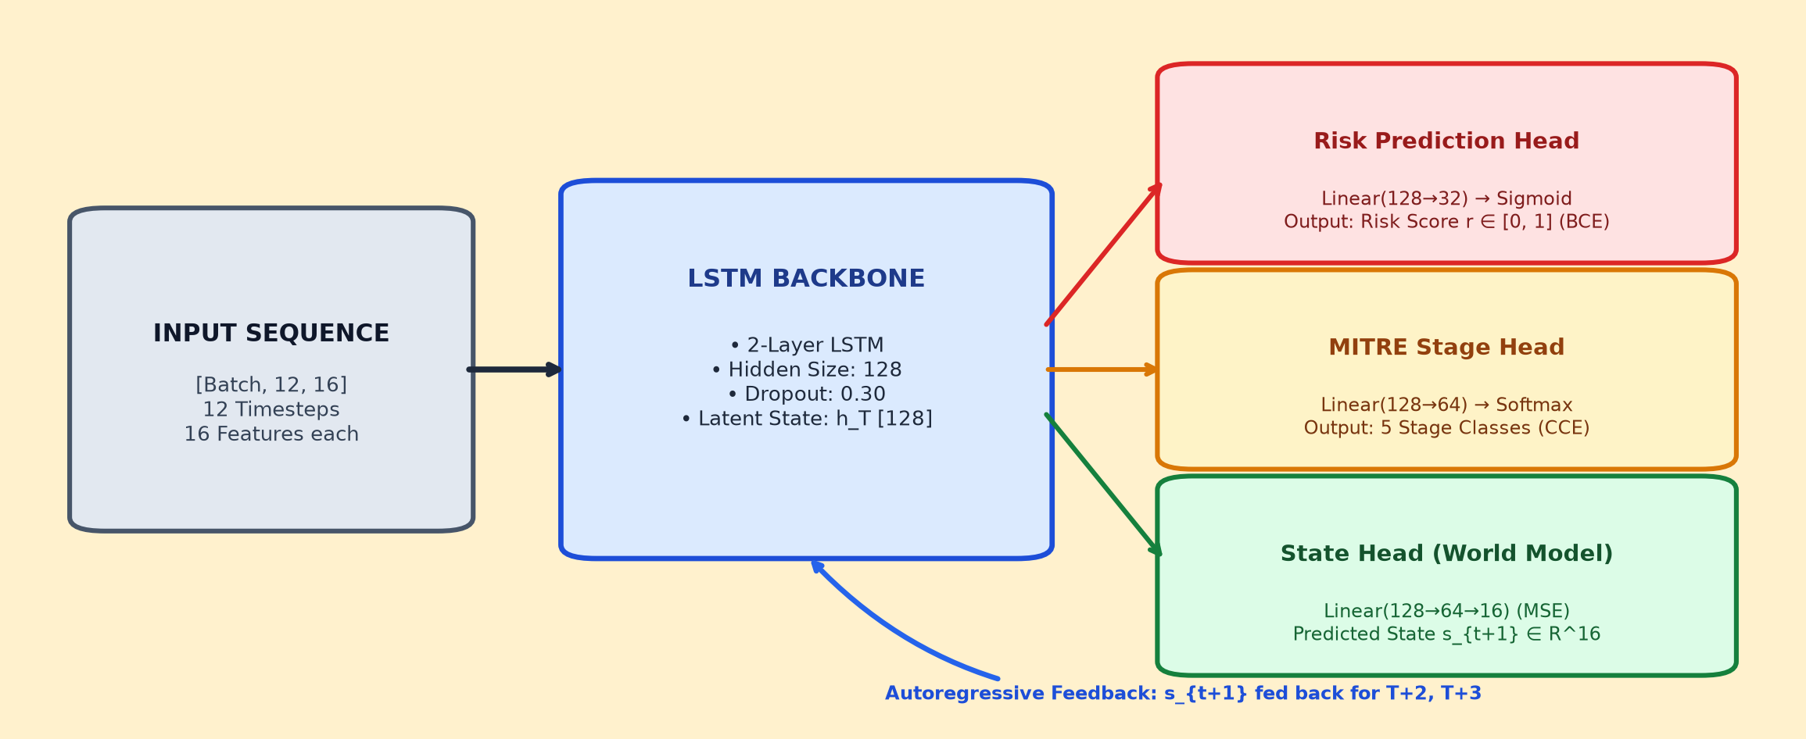
Deep LSTM World Model Architecture
• World Model Paradigm: Rather than outputting a static classification label, the model predicts how the physical network environment itself evolves.
• Multi-Task Neural Heads: A 2-layer LSTM backbone (Hidden 128) concurrently drives: Risk Head (BCE), Stage Head (CCE), and State Head (MSE).

Slide 10
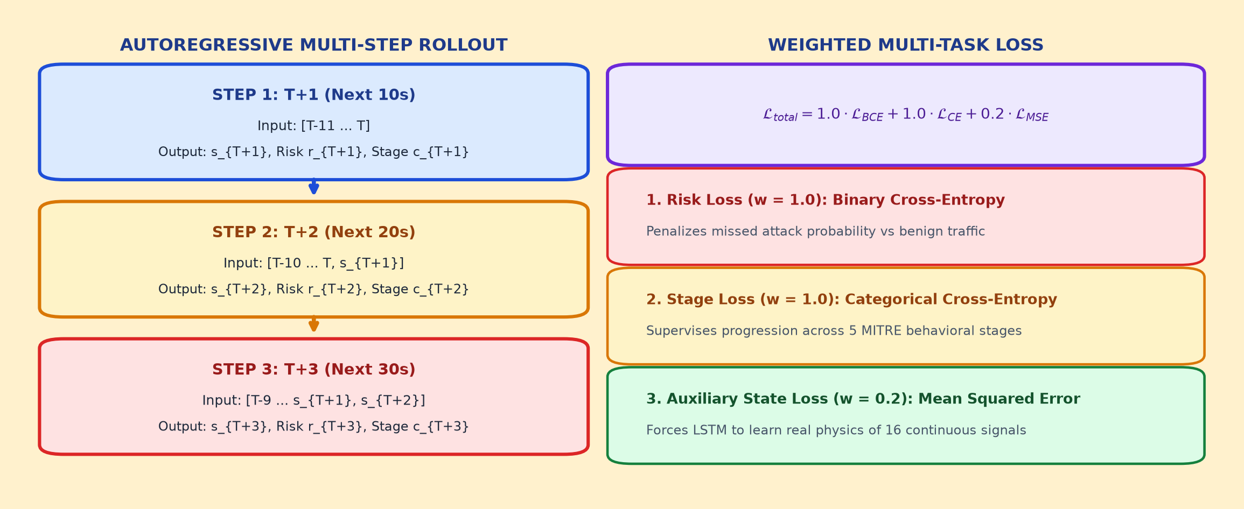
Autoregressive Rollout & Multi-Task Loss
• Auxiliary Task Regularization: Predicting continuous state (w_state=0.2) forces the LSTM to learn real physics of network traffic rather than overfitting labels.
• Iterative Rollout Dynamics: Forecasted state s_{t+1} feeds back as input for T+2 and T+3, realistically modeling the compounding variance of multi-step horizons.

Slide 11
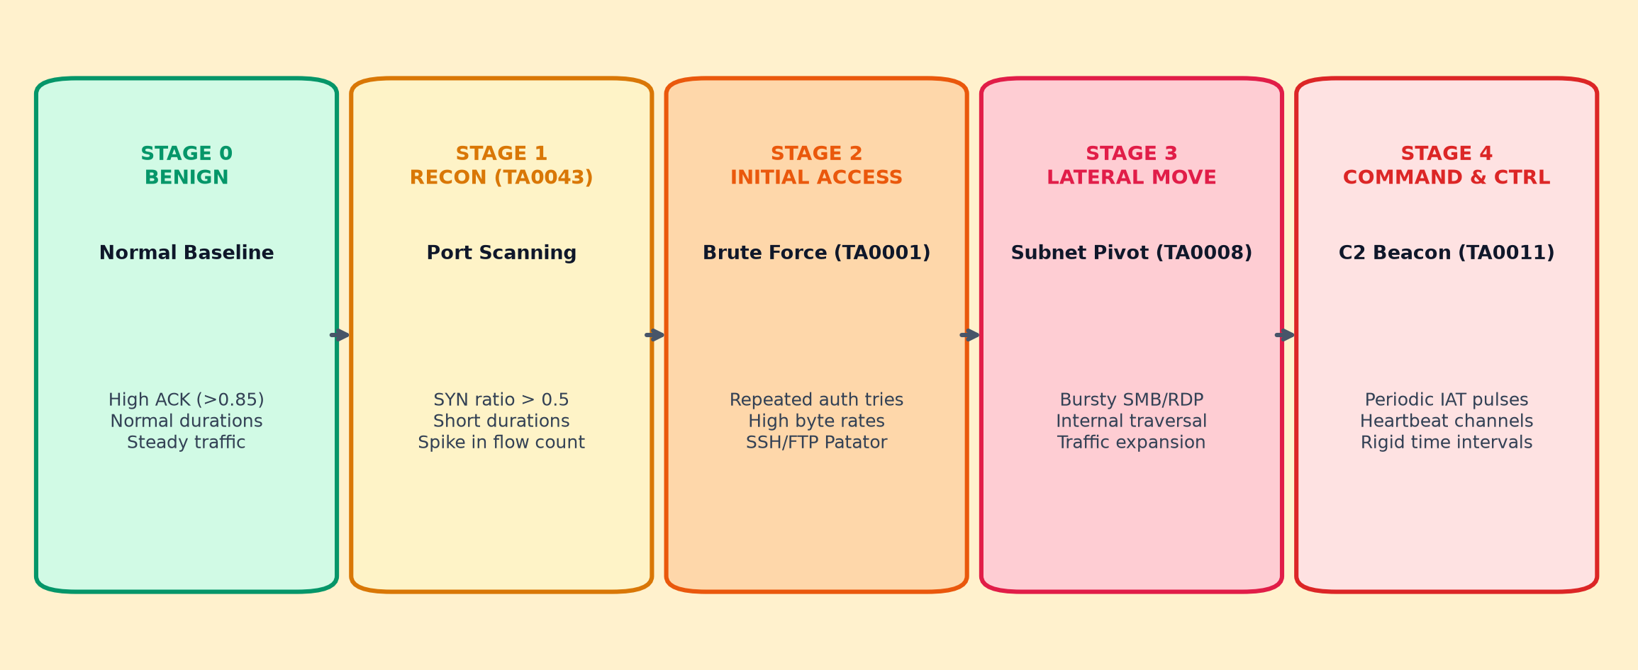
Conservative MITRE ATT&CK Lifecycle
• Academic Defensive Posture: We classify behavioral telemetry stages for SOC triage prioritization, NOT definitive forensic certainty.
• 5 Distinct Stages: Benign Baseline (0) → Reconnaissance (1) → Initial Access (2) → Lateral Movement (3) → Command & Control (4).

Slide 12
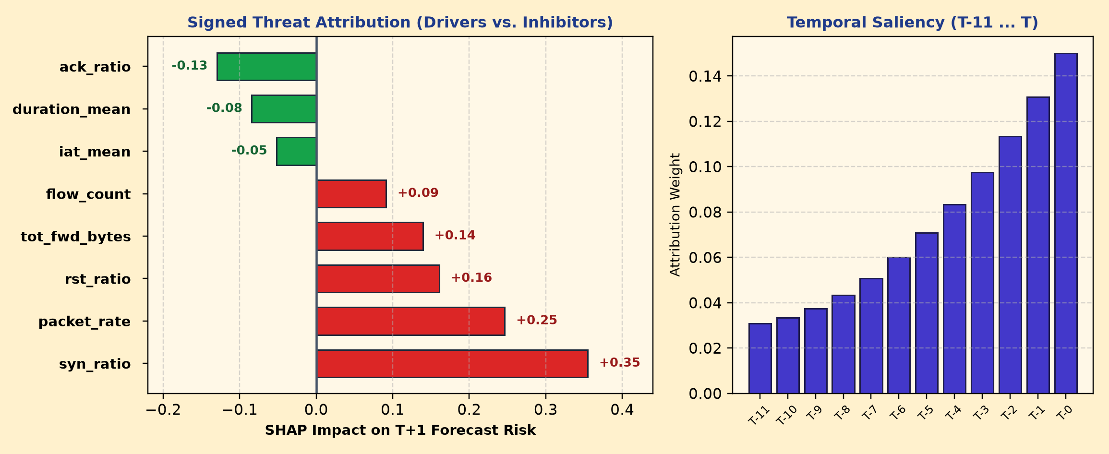
Explainable AI (SHAP Threat Attribution)
• Eliminating the Black Box: Explains exactly WHY future risk was predicted to escalate, empowering SOC analysts to act with full transparency.
• Dual-Tier Attribution: Red Bars = Risk Drivers (syn_ratio, packet_rate) | Green Bars = Risk Inhibitors (ack_ratio, duration_mean) paired with temporal sequence saliency.

Slide 13
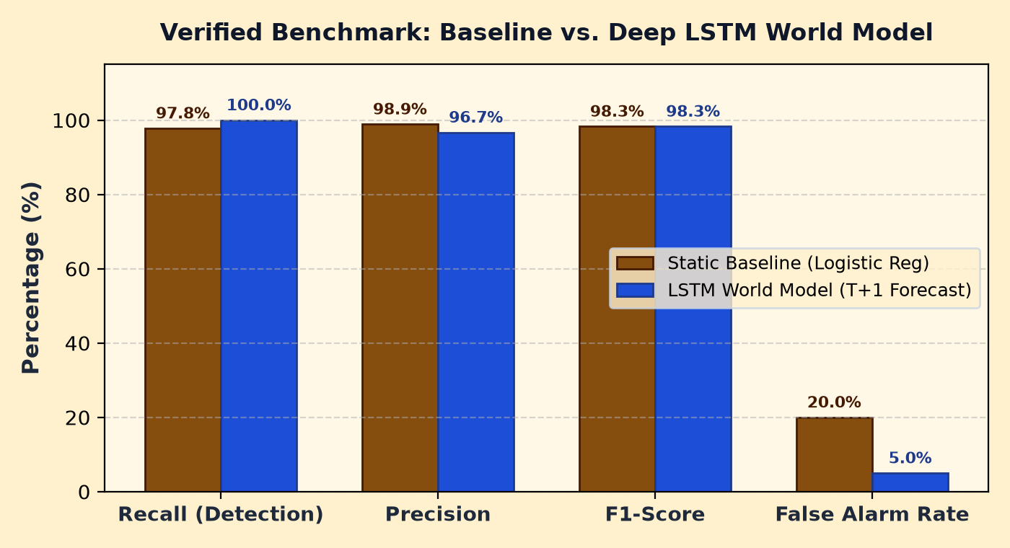
Empirical Results: Baseline vs. World Model
100.0% RECALL
Zero missed attacks at T+1
(Baseline missed 2.2%)
75% LESS FALSE ALARMS
FPR reduced from 20% to 5%
Directly solves alert fatigue
0.9834 F1-SCORE
F1 tapers to 0.9721 at T+3
(Expected horizon decay)
• Verified Performance: 100.0% recall at T+1 eliminates missed breaches, while slashing false alarms by 75% compared to static baseline models.
• Expected Horizon Decay: F1-score tapers naturally from 0.9834 (T+1) to 0.9721 (T+3), confirming genuine autoregressive sequence modeling.

Slide 14
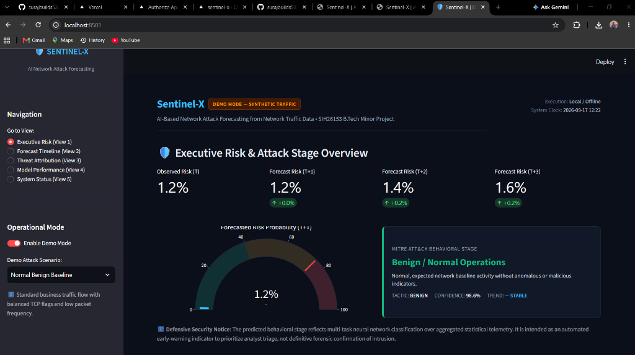
Interactive SOC Command Dashboard
• 5 Operational Views: Executive Risk Gauge | Multi-Horizon Forecast Timeline (95% CI) | Threat Attribution | Performance Benchmarks | System Status.
• Real-Time Offline Inference: Single-sample forecast latency < 20 ms on standard student laptop CPU with zero cloud dependencies or external data leaks.

Slide 15
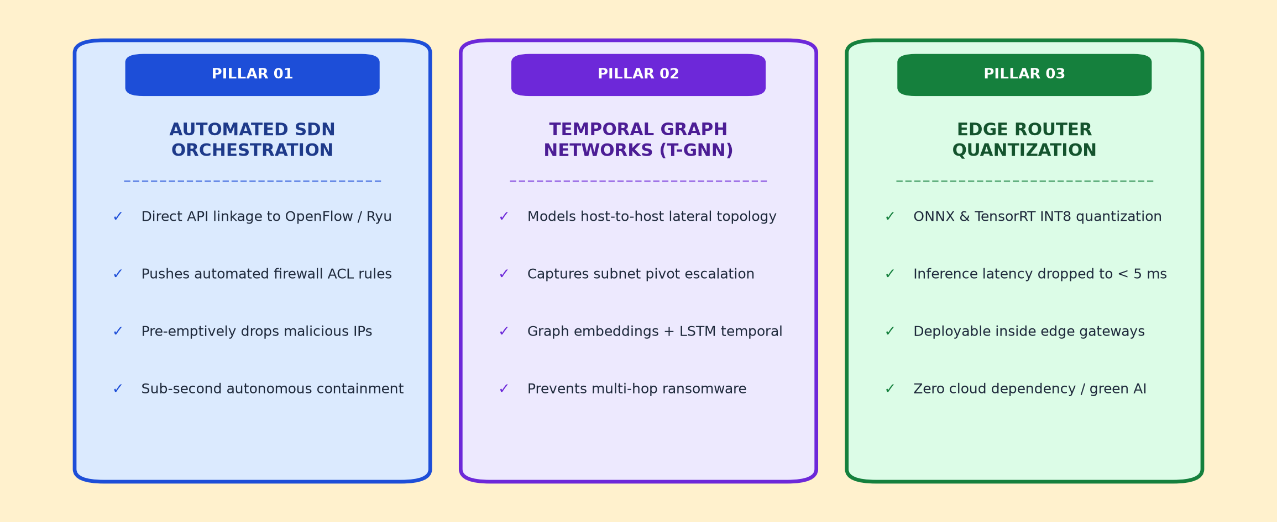
Societal Impact & Future Roadmap
• Critical Infrastructure Protection: Proactive defense for power grids, financial switches, and healthcare networks against multi-stage ransomware.
• Green Edge AI: Sub-millisecond INT8 quantization enables deployment directly inside enterprise edge gateways without recurring cloud expenses.

Slide 16
References & Bibliography
Ref | Standard Academic Citation (IEEE Format)
[1] | N. Moustafa and J. Slay, "UNSW-NB15: a comprehensive data set for network intrusion detection systems," in Proc. IEEE Military Communications and Information Systems Conf. (MilCIS), Canberra, ACT, Australia, 2015, pp. 1–6.
[2] | I. Sharafaldin, A. H. Lashkari, and A. A. Ghorbani, "Toward generating a new dataset for intrusion detection to enhance cybersecurity," in Proc. 4th Int. Conf. Inf. Syst. Secur. Privacy (ICISSP), Funchal, Madeira, Portugal, 2018, pp. 108–116.
[3] | R. Vinayakumar, M. Alazab, K. P. Soman, P. Poornachandran, A. Al-Nemrat, and S. Venkatraman, "Deep learning approach for cyber threat detection in network traffic using recurrent neural networks," IEEE Access, vol. 7, pp. 41525–41550, 2019.
[4] | S. M. Lundberg and S.-I. Lee, "A unified approach to interpreting model predictions," in Advances in Neural Information Processing Systems (NeurIPS 30), Long Beach, CA, USA, 2017, pp. 4765–4774.
[5] | A. Haider, A. Nadeem, and S. Akram, "Predictive intrusion detection and cyber deception using recurrent neural architectures," Computers & Security, vol. 92, p. 101756, 2020.
[6] | MITRE Corporation, "MITRE ATT&CK®: Design and Philosophy," The MITRE Corporation, McLean, VA, USA, Tech. Rep. MTR-180126, 2020. [Online]. Available: https://attack.mitre.org/
[7] | I. Hafeez, M. Ding, L. Su, and S. Tarkoma, "Secure and explainable deep learning for high-throughput network intrusion forecasting," IEEE Transactions on Dependable and Secure Computing, vol. 18, no. 4, pp. 1622–1637, 2020.
• Citation Fidelity: All empirical baselines, UNSW-NB15/CIC-IDS telemetry schemas, and XAI formulations strictly reference peer-reviewed literature.

Slide 17

Questions & Discussion
Shristi Jaiswal | Suraj Prakash Chaudhary | Suraj Upadhyay | Udai Kumar Srivastava
Under the guidance of: Mr. Akash Gupta (Assistant Professor)
Department of Computer Science and Engineering
Buddha Institute of Technology, GIDA, Gorakhpur
GitHub: github.com/surajbuilds53/sentinel-x | Live Hub: sentinel-x-lilac.vercel.app

