Slide 1

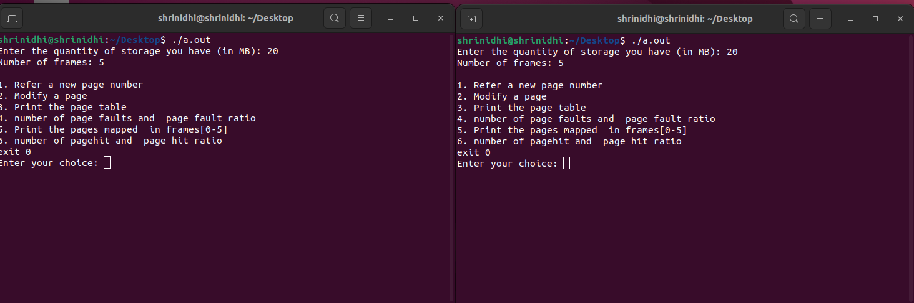
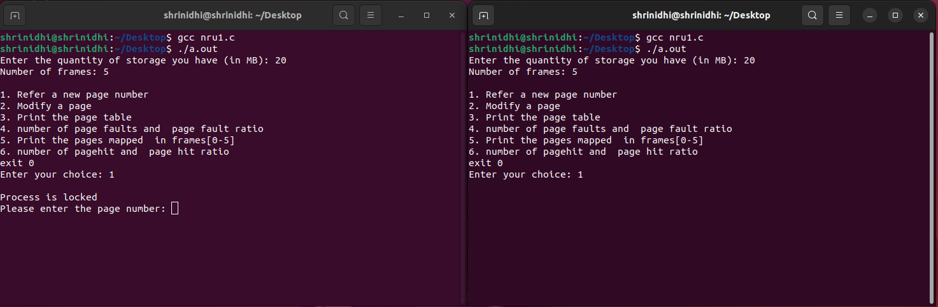
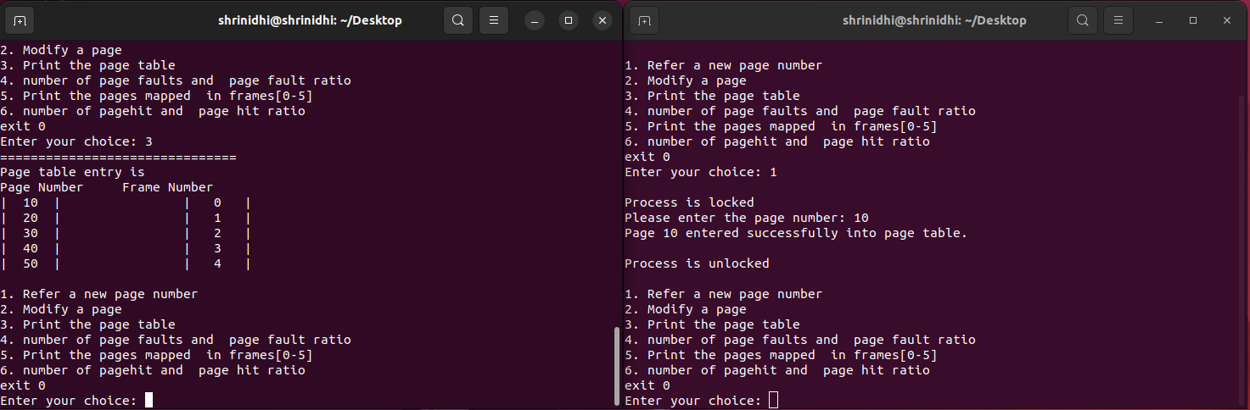
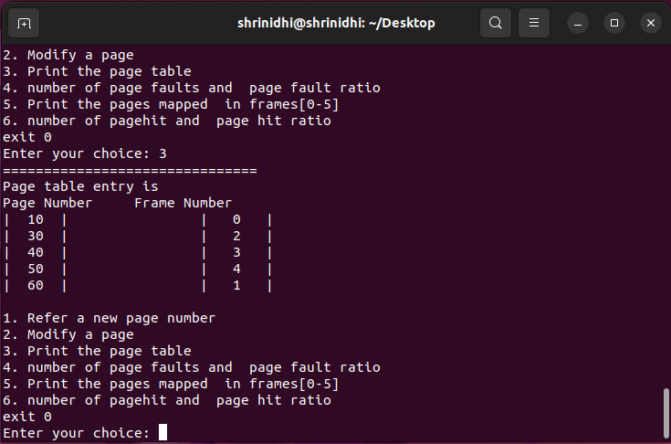


Implementation of Not Recently Used page replacement Algorithm
Department of Computer Science Engineering
R V College of Engineering
INTRODUCTION
System Architecture
Methodology
SYSTEM CALLS USED
Output/Result
Introducing the Not Recently Used (NRU) Page Replacement Algorithm .In the intricate dance of memory management within computer systems, the Not Recently Used (NRU) page replacement algorithm emerges as a graceful yet powerful performer.Implementation of the Not Recently Used (NRU) page replacement algorithm under varying memory configurations, comparing it with other established algorithms, to determine its advantages for practical implementation in modern operating systems.
Page Table: Each process in the system has a page table that maps virtual pages to physical frames. This page table includes additional bits for tracking the referenced and modified status of each page
Hardware Support: The CPU's memory management unit (MMU) or hardware page table walker is responsible for updating the referenced and modified bits whenever a page is accessed or modified. This hardware support ensures efficient tracking of page usage.
Page Replacement Queue: The operating system maintains a data structure, such as a queue or a list, to keep track of the pages eligible for replacement. Pages are organized into classes within this queue based on their referenced and modified status
Interrupt Handling: When the NRU algorithm selects a victim page for replacement, it may trigger a page fault interrupt. The operating system's interrupt handler is responsible for handling this interrupt and performing necessary actions, such as fetching the required page from secondary storage and updating the page tables.
A reference bit (R) and a modified bit (M) are given to every page in memory. Normally, each page table entry for a page contains these parts.
The algorithm starts the NRU selection procedure at regular intervals or in response to specified events (such as clock ticks or timer interrupts).
Based on their R and M bits, the algorithm sorts all of the pages into one of the following four classes-
Class 0 − Pages have R and M values of 0.
Class 1 − Pages have R = 0 and M = 1.
Class 2 − ages where R = 1 and M = 0.
Class 3 − Pages where R and M both equal 1.
A page is chosen for eviction by the algorithm after the pages have been classified. It starts by looking for the class with the lowest number that is not empty. The algorithm favors the class with the lesser number of pages when there are numerous classes. For instance, class 0 would be chosen if both class 0 and class 1 had pages.
1.sem_wait: sem_wait decrements the semaphore pointed by sem. If the semaphore value is non-zero, the decrement happens right away. If the semaphore value is zero, the call blocks till the time semaphore becomes greater than zero and the decrement is done. sem_wait returns zero on success and -1 on error. In case of error, the semaphore value is left unchanged and errno is set to the appropriate error number.
sem_init(sem_t *sem, int pshared, unsigned int value); sem_wait(sem_t *sem);
2. sem_post: sem_post increments the semaphore. It provides the V operation for the semaphore. It returns 0 on success and -1 on error.
sem_post(sem_t *sem);
3. sem_open: sem_open is the call to get started for a semaphore. sem_open opens an existing semaphore or creates a new semaphore and opens it for further operations.
The first parameter, name, is the name of the semaphore.The oflag can have O_CREAT, in which case, the semaphore is created if it does not already exist.
If both O_CREAT and O_EXCL are specified, the call gives an error, if the semaphore with the specified name already exists.
If the oflags parameter has O_CREAT set, the second form of sem_open has to be used and two additional parameters, mode and value have to be specified. The mode parameter specifies the permissions for the semaphore, which are masked with the umask for the process, similar to the mode in the open system call for files.
The last parameter, value is the initial value for the semaphore. If O_CREAT is specified in oflag and the semaphore already exists, both the mode and value parameters are ignored.
sem_t *sem_open (const char *name, int oflag);
sem_t *sem_open (const char *name, int oflag, mode_t mode, unsigned int value);
Features
CONCLUSION
In conclusion, the Not Recently Used (NRU) page replacement algorithm stands as a foundational tool for optimizing memory management within operating systems. Its ability to categorize pages based on recent use history plays a pivotal role in reducing page faults and enhancing overall system performance. The algorithm's simplicity and low computational overhead make it particularly advantageous for systems with limited resources, allowing for efficient memory management without significant processing burden.
Start
Initialize page table
Paging
Time interrupt or clock tick
TEAM MEMBERS
0
1
2
3
yes
NO
REFERENCES
FNO | PNO | MB | RB
0 | 0 | 0 | 0
1 | 1 | 0 | 0
2 | 2 | 0 | 0
3 | 3 | 0 | 0
Page 0
Page 1
Page 2
Page 3
Scan pages
European journal of engineering and technology vol. 4 no. 5, 2016 issn 2056-5860, muhammad waqar, anas bilal,comparative analysis of replacement algorithms techniques regarding to technical aspects
American Journal of Engineering Research (AJER) e-ISSN: 2320-0847 p-ISSN : 2320-0936 Volume-9, Issue-3, pp-193-197, Enayet Kabir, Md. Muniruzzaman, Most.Masuma Akther,Advancement and Analysis of Proficient Page Replacement Algorithm
Shrinidhi I 1RV22CS193
Suraj Chanaveeragoudra 1RV22CS211
Classify pages
Select class
PAGES
PAGE TABLE
PHYSICAL MEMORY
Random page selection
Evict page
Clear reference bits
STOP

