Slide 1
Experiential Learning Phase -II :
Operating System (CS235AI)
Implementing Not Recently Used
Page Replacement Algorithm
Presented by
Shrinidhi I 1RV22CS193
Suraj Chanaveeragoudra 1RV22CS211

Slide 2
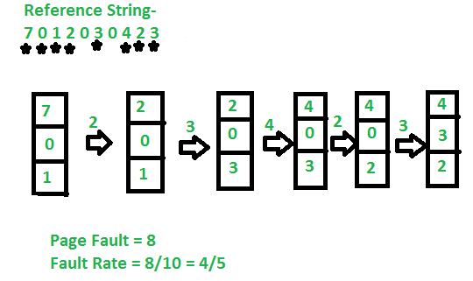
Problem Statement
Implementation of the Not Recently Used (NRU) page replacement algorithm under varying memory configurations, comparing it with other established algorithms, to determine its advantages for practical implementation in modern operating systems.

Slide 3
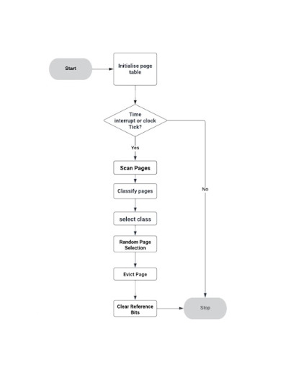
Methodology
Not Recently Used(NRU) Algorithm
A reference bit (R) and a modified bit (M) are given to every page in memory. Normally, each page table entry for a page contains these parts.
The algorithm starts the NRU selection procedure at regular intervals or in response to specified events (such as clock ticks or timer interrupts).
Based on their R and M bits, the algorithm sorts all of the pages into one of the following four classes-
Class 0 − Pages have R and M values of 0.
Class 1 − Pages have R = 0 and M = 1.
Class 2 − ages where R = 1 and M = 0.
Class 3 − Pages where R and M both equal 1.
A page is chosen for eviction by the algorithm after the pages have been classified. It starts by looking for the class with the lowest number that is not empty. The algorithm favors the class with the lesser number of pages when there are numerous classes. For instance, class 0 would be chosen if both class 0 and class 1 had pages.

Slide 4
Methodology
NRU Algorithm
The program picks a page at random for eviction from the designated class. This can be done by selecting a page at random after iterating over all of the pages in the class or by using a random number generator.
A replacement page can then be loaded if necessary when the selected page is removed from memory. An appropriate modification is made to the related page table entry.
Finally, to get ready for the subsequent selection cycle, all of the memory's remaining pages have their reference bits (R) cleared (set to 0).
NRU tries to delete pages that are less likely to be needed in the near future by routinely scanning and evicting pages that have yet to be utilized (i.e., having a reference bit of 0). NRU does not take into account the frequency of page references, which can lead to a less-than-ideal performance in some circumstances.

Slide 5
System Architecture
Page Table: Each process in the system has a page table that maps virtual pages to physical frames. This page table includes additional bits for tracking the referenced and modified status of each page
Hardware Support: The CPU's memory management unit (MMU) or hardware page table walker is responsible for updating the referenced and modified bits whenever a page is accessed or modified. This hardware support ensures efficient tracking of page usage.
PAGING:
FNO | PNO | MB | RB
0 | 0 | 0 | 0
1 | 1 | 0 | 0
2 | 2 | 0 | 0
3 | 3 | 0 | 0
0
1
2
3
Page 0
Page 1
Page 2
Page 3
PAGES
PAGE TABLE
PHYSICAL MEMORY

Slide 6
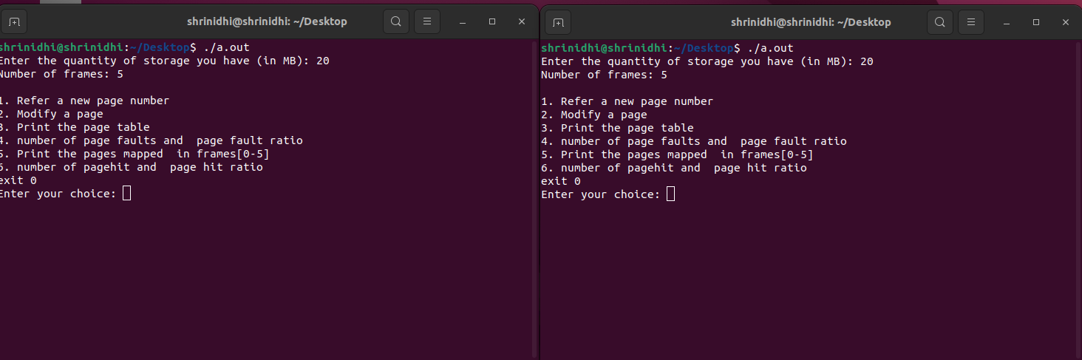
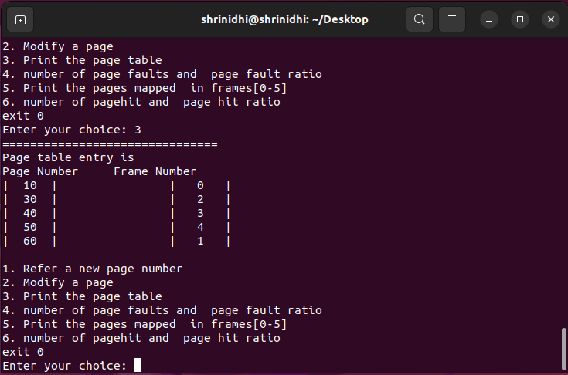
Output/result

Slide 7
Research papers/Blogs/Books referred
Sl No | Author and Paper title | Details of Publication | Summary of the Paper
1 | Muhammad Waqar, Anas Bilal COMPARATIVE ANALYSIS OF REPLACEMENT ALGORITHMS TECHNIQUES REGARDING TO TECHNICAL ASPECTS | European Journal of Engineering and Technology Vol. 4 No. 5, 2016 ISSN 2056-5860 | This paper explores various page replacement algorithms used in computer memory management, including FIFO, Belady's MIN, Optimal Algorithm, LRU, LRU Approximation, Hybrid LRU, CLOCK Algorithm, Dueling CLOCK, LRIS, CLOCK-Pro, and ARC. It compares LRU with hybrid LRU and evaluates their performance using examples. Additionally, it assesses LRU, FIFO, and Optimal algorithms, focusing on their performance as the number of frames increases and its impact on page fault rates, aiming to determine HIT-ratio across different scenarios.
2 | Enayet Kabir, Md. Muniruzzaman, Most.Masuma Akther Advancement and Analysis of Proficient Page Replacement Algorithm | American Journal of Engineering Research (AJER) e-ISSN: 2320-0847 p-ISSN : 2320-0936 Volume-9, Issue-3, pp-193-197 | In this paper we studied different page replacement algorithms and compared their performance. We proposed a new page replacement algorithm that uses the combination of sequential and LRU methods to obtain the better performance than that of various existing methods. We also give our attention to substitute some former method characteristic based on new idea. Key concept is that the replacement algorithm should reduce the page fault of system.

Slide 8
Use Cases
Variable-sized processes − Non-contiguous allocation is particularly useful when dealing with processes of varying sizes. It allows memory to be dispersed among several regions, enabling efficient utilization of available memory.
Dynamic memory management − Non-contiguous allocation enables dynamic memory management, allowing memory to be allocated and deallocated in response to the initiation or termination of activities. This flexibility is essential in environments where processes have changing memory requirements.
Effective memory utilization − Non-contiguous allocation ensures efficient memory utilization by allocating memory blocks according to the actual needs of the processes. It prevents wasting memory by allocating only the necessary amount of memory for each process.
Fragmentation management − While non-contiguous allocation can increase external fragmentation, it helps reduce internal fragmentation. Internal fragmentation occurs when allocated memory blocks have empty or partially utilized space. By allocating memory blocks based on the specific needs of processes, internal fragmentation is minimized.
Handling large datasets − Non-contiguous allocation is beneficial when dealing with large datasets that cannot fit into a single contiguous memory block. The ability to allocate memory in multiple non-contiguous blocks allows processes to work with extensive data without exhausting the available memory resources.
Virtual memory systems − Non-contiguous allocation is a fundamental technique used in virtual memory systems. It allows the operating system to map logical addresses to physical addresses in a flexible manner, enabling processes to access memory in a non-contiguous fashion.

Slide 9
Benifits
Advantages of the NRU page replacement algorithm
Simplicity − NRU is a relatively easy-to-implement page replacement method. The simplicity of NRU, for instance, may assist embedded systems or older hardware with memory restrictions.
Favoring Rarely Visited Pages − NRU gives priority to evicting rarely visited pages. NRU can help ensure that less often used pages are removed first, making space for more actively utilized pages, on a system where a particular application or data set is used infrequently yet demands a significant amount of memory.
Randomized Eviction − To choose which page to evict from each class, NRU uses a random selection technique. Additionally, it can make evictions less predictable, making it more difficult for malicious software to take advantage of particular eviction patterns.

Slide 10
Relevance of the project to the course
Directly applies core concepts of memory management studied in the operating system course.
Enhances understanding of page replacement algorithms through practical implementation.
Provides hands-on experience with managing system resources under varying memory access patterns.
Illustrates the importance of efficient memory utilization in real-world operating system environments.

Slide 11
REFERENCES (As per IEEE format and must be Numbered
consecutively in order of first mention) & Annexures / Appendix
European journal of engineering and technology vol. 4 no. 5, 2016 issn 2056-5860, muhammad waqar, anas bilal,comparative analysis of replacement algorithms techniques regarding to technical aspects
American Journal of Engineering Research (AJER) e-ISSN: 2320-0847 p-ISSN : 2320-0936 Volume-9, Issue-3, pp-193-197, Enayet Kabir, Md. Muniruzzaman, Most.Masuma Akther,Advancement and Analysis of Proficient Page Replacement Algorithm
3. Gururaj S. Rao. Performance analysis of cache memories. J. ACM, 25(3):378-395, 1978 [3].
4. William D. Strecker. Cache memories for pdp-11 family computers. In ISCA, pages 155-158, 1976 [4].
5. Andrew S. Tanenbaum. Modern Operating Systems. Prentice-Hall, 1992.
6. Hongliang, G., Chris, W., "A Dueling Segmented LRU Replacement Algorithm with Adaptive Bypassing", JWAC 2010 - 1st JILP Worshop on Computer Architecture Competitions: Cache Replacement Championship (2010), pp. 213 – 216, 2010

