Slide 1

CFD Modeling of a close loop enhanced geothermal system
Supervisor: Dr. Harshwardhan H. Katkar
By: Suraj Choudhary
Roll No: 241020035

Slide 2

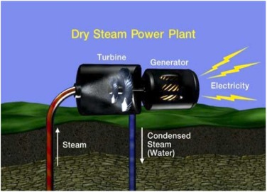
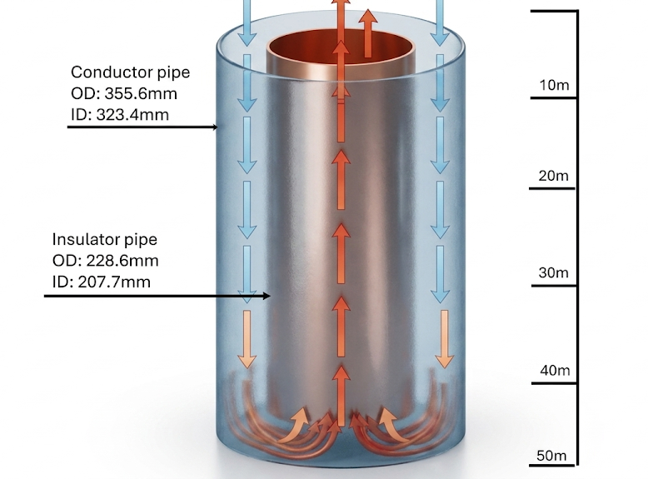
Motivation:
High cost of conventional geothermal systems (multiple-wells).
Limited applicability to high-temperature reservoirs only.
Environment concerns from fluid extraction and re-injection.
Need for a cost-effective, sustainable solution (closed loop system).
Abdulrazzaq et al. (2026)

Slide 3
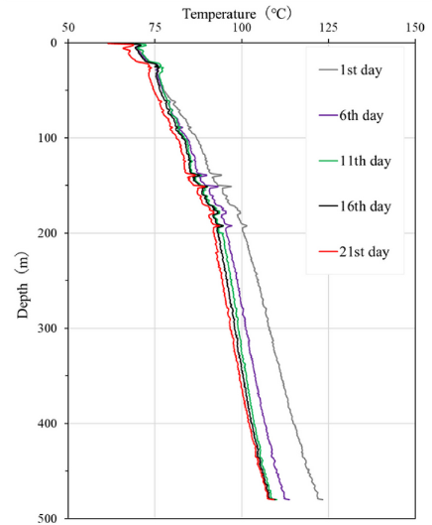
Literature review:
Pokhrel et al. (2022) – Field Experiment
The temperature profiles show progressive thermal depletion along the 500 m borehole over 21 days of operation.
Gap Addressed by Present Study
Prior transient model (Pokhrel et al.) did not evaluate net useful energy. This work adds steady-state CFD analysis and subtracts pumping losses to quantify true efficiency.
S. Pokhrel et al. (2022)

Slide 4
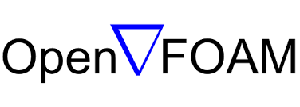

Methodology:
Meshing and generation of grids
Boundary conditions and material properties
Post processing
Geometry development
OpenFOAM solver selection
Governing equations

Slide 5
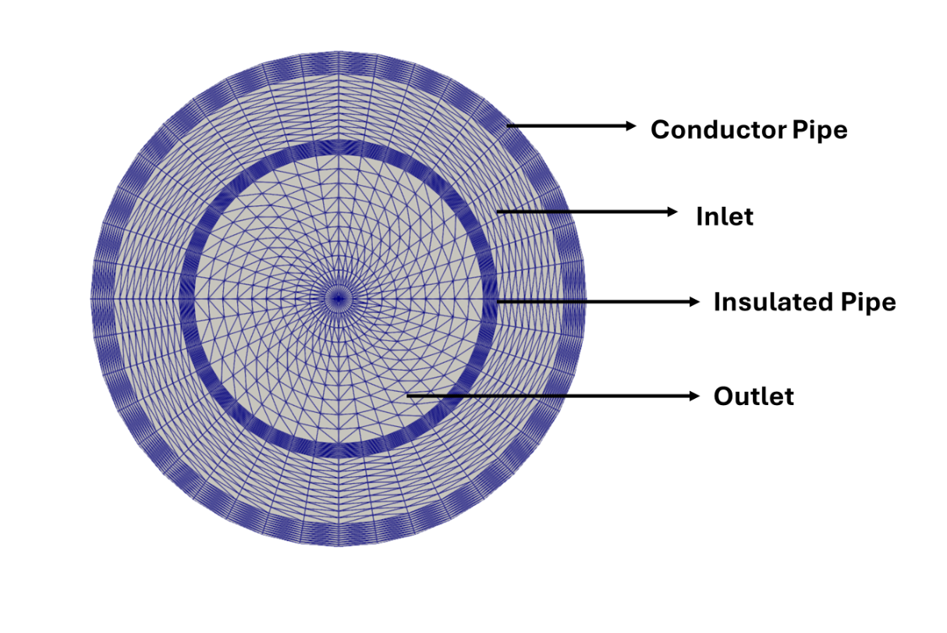
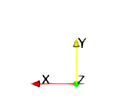
Geometry:
Structure parameter | Conductor Pipe | Insulated Pipe
Inner diameter (mm) | 323.4 | 207.7
Outer diameter (mm) | 355.6 | 228.6
Depth (m) | 50 | 49
S. Pokhrel et al. (2022)

Slide 6
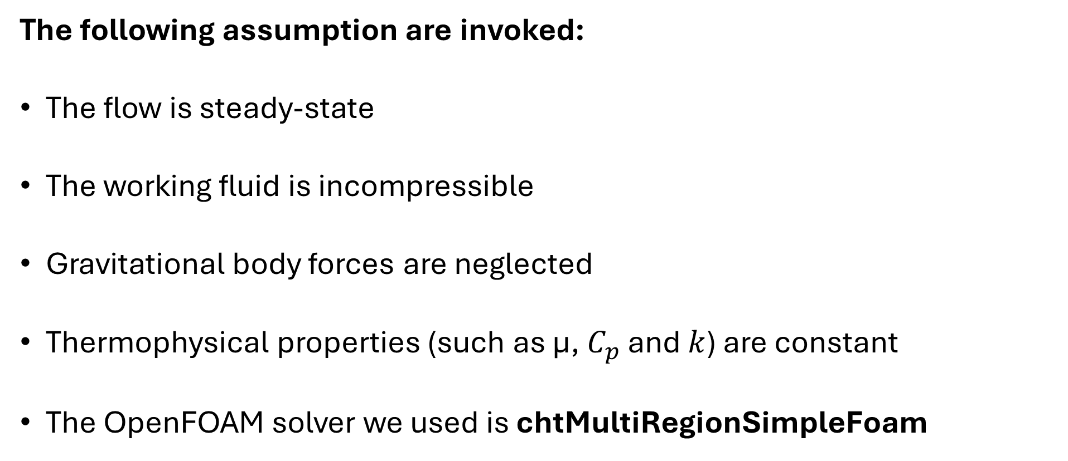
Solver selection:
The following assumption are invoked:
The flow is steady-state
The working fluid is incompressible
Gravitational body forces are neglected
Thermophysical properties (such as µ, $C_{p}$ and $k$) are constant
The OpenFOAM solver we used is chtMultiRegionSimpleFoam

Slide 7
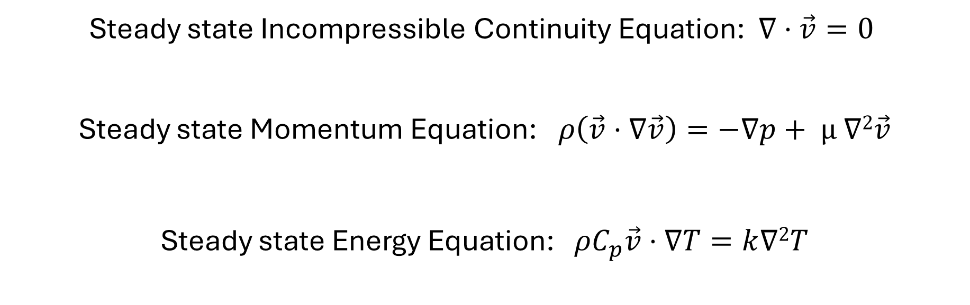
Governing Equations:
Steady state Incompressible Continuity Equation: $∇⋅\vec{v}=0$
Steady state Momentum Equation:$ρ\left(\vec{v}⋅∇\vec{v}\right)=−∇p+ µ$ $∇2\vec{v}$
Steady state Energy Equation: $ρC_{p}\vec{v}⋅∇T=k∇2T$
Notes:
1.CONSERVATION OF MASS, NO ACCUMULATION OF FLUID INSIDE THE CONTROL VOLUME.
Divergence of velocity:
2.This equation comes from newtons second law(F=ma)
Conservation acceleration term, even in steady flow, velocity may change with space
Viscous diffusion of momentum, internal frictional resistance
3. Convective heat transfer term (bulk motion) in flowing fluid
Heat conduction term(diffusion)

Slide 8
Meshing and Grid generation:
Parameters | Discription
Utility | blockMesh
Cell type | Structured hexahedral
Total cell | 1.92 million
Radial cell | Resolution 10 per block
Circumferential cell | Resolution 10 per block
Axial cell | Resolution 1200

Slide 9
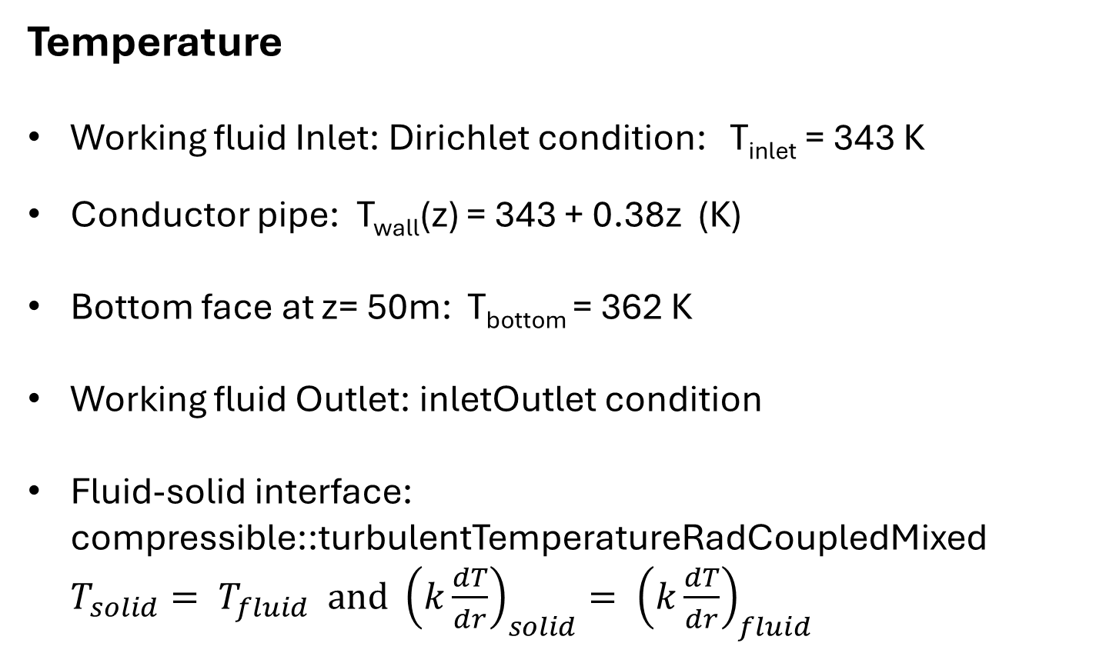
Boundary conditions:
Temperature
Working fluid Inlet: Dirichlet condition: T_{inlet} = 343 K
Conductor pipe: T_{wall}(z) = 343 + 0.38z (K)
Bottom face at z= 50m: T_{bottom} = 362 K
Working fluid Outlet: inletOutlet condition
Fluid-solid interface: compressible::turbulentTemperatureRadCoupledMixed $T_{solid}= T_{fluid} and$ ${\left(k\frac{dT}{dr}\right)}_{solid}{= \left(k\frac{dT}{dr}\right)}_{fluid}$

Slide 10
Boundary conditions:
Velocity
Inlet (annulus top face) : Dirichlet condition: U_{inlet} = (0,0, V) m/s where, V= m/(ρ.A)
Outlet (inner pipe top face): inletOutlet condition
All solid walls and fluid-solid interfaces: no-slip condition: U_{wall} = (0,0,0) m/s
Pressure
The SIMPLE – Semi-implicit method for pressure linked equation

Slide 11
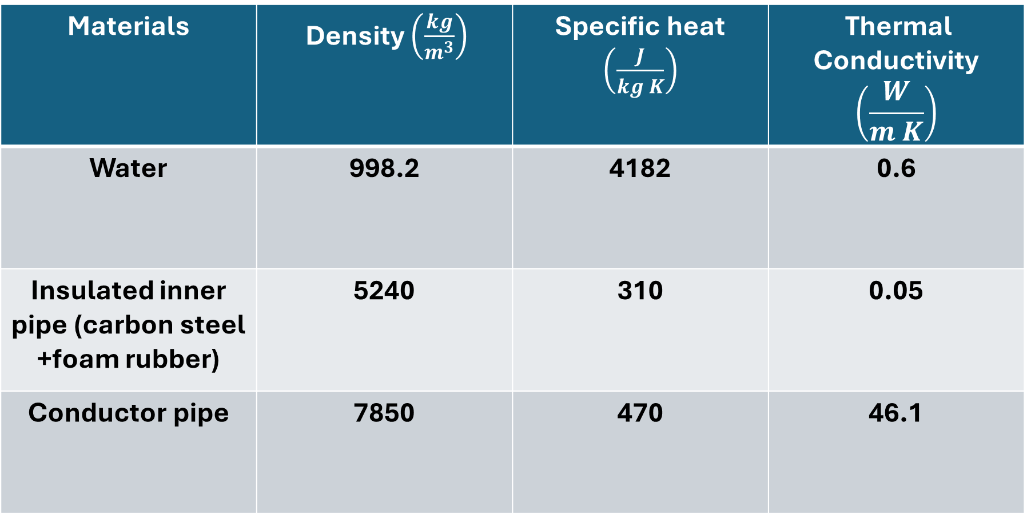
Material properties:
Materials | Density $\left(\frac{kg}{m^{3}}\right)$ | Specific heat $\left(\frac{J}{kg K}\right)$ | Thermal Conductivity $$\left(\frac{W}{m K}\right)$$
Water | 998.2 | 4182 | 0.6
Insulated inner pipe (carbon steel +foam rubber) | 5240 | 310 | 0.05
Conductor pipe | 7850 | 470 | 46.1
S. Pokhrel et al. (2022)

Slide 12
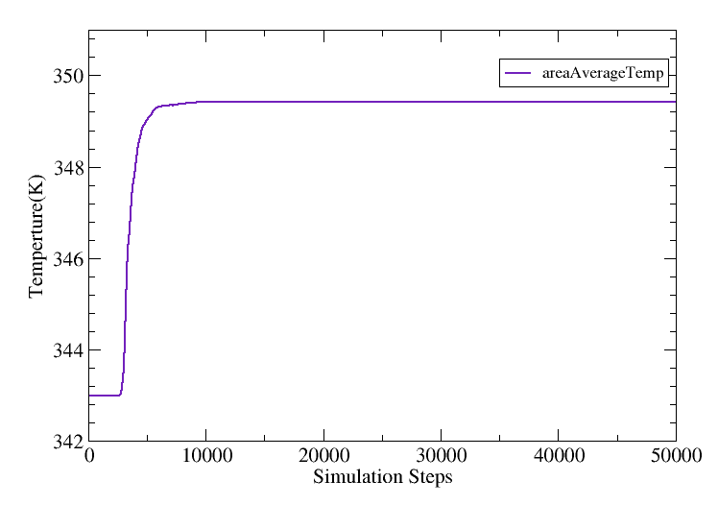
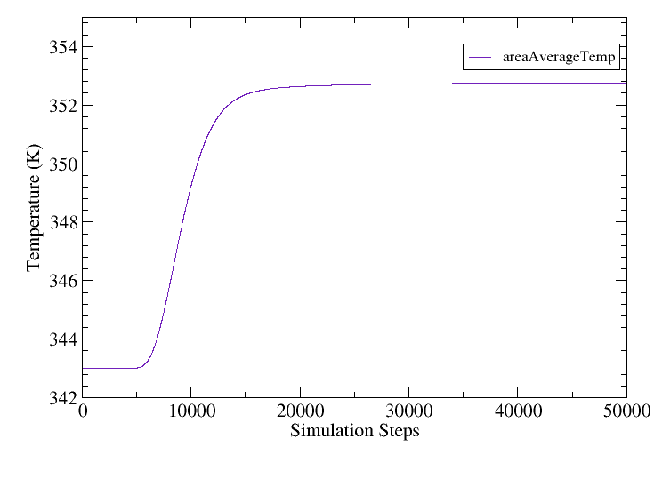
Steady-State Convergence:
Laminar regime
Turbulent regime

Slide 13
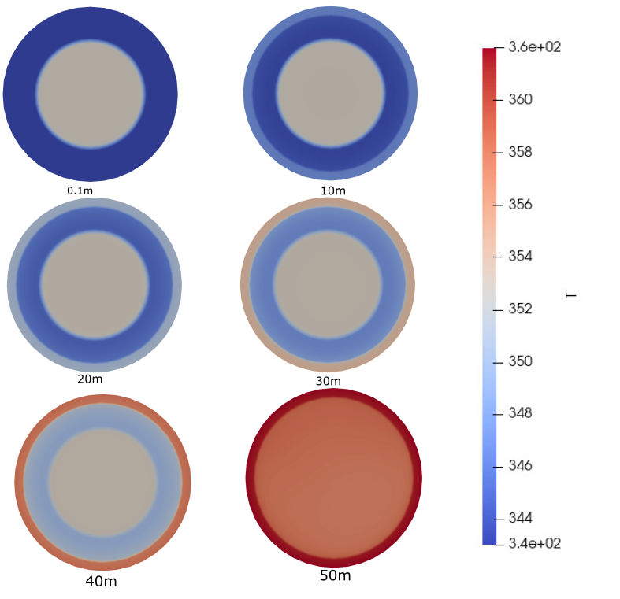
The cross-sectional top view provides the visual representation of thermal development within the system along the depth from the inlet z=0.1 m to the bottom z=50 m

Slide 14
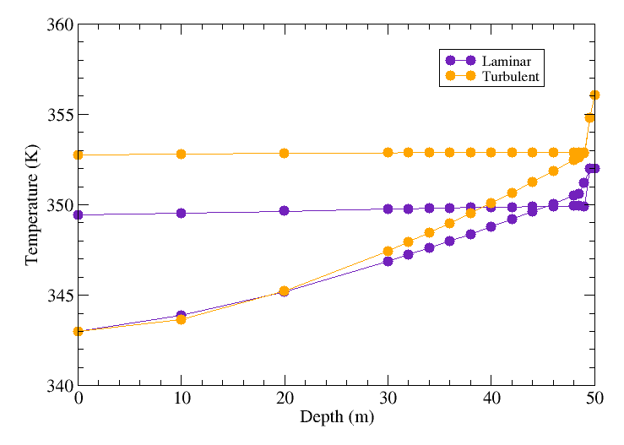
Temperature Profiles:
Outlet
At z= 50m : T_{bottom} = 362 K
Inlet

Slide 15
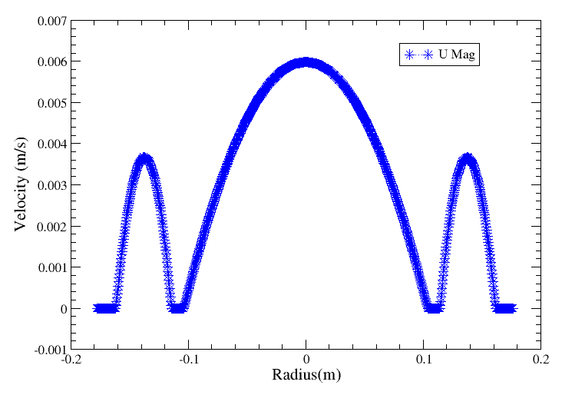
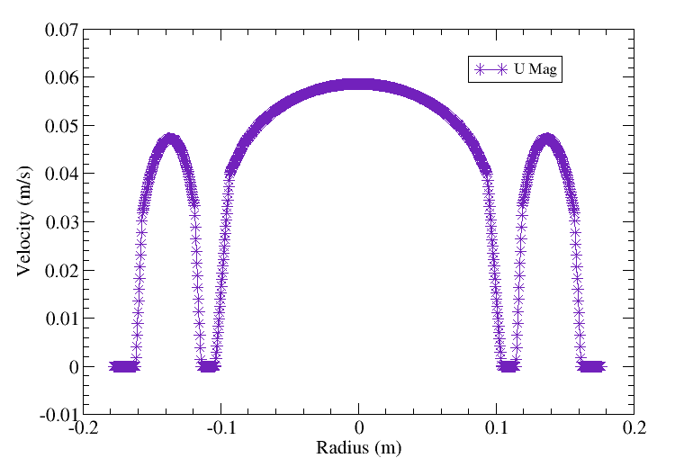
Velocity profiles(fully developed region):
Laminar regime
Turbulent regime
z = 25m
z = 25m

Slide 16
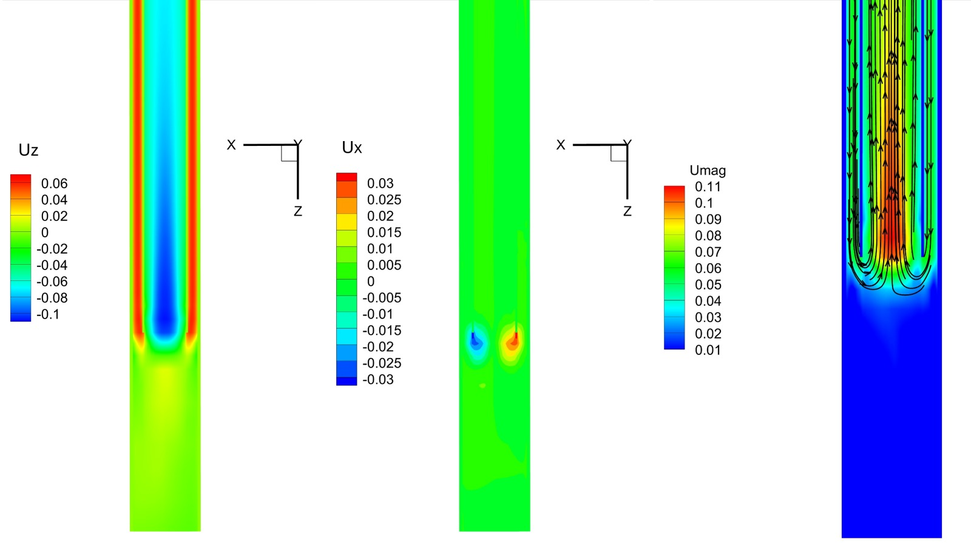
Bottom hole region:

Slide 17
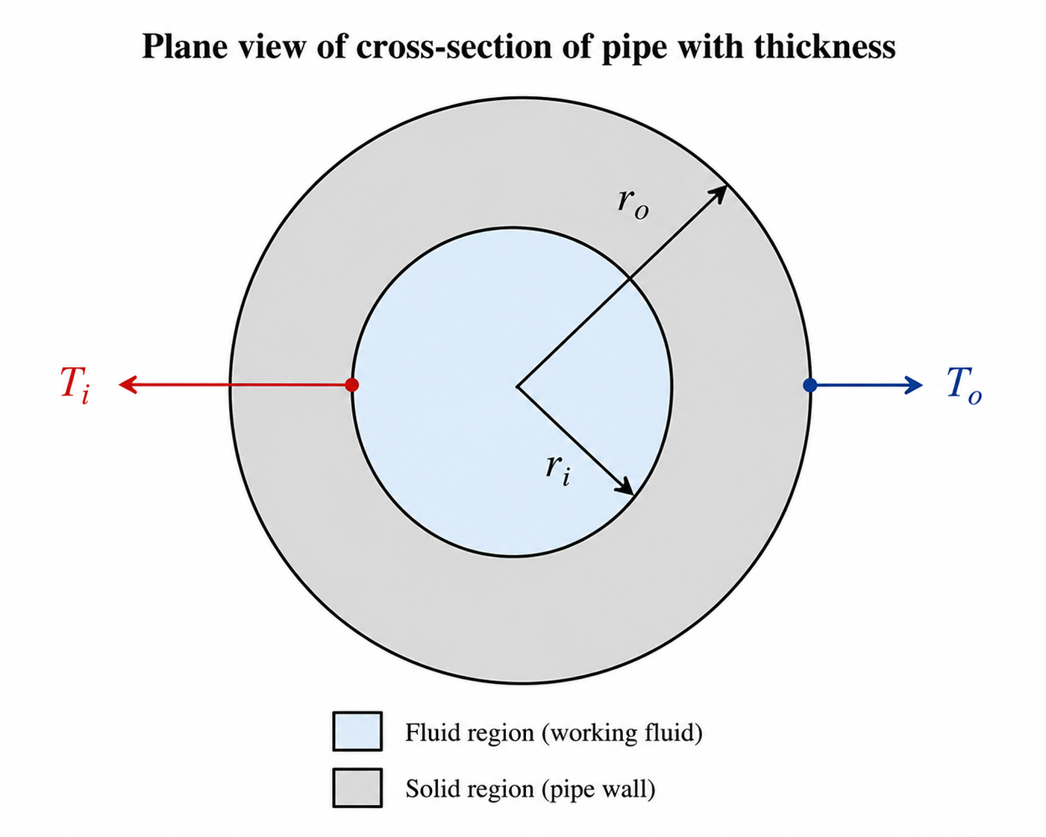

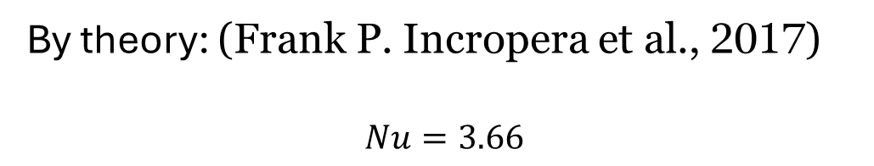
Model Validation for Laminar flow:
Constant wall temperature condition (Insulated pipe):
By simulation:
By theory: (Frank P. Incropera et al., 2017)
$$Nu=3.66$$
$V_{avg}$ = $\frac{2}{R^{2}}\int_{0}^{R}{u\left(r,z\right) rdr}$ $$T_{m}= \frac{2}{V_{avg}R^{2}}\int_{0}^{R}{T\left(r,z\right)u\left(r,z\right) rdr}$$
$h=\frac{qs }{Ts−Tm}=19.3621$ $\frac{W}{m^{2} K}$
$$qs= \frac{k(To−Ti)}{ro\ln\left(\frac{ro}{ri}\right)}$$
$Nu=\frac{h D}{k_{fluid}}$ =$6.7044$

Slide 18

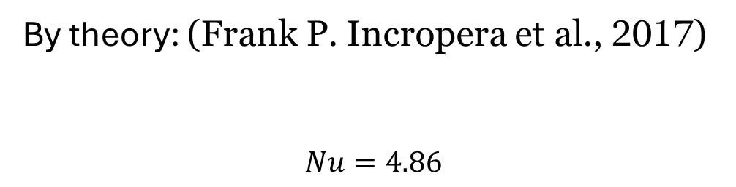
Model Validation for Laminar flow:
Constant wall heat flux condition (Conductor pipe):
$V_{avg}= \frac{2}{{Ri}^{2}−{r0}^{2}}$ $\int_{r0}^{Ri}{u\left(r,z\right) rdr}$
$$T_{m}= \frac{2}{V_{avg}({Ri}^{2}−{ro}^{2})}\int_{ro}^{Ri}{T\left(r,z\right)u\left(r,z\right) rdr}$$
$h=\frac{qs ∗ Ao}{(Ts−Tm) Ai}$ = $8.63809$ $\frac{W}{m^{2} K}$
$$qs= \frac{k(To−Ti)}{Ro\ln\left(\frac{Ro}{Ri}\right)}$$
$Nu=\frac{h D_{h}}{k_{fluid}}$ = $3.2956$
By simulation:
By theory: (Frank P. Incropera et al., 2017)
$$Nu=4.86$$

Slide 19



Turbulent Flow Validation using Dittus-Boelter Correlation:
By simulation:
By theory: (Frank P. Incropera et al., 2017)
$V_{avg}$ = $\frac{2}{R^{2}}\int_{0}^{R}{u\left(r,z\right) rdr}$ $$T_{m}= \frac{2}{V_{avg}R^{2}}\int_{0}^{R}{T\left(r,z\right)u\left(r,z\right) rdr}$$
$h=\frac{qs }{Ts−Tm}=262.103$ $\frac{W}{m^{2} K}$
$$qs= \frac{k(To−Ti)}{ro\ln\left(\frac{ro}{ri}\right)}$$
$Nu=\frac{h D}{k_{fluid}}$ =$90.75$
$Nu$: $0.023 . {Re}^{0.8}$. ${Pr}^{0.333 }$
$$Nu: 83.57$$

Slide 20
Parametric study:
Working Fluids | Thermal Conductivity(k) | Specific Heat(C_{p}) | Viscosity(µ) | Density(ρ)
Water | High | 4181 | 0.001 | 998.2
CuO/water (R.Kavitha et al. 2022) | High(enhanced) | 4100 | 0.00084 | 1015
Mineral Oil (PubChem) | Low | 1860 | 0.00989 | 880
PG (DowCAL Geo-200) | Moderate | 3990 | 0.00174 | 1018

Slide 21
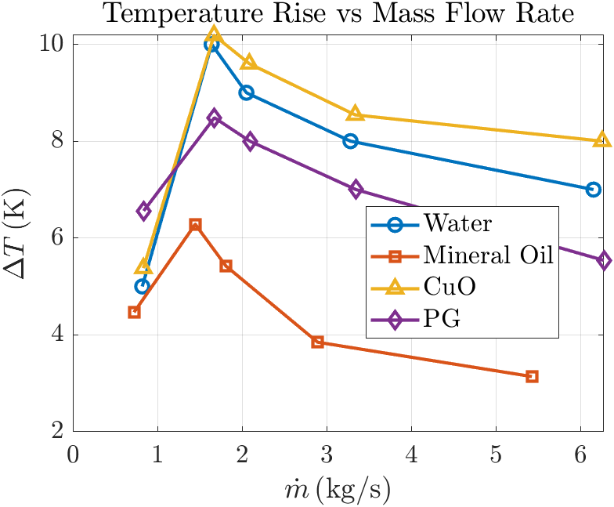
Effect of Mass Flow Rate on ΔT:

Slide 22
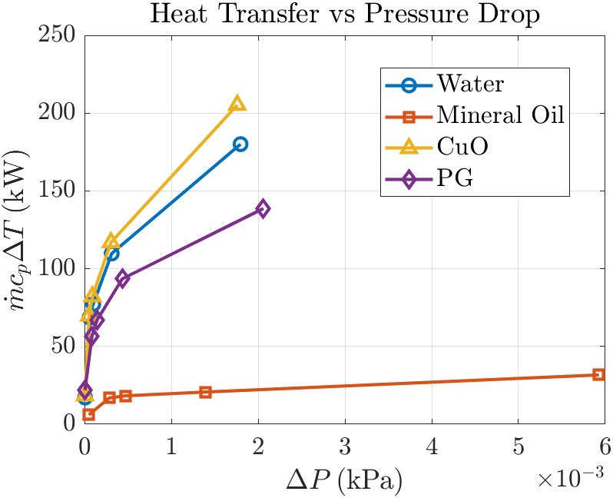
Effect of Heat Transfer rate on ΔP:

Slide 23
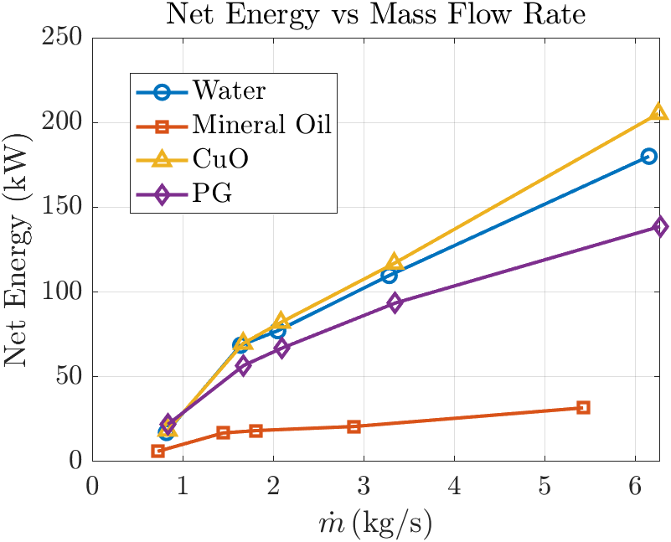
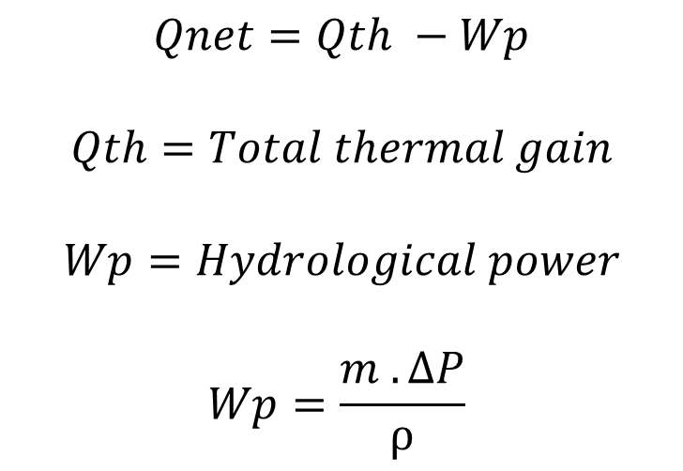
Effect of Net Energy on Mass Flow Rate:
$$Qnet=Qth −Wp$$
$$Qth=Total thermal gain$$
$$Wp=Hydrological power$$
$$Wp=\frac{m . ΔP}{ρ}$$

Slide 24
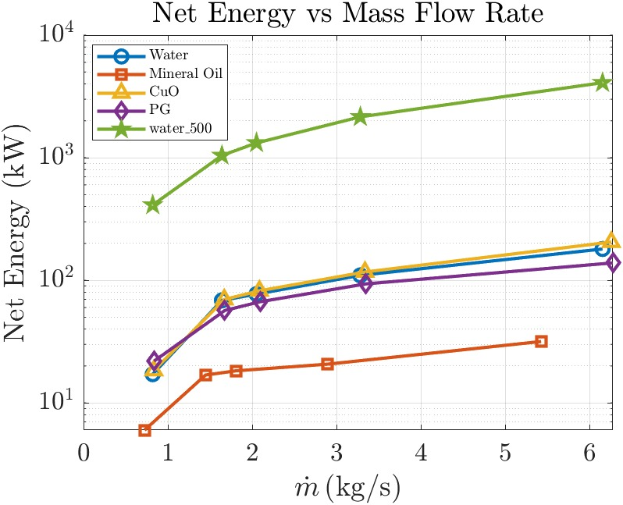
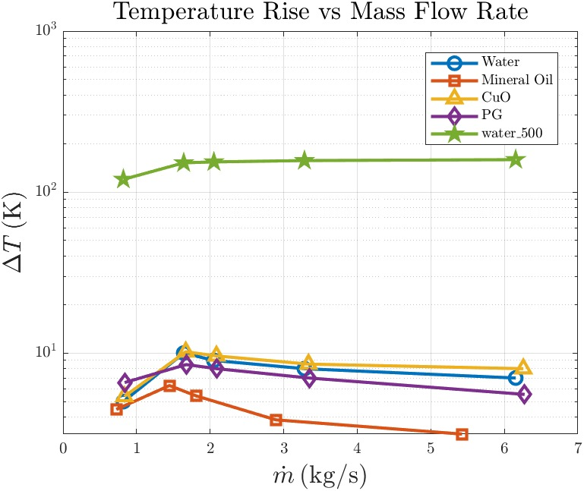
Scaling Analysis: (50 vs 500 meters)

Slide 25
Conclusion:
Successfully developed a 3D, steady state, finite volume-based computational model, in OpenFOAM to solve conjugate heat transfer and fluid flow phenomena.
Turbulent flow gives high heat extraction than laminar flow
CuO/water nanofluid achieved the highest net energy.
Scaling the system to 500 meter delivered 22-fold higher net energy than 50 meter system.

Slide 26
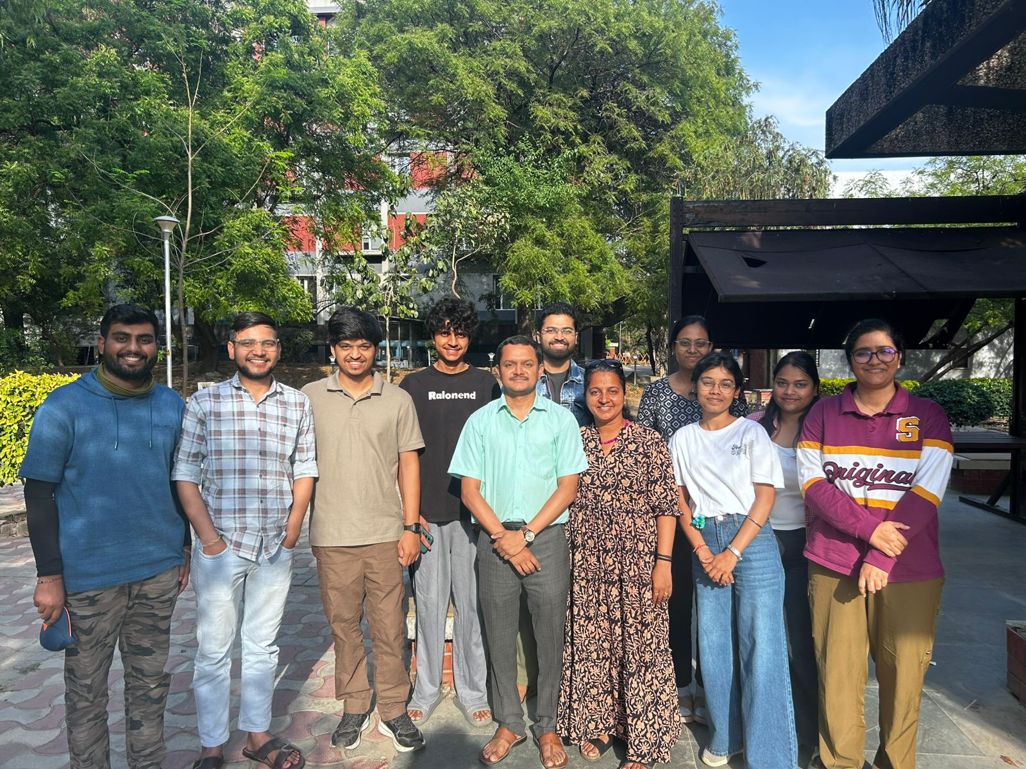

Thank you everyone

