Slide 1
DEVELOPMENT OF FILTERS FOR TRANSCRIPTION BETWEEN ENGLISH AND BENGALI DOCUMENTS
Sushmita Sen (Exam Roll : 111105027)
Surajeet Bharati (Exam Roll : 111105044)
Project Guide : Manas hira

Slide 2
What is it ?
Transcript Bengali Document to equivalent English Script and vice-versa
Look and Feel will be unchanged.
Support Multiple format conversion (HTML, PDF, DOC)
It will be a web application
Any device with a browser can use

Slide 3
Dataset Design
Storing and searching in a dictionary containing each and every word and its transcribed form will be wastage of resources
The following approach is better in terms of resources
বালক : baalak
ব - b
া - aa
ল - la
ক - k

Slide 4
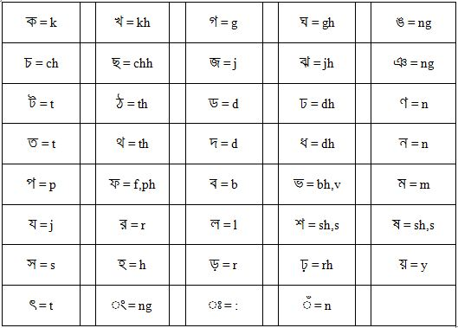
Dataset Sample

Slide 5
Use of Lexical Analyzer
The Data-set will be stored using Lexical Analyzer instead of any data structure
Longest Match in input file will be replaced by its transcribed form

Slide 6
Implementation

Slide 7
Implementation
Used JAVA Servlet to implement Back-end
Used HTML5 and CSS3 to design front-end
Used Apache Tomcat 7 as Java Web-server

Slide 8
Transcription Process
File selected by User
Servlet upload the file into server
Servlet request lexical analyzer to transcribe the document
Lexical Analyzer Create Output file
Servlet Redirect control to Transcribed File
Servlet Perform Necessary Format Conversion
Servlet Perform Necessary Format Conversion

Slide 9
Transcription Between Different Formats

Slide 10
HTML to HTML
Uploaded file will be transcribed using Lexical Analyzer
Lexical analyzer parses the HTML file and replaces longest match

Slide 11
HTML to PDF
Uploaded file will be transcribed using Lexical Analyzer
Transcribed HTML output will be converted to PDF using WKHTMLTOPDF

Slide 12
HTML to DOC
Uploaded file will be transcribed using Lexical Analyzer
Transcribed HTML output will be converted to PDF using WKHTMLTOPDF
Output PDF will be converted to DOC file using PDFBox API

Slide 13
PDF or DOC to Other Formats
Convert to equivalent HTML file using text extraction API
Do Transcription and format conversation as said before
Look and feel will not be preserved.

Slide 14
Limitation
Limitation in Data-set
- Language Specific anomalies can not be covered.
Limitation in File Format Conversion
- During conversation for PDF and DOC input file.

Slide 15
Future Scope
Improvement in data-set
Improvement of the regular expressions in the lexical analyzer
Use of better API for improvement in file format conversion.

