Slide 1


Bosch AI Hackathon

Slide 2
AI Warriors
1.Team Leader Name: Vrindha Sham Bhatt
2.Team Member Name: 1)Thanushree D
2)Suraj V Ghorpade
3.Team Leader Phone Number: 9108605859
4.Team Leader Email ID: vrindha99@gmail.com

Slide 3
Model Description
The Model is based on YOLOv3 model for object detection.
You Only Look Once or YOLO is one of the popular algorithms in object detection used by the researchers around the globe.
The unified architecture of YOLO is extremely fast in manner.
This algorithm outperforms the other detection methods, including DPM and R-CNN, when generalising from natural images to other domains like artwork.
The AI model developed is capable of detecting Furniture(Chair) one of the obstacle which has to be detected by the cleaning robots using Yolov3.

Slide 4
Features of your Model
The images for the Training dataset has been captured from point of view of the cleaning robot.
Robot considering the dimensions and resolution mentioned in the problem statement.
Around 100 images of chair were labelled using LabellImg.exe.
Trained on google colab gpu using yolo v3 configuration.
The accuracy of the detection achieved was 88%.

Slide 5
Tech Stack
Python
Opencv
YoloV3

Slide 6
Why your Model is the best?
The base YOLO model processes images in real-time at 45 frames per second, while the smaller version of the network, Fast YOLO processes an astounding 155 frames per second while still achieving double the mAP of other real-time detectors.
After the training, the classifier achieves a top-1 accuracy of 76.5% and a top-5 accuracy of 93.3%.

Slide 7
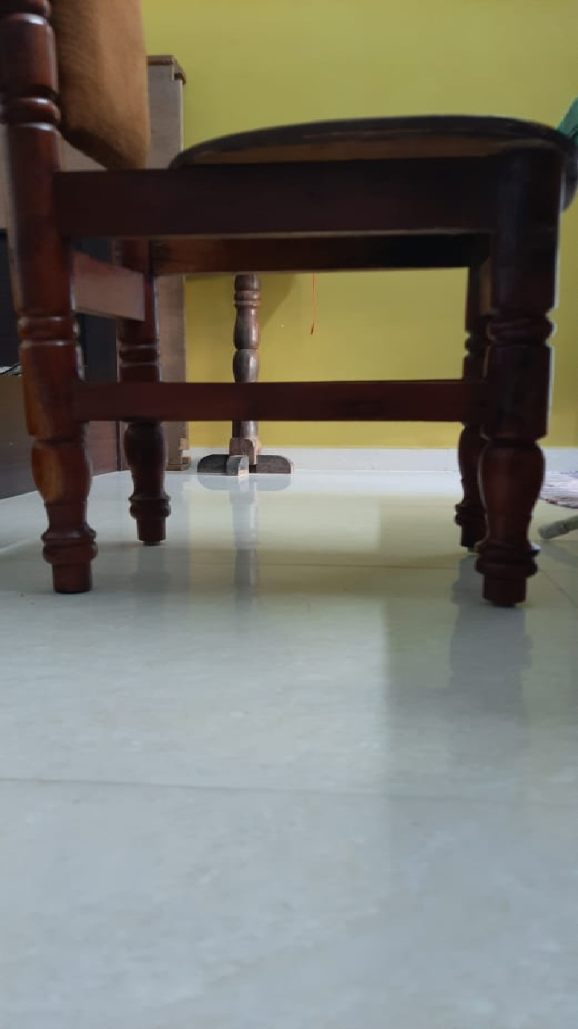
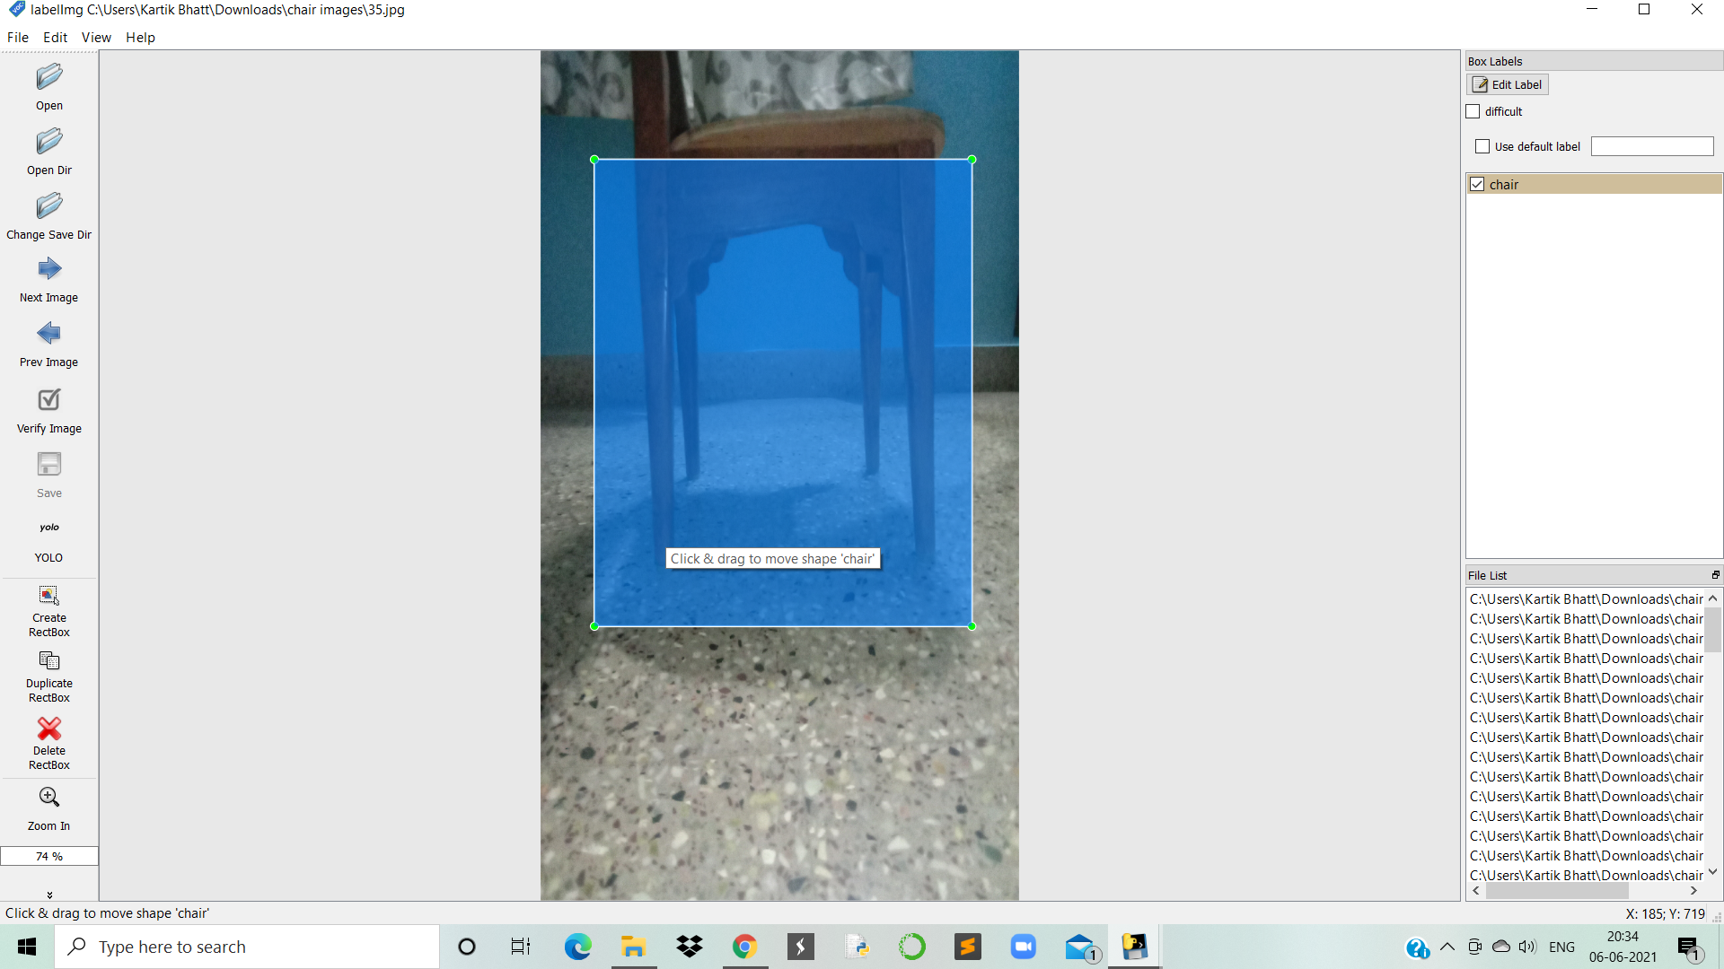
Labelled Images used for Training Model

Slide 8
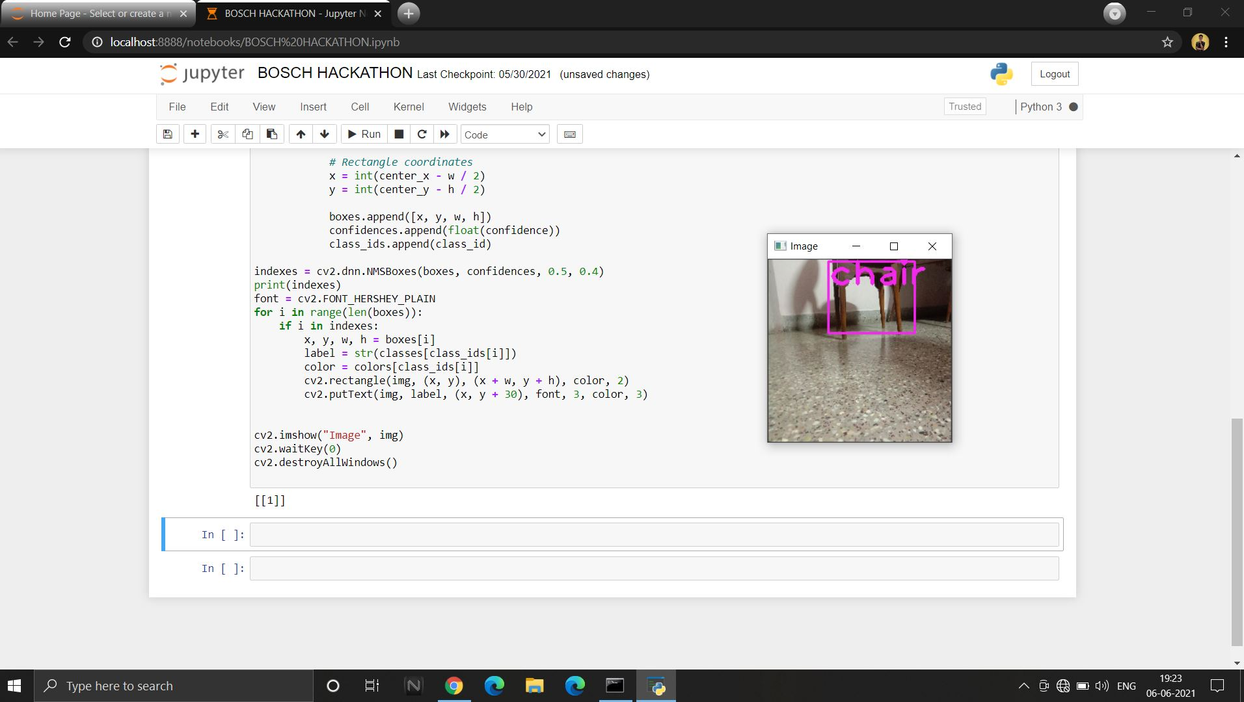
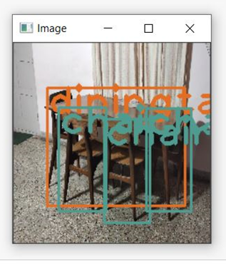
Images used in the Testing Model

Slide 9
Working Model
The project files are being uploaded in the Zip file .

Slide 10


