Slide 1
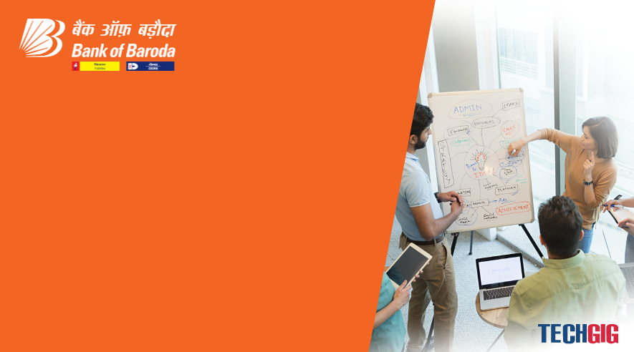

Bank of Baroda Hackathon - 2022
Technology Partner
Your Team Name : Reva Tech.
Your team bio : We are working in MNC company. Having more than 8-10 year of expreince in product development.
Date : 8/05/2022

Slide 2
Problem Statement?
Why did you decide to solve this Problem statement? I am problem solver and always found out better solution to solve real world problem. It is real problem people are using in daily life. Even i am also faced then issue when i was submit my cheque. It will take 2-3 day for procesing. I think we can also this problem to save time as well as humam effort using AI aur some automation. I have idea to solve this problem and reducing time. I belive with the help of technology we will process thousand and miliion of cheque within minutes.

Slide 3
User Segment & Pain Points
Which user /advertiser segment would be early adopter of your product & why? All banking user beacuse we are providing better solution to save time and effort. We are providing facility to process cheque on figure tips. Why : as i said it will save lot of time and also money transfter with in second just like in UPI. We will provide better security so user has all control after submiting cheque.

Slide 4
Pre-Requisite
What are the alternatives/competitive products for the problem you are solving? 1) Aternatives:
1) We are provding easy process of cheque. Then can upload cheque using mobile and desktop . No need to visit bank.
2) We are verified before final process with all detail. Like amount, issuer name, account number. Once use confirmed then we will process the cheque . It will provide using satification about security.

Slide 5
Azure tools or resources
Azure tools or resources which are likely to be used by you for the prototype, if your idea gets selected 1) I would like to use Azure Resource Manager, Azure logic , Azure Storage, Azure database

Slide 6
Any Supporting Functional Documents
Present your solution, talk about methodology, architecture & scalability

Slide 7
Key Differentiators & Adoption Plan
How is your solution better than alternatives and how do you plan to build adoption? Plan is simple. We are scaning the cheque and send verfication to user. User need to verifity the all details mention in cheque. Once he verified check will be processed. Smart phone user just verfied using figure. We will verifiy details based on figure we will check KYC details and If all are match then we will process. Also we provide decline button as well with feedback option. If he want to decline the cheque so he can. Normal phone user get a link to verified his/her details. Where he need to enter addhar card number based of that we will verfied all the details and process the cheque.

Slide 8
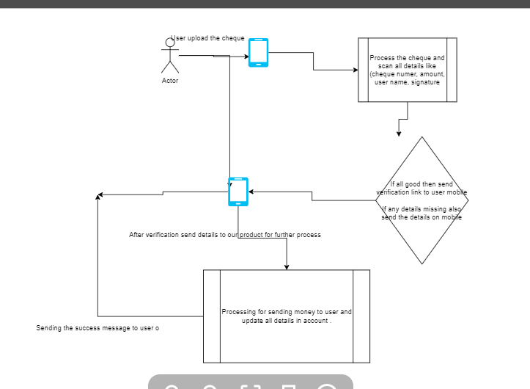
GitHub Repository Link & supporting diagrams, screenshots, if any
How far it can go?

Slide 9
Thank You
Team member names

