Slide 1
Quora : Question Pair Similarity
Final Presentation

Slide 2
TEAM DATA DYNAMOS
Rini Varghese
Shweta Kulkarni
Suraj Honkamble
Uma Naga Silpa Bhupathiraju
Utkarsha A. Narkhede

Slide 3
INTRODUCTION
Quora: Connecting Users with Knowledge
Quora is a popular social network where users seek answers to their questions. It stands out for its:
Vast Knowledge Base: Quora hosts a diverse community of users with expertise in various domains, resulting in a wealth of knowledge.
Quality of Answers: Users receive high-quality responses from experts, professionals, and enthusiasts, ensuring accurate and helpful information.
Engaging Discussions: Quora encourages meaningful conversations and insights by fostering discussions and sharing perspectives.

Slide 4
challenge
“Numerous Similar Questions”
Negative Impact on User Experience
Burden on Writers

Slide 5
Solution: To address these issues, this project aims to develop a model that can accurately classify whether a pair of questions on Quora are duplicates or not. By doing so, we can enhance the user experience by reducing search time, minimizing duplicate questions, and providing more value to Quora's user base.

Slide 6





Workflow
Step 1
Step 2
Step 3
Step 4
Step 5
load the dataset
Data Cleaning And
Exploratory data analysis
Feature engineering and extraction
Model building
Experiment tracking using MLFlow

Slide 7
Load the dataset
In the first step, we import the required libraries and modules that are necessary for our project
Next, we load the dataset that contains the relevant information for our task.
Dataset Description:
Column | information
id | Unique id for each row
qid1 | Question 1 id
qid2 | Question 2 id
question1 | Question 1 content
question2 | Question 2 content
is_duplicate | Question is duplicate or not

Slide 8
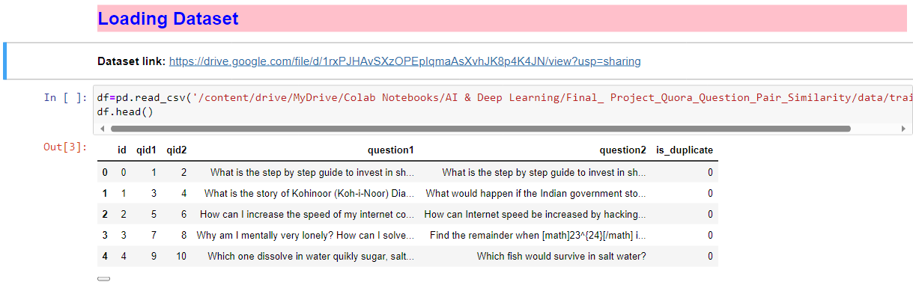
Dataset Snippet

Slide 9
DATA CLEANING
Handle missing values: Totally 3 missing values in dataset. We have huge dataset so we can afford to drop the missing rows.
Remove duplicates: There is no duplicate question pairs or observations in the dataset.

Slide 10
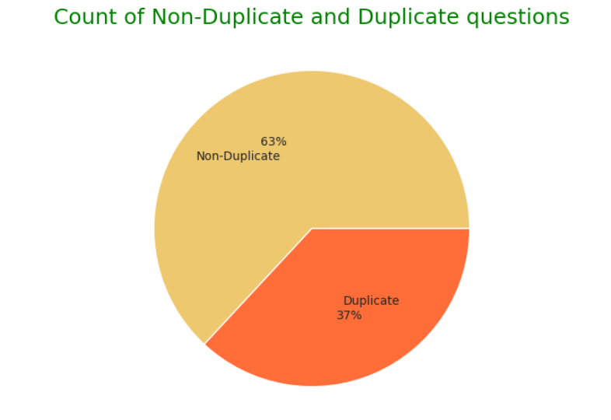
DATA IMBALANCE CHECK
63% Rows belongs to class-0 which is Non-duplicate, and 37% Rows belongs to class-1, which is duplicate.
No strict Data imbalance in this dataset.

Slide 11
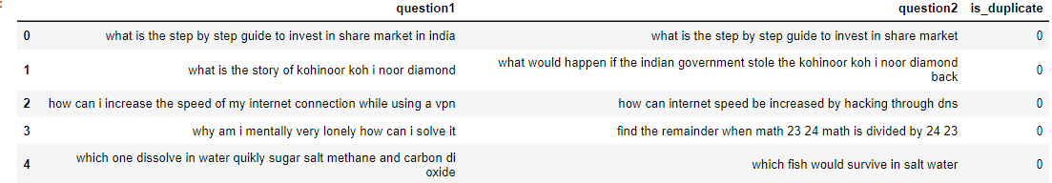
TEXT PREPROCESSING
Lowering text, Removing punctuations, Spelling corrections, Contractions, Removing extra spaces.
We did not removed stopwords and apply stemming or Lemmatization because we needed all content to create sentence vector using BERT.
Dataset having Clean questions :

Slide 12
FEATURE EXTRACTION
In the context of feature extraction from the dataset, it typically refers to extracting additional features or information from the existing data that can be relevant or informative for the machine learning model.
Basic Features
Length Based Features
Token Based Features
Fuzzy Features

Slide 13
FEATURE EXTRACTION
Basic Features
Length Based Features
Token Based Features
Fuzzy Features
Each question length
Number of words in each questions
Total Words in both questions
Common words in both question
Word sharing
Mean length of two questions
Absolute length difference of two questions
Longest substring ratio
First word equal or not
Last word equal or not
Ratio of common token count to max token count among question
Ratio of common token count to min token count among question
Ratio of common stopword count to max stopword count among question
Ratio of common stopword count to min stopword count among question
Ratio of common words to length of the smaller question
Ratio of common words to length of the smaller question
Fuzzy ratio
Fuzzy partial ratio
Fuzzy token sort ratio
Fuzzy token set ratio

Slide 14
EXPLORATORY DATA ANALYSIS
ANALYSIS INVOLVED FOLLOWING THINGS
Similar and Non-Similar question
Target class imbalance check
Extracted features impact on target

Slide 15
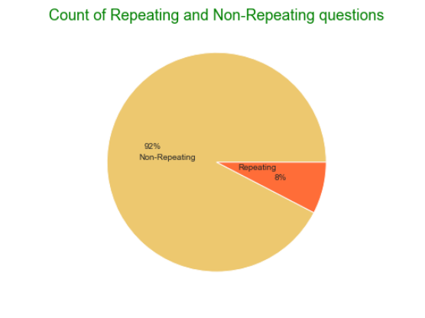
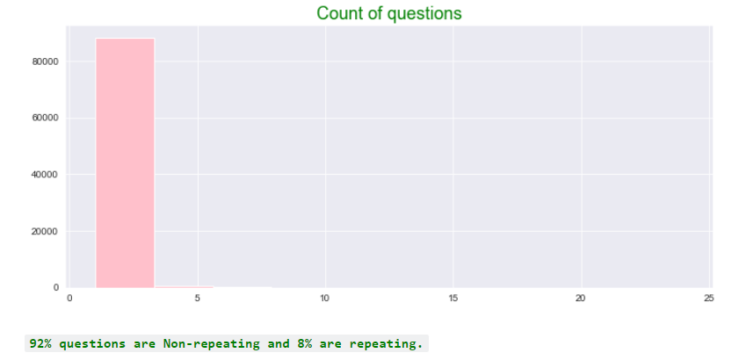
Similar and Non-similar question count Analysis

Slide 16
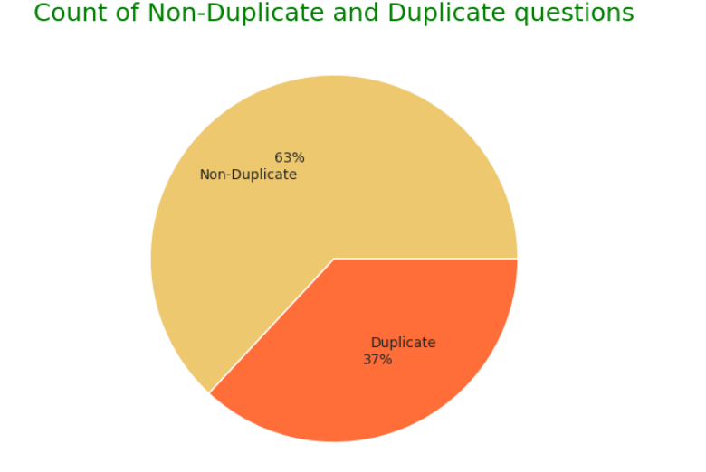
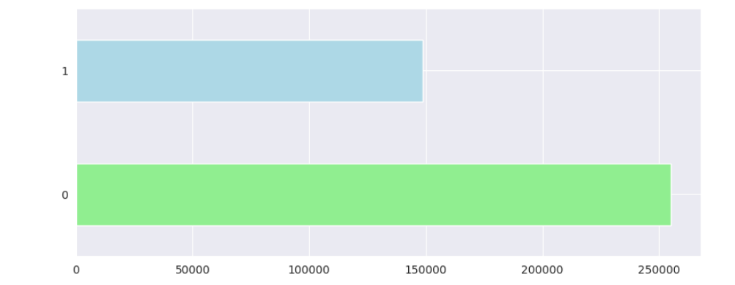
Target class Imbalance analysis

Slide 17
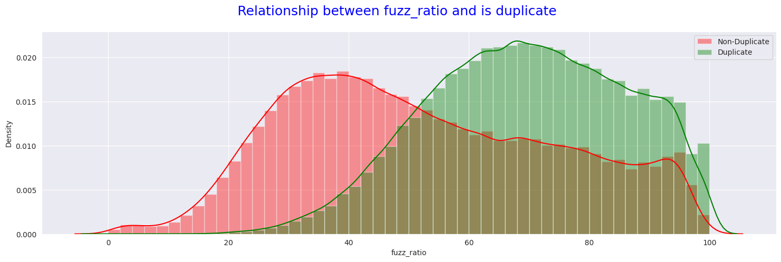
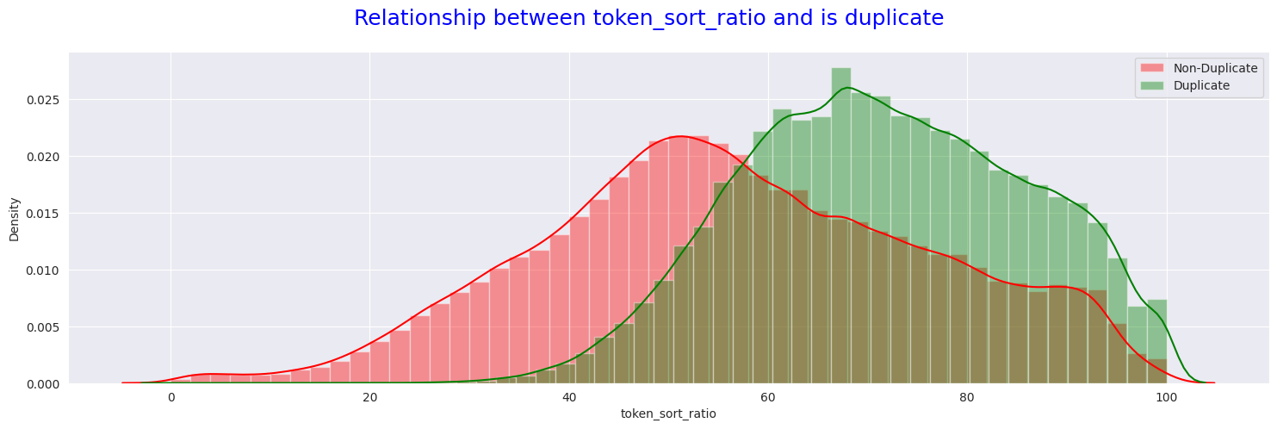
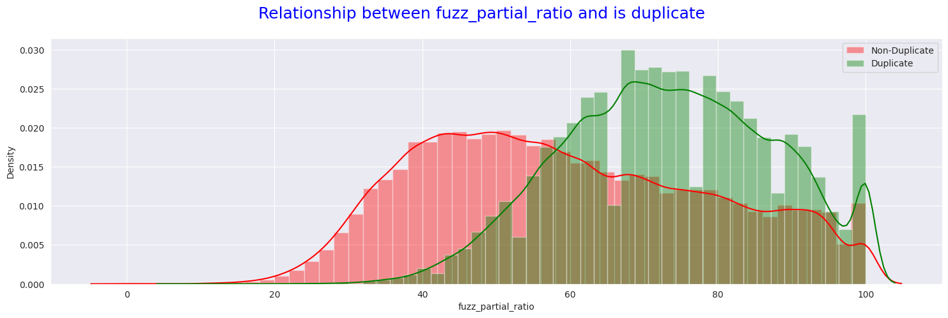
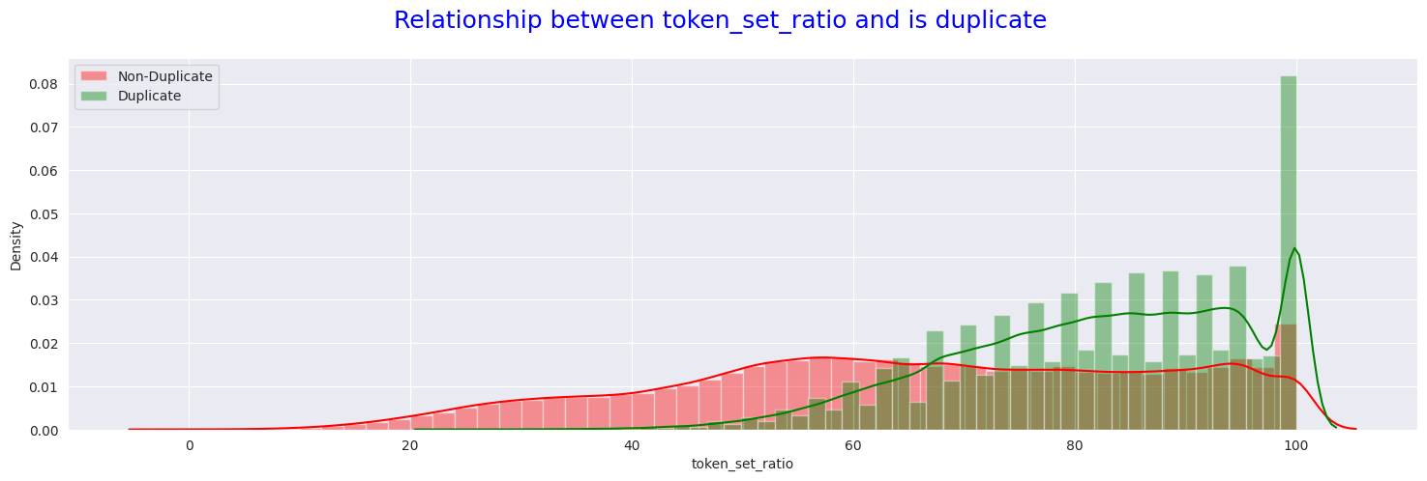
Fuzzy features Impact analysis

Slide 18
Key Finding In EDA: 1. 8% questions are similar, 92% are not similar. 2. 63% rows belongs to class-0 and 37% rows belongs to class-1. 3. From graph we observed that basic features have less impact on target class. 4. Token based and Length based features have significantly less impact on target class. 5. Fuzzy features have significantly high impact on Target.

Slide 19
APPROACHES WE USED: 1. Basic approach with no text preprocessing and using BOW. 2. Basic approach with preprocessed data and using BOW, TFIDF. 3. Advance approach with preprocessing and extracted features and using BOW, TFIDF. 4. Advance approach using own embedding. 5. Advance approach using Pre-trained model, Word2Vec, GloVe and BERT. **Best approach is using BERT so we walk you through this Method.**

Slide 20
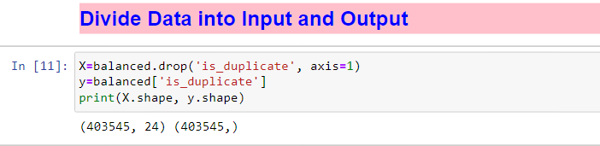
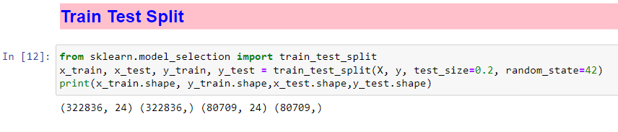
DATA PREPROCESSING FOR MACHINE LEARNING
Dividing Data into Input and Output Features:
Splitting the dataset into training and testing sets:

Slide 21
USING BERT TO CONVERT TEXT TO NUMERICAL VECTOR
About BERT:
BERT is a machine learning model for natural language processing that uses bidirectional transformers to pre-train deep representations from unlabeled text1234. It can be fine-tuned for various language tasks, such as question answering and sentiment analysis, by using additional datasets
Loading BERT:

Slide 22
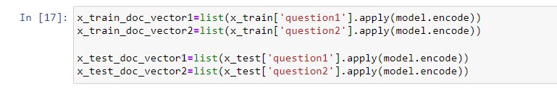
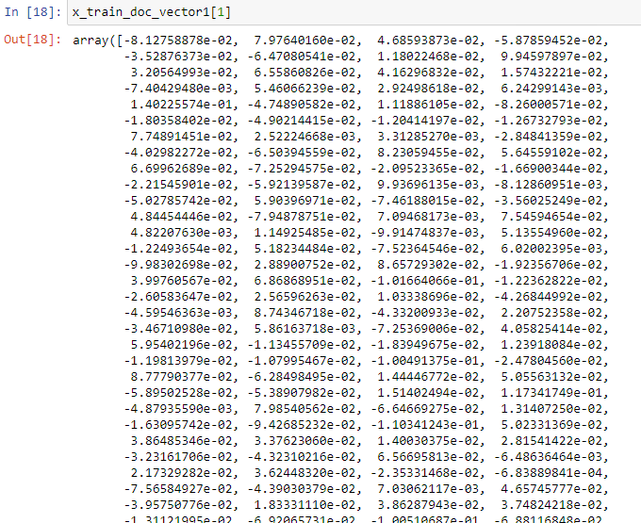
APPLYING VECTORIZATION USING BERT
Vectorizing both question in training and testing set:
Sample Vector:

Slide 23
MODEL BUILDING EXPERIMENT TRACKING
**Here we tracked every experiment while training the model to save time**
Choose a suitable machine learning algorithm or model architecture that is appropriate for your task. For NLP tasks such as text classification or question pair similarity, popular models include RANDOM FOREST AND XGBOOST.
Model Selection
Train your selected model on the training data. This involves feeding the model with input features and their corresponding target labels and optimizing its internal parameters to make accurate predictions.
Model training

Slide 24
METRICS WE USED FOR MODEL EVALUATION
Confusion Matrix:
The confusion matrix provides a breakdown of the predicted and actual labels, helping you identify true positives, true negatives, false positives, and false negatives.
Classification report:
Precision
Recall
F1-score

Slide 25
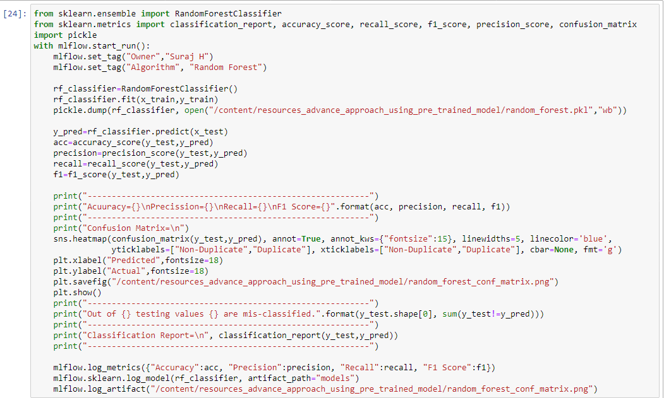
RANDOM FOREST MODEL BUILDING AND EXPERIMENT TRACKING

Slide 26
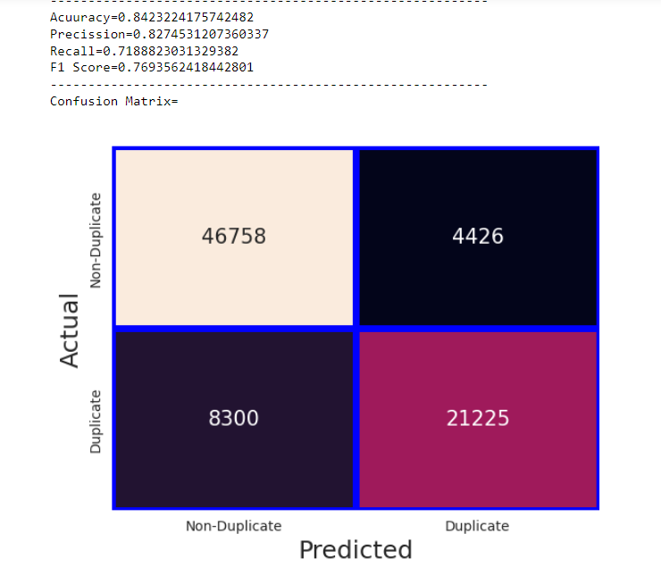
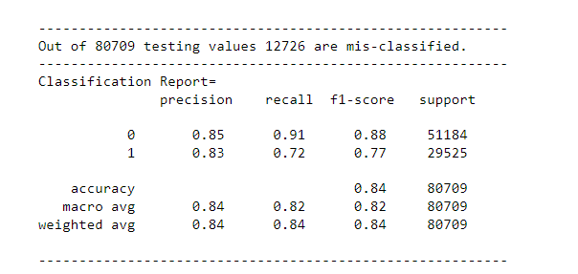
RANDOM FOREST MODEL EVALUATION

Slide 27
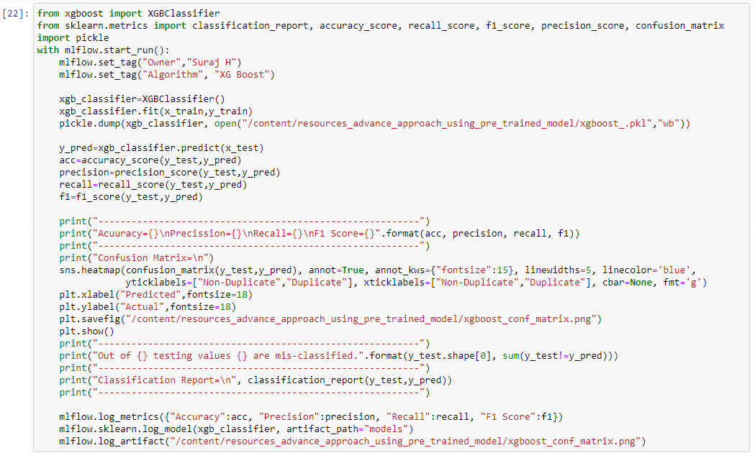
XGBOOST MODEL BUILDING AND EXPERIMENT TRACKING

Slide 28
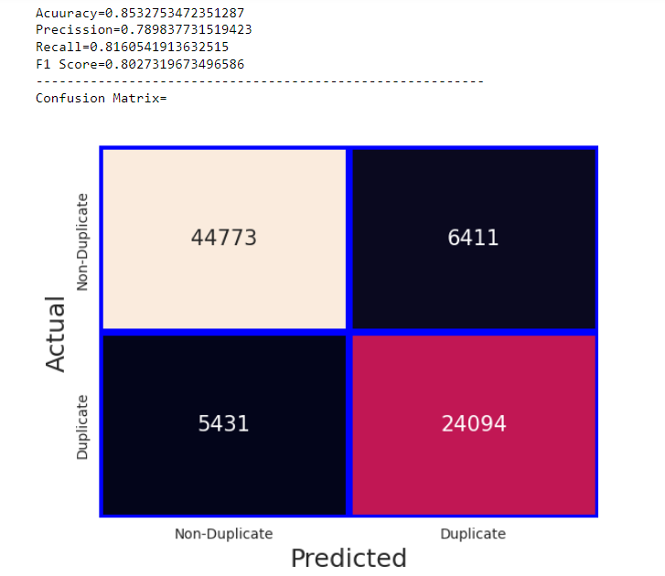
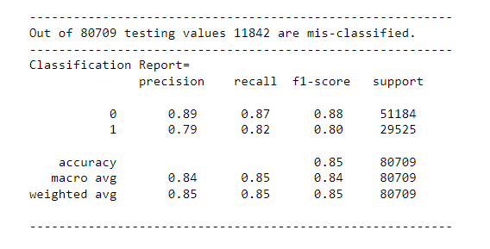
XGBOOST MODEL EVALUATION

Slide 29
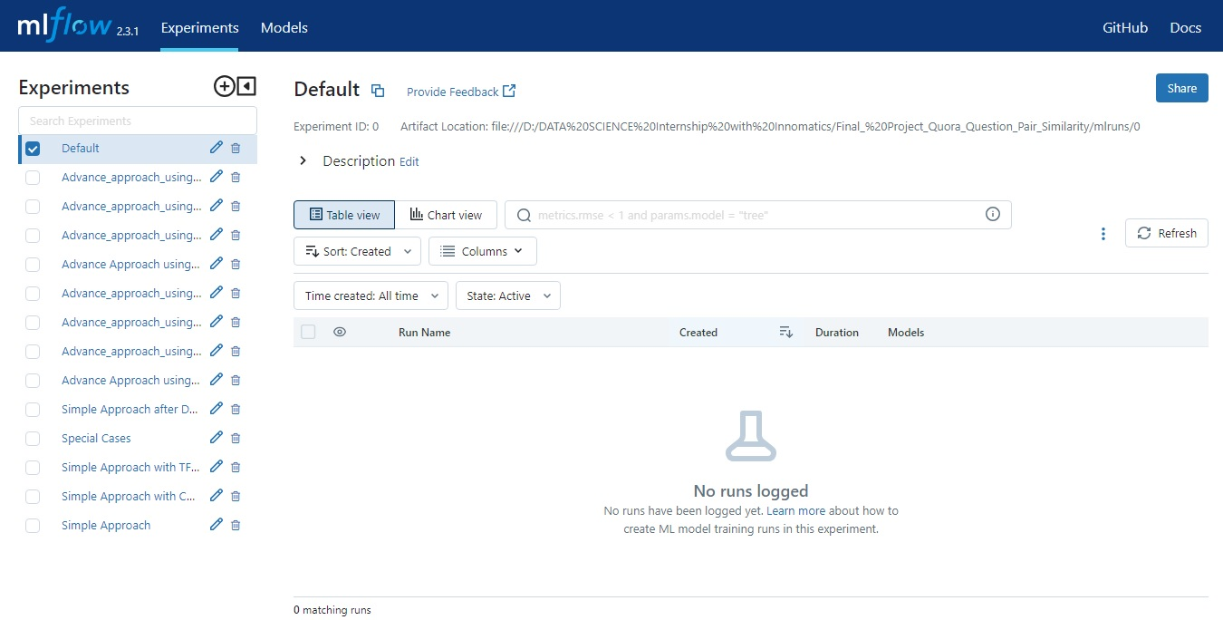
EXPERIMENT TRACKING USING MLFLOW- ALL EXPERIMENTS
Need: storing, managing and monitoring machine learning life cycle such model training, hyperparameters, evaluation of model using different evaluation matrix, and also for model registry to productionize best model.
Parameters: 1. Experiment Tags 2. Hyperparameters of algorithm 3. Artifacts 4. Matrices 5. Logging of Model

Slide 30
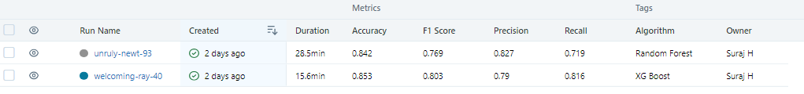
MLFLOW UI BEST EXPERIMENTS
BEST EXPERIMENTS: Using BERT as a text to numeric vector conversion technique and XGBoost as a Machine Leaning classification model we received 86% accuracy with 88% f1 score for class-0 and 80% f1 score for class-1.

Slide 31
Challenges faced
1. Main Challenge we faced is the type of data. Working with textual data is bit difficult.
2. Class imbalance in the dataset.
3. Selecting Best Vectorization technique. Hence we tried all possible vectorization techniques.
4. Handling Vector in BOW and TFIDF. Vectors created by these two vectorization techniques are dense with high dimension.

Slide 32
What we might have tried?
1. We would have been extracted more advance feature which might improve our model performance.
2. We should have been tried Deep Learning Techniques like RNN, LSTM.
3. As our data consist two questions, Siamese Network will be the best suited model.

Slide 33
THANK YOU

