Slide 1

HEALTHCARE
ANALYTICS
Executive Dashboard | Power BI & DAX
Patient activity • Appointment performance • Operational efficiency
Project presentation | Soumya Roy

Slide 2
Executive summary
A single-page overview of healthcare performance and service delivery.
Monitor patient and appointment activity at a glance
Compare current-month performance against the previous month
Explore department, gender, diagnosis and operational patterns
Use interactive slicers for targeted analysis
HEALTHCARE ANALYTICS • EXECUTIVE DASHBOARD
02

Slide 3
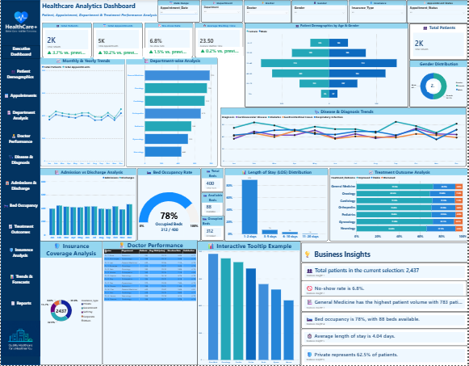
Executive dashboard — report view
Screenshot from the provided Power BI report.
HEALTHCARE ANALYTICS • EXECUTIVE DASHBOARD
03

Slide 4
Four headline KPIs
Values visible in the supplied dashboard screenshot; filter-dependent in Power BI.
TOTAL PATIENTS
TOTAL APPOINTMENTS
2K
5K
Patient volume
Appointment volume
NO-SHOW RATE
AVERAGE WAITING TIME
6.8%
23.50
Attendance performance
Waiting-time indicator
HEALTHCARE ANALYTICS • EXECUTIVE DASHBOARD
04

Slide 5
Analytical workflow
From healthcare records to an interactive executive report.
01
02
03
04
Data preparation
Data model
DAX measures
Visualization
Power Query cleaning and type validation
Healthcare records and date dimension
Core KPIs and monthly trend calculations
Cards, charts, slicers and comparisons
HEALTHCARE ANALYTICS • EXECUTIVE DASHBOARD
05

Slide 6
Month-over-month DAX logic
All four trend measures share a consistent time-intelligence pattern.
VAR CurrentMonthValue = [Base KPI]
VAR PrevMonthValue =
CALCULATE(
[Base KPI],
DATEADD('Date_Table'[Date], -1, MONTH)
)
VAR ChangePercent =
DIVIDE(CurrentMonthValue - PrevMonthValue, PrevMonthValue)
Monthly change (%) = (current − previous) / previous × 100
HEALTHCARE ANALYTICS • EXECUTIVE DASHBOARD
06

Slide 7
Patient growth
Underlying KPI: [Total Patients] • Increase = growth
VAR CurrentMonthValue = [Total Patients]
VAR PrevMonthValue =
CALCULATE(
[Total Patients],
DATEADD('Date_Table'[Date], -1, MONTH)
)
VAR ChangePercent =
DIVIDE(CurrentMonthValue - PrevMonthValue, PrevMonthValue)
RETURN
FORMAT(ABS(ChangePercent), "0.0%")
Final dashboard measure also adds ▲ / ▼ and “vs. previous month”.
HEALTHCARE ANALYTICS • EXECUTIVE DASHBOARD
07

Slide 8
Appointment growth
Underlying KPI: [Total Appointments] • Increase = more appointments
VAR CurrentMonthValue = [Total Appointments]
VAR PrevMonthValue =
CALCULATE(
[Total Appointments],
DATEADD('Date_Table'[Date], -1, MONTH)
)
VAR ChangePercent =
DIVIDE(CurrentMonthValue - PrevMonthValue, PrevMonthValue)
RETURN
FORMAT(ABS(ChangePercent), "0.0%")
Final dashboard measure also adds ▲ / ▼ and “vs. previous month”.
HEALTHCARE ANALYTICS • EXECUTIVE DASHBOARD
08

Slide 9
No-show rate change
Underlying KPI: [No-show Rate] • Decrease = favorable
VAR CurrentMonthValue = [No-show Rate]
VAR PrevMonthValue =
CALCULATE(
[No-show Rate],
DATEADD('Date_Table'[Date], -1, MONTH)
)
VAR ChangePercent =
DIVIDE(CurrentMonthValue - PrevMonthValue, PrevMonthValue)
RETURN
FORMAT(ABS(ChangePercent), "0.0%")
Final dashboard measure also adds ▲ / ▼ and “vs. previous month”.
HEALTHCARE ANALYTICS • EXECUTIVE DASHBOARD
09

Slide 10
Waiting-time change
Underlying KPI: [Average Waiting Time] • Decrease = favorable
VAR CurrentMonthValue = [Average Waiting Time]
VAR PrevMonthValue =
CALCULATE(
[Average Waiting Time],
DATEADD('Date_Table'[Date], -1, MONTH)
)
VAR ChangePercent =
DIVIDE(CurrentMonthValue - PrevMonthValue, PrevMonthValue)
RETURN
FORMAT(ABS(ChangePercent), "0.0%")
Final dashboard measure also adds ▲ / ▼ and “vs. previous month”.
HEALTHCARE ANALYTICS • EXECUTIVE DASHBOARD
10

Slide 11
Executive visualizations
Different views reveal complementary aspects of healthcare operations.
Monthly & yearly patient / appointment trends
Department-wise patient volume comparisons
Gender distribution and demographic breakdowns
Diagnosis-based appointment analysis
Admissions, discharges and hospital capacity indicators
HEALTHCARE ANALYTICS • EXECUTIVE DASHBOARD
11

Slide 12
Interactive exploration
Report slicers help narrow the analysis without changing the underlying measures.
Appointment date
Department
Compare selected periods
Focus on a clinical unit
Doctor
Other filters
Explore provider-level context
Gender, status and insurance
HEALTHCARE ANALYTICS • EXECUTIVE DASHBOARD
12

Slide 13
Interpretation & validation
Good dashboard documentation distinguishes calculation logic from business meaning.
A positive patient trend indicates growth, not automatically better care
Lower no-show rates and shorter waits are generally favorable
Relative percent change differs from percentage-point change
Date-table continuity, relationships and filter context affect results
Existing base-measure DAX should be verified before publishing as source
HEALTHCARE ANALYTICS • EXECUTIVE DASHBOARD
13

Slide 14
THANK YOU
Healthcare Analytics | Executive Dashboard
Power BI • DAX • Data modeling • Business intelligence
Soumya Roy

