Slide 1



Blood Bank Management System
Group No:85
Submitted By:
Mr. Suraj Patil
Mr. Prathamesh Mali
Submitted to:
Mrs. Sonali Mogal
Mrs. Shraddha Salunkhe

Slide 2
Key Points
Introduction
Aims and objectives
Software requirements
Context free diagram
Steps for application usage
User and Admin Components

Slide 3
Introduction
Blood Bank Management System is designed for the blood bank to gather blood from various sources and distribute it to the needy people you have requirements for it.
The software is designed to handle the daily transactions of the blood bank and search the details when required.
It also helps to register the details of donors, blood collection details as well as blood issue reports.
The software application is designed in such a manner that it can suit the needs of all the blood bank requirements in the course of future.

Slide 4
Aims and objectives
The main aim of this project is to save the lives of people by providing blood. We aim to bridge the gap between blood donors and requestors. We’ll be displaying the Donor. The major problem in old blood banking systems was that they don’t follow the actual needs of users. Traditional blood banking system were developed by a 1 or 2 perspectives. This application is providing each entity the facility to approach nearby blood donors so that it will become much easier to search rare blood groups in the hour of need.

Slide 5
Software Requirements
Project Name | Blood Bank Management System
Language Used | Java (Spring Boot)
Database | MySQL 8.0
User Interface Design | React (18), JavaScript, NodeJS
Web Browser | Google Chrome, Mozilla
Software | Spring Tool Suite

Slide 6
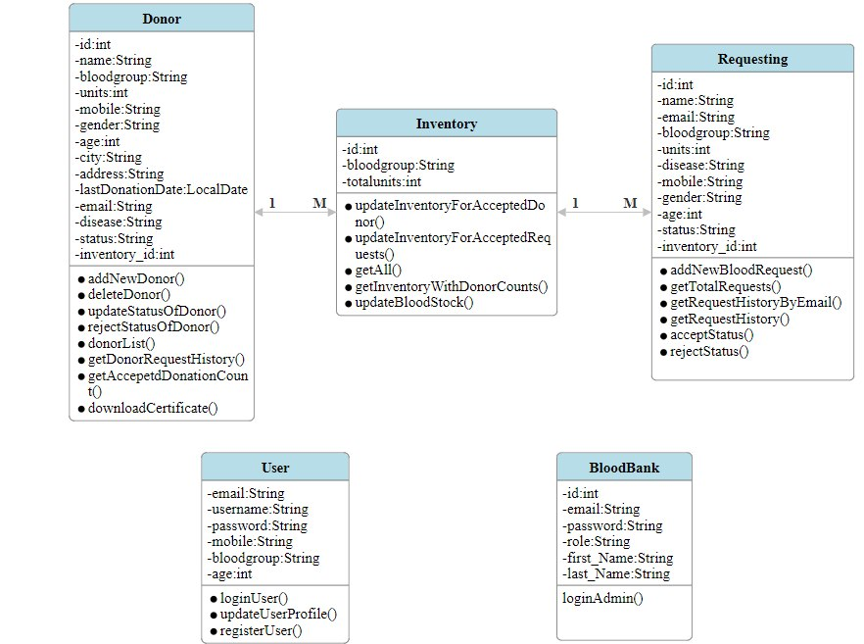
Class Diagram

Slide 7
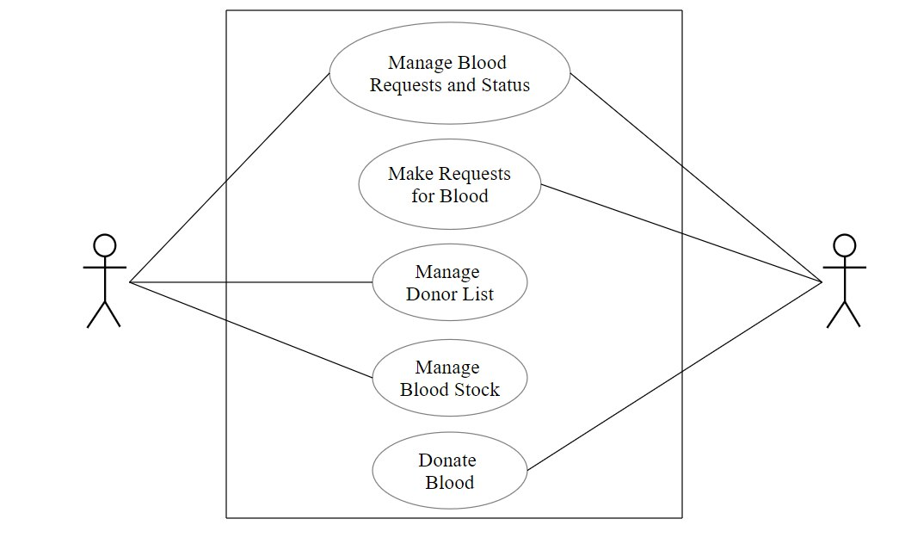
Use Case Diagram:

Slide 8
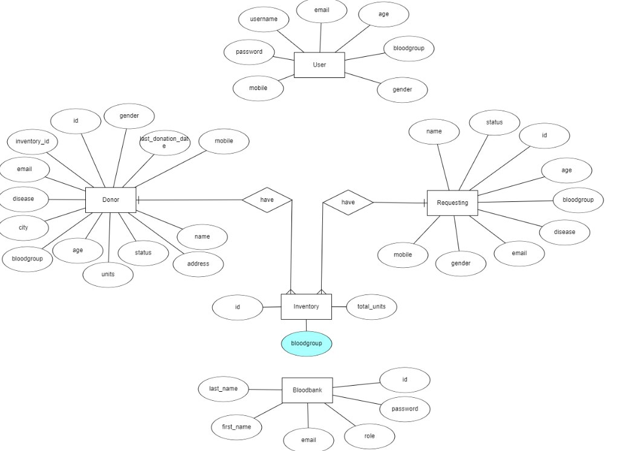
E-R Diagram

Slide 9
Steps for application usage:
Register as new user/donor if not registered.
Login with username and password.
User dashboard will open.
Make request for the specific blood group’s blood if available.
Blood group available or not can be checked on the user’s dashboard.
See his/her blood request status as accepted/rejected by the Admin.
Make blood donation request by filling the form.
Lastly, admin handles all the functionalities by admin login to the admin’s dashboard and accepting/rejecting the receiver’s or donor’s requests.

Slide 10
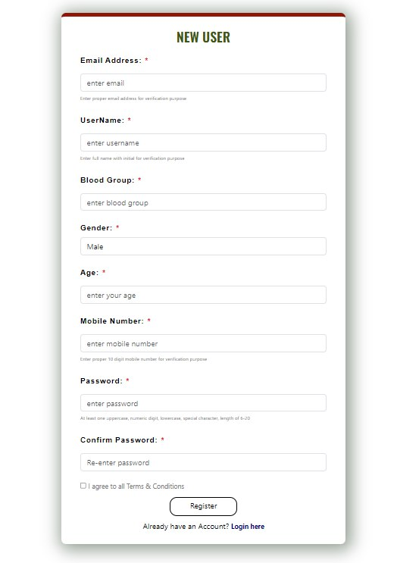
Registration Form

Slide 11
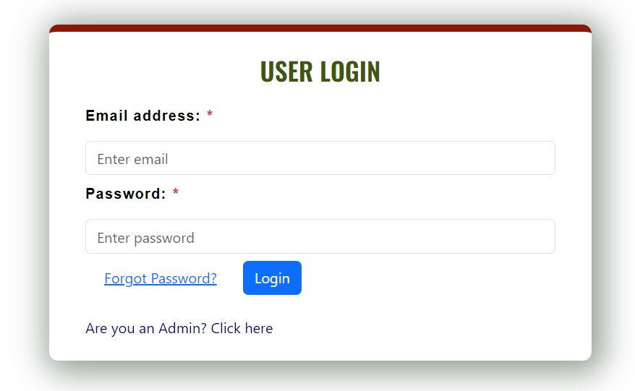
User Login

Slide 12
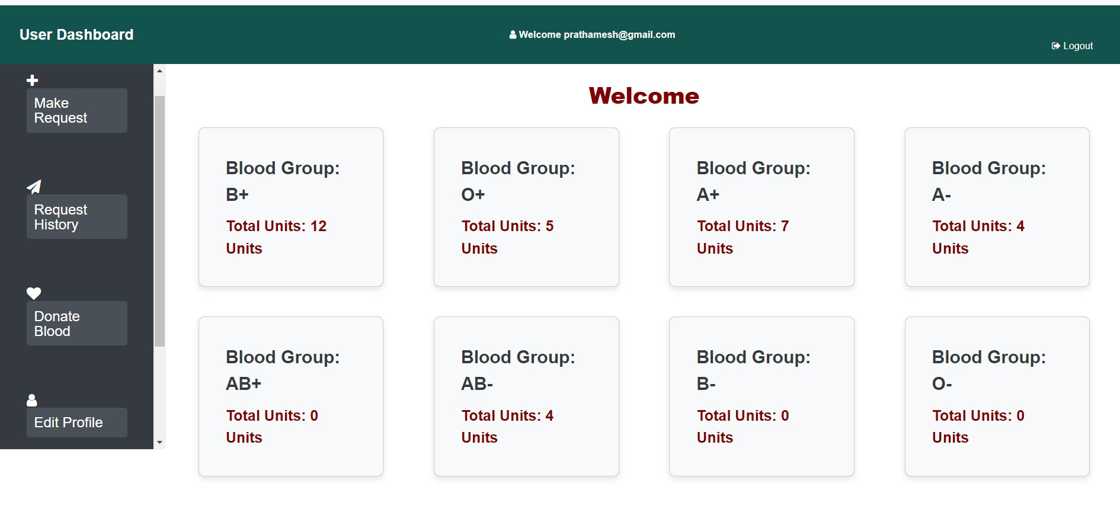
User Dashboards

Slide 13
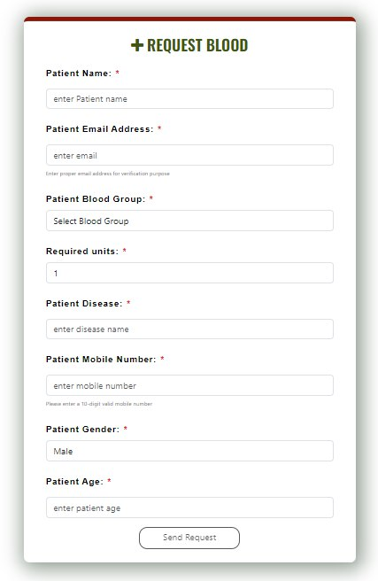
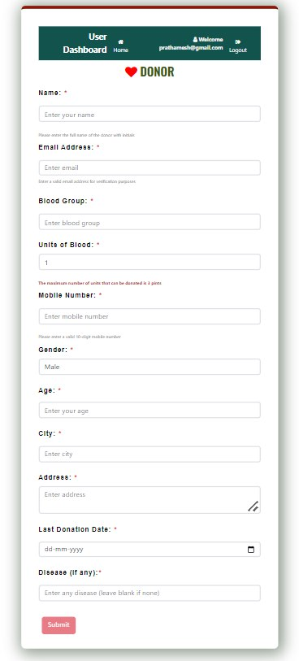
Blood Request From User/ Donor’s Request For Donation

Slide 14
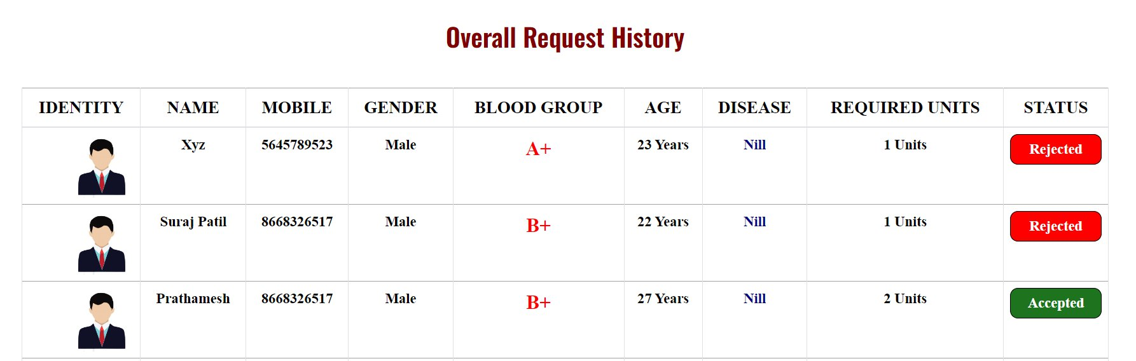
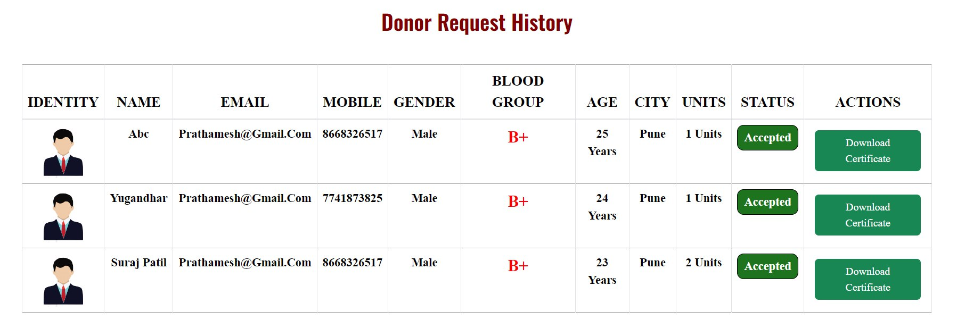
User’s Request History/ Donor’s Request History

Slide 15
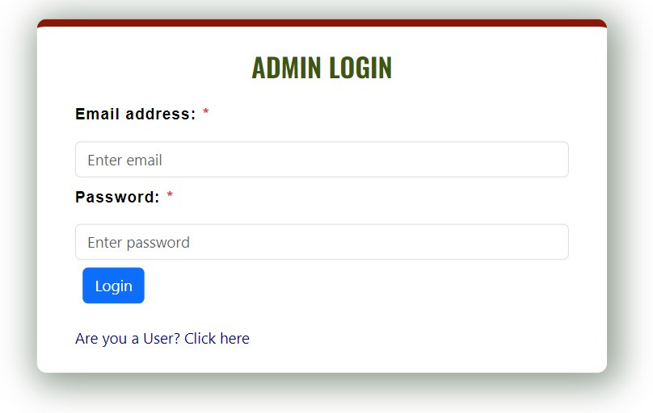
Admin Login

Slide 16
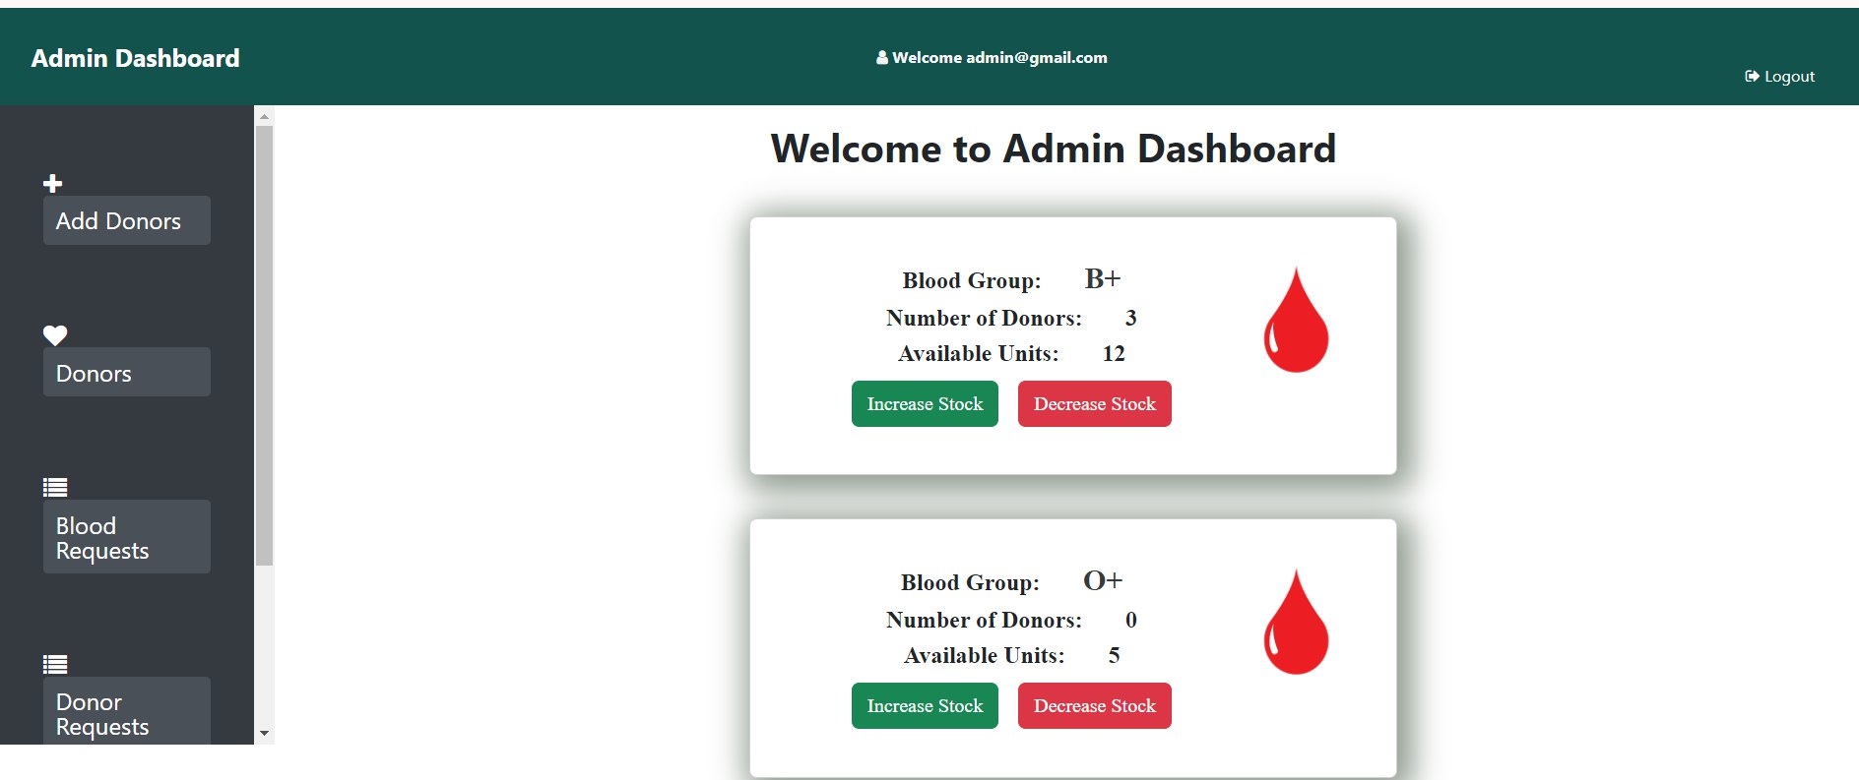
Admin Dashboard

Slide 17
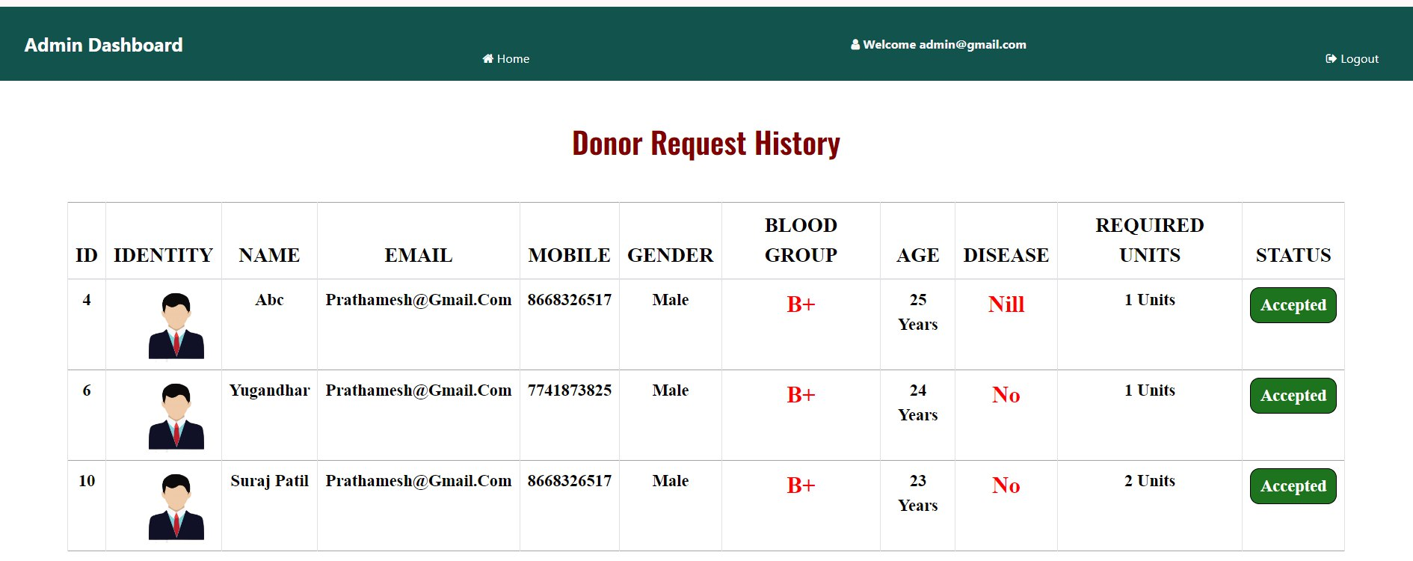
Receiver’s/Donor’s Acceptance

Slide 18
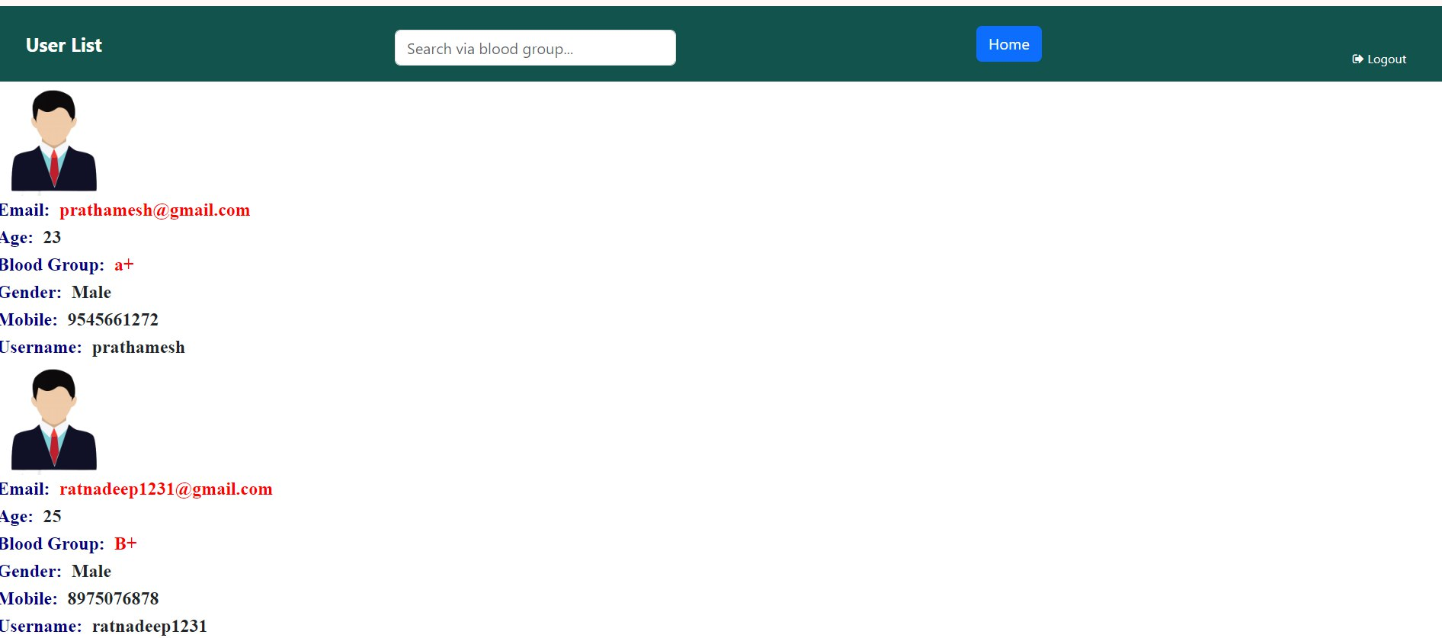
User’s List

Slide 19
Compatibility of project:
In this, receiver identify donor’s blood type as A, B, AB, O and the type positive or negative.
All the donated blood is tested for infections such as HIV/any disease if any. The blood is usually discarded if any of these tests are positive.
Before transfusion, compatibility testing between donor’s and receiver’s/patients blood must be done.
Firstly, the testing is done to determine the blood type of patients and performed cross matching test to identify compatible blood components for blood transfusions.

Slide 20
Conclusion
As the donor’s data is saved in the system, we can reject those who have HIV/any other infections.
As we have the contact details of the donor, we can contact donor whenever requirement comes.
Since we have the expiry date validation for the packs i.e blood samples older than 90 days aren’t valid, we can have proper storage management system.

