Slide 1
Processes
What is Process?
In computing, a process is the instance of a computer program that is being executed by one or many threads.

Slide 2
Preemptive Processes
What is Preemptive Process?
Preemption is the act of temporarily interrupting an executing task, with the intention of resuming it at a later time.
Process which can hold execution

Slide 3
Non - Preemptive Processes
What is Non - Preemptive Process?
Doesn’t support Preemption
Once the CPU is allocated, it will get completed and then only it will free the CPU.

Slide 4
Process Concept
An operating system executes a variety of programs:
Batch system – jobs
Time-shared systems – user programs or tasks
Textbook uses the terms job and process almost interchangeably.
Process – a program in execution; process execution must progress in sequential fashion.
A process includes:
program counter
stack
data section

Slide 5
Process State
As a process executes, it changes state
new: The process is being created.
running: Instructions are being executed.
waiting: The process is waiting for some event to occur.
ready: The process is waiting to be assigned to a processor.
terminated: The process has finished execution.

Slide 6
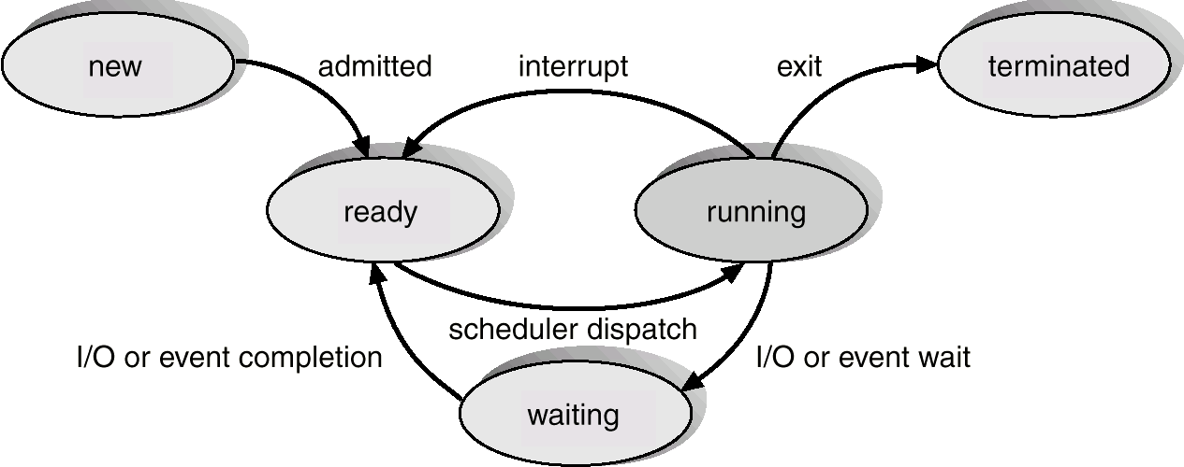
Diagram of Process State

Slide 7
Process Control Block (PCB)
Information associated with each process.
Process state
Program counter
CPU registers
CPU scheduling information
Memory-management information
Accounting information
I/O status information

Slide 8
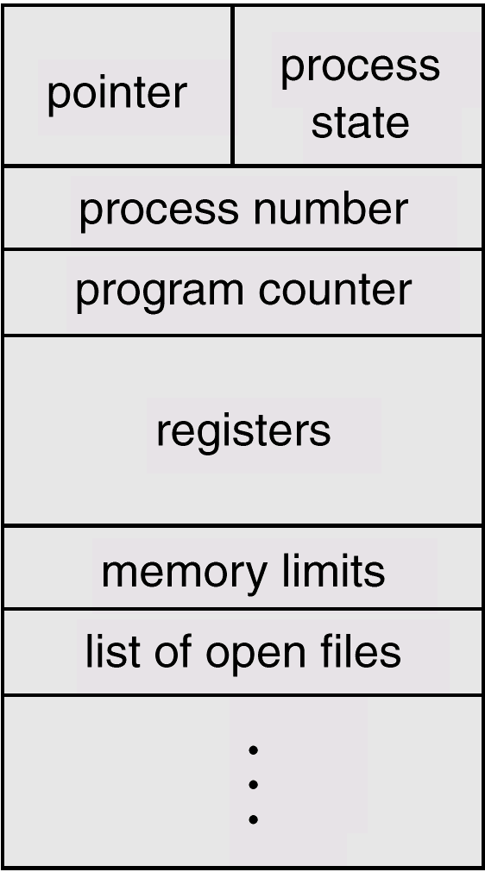
Process Control Block (PCB)

Slide 9
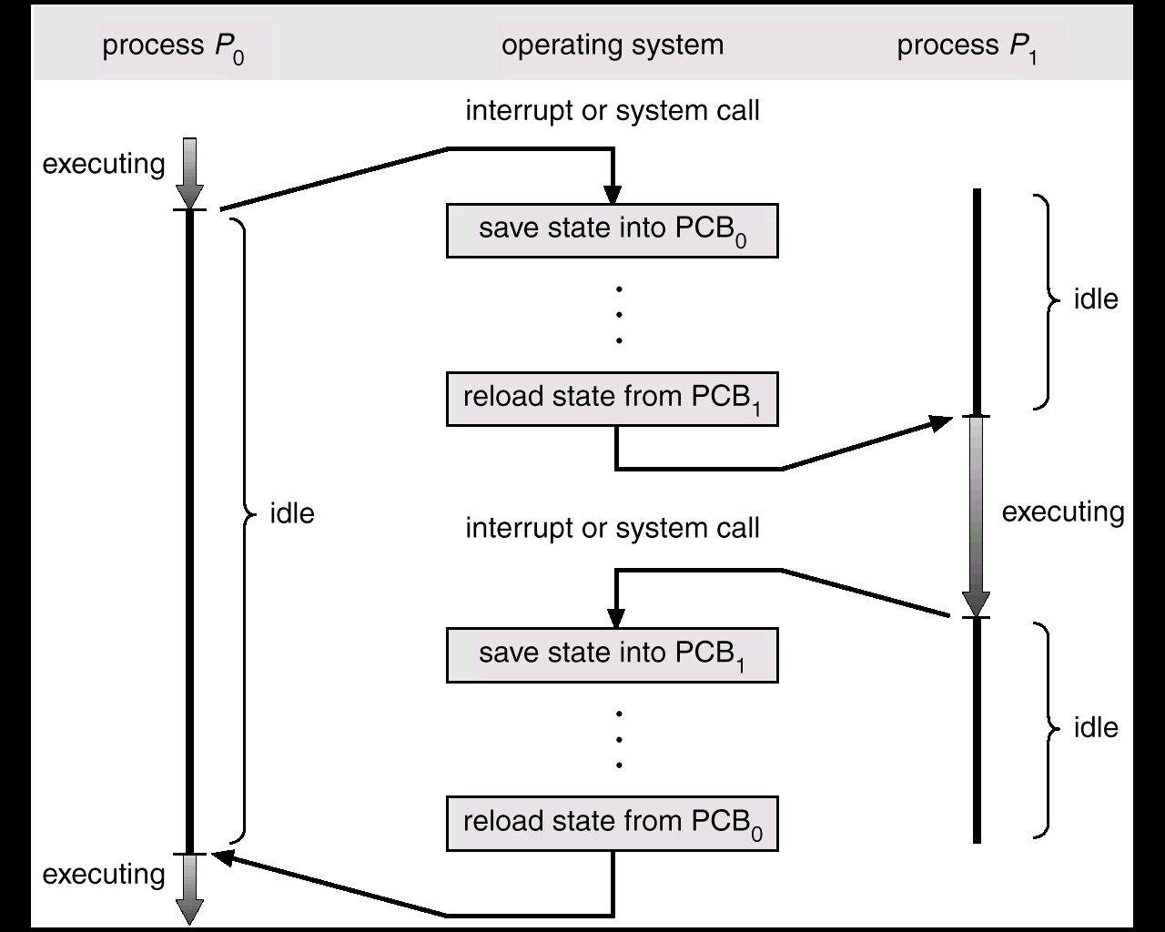
CPU Switch From Process to Process

Slide 10
Context Switch
When CPU switches to another process, the system must save the state of the old process and load the saved state for the new process.
Context-switch time is overhead; the system does no useful work while switching.
Time dependent on hardware support.

Slide 11
Process Scheduling Queues
Job queue – set of all processes in the system.
Ready queue – set of all processes residing in main memory, ready and waiting to execute.
Device queues – set of processes waiting for an I/O device.
Process migration between the various queues.

Slide 12
Schedulers
Long-term scheduler (or job scheduler) – selects which processes should be brought into the ready queue.
Short-term scheduler (or CPU scheduler) – selects which process should be executed next and allocates CPU.

Slide 13
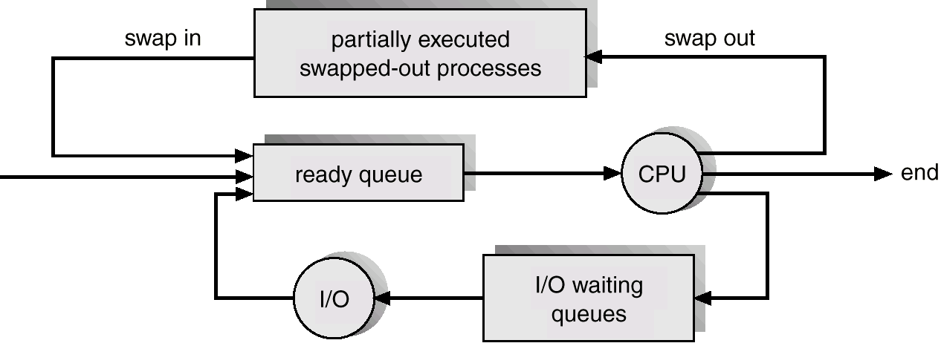
Addition of Medium Term Scheduling

Slide 14
Schedulers (Cont.)
Short-term scheduler is invoked very frequently (milliseconds) ⇒ (must be fast).
Long-term scheduler is invoked very infrequently (seconds, minutes) ⇒ (may be slow).
The long-term scheduler controls the degree of multiprogramming.
Processes can be described as either:
I/O-bound process – spends more time doing I/O than computations, many short CPU bursts.
CPU-bound process – spends more time doing computations; few very long CPU bursts.

Slide 15
Scheduling Criteria
CPU utilization – keep the CPU as busy as possible
Throughput – # of processes that complete their execution per time unit
Turnaround time – amount of time to execute a particular process
Waiting time – amount of time a process has been waiting in the ready queue
Response time – amount of time it takes from when a request was submitted until the first response is produced, not output (for time-sharing environment)

Slide 16
Scheduling Algorithm Optimization Criteria
Max CPU utilization
Max throughput
Min turnaround time
Min waiting time
Min response time

Slide 17
First- Come, First-Served (FCFS) Scheduling
Process Burst Time
P₁ 24
P₂ 3
P₃ 3
Suppose that the processes arrive in the order: P₁ , P₂ , P₃ The Gantt Chart for the schedule is:
Waiting time for P₁ = 0; P₂ = 24; P₃ = 27
Average waiting time: (0 + 24 + 27)/3 = 17

Slide 18
FCFS Scheduling (Cont.)
Suppose that the processes arrive in the order:
P₂ , P₃ , P₁
The Gantt chart for the schedule is:
Waiting time for P₁ = 6; P₂ = 0; P₃ = 3
Average waiting time: (6 + 0 + 3)/3 = 3
Much better than previous case
Convoy effect - short process behind long process
Consider one CPU-bound and many I/O-bound processes

Slide 19
Shortest-Job-First (SJF) Scheduling
Associate with each process the length of its next CPU burst
Use these lengths to schedule the process with the shortest time
SJF is optimal – gives minimum average waiting time for a given set of processes
The difficulty is knowing the length of the next CPU request
Could ask the user

Slide 20
Example of SJF
ProcessArriva l Time Burst Time
P₁ 0.0 6
P₂ 2.0 8
P₃ 4.0 7
P₄ 5.0 3
SJF scheduling chart
Average waiting time = (3 + 16 + 9 + 0) / 4 = 7

Slide 21
Example of Shortest-remaining-time-first
Now we add the concepts of varying arrival times and preemption to the analysis
ProcessA arri Arrival TimeT Burst Time
P₁ 0 8
P₂ 1 4
P₃ 2 9
P₄ 3 5
Preemptive SJF Gantt Chart
Average waiting time = [(10-1)+(1-1)+(17-2)+5-3)]/4 = 26/4 = 6.5 msec

Slide 22
Priority Scheduling
A priority number (integer) is associated with each process
The CPU is allocated to the process with the highest priority (smallest integer ≡ highest priority)
Preemptive
Nonpreemptive
SJF is priority scheduling where priority is the inverse of predicted next CPU burst time
Problem ≡ Starvation – low priority processes may never execute
Solution ≡ Aging – as time progresses increase the priority of the process

Slide 23
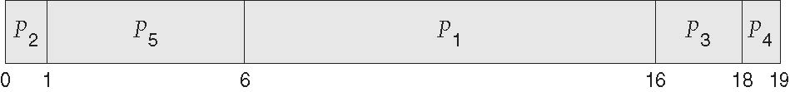
Example of Priority Scheduling
ProcessA arri Burst TimeT Priority
P₁ 10 3
P₂ 1 1
P₃ 2 4
P₄ 1 5
P₅ 5 2
Priority scheduling Gantt Chart
Average waiting time = 8.2 msec

Slide 24
Round Robin (RR)
Each process gets a small unit of CPU time (time quantum q), usually 10-100 milliseconds. After this time has elapsed, the process is preempted and added to the end of the ready queue.
If there are n processes in the ready queue and the time quantum is q, then each process gets 1/n of the CPU time in chunks of at most q time units at once. No process waits more than (n-1)q time units.
Timer interrupts every quantum to schedule next process
Performance
q large ⇒ FIFO
q small ⇒ q must be large with respect to context switch, otherwise overhead is too high

Slide 25
Example of RR with Time Quantum = 4
Process Burst Time
P₁ 24
P₂ 3
P₃ 3
The Gantt chart is:
Typically, higher average turnaround than SJF, but better response
q should be large compared to context switch time
q usually 10ms to 100ms, context switch < 10 usec

Slide 26
Process Creation
Parent process creates children processes, which, in turn create other processes, forming a tree of processes.
Resource sharing
Parent and children share all resources.
Children share subset of parent’s resources.
Parent and child share no resources.
Execution
Parent and children execute concurrently.
Parent waits until children terminate.

Slide 27
Process Creation (Cont.)
Address space
Child duplicate of parent.
Child has a program loaded into it.
UNIX examples
fork system call creates new process

Slide 28
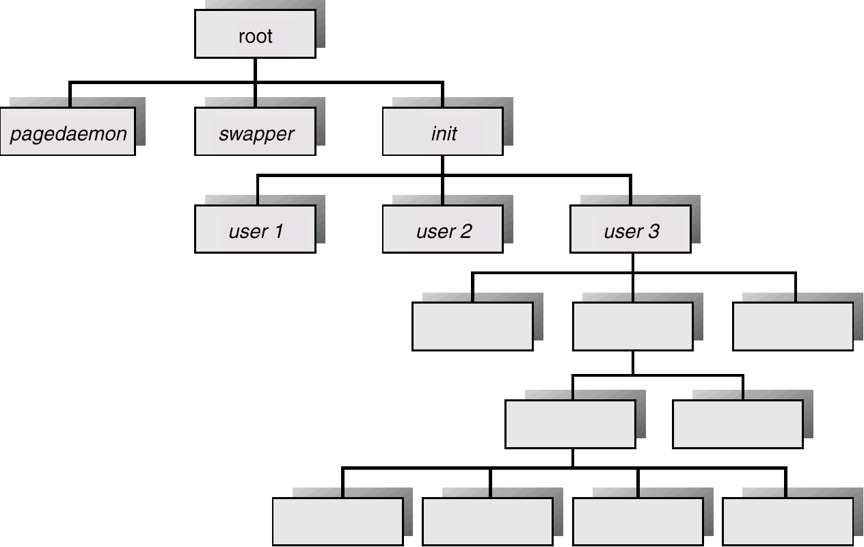
A Tree of Processes On A Typical UNIX System

Slide 29
Process Termination
Process executes last statement and asks the operating system to decide it (exit).
Output data from child to parent (via wait).
Process’ resources are deallocated by operating system.
Parent may terminate execution of children processes (abort).
Child has exceeded allocated resources.
Task assigned to child is no longer required.
Parent is exiting.
Operating system does not allow child to continue if its parent terminates.

