Slide 1
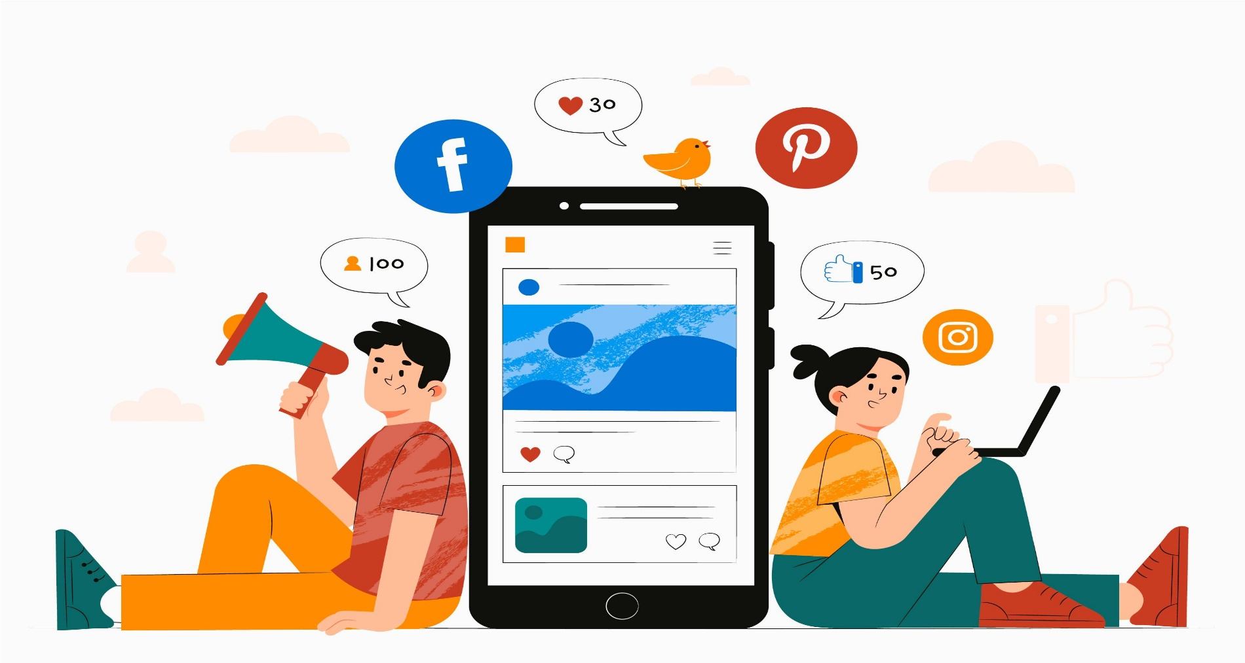
SOCIAL MEDIA ANALYSIS
Submitted By: Suraj Jaiswal

Slide 2






AGENDA
Problem Statement
Data Description
Database Schema
Key Metrics and Visualization
Targeted marketing strategies
Conclusions

Slide 3

PROBLEM STATEMENT
You are hired as a data analyst at Meta and asked to collaborate with the Marketing team. Marketing teams want to leverage Instagram's user data to develop targeted marketing strategies that will increase user engagement, retention, and acquisition. Provide insights and recommendations to address the following objectives.

Slide 4
DATA DESCRIPTION
The dataset contain information about 7 tables. Below is an overview of the dataset.
Users Table : Information about users on the platform.
Photo Table : Information about the photos uploaded by users.
Comments Table : Stores all comments made by users on photos.
Likes Tables : Tracks which users liked which photos.
Follows Table : Track users relationships (followers and followees).
Tags Table : Stores unique tags that are associated with photos.
Photo Tags Table : Connect photos with tags.
comments_id : unique identifier for each comment
comment_text : text content of a given comment
user_id : unique identifier for each user
photo_id : unique identifier for each photo
created_at : date of interaction in the form like, photos, tags
follower_id : user_id of the follower for a certain user
followee_id : user_id of followee for a certain user
tag_id : unique identifier for each tag
image_url : link to the image posted on the platform
username : username chosen by the user

Slide 5
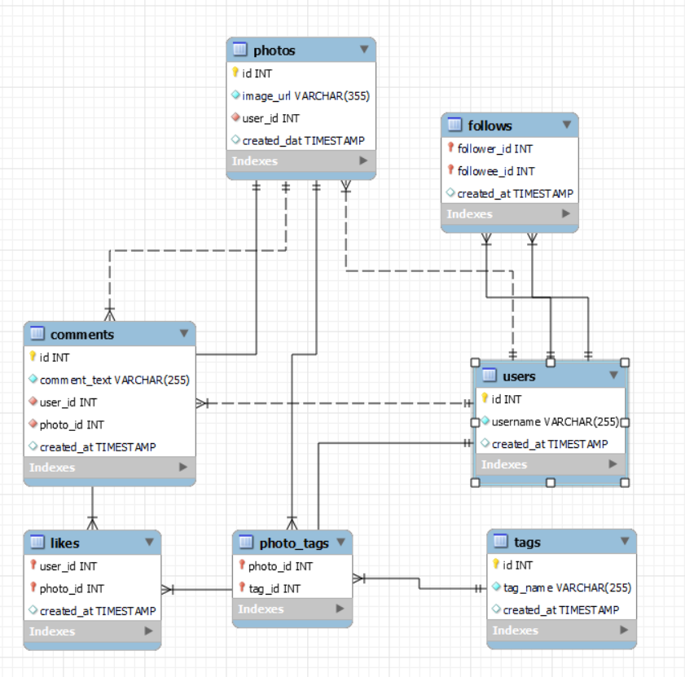
DATABASE SCHEMA

Slide 6
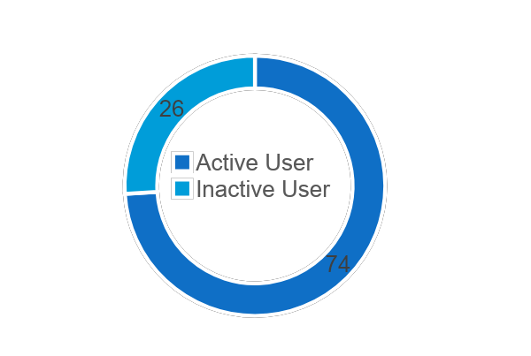
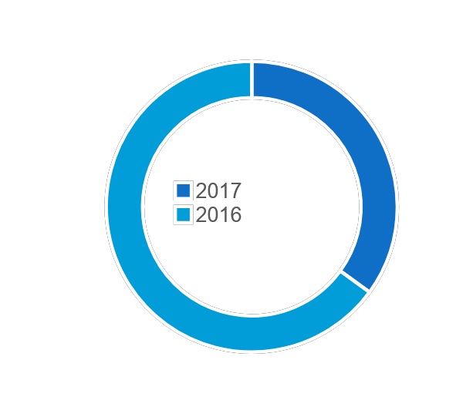
KEY METRICS AND VISUALIZATION
USERS
Activity Wise
Inactive Users: 26
Active Users: 74
The 26 inactive users highlight a potential retention issue.
Joining Year Wise
2016: 65
2017: 35
The drop in new users in 2017, the priority should be on
boosting user acquisition.

Slide 7
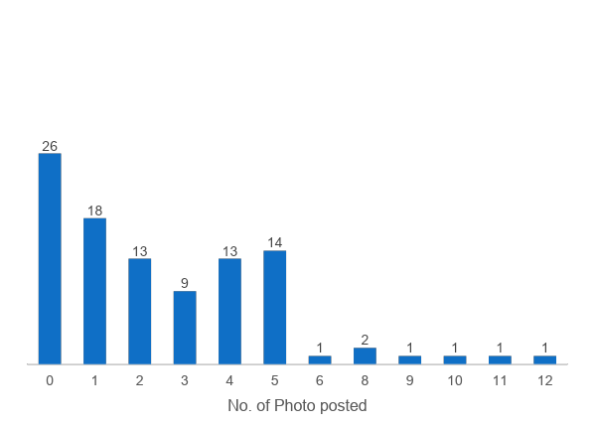
2. POSTS
26 Users have posted 0 photos, highlighting a large portion of inactive users.
Only 6 users posted more than 6 photos and 1 user posted 12 posts. Revealing a lack of highly active users on the platform.

Slide 8
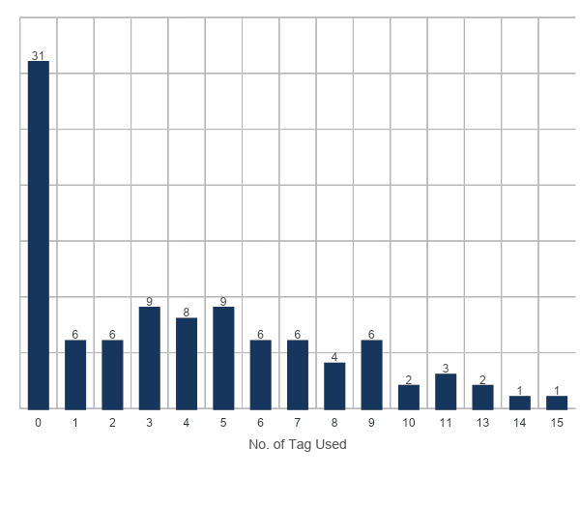
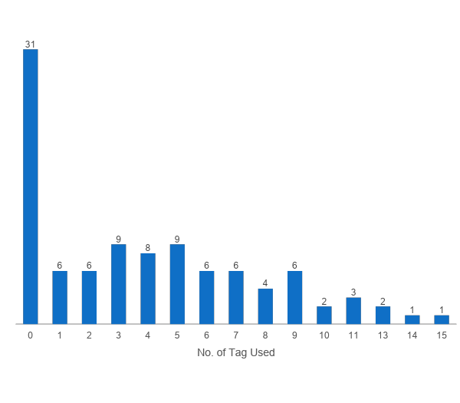
3. TAGS
There are 21 different tags used by the users.
High Inactivity with Tags
31 users have used 0 tags, also indicating a significant portion of users who do not engage with tags at all.
Few Highly Active Tag Users
Only a small number of users have used more than 5 tags
1 user using up to 15 tags
It demonstrate that few users are highly engaged with tagging.

Slide 9
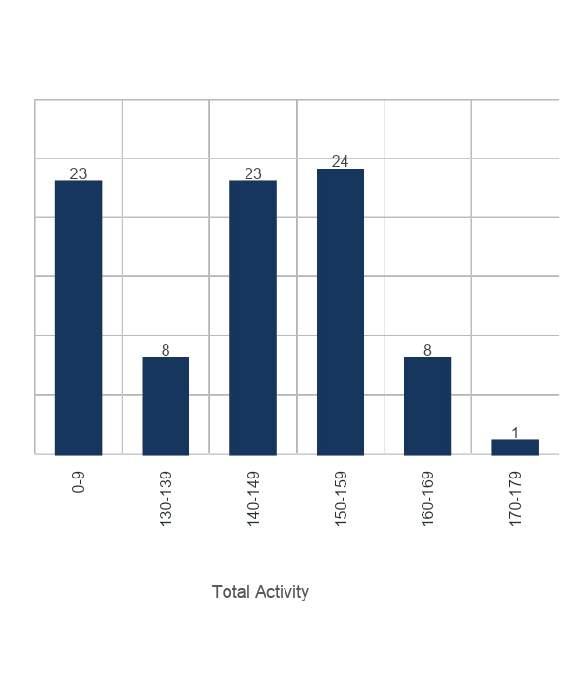
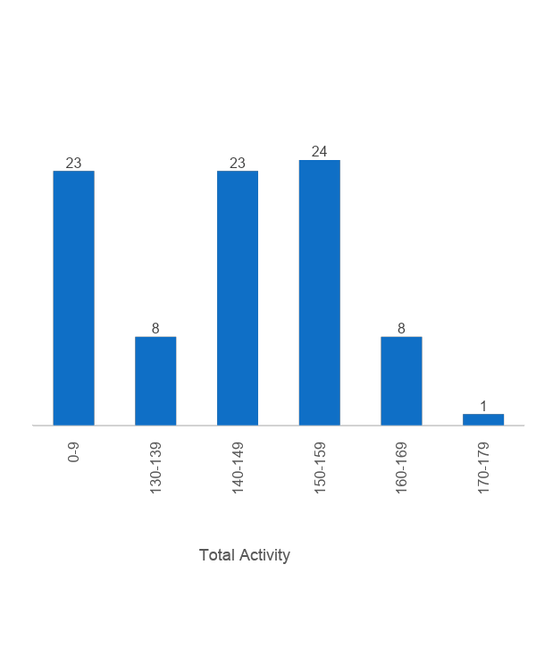
4. Activity Level
A user who actively posts, tags, comments, and likes are likely to have a higher activity level, indicating a vibrant engagement with the community.
Low Activity: 23 users fall in the 0–9 range, showing very low participation in terms of their overall activity (posting, commenting, liking).
Moderate Activity: 8 users are in the 130–139 range, indicating a smaller but active group.
High Activity: Only 1 user is in the 170–179 range, showing very high activity is rare.

Slide 10
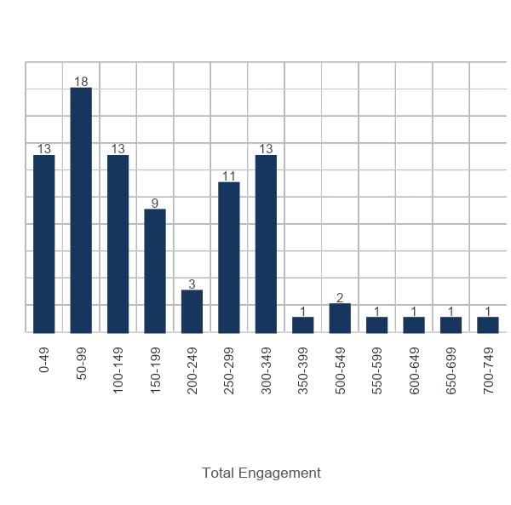
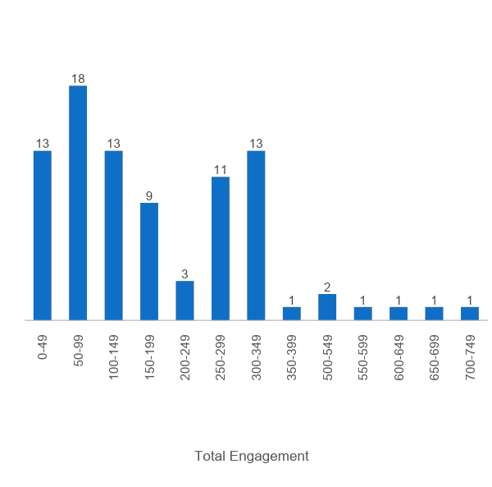
5. Engagement
Low Engagement: 13 users fall in the 0–49 range, indicating minimal interaction.
Moderate Engagement:18 users are in the 50–99 range, showing some engagement but not very high.
High Engagement:13 users in the 300-349 range, which is indicating moderate to high engagement.
Very High Engagement: Only 1–2 users are in the 500+ ranges (500–749), showing very high engagement is rare.

Slide 11
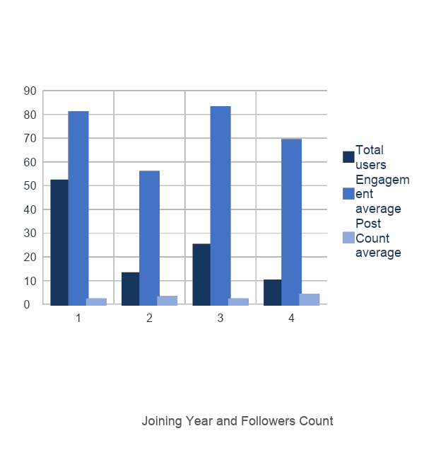
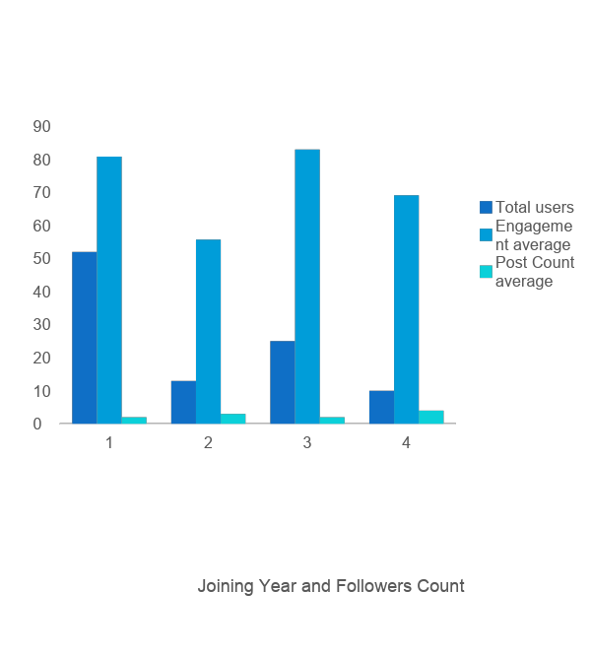
ENGAGEMENT BASED ON JOINING YEAR AND FOLLOWER COUNT
Newer users(2017) are more actively contributing content.
Users from 2017 with 76 followers have the highest average engagement.
Users with 77 followers shows highest average posting activity.

Slide 12
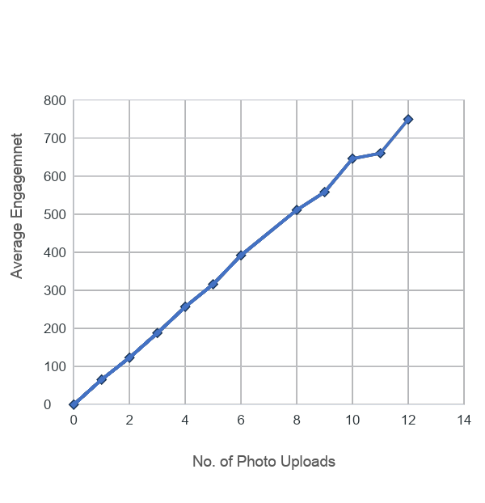
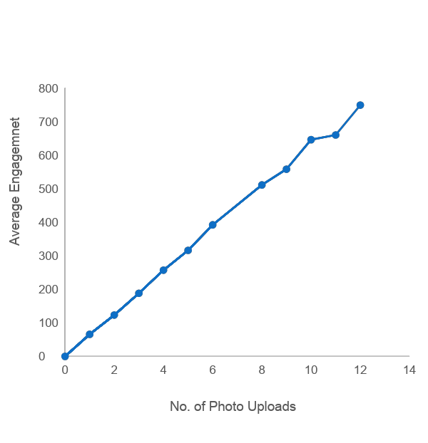
CORRELATION BETWEEN UPLOADS & ENGAGEMENT
There is a positive correlation between photo uploads and total engagement—more uploads generally lead to higher engagement.
Users with 12 photo uploads have the highest average engagement (749), indicating frequent posting boosts interaction.
Between 10 and 11 uploads, growth slows, showing that more content doesn’t always mean more engagement; content quality matters.

Slide 13
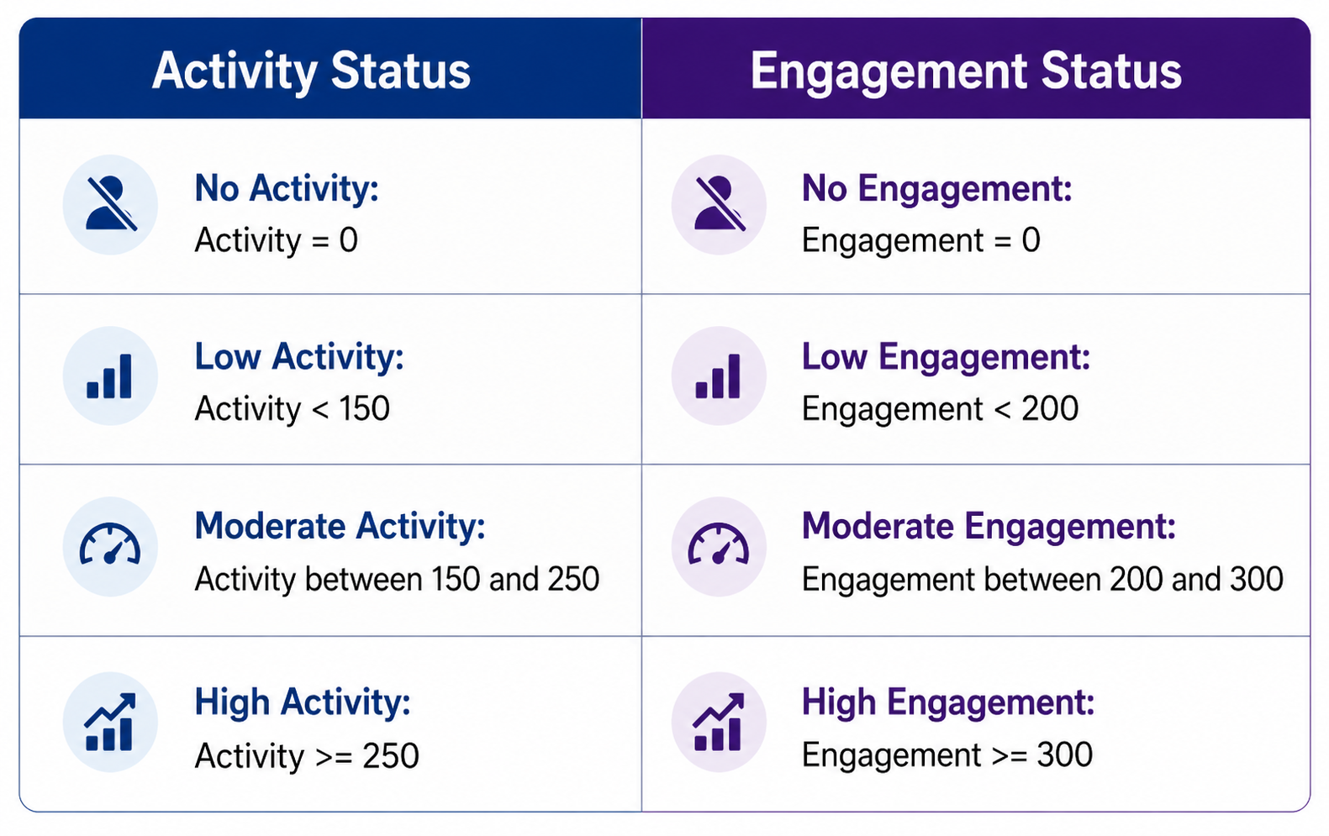
USER SEGMENTATION
To develop marketing strategies, understanding the User’s activity and engagement level is important. Thus users are segmented into different categories based on the following categories in the image:

Slide 14
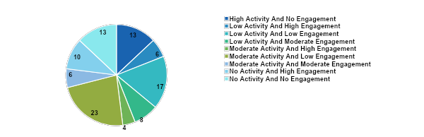
USER BASED ON USER BEHAVIOUR AND ENGAGEMENT DATA

Slide 15
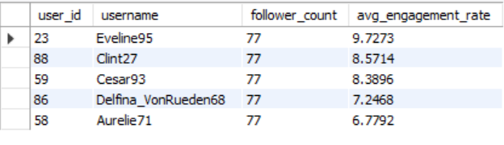
POTENTIAL INFLUENCERS
Users with a High Engagement and High Follower are prime candidates.
The top 5 potential influencers based on their follower count and average engagement rate, ensuring that the most influential users are prioritized for analysis or marketing campaigns.

Slide 16
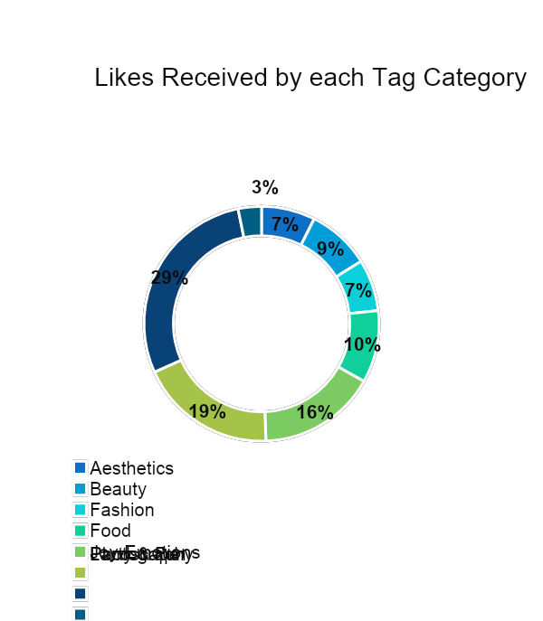
CONTENT-CENTRIC ANALYSIS
This insight is more valuable for developing personalized marketing strategies. It is actionable for improving engagement by understanding user content preferences.
Most Liked Categories- Party & Fun, Landscape, Joy–Emotions—users prefer energetic, visually appealing, and positive content.
Least Liked categories- Photography, Aesthetics—lower engagement overall but may appeal to niche audiences.

Slide 17
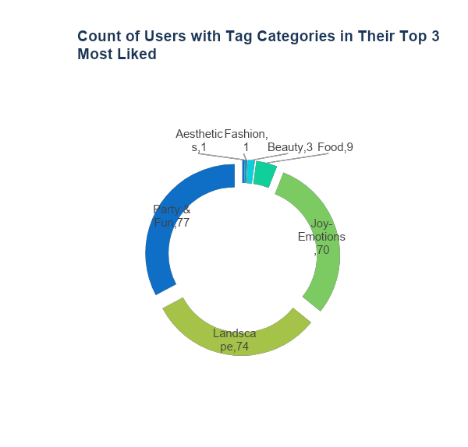
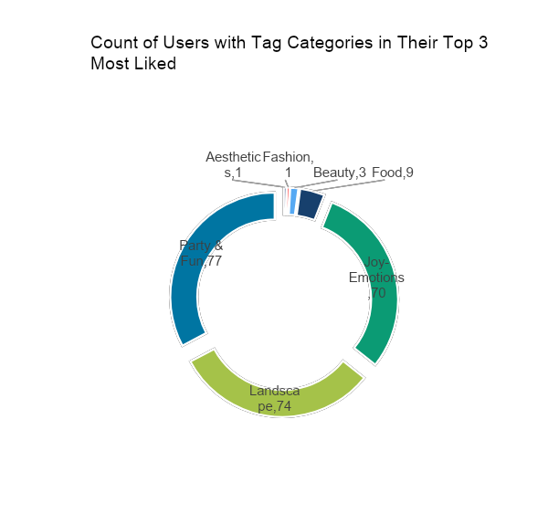
USER-CENTRIC ANALYSIS
This insight helps in optimizing content creation and overall platform engagement.
It guides content strategy for audience appeal, but is less effective for long-term retention and acquisition.
Photography: Used by users but has low engagement, not appearing in top 3 liked categories.
Top Tags: Party & Fun, Landscape, Joy–Emotions—commonly appear in users’ top 3 liked categories.

Slide 18
MARKETING STRATEGIES
1.USER RETENTION
Concern:
Users with no activity, no engagement, or both.
Solution:
Reconnection Strategies: Recommend relevant content, trending hashtags, and engaging profiles based on past interests.
Special Offers: Provide time-limited discounts on premium features to encourage return.
Onboarding Support: Share quick guides on new features and trends to help users re-engage.
User Feedback: Use short surveys with incentives to understand inactivity and improve retention strategies.

Slide 19
2.USER ACQUISITION
Concern:
Decline in users since 2017, difficulty attracting new users, and uneven engagement levels (high vs low).
Solution:
New User Onboarding: Create a personalized onboarding experience with features, popular tags, and success stories.
Tag Education Initiatives: Run campaigns (blogs, videos) to highlight the benefits of using tags.
Referral Program: Offer rewards like discounts or exclusive content for inviting new users.
Engagement Strategies: Use personalized emails to promote features, trending content, and tutorials.

Slide 20
3.USER ENGAGEMENT
Concern:
Need to improve engagement among moderate users; 31 users have not used tags, reducing discoverability; active users post only 1–3 photos.
Solution:
User Recognition Programs: Introduce “User of the Month” and photo contests to boost engagement.
Educational Resources: Offer tutorials and webinars on improving engagement and using platform features.
Community Building: Create forums, social events, and ambassador programs to strengthen user connections.
Influencer Partnerships: Collaborate with influencers to attract new users and increase activity.

Slide 21
RECOMMENDATIONS
User Acquisition Effort:
Attract new users through influencer partnerships and ambassador programs, while implementing educational initiatives to facilitate effective platform engagement.
Combine influencer partnerships and ambassador programs with educational initiatives to attract and effectively onboard new users.
User Retention Strategies:
Implement personalized content recommendations, exclusive offers, and feedback mechanisms to retain users and address inactivity.
Retain users and address inactivity through personalized content recommendations, exclusive offers, and proactive feedback mechanisms.
User Engagement initiatives:
Implement re-engagement campaigns, promote tag usage, and foster community building activities to encourage inactive users and enhance their overall experience.
Encourage inactive user engagement through re-engagement campaigns, tag usage promotions, and community building activities.

