Slide 1

SMART INDIA HACKATHON 2026
SUCHAK — FLOOD EARLY-WARNING SYSTEM
PROBLEM STATEMENT ID : SIH26223
PROBLEM STATEMENT TITLE : Student Innovation — Disaster management includes ideas related to risk mitigation, Planning and management before, after or during a disaster.
THEME : Disaster Management
PS CATEGORY : Hardware
TEAM ID : — 155626
TEAM NAME : VE GA

Slide 2
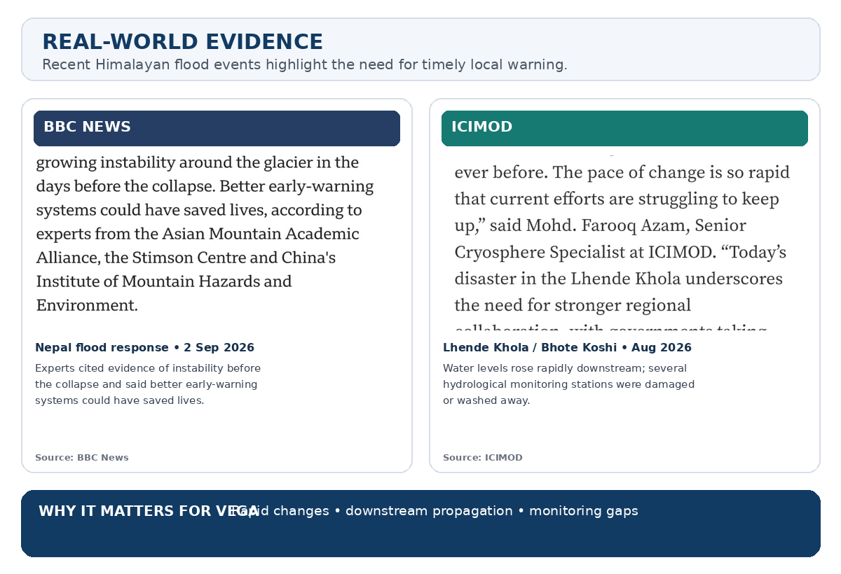

SUCHAK — FLOOD EARLY-WARNING SYSTEM
VE GA
PROBLEM
Right now an alert has to pass through people before it reaches anyone who can act.
• Flood alerts can be delayed by centralized monitoring and multiple decision stages.
• Remote areas may also have limited local monitoring and unreliable connectivity.
SOLUTION
So we let the sensors decide on the spot, zone by zone.
• Distributed sensors + local gateways for zone-wise flood monitoring.
• Camera and vibration / frequency nodes give early flash-flood indication.
• LoRa carries processed results only — never raw video.
• Local risk detection and siren alerts even when the Internet is unavailable.
• Risk information is shared with downstream zones as conditions change.
• Public Web Dashboard for showing Zone risk map.
• Authorities Local Dashboard for Siren Control, Node(s) health & zone risk map.
Rainfall + Water Level + Vibration + Camera
→ Local Risk → Downstream Warning → Alert
Github Repository : https://github.com/surajjha0622/Suchak

Slide 3
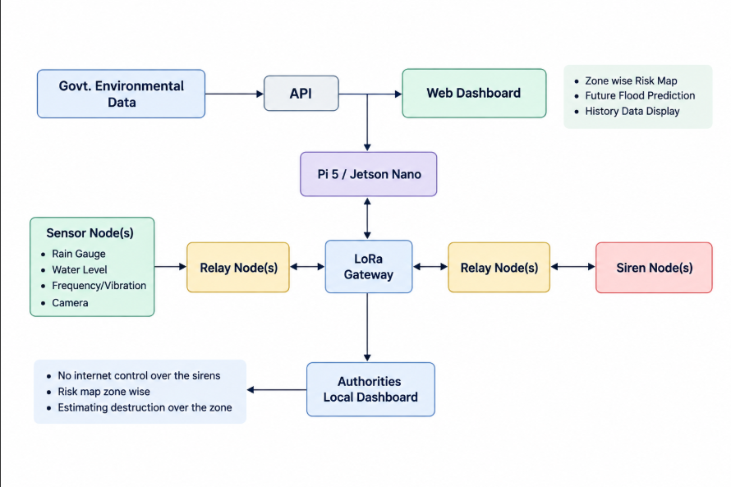


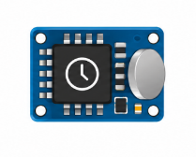








TECHNICAL APPROACH
VE GA
1. DATA COLLECTION
• Rainfall measured using a rain gauge.
• Water level measured at selected river / stream points.
• Camera nodes watch strategic points (bridges, culverts, narrow channels).
• Vibration / frequency sensors detect approaching flash floods.
• Government weather data used when available.
2. COMMUNICATION
• ESP32 collects the readings.
• to theSX1262 LoRa sends the data zone gateway.
• Camera sends only the detection result and its confidence — never video.
• Gateway-to-gateway links share important risk information.
VEGA Flood Early Warning System, Disaster Management, Hyperlocal Flood Monitoring, Distributed Sensor Network, Zone Based Monitoring, Cooperative Flood Warning, Upstream Downstream Warning, Rain Gauge, Rainfall, Rainfall Measurement, Water Level Sensor, Water Level, River Level, Rate of Rise, ESP32, DS3231 RTC, Real Time Clock, Sensor Node, Field Node, SX1262, LoRa, Long Range Communication, Low Power Communication, Zone Gateway, Gateway, Edge Processing, Local Processing, Data Quality Check, Risk Assessment, Risk Level, Adaptive Sampling, Sampling Frequency, Downstream Monitoring, Cooperative Response, Local Alert, Local Siren, Authorities Dashboard, Public Dashboard, Offline Mode, Local Risk Logic, Data Buffering, Data Synchronization, Solar Power, LiFePO4, Low Power Operation, Flood Warning, Flood Alert, Early Warning System, Early Warning, Hydrological Monitoring, Hydrological Data, Environmental Monitoring, Real Time Monitoring, Remote Monitoring, Wireless Sensor Network, IoT, IoT and Electronics, Embedded System, Edge Computing, Edge Gateway, LoRa Communication, LoRa Node, LoRa Gateway, Rainfall Monitoring, Water Level Monitoring, River Monitoring, Flood Risk, Zone Risk, Risk Detection, Risk Classification, Local Warning, Downstream Alert, Upstream Alert, Offline Operation, Resilient Communication.
3. PROCESSING
• Check incoming sensor data.
• Calculate rate of rise from water-level readings.
• Fuse rainfall, water level, vibration signature and camera result.
• Each result carries a high / medium / low confidence.
• Assign a local risk level.
4. RESPONSE
• Rising risk → sampling frequency increases.
• Vibration or camera flag → level and camera checks increase.
• Upstream alert → downstream zone checks more often.
• Confirmed high-confidence risk → local siren and dashboard alert.
OFFLINE MODE
LoRa Gateway, Authorities Dashboard, Sirens and Pi 5/ Jetson Nano keeps working without Internet — data is stored locally, local alerts continue, and stored data syncs when Internet returns.
TECH STACK
Raspberry Pi
ESP32
LoRa
RTC
FastAPI
QGIS/GIS
TimeScaleDB
Python
PostgreSQL
Camera
Vibration

Slide 4
FEASIBILITY AND VIABILITY
VE GA
FEASIBILITY: ENGINEERING RISKS → MITIGATION
PROBLEM
SOLUTION
WHY IT IS VIABLE
Remote power
Solar + LiFePO₄ + deep sleep + RTC scheduling
Low-power operation reduces maintenance.
Internet failure
Gateway processes and stores data locally
Detection and local alerts do not depend on the Internet.
Video is too heavy for LoRa
Camera frame processed on the node; only result + confidence sent
Keeps the LoRa link light and the node low-power.
False alarms from a single sensor
Vibration, camera, rainfall and level cross-checked with confidence levels
A siren fires only on agreeing, high-confidence signals.
Fast changing conditions
Rate of rise + adaptive sampling
More readings are taken when conditions change.
Different conditions at different locations
Multiple nodes at important locations
Risk can be checked zone by zone.
IMPLEMENTATION PATH
1 BENCH TEST
2 FIELD NODE
3 MULTI-NODE PILOT
4 VALIDATE + SCALE

Slide 5
IMPACT AND BENEFITS
VE GA
IMPACT ON DISASTER PREPAREDNESS
EARLIER LOCAL WARNING
ZONE-WISE RISK
COOPERATIVE ALERTS
• Rain, water level, vibration and camera watched together.
• Flash-flood signs can be caught before the water arrives.
• Shows where the risk is actually increasing.
• Avoids treating the whole region as one risk zone.
• Upstream risk triggers increased monitoring downstream.
• Confirmed risk is passed on to the next zone.
WORKS WITHOUT INTERNET
FEWER FALSE ALARMS
BETTER RESPONSE
• Gateway continues local monitoring.
• Camera inference runs on the node, not in the cloud.
• Every result carries a high / medium / low confidence.
• Sirens fire only when signals agree.
• Sensor status, zone risk and siren control in one place at Authorities Dashboard.
• Authorities can act on what is happening in each zone based on data shown on their dashboard.
Rainfall + Level + Vibration + Camera → Rate of Rise → Local Risk → Downstream Warning → Local Action

Slide 6
RESEARCH AND REFERENCES
VE GA
SOURCE LINKS — RESEARCH, ARCHITECTURE & COMPONENT REFERENCES
RESEARCH / SYSTEM BASIS
    • WMO — Flash Flood Guidance System (FFGS)
    Flash-flood monitoring and rainfall-based guidance
    https://wmo.int/projects/ffgs
    • WMO — Early Warnings for All
    Early warning and response framework
    https://wmo.int/all-activities/build-resilience/early-warnings-all
    • Central Water Commission (CWC)
    Hydrological observation and river monitoring
    https://cwc.gov.in/hydro-meteorological-observation
    • India Meteorological Department (IMD)
    Rainfall monitoring and meteorological information
    https://mausam.imd.gov.in/responsive/rainfallinformation.php
    • Uttarakhand SDMA (USDMA)
    State and district disaster-management information
    https://usdma.uk.gov.in/documents/
HARDWARE / SENSING
      • Espressif — ESP32
      Low-power MCU with wireless connectivity
      https://documentation.espressif.com/esp32_datasheet_en.html
      • Semtech — SX1262 LoRa transceiver
      Long-range, low-power link between nodes and gateway
      https://www.semtech.com/products/wireless-rf/lora-connect/sx1262
      • Analog Devices — ADXL345 accelerometer
      Vibration / frequency sensing for flash-flood signatures
      https://www.analog.com/en/products/adxl345.html
      • OpenCV
      On-node camera processing — result and confidence only
      https://opencv.org/
      • Analog Devices — DS3231 RTC
      High-accuracy real-time clock for timestamping
      https://www.analog.com/en/products/ds3231.html
PRIOR IMPLEMENTATION
      • CrashLink — Previous LoRa prototype by Team VE GA
      ESP32 + LoRa distributed alert communication
      https://github.com/surajjha0622/CrashLink
      • https://cdn.hackclub.com/01a0ede5-a87b-7dbc-aa6c-1d46db80e490/WhatsApp%20Video%202026-09-29%20at%206.24.38%20PM.mp4
The research sources provide the basis for flood monitoring and early warning.
Zone coordination, adaptive sampling, on-node camera inference and local risk logic are proposed VE GA features.

