Slide 1

SMART INDIA HACKATHON 2026
VEGA — ENVIRONMENTAL INTELLIGENCE NETWORK
PROBLEM STATEMENT ID : SIH26178
PROBLEM STATEMENT TITLE : A resilient, AI-powered environmental monitoring network for early detection and actionable alerts.
THEME : Disaster Management
PS CATEGORY : Hardware
TEAM ID : — 155626
TEAM NAME : VE GA

Slide 2
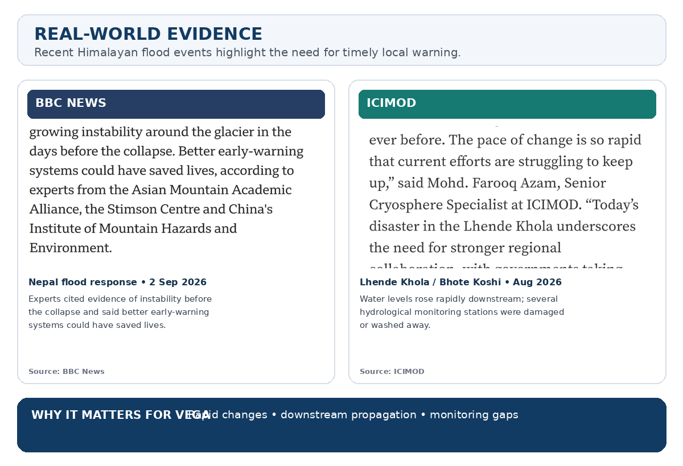

VEGA — ENVIRONMENTAL INTELLIGENCE NETWORK
VE GA
PROBLEM
Environmental risk can change locally before centralized systems have enough ground information.
• Environmental hazards can develop rapidly while centralized monitoring may lack localized, real-time ground intelligence.
• Remote regions can also face sparse sensing and unreliable connectivity.
SOLUTION
VEGA moves sensing and first-level intelligence closer to the environment.
• Distributed sensor nodes + local gateways for zone-wise monitoring.
• Flood sensing is the current prototype; modular nodes can extend to other hazards.
• Lightweight on-device AI / anomaly detection is the proposed local-intelligence layer.
• LoRa sends critical alerts, summaries and risk assessments.
• Local detection and alerts continue during Internet outages.
• Risk information is shared across zones and shown on regional maps.
Environmental Sensors → Edge AI → Local Risk → Alert / Downstream Warning
GitHub Repository : https://github.com/surajjha0622/Suchak

Slide 3
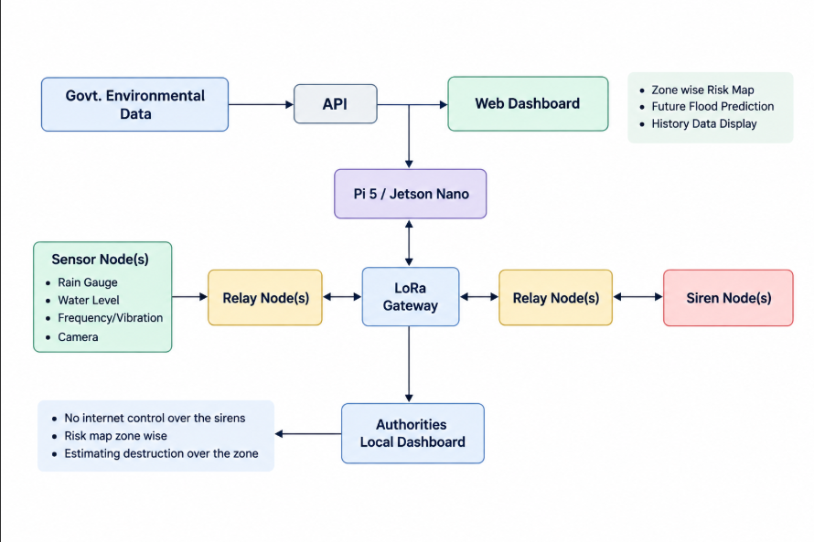


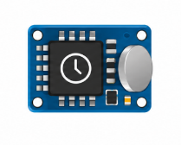








TECHNICAL APPROACH
VE GA
1. DATA COLLECTION
• Current prototype: rainfall + water level.
• ESP32 collects sensor readings.
• DS3231 provides timestamps.
• Modular interfaces can add smoke, air quality, heat, gas, soil moisture or vibration sensors.
2. COMMUNICATION
• Sensor readings are packaged at the node.
• SX1262 LoRa sends compact observations and alerts to the zone gateway.
• Zone gateways can share important risk information downstream.
VEGA Flood Early Warning System, Disaster Management, Hyperlocal Flood Monitoring, Distributed Sensor Network, Zone Based Monitoring, Cooperative Flood Warning, Upstream Downstream Warning, Rain Gauge, Rainfall, Rainfall Measurement, Water Level Sensor, Water Level, River Level, Rate of Rise, ESP32, DS3231 RTC, Real Time Clock, Sensor Node, Field Node, SX1262, LoRa, Long Range Communication, Low Power Communication, Zone Gateway, Gateway, Edge Processing, Local Processing, Data Quality Check, Risk Assessment, Risk Level, Adaptive Sampling, Sampling Frequency, Downstream Monitoring, Cooperative Response, Local Alert, Local Siren, Authorities Dashboard, Public Dashboard, Offline Mode, Local Risk Logic, Data Buffering, Data Synchronization, Solar Power, LiFePO4, Low Power Operation, Flood Warning, Flood Alert, Early Warning System, Early Warning, Hydrological Monitoring, Hydrological Data, Environmental Monitoring, Real Time Monitoring, Remote Monitoring, Wireless Sensor Network, IoT, IoT and Electronics, Embedded System, Edge Computing, Edge Gateway, LoRa Communication, LoRa Node, LoRa Gateway, Rainfall Monitoring, Water Level Monitoring, River Monitoring, Flood Risk, Zone Risk, Risk Detection, Risk Classification, Local Warning, Downstream Alert, Upstream Alert, Offline Operation, Resilient Communication.
EDGE AI / TINYML
3. ON-DEVICE INTELLIGENCE
• Data-quality checks + temporal feature extraction.
• Rate of rise is calculated from water-level readings.
• Proposed lightweight AI / anomaly model runs locally.
• Current flood prototype uses local risk logic while the AI layer is developed and validated.
4. RESPONSE
• Rising risk → adaptive sampling.
• Local hazard detection → local alert.
• Upstream risk → downstream zone increases monitoring.
• Critical alerts and risk summaries reach dashboards.
OFFLINE MODE
Local sensing, edge processing, LoRa communication and alerts continue without continuous Internet. Data and event summaries are buffered and synchronized when connectivity returns.
TECH STACK
Raspberry Pi
ESP32
LoRa
RTC
FastAPI
QGIS/GIS
TimeScaleDB
Python
PostgreSQL

Slide 4
FEASIBILITY AND VIABILITY
VE GA
FEASIBILITY: ENGINEERING RISKS → MITIGATION
PROBLEM
SOLUTION
WHY IT IS VIABLE
Remote power
Solar + LiFePO₄ + deep sleep + RTC scheduling
Low-power operation reduces maintenance.
Internet failure
Gateway processes and stores data locally
Detection and local alerts do not depend on the Internet.
AI inference constrained at the node
Lightweight anomaly model / TinyML for local inference
Local decisions reduce latency and bandwidth.
False alarms from noisy sensor data
Data-quality checks + temporal features + model confidence
Risk uses validated observations and model output.
Fast-changing conditions
Rate of rise + adaptive sampling + local anomaly detection
More observations when conditions change.
Different hazards at different locations
Modular sensor nodes for flood, fire, air quality and other hazards
Common gateway, risk engine and dashboard architecture.
IMPLEMENTATION PATH
1 BENCH TEST
2 FIELD NODE
3 MULTI-NODE PILOT
4 VALIDATE + SCALE

Slide 5
IMPACT AND BENEFITS
VE GA
IMPACT ON DISASTER PREPAREDNESS
EARLIER LOCAL WARNING
• Local sensing detects changing environmental conditions.
• Edge intelligence supports faster localized detection.
MULTI-HAZARD, MODULAR DESIGN
• Flood monitoring is the current prototype.
• Modular nodes can extend to fire, air quality, heat and other hazards.
COOPERATIVE ALERTS
• Risk summaries move from local zones to regional systems.
• Downstream zones can increase monitoring when upstream risk rises.
WORKS DURING CONNECTIVITY LOSS
• Local sensing and edge intelligence continue without continuous Internet.
• Events are buffered and synchronized later.
LOWER BANDWIDTH & LATENCY
• Only critical alerts, summaries and risk assessments leave the node.
• Local inference reduces cloud dependence.
ACTIONABLE RISK INFORMATION
• Zone-wise maps, sensor status and alerts support authorities and communities.
• Central analytics can support long-term trends.
Environmental Sensing → Edge AI → Local Risk → Alert / Risk Map → Regional Response

Slide 6
RESEARCH AND REFERENCES
VE GA
SOURCE LINKS — RESEARCH, ARCHITECTURE & COMPONENT REFERENCES
PROBLEM STATEMENT / SYSTEM BASIS
• Smart India Hackathon 2026 — SIH26178
Qualcomm Inc | Hardware | Disaster Management
https://sih2026.vuce.in/ps/SIH26178
• WMO — Early Warnings for All
https://wmo.int/all-activities/build-resilience/early-warnings-all
• WMO — Flash Flood Guidance System
https://wmo.int/projects/ffgs
• Central Water Commission — Hydrological Observation
https://cwc.gov.in/hydro-meteorological-observation
• India Meteorological Department — Rainfall Information
https://mausam.imd.gov.in/responsive/rainfallinformation.php
HARDWARE / EDGE REFERENCES
• Espressif — ESP32
https://documentation.espressif.com/esp32_datasheet_en.html
• Semtech — SX1262 LoRa
https://www.semtech.com/products/wireless-rf/lora-connect/sx1262
• Analog Devices — DS3231 RTC
https://www.analog.com/en/products/ds3231.html
• TensorFlow Lite for Microcontrollers
Lightweight ML inference on microcontrollers
https://www.tensorflow.org/lite/microcontrollers
PRIOR IMPLEMENTATION
• CrashLink — ESP32 + LoRa prototype by Team VEGA
https://github.com/surajjha0622/CrashLink
References establish the environmental monitoring, early-warning and hardware basis. VEGA-specific edge intelligence, cooperative communication and modular multi-hazard architecture are proposed system features.

