Slide 1

MongoDB
Introduction to NoSQL databases,
Installation and configuration of MongoDB,
CRUD operations in MongoDB,
Indexing and querying in MongoDB,
Schema design and data modeling

Slide 2
Introduction to NoSQL databases
Traditional web apps used relational databases (SQL) for data storage.
Data stored in normalized tables connected via primary–foreign key relationships.
As web apps scaled, performance and availability issues arose.
To solve this, NoSQL databases emerged — designed for:
  High availability
  Simple querying
  Horizontal scaling
NoSQL types include:
  Key-value stores
  Column stores
  Object stores
  Document stores (most popular)

Slide 3
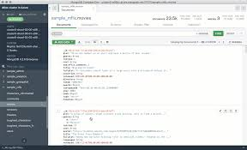
Introduction to MongoDB
MongoDB is a document-oriented NoSQL database.
Data is stored as JSON-like documents instead of tables.
Each document can store complex, hierarchical data.
Example: A blog post and its comments can be stored in one JSON document rather than multiple SQL tables.

Slide 4
Advantages of Document Databases (like MongoDB)
Faster reads – no need to join tables or rebuild objects.
Schemaless – allows flexible data structures:
  Different documents can have different fields.
  Easy to add new properties without altering the schema.
Ideal for dynamic or evolving data models.
Example Use Case
In an e-commerce app, products like chairs and closets can have different attributes.
MongoDB allows both to exist in the same collection without empty columns or complex key-value tables.

Slide 5
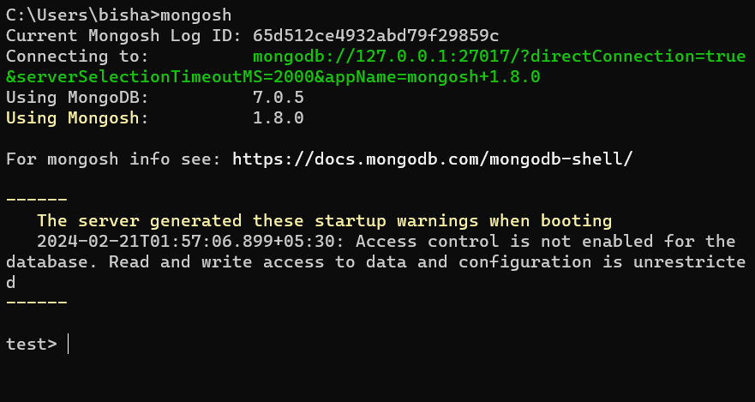
Installation and configuration of MongoDB
Installing MongoDB
MongoDB: The World’s Leading Modern Database | MongoDB
Installing MongoDB on Windows
Running MongoDB manually
Running MongoDB as a Windows Service
Installing MongoDB on Mac OS X and Linux
Installing MongoDB from binaries
Install MongoDB using a package manager
Using the MongoDB shell

Slide 6
CRUD operations in MongoDB
MongoDB CRUD (Create, Read, Update, Delete) Operations Overview
1. Creating Documents
a. Using insert()
b. Using update() with upsert
db.posts.insert({ "title": "Second Post", "user": "alice" })
db.posts.update(
{ "user": "alice" },
{ "title": "Second Post", "user": "alice" },
{ upsert: true }
)

Slide 7
c. Using save()
2. Reading Documents
a. Find all documents
b. Find using equality condition
c. Using query operators
db.posts.save({ "title": "Second Post", "user": "alice" })
db.posts.find()
// or
db.posts.find({})
db.posts.find({ "user": "alice" })
db.posts.find({ "user": { $in: ["alice", "bob"] } })

Slide 8
d. Building AND/OR queries
AND query → multiple conditions in one object:
OR query → use $or operator:
3. Updating Documents
a. Using update()
b. Using save()
db.posts.find({ "user": "alice", "commentsCount": { $gt: 10 } })
db.posts.find({ $or: [{ "user": "alice" }, { "user": "bob" }] })
db.posts.update(
{ "user": "alice" }, // filter
{ $set: { "title": "Second Post" } }, // update
{ multi: true } // update multiple docs
)
db.posts.save({
"_id": ObjectId("50691737d386d8fadbd6b01d"),
"title": "Second Post",
"user": "alice"
})

Slide 9
4. Deleting Documents
a. Delete all documents
b. Delete multiple matching documents
c. Delete a single document
db.posts.remove()
db.posts.remove({ "user": "alice" })
db.posts.remove({ "user": "alice" }, true)

Slide 10
Summary Table
Operation | Method | Description
Create | insert(), update(upsert), save() | Adds new documents
Read | find(), find({}) | Retrieves documents
Update | update(), save() | Modifies existing documents
Delete | remove() | Deletes documents

Slide 11
Indexing and Querying in MongoDB
MongoDB Indexing
Indexes are special data structures that improve query performance.
Without indexes, MongoDB must scan the entire collection to find matching documents.
With indexes, MongoDB can directly locate matching documents efficiently.
Without an index → MongoDB checks every document.
With an index on commentsCount → MongoDB quickly retrieves documents where the count > 10.

Slide 12
Ad Hoc Queries
MongoDB supports dynamic (ad hoc) queries, similar to SQL’s flexibility.
Unlike key-value stores (which only query by key), MongoDB allows complex and dynamic queries without predefined structures.
Queries are performed on BSON documents using MongoDB’s own query language.
Advantage → Can query on any field, not just keys.
Drawback (without indexing) → Full collection scans cause slow performance on large datasets.
SELECT * FROM Posts WHERE Title LIKE '%mongo%’;
Equivalent in MongoDB:
db.posts.find({ title: /mongo/ });

Slide 13
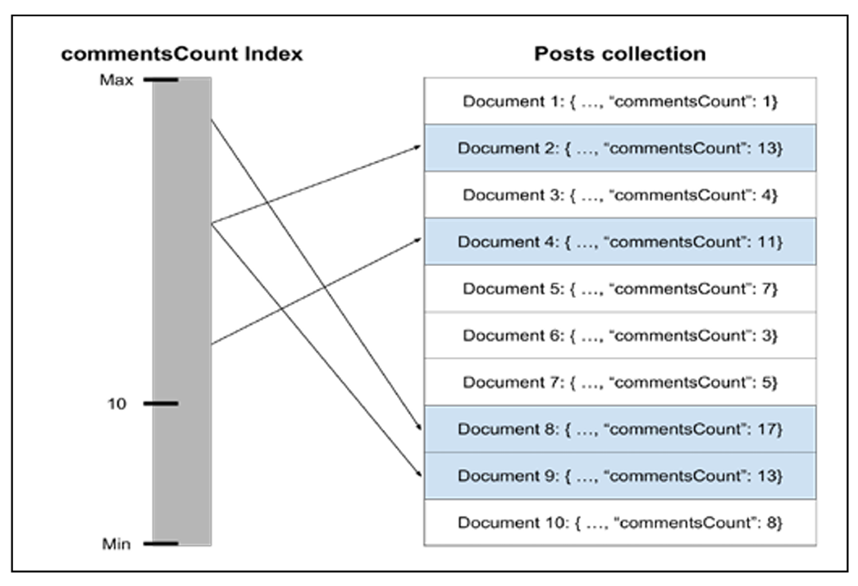
Example:
Document
Query
{
"_id": ObjectId("52d02240e4b01d67d71ad577"),
"title": "First Blog Post",
"comments": [],
"commentsCount": 12
}
db.posts.find({ commentsCount: { $gt: 10 } })

Slide 14
Schema design and data modeling
MongoDB Replica Set (Data Redundancy & High Availability)
A replica set = group of MongoDB servers hosting the same dataset.
Primary node → handles all write operations.
Secondary nodes → replicate data from primary and can serve read operations.
Ensures data redundancy and fault tolerance.
Automatic failover:
  If the primary is unreachable for >10 seconds,a secondary is automatically promoted to primary.
When the old primary rejoins, it becomes a secondary again.
Improves data safety, availability, and read scalability.

Slide 15
MongoDB Sharding (Horizontal Scaling)
Scaling problem: as data grows, one machine cannot handle all operations efficiently.
Two approaches:
  Vertical scaling: upgrade single machine (CPU, RAM) → limited and expensive.
  Horizontal scaling: distribute load across multiple machines.
Sharding = horizontal scaling in MongoDB.
Data is divided into shards (each shard stores part of the dataset).
Together, all shards act as a single logical database.
Query routers and configuration servers handle routing of queries to correct shards.
Benefits: handles large-scale data, increases performance, and distributes workload.

Slide 16
MongoDB Shell (Command-Line Interface)
A JavaScript-based CLI used to interact with MongoDB.
Start shell:
Connects to default test database automatically.
Use a specific database:
Databases and collections are created lazily when the first document is inserted.
List databases:
$ mongo
> use mean
> show dbs

Slide 17
MongoDB Databases
Each MongoDB server can hold multiple databases.
Databases are lightweight and auto-created when data is inserted.
→ connects directly to the mean database.
MongoDB Collections
A collection = equivalent of a table in relational databases.
Created automatically when the first document is inserted.
Collections are schema-less — can store different document structures.
$ mongo mean
Retrieve all documents:
> db.posts.find()
List all collections:
> show collections
> db.posts.insert({"title": "First Post", "user": "bob"})
Delete a collection:
> db.posts.drop()

