Slide 1
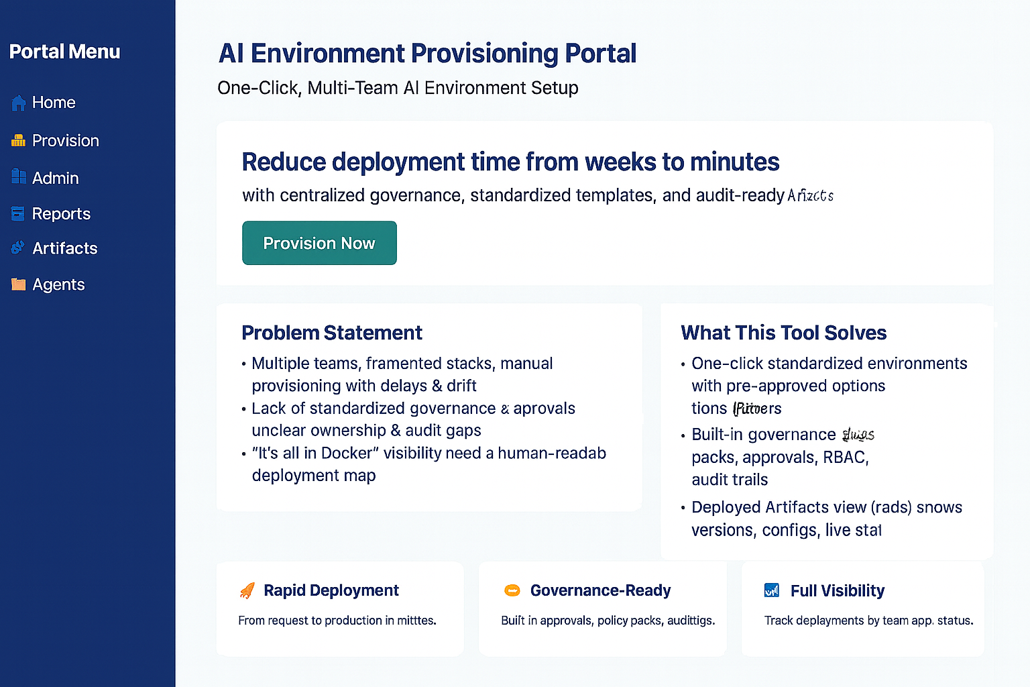
Portal Menu
Home
Provision
Admin
Reports
Console
Artifacts
Future Releases
Logout

Slide 2
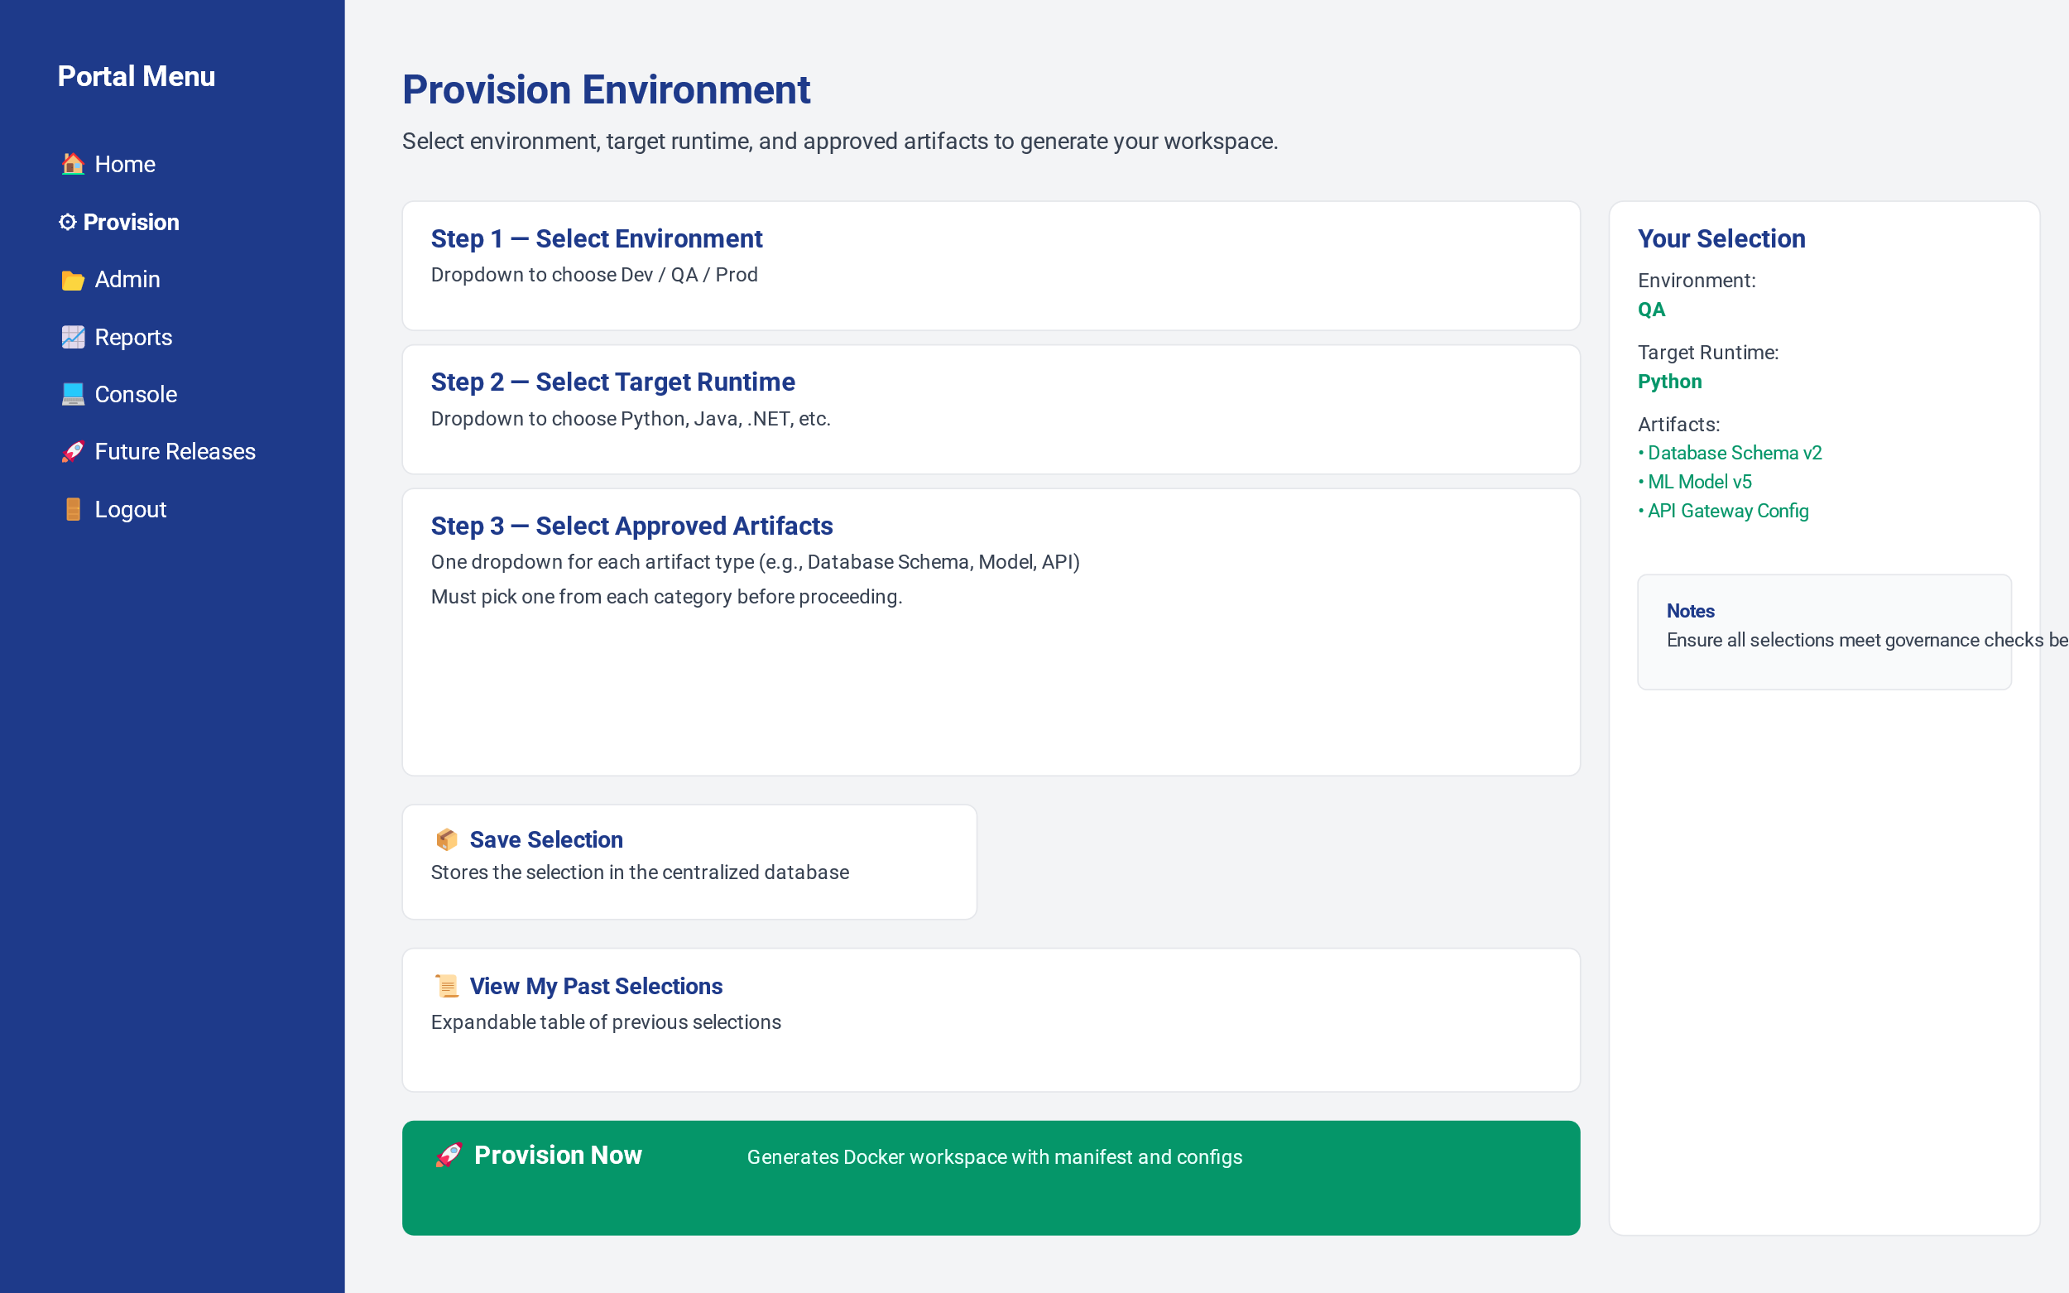
Portal Menu
Home
Provision
Admin
Reports
Console
Artifacts
Future Releases
Logout

Slide 3
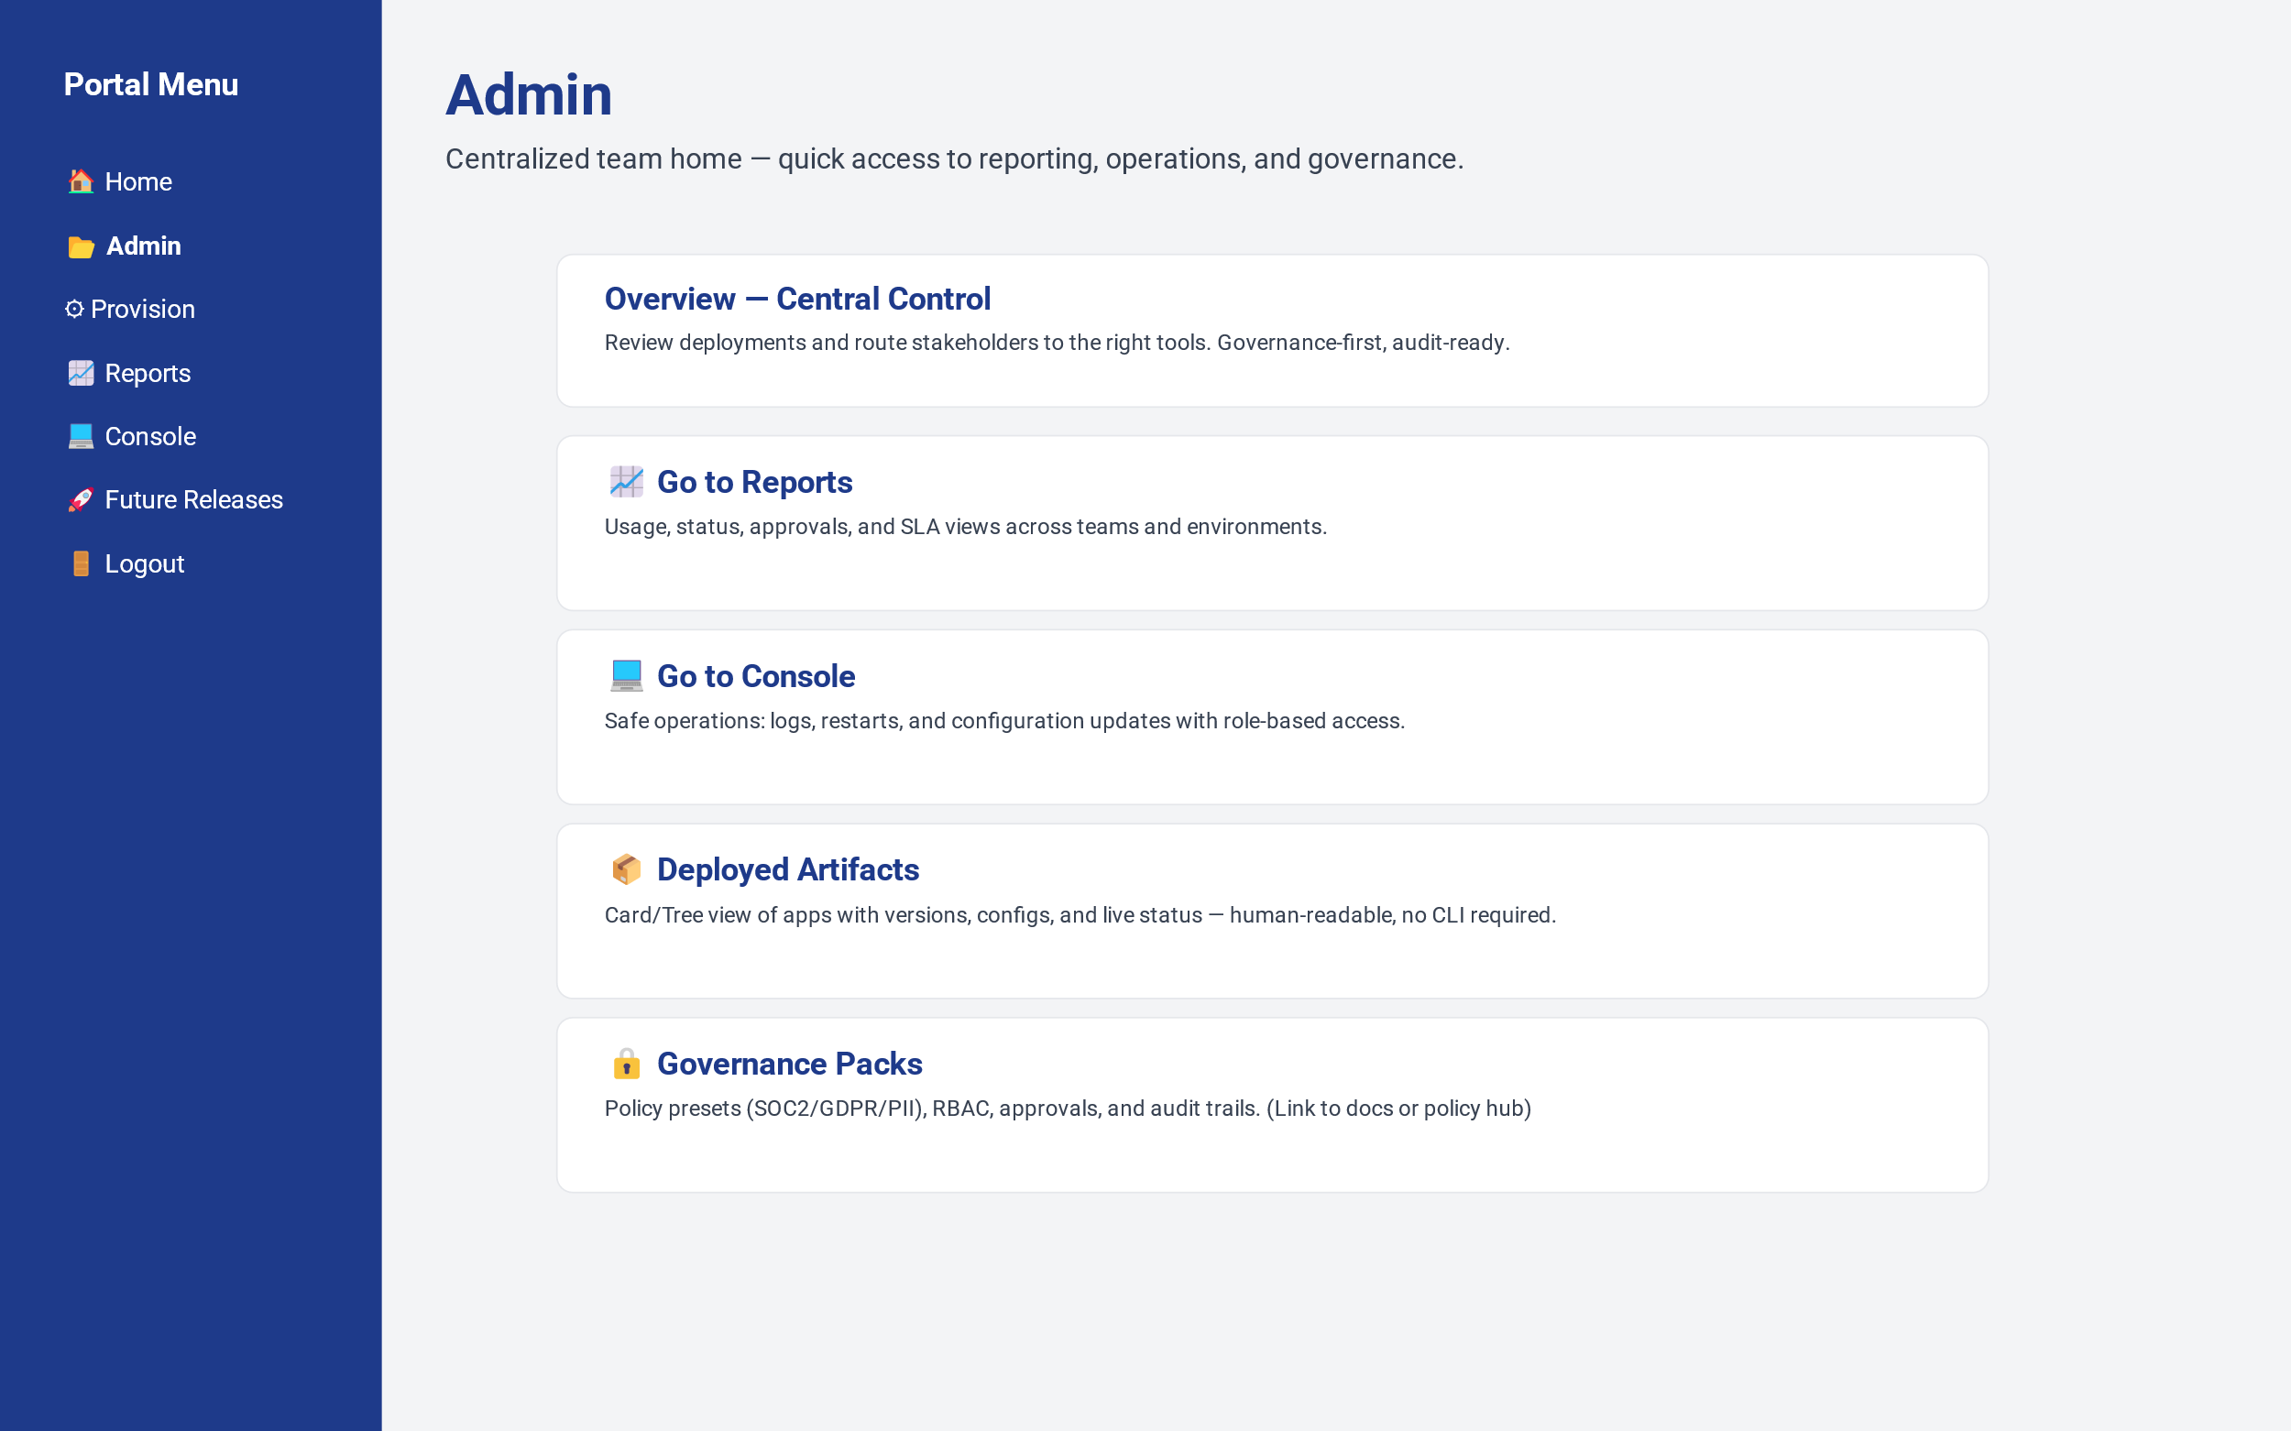
Portal Menu
Home
Provision
Admin
Reports
Console
Artifacts
Future Releases
Logout

Slide 4
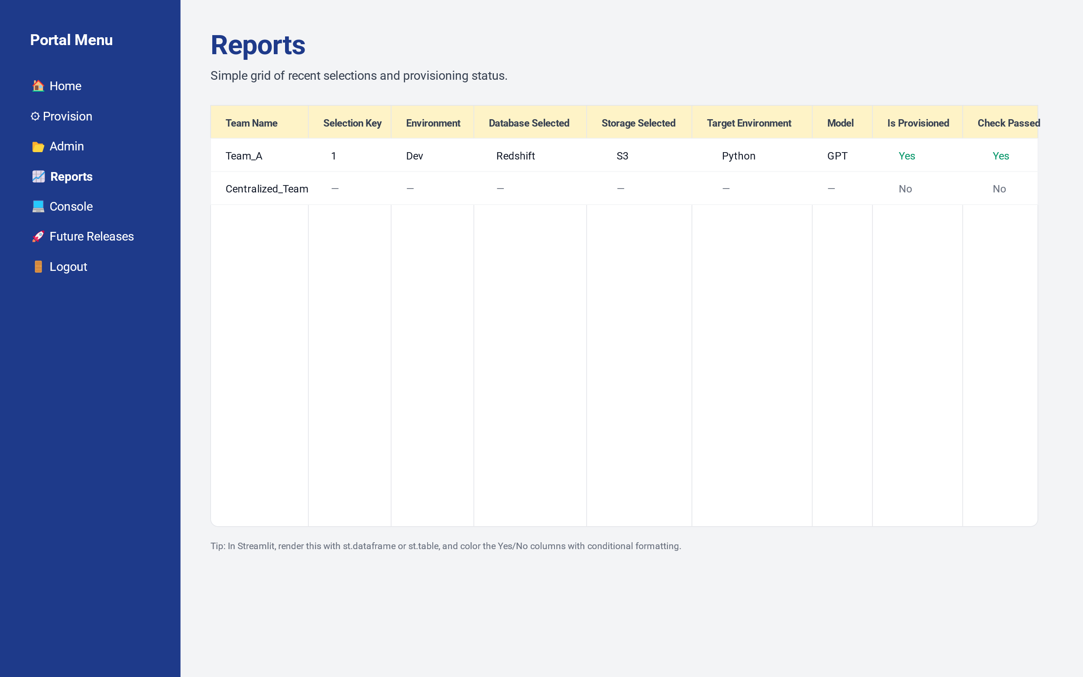
Portal Menu
Home
Provision
Admin
Reports
Console
Artifacts
Future Releases
Logout

Slide 5
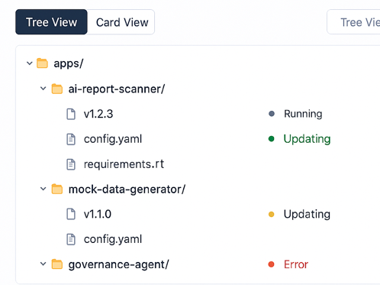
Portal Menu
Home
Provision
Admin
Reports
Console
Artifacts
Future Releases
Logout
Deployed Artifacts

Slide 6
Portal Menu
Home
Provision
Admin
Reports
Console
Artifacts
Future Releases
Logout
Console
Agents Health Check
Output of Agents Health Check
Post Provision Sample LLM Agent
Same UI We had where we ask user for Cusine type and it gives Answer
Agent3
Output of Agent 3

Slide 7
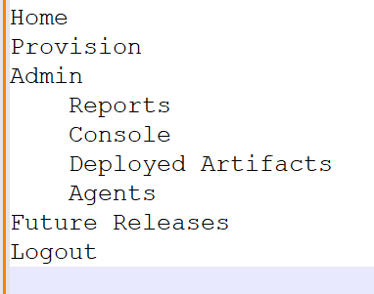
Menu Items should be

Slide 8

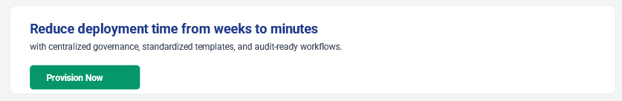
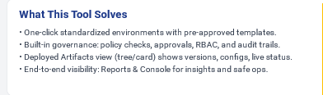

Portal Menu
Home
Provision
Admin
Reports
Console
Artifacts
Logout

Slide 9
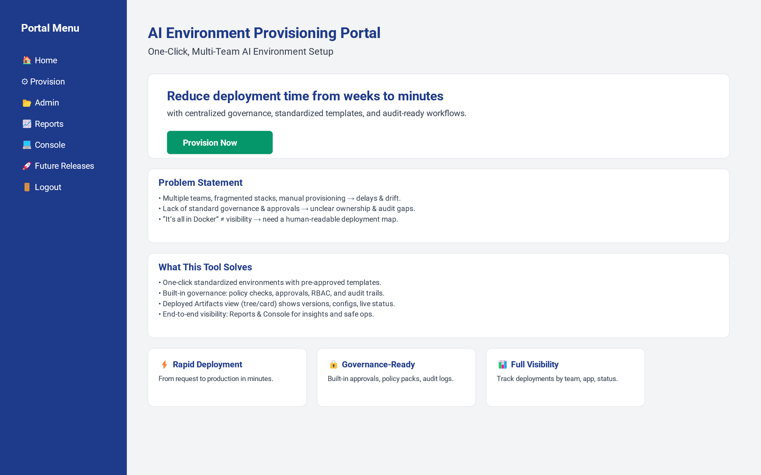
Problem Statement
One-click standardized environments with pre-approved options
Keep it but add Future Release in bracket
Keep it
Keep it

Slide 10
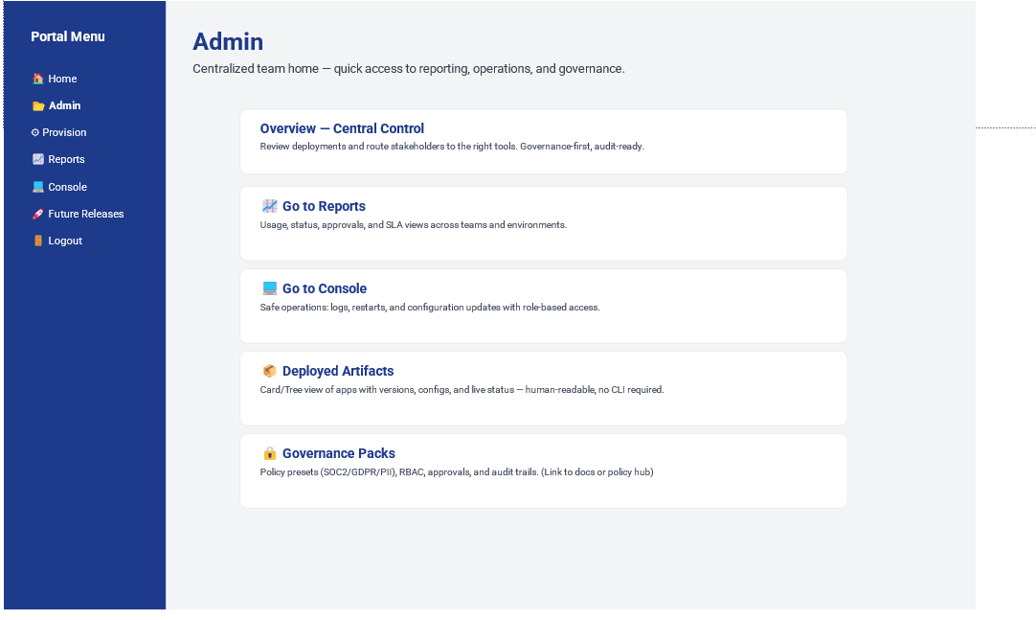
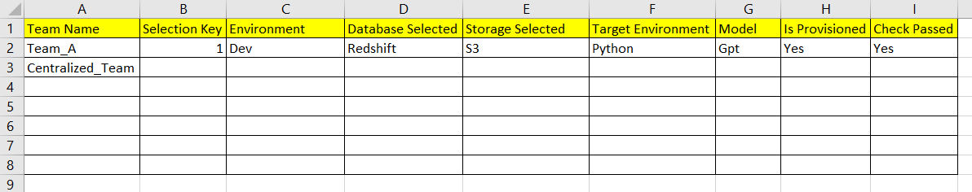
Reports

Slide 11
Console

Slide 12
Future Release
Abc
Zyx
Kja;ljsdfs

