Slide 1
EDA MASTER PROJECT PRESENTATION.
Name:- Healthcare Disease Analysis and Prediction System.
-------------------------------------------------------------------------
Dataset:- disease prediction,
------------------------------------
Business Domain :- Healthcare,
----------------------------------------
Total records :- 10000
Presented by :- Suraj Kapare

Slide 2
Project Objective : -
To Analyze patient demographic and health-related attributes.
To Identify patterns associated with disease prediction.
To Clean and preprocess the healthcare dataset.
To Analyze relationships between numerical and categorical variables.
To Generate meaningful insights for further analytics and ML modeling.

Slide 3
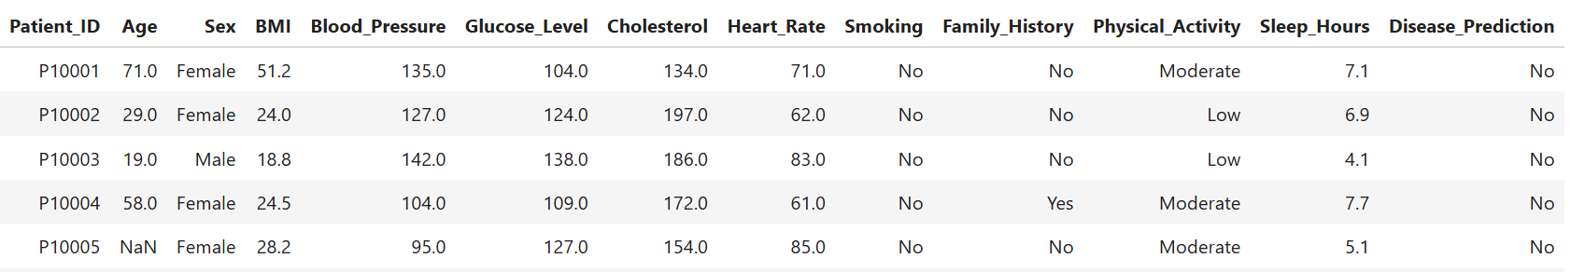
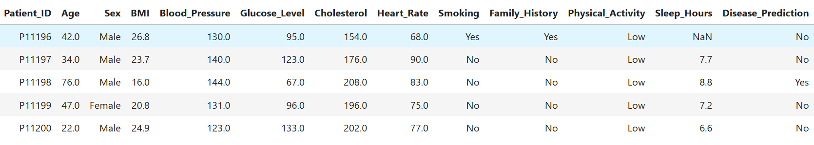
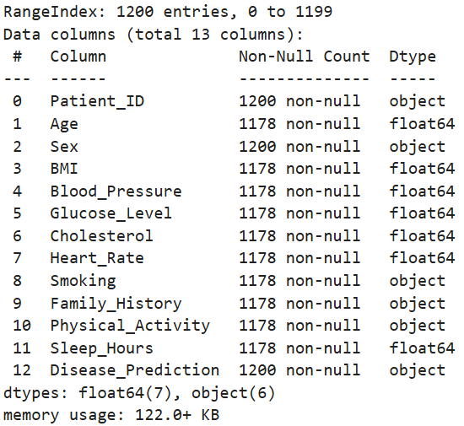
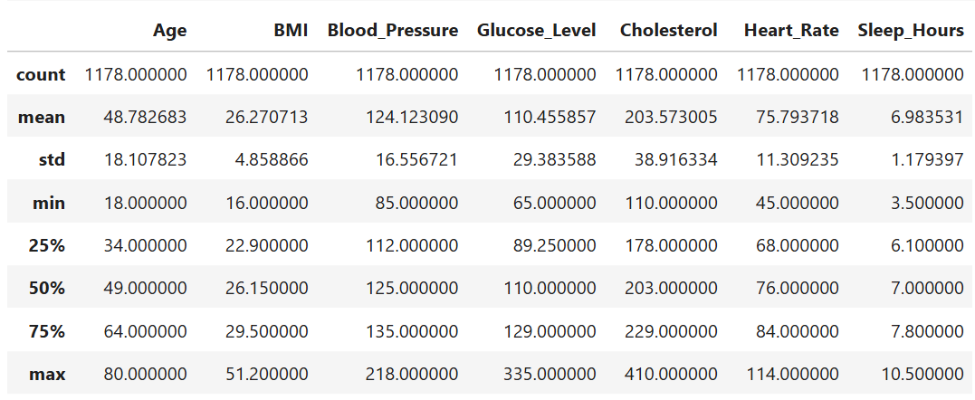
Load dataset and take overview of the data and understand data.
Overview of Top & bottom 5 rows :-
Basic information :-
Stastictical summary of numeric columns :-

Slide 4
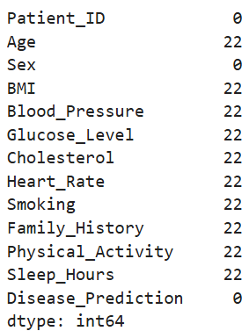
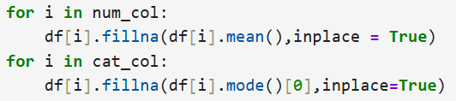
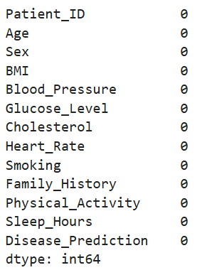
Check the null values in dataset and treat them on the basis of column type.
Checking null values:-
Result :-
Treating Null values:-
Result :-
Insights :- We filled the null values by mean , median , and mode for
every column with suitable values

Slide 5
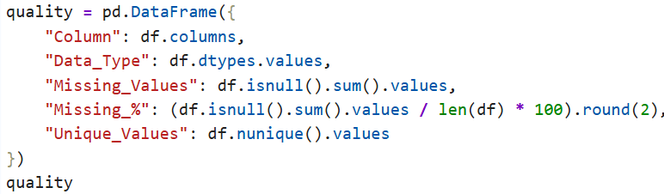

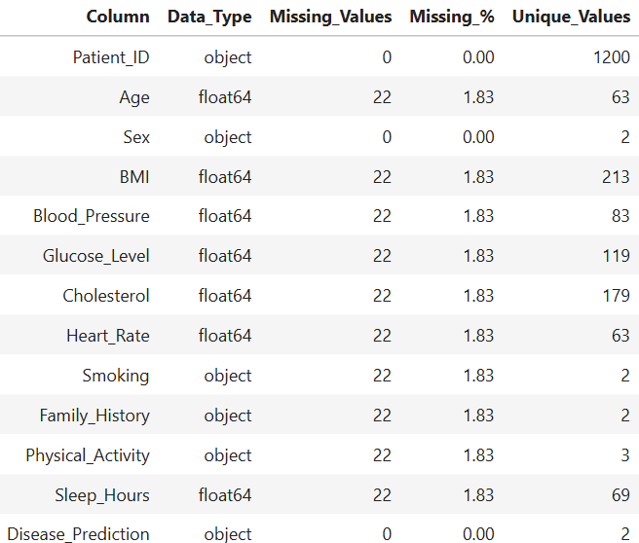
Quality checking of the data by creating new table:-
Python code to create new table of data quality using dictionary:-
Checking and Treating duplicate values
Python Code:-
Result :-
Insights :- In this dataset there is no duplicate values are present
Insights :- In observation we can see the data type missing value count ,
persentage of missing value and unique values of the all columns.

Slide 6
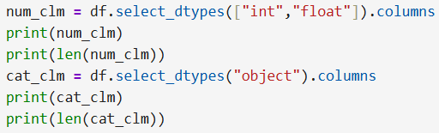
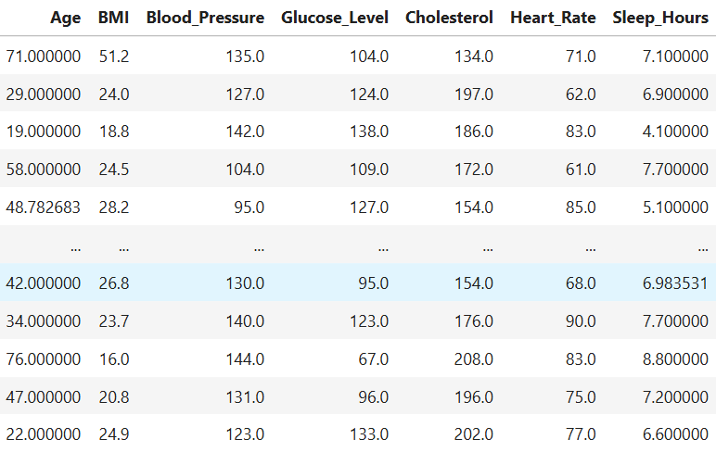
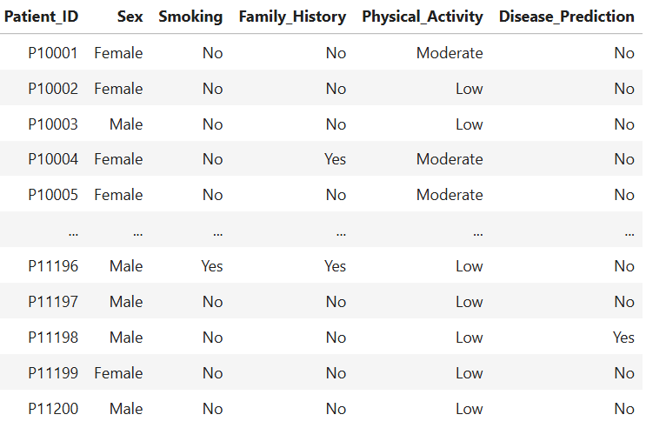
Seperate the numerical and categorical columns.
Python code :-
Result :-
Numerical columns :-
Categorical columns :-
Insights :- we have the separate the both numerical and categorical columns.
Now we can analysis the numerical and categorical feachers easily.

Slide 7
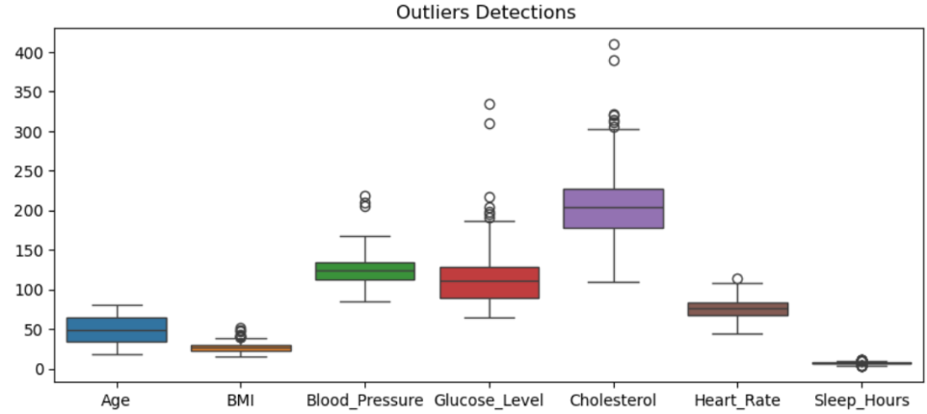
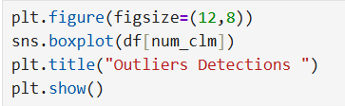
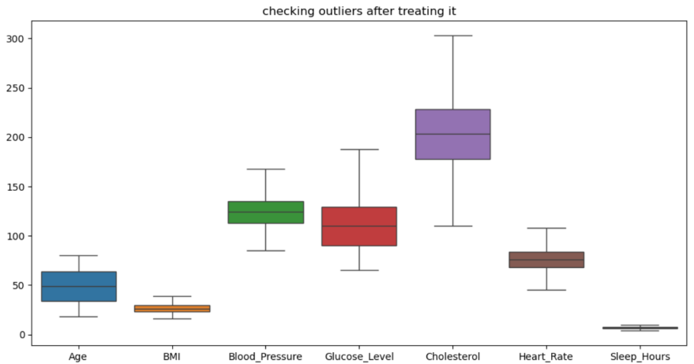
Checking the outliers in numerical columns.
Python code :-
Outluers detected in 6 columns
Result :-
Insights :- We check the outliers using boxplot and we get the outlieers in 6 columns
Using caping methode we treated the outliers.

Slide 8

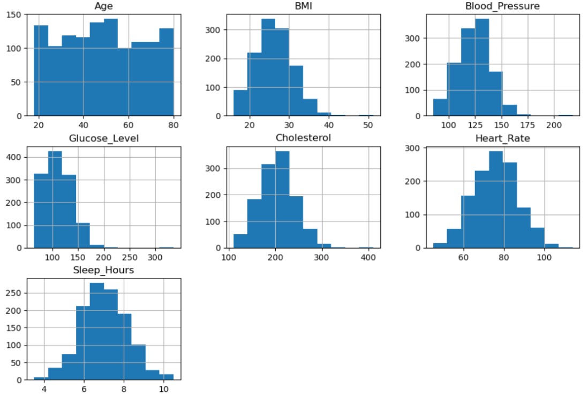
Checking the skewness of all numeric columns.
Python code :-
Result :-
Insights :-
In dataset we can see the all numerical columns have Approximately symmetric ,
Perfectly symmetric .
This means our numeric columns are balanced.

Slide 9
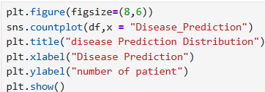
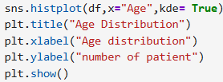
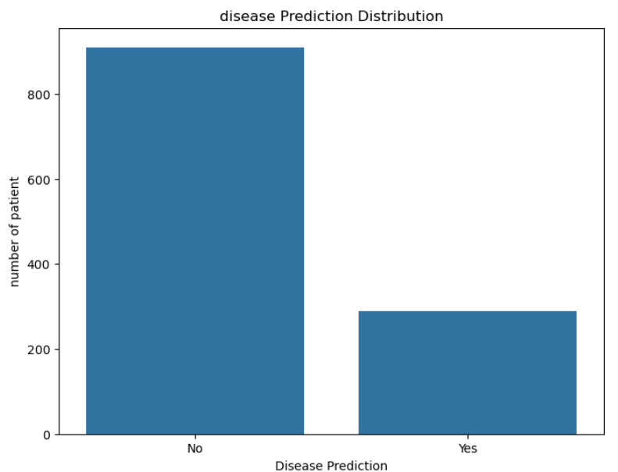
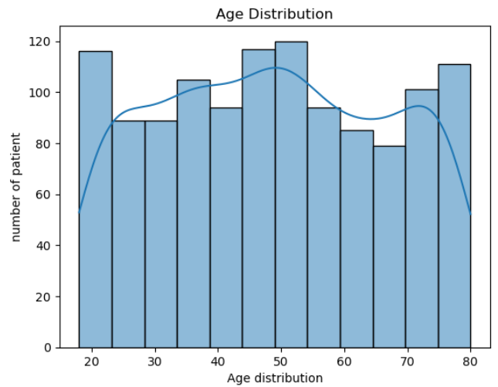
Univariate Analysis:-
Disease Prediction distribution:-
Age distribution analysis:-
Insights:-
In these dataset we can see the both disease-positive and disease-negative patients,
but the negative class represent the larger proportion of observation
Patients are distributed across a different age range, we can see the largest
occurance around the central age groups.

Slide 10
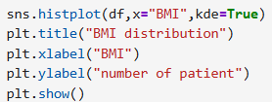
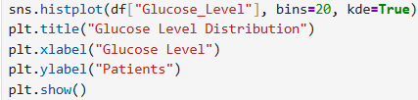
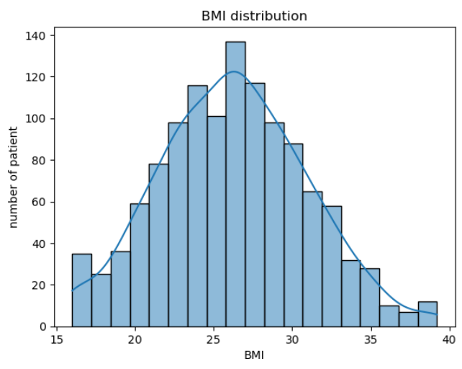
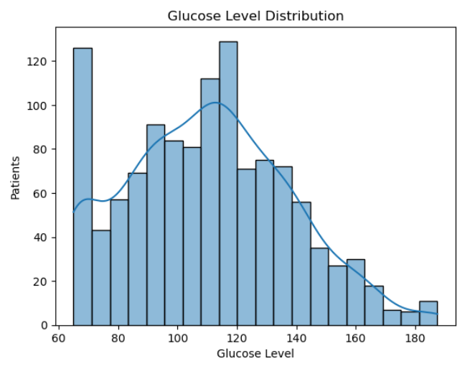
Univariate Analysis:-
BMI Distribution :-
Glucose Level Distribution:-
Insights:-
most patient have body mass index in between 20 to 30, BMI values are
concentrated within the central range
Most observations are concentrated within the central glucose range

Slide 11


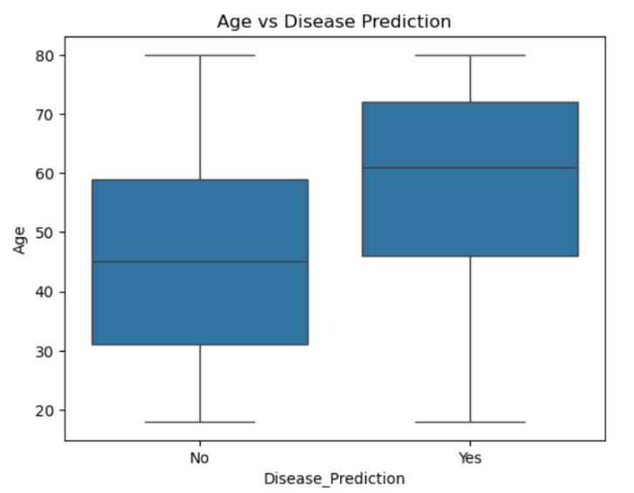
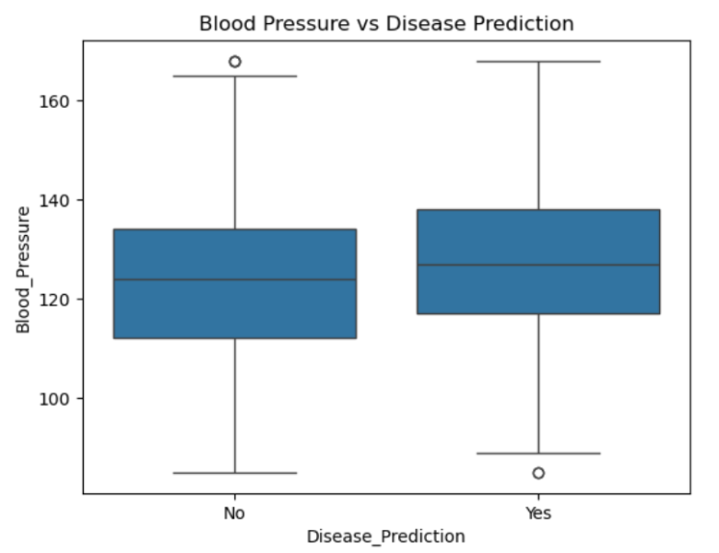
Bivariate Analysis:-
Age vs Disease Prediction :-
Blood Pressure vs Disease Prediction:-
Insights:-
the disease-positive group shows a different age distribution compared with the
disease-negative group
“Yes” have a slightly higher median blood pressure than those with “No,”

Slide 12
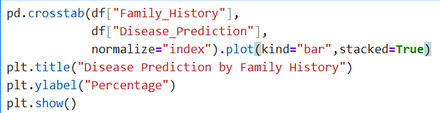

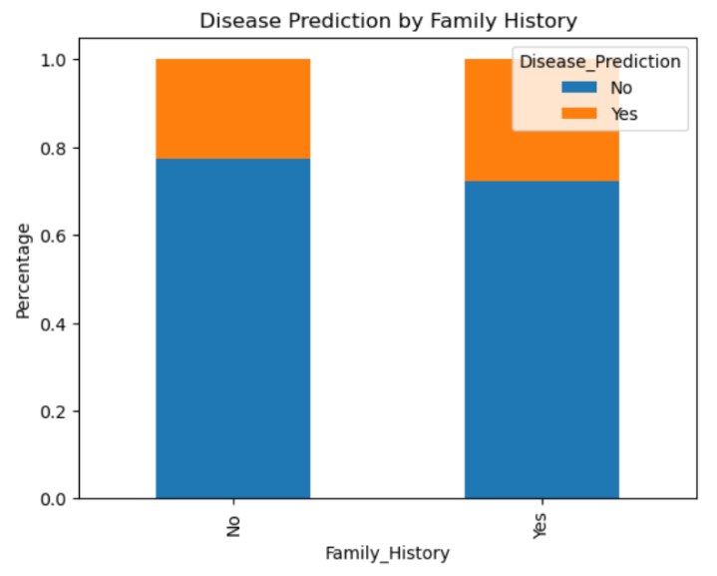
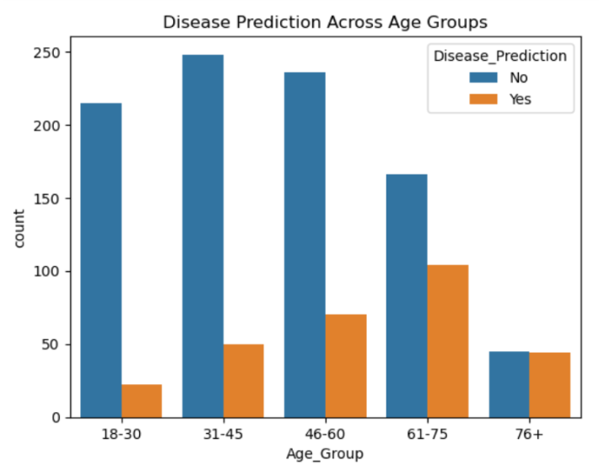
Bivariate Analysis:-
Disease prediction by family
history:-
Disease Prediction Across Age Groups:-
Insights:-
Patients with a reported family history show a different disease-prediction
distribution compared with patients without a family history.
Disease-positive predictions vary across age groups, with the older age categories
showing higher positive prediction rates than younger groups

Slide 13
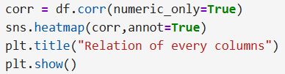

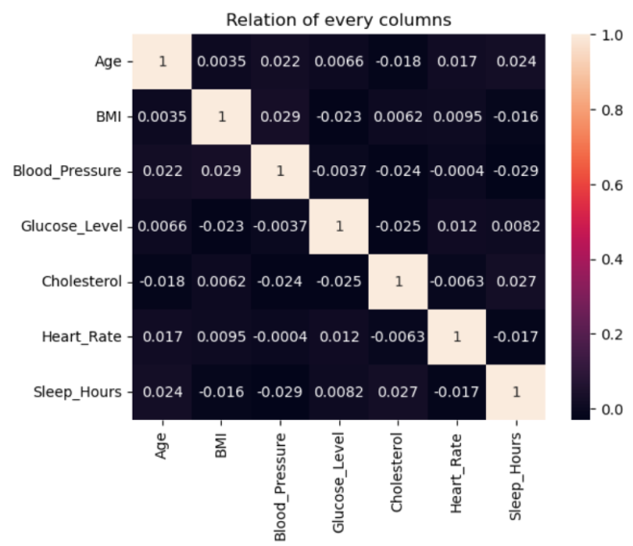
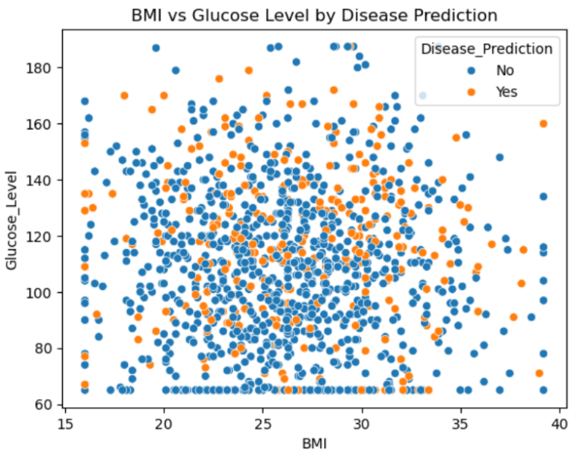
Multivariate Analysis:-
Correlation heatmap :-
BMI + Glucose + Disease Prediction :-
Insights:-
this heatmap show the how strong relationship between every numeric columns.
The scatter plot shows how BMI and glucose jointly vary across prediction groups
and helps identify whether disease-positive observations tend to concentrate in
particular regions.

Slide 14
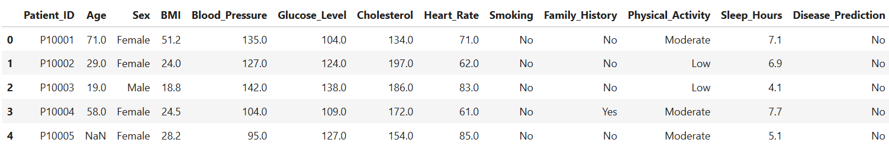
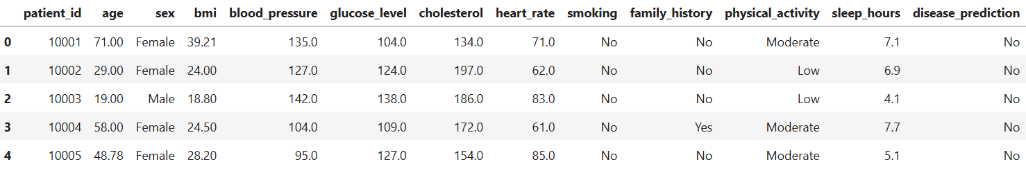
Checking the dataset before and after the EDA analysis :-
Before :-
After :-

