Slide 1
KIPA PROJECT DIGITAL TRANSFORMATION OF ORGANIZATIONS
Modou Lamin Manjang
Aiman Alam
Suraj Karakulath
Husnain Dawood
Niloufar Shokri
Sergey Polyarus

Slide 2
PURPOSE OF THE PROJECT
Discover Waste Price determinants
Potential Price Determinants –
Weather (Extreme Wind | Temp)
Energy (oil, electricity, gas)
business cycle ( CPI | DAX | IFO | BAU)
Euwid
Quantities

Slide 3
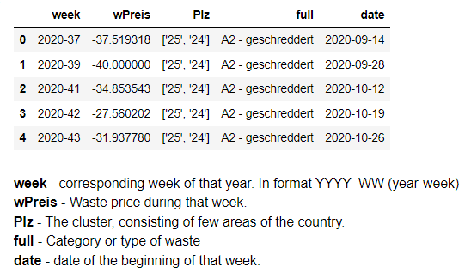
WASTE DATASET

Slide 4
WASTE DATASET FEATURES
Contain waste price information for country Germany divided into cluster formation where each cluster represents few area of the country.
In total there are 10 clusters in this dataset
In total there are 4 categories of waste categories and not each cluster have all of them.
The data is given on weekly basis starting from week 37 of year 2020.
The waste price (wpreis) basically means the amount supplier has to pay to get the waste materials (when wpreis is negative) or the amount the suppliers get to take the waste materials ( when wpreis is positive).

Slide 5
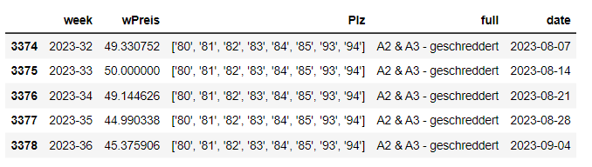
We can see wPreis is positive here

Slide 6
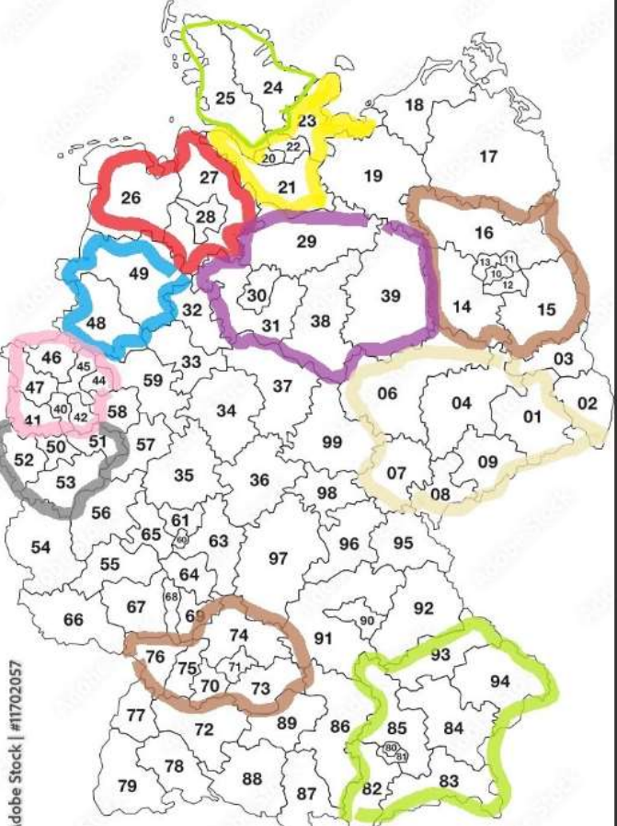
10 CLUSTERS
"['10', '11', '12', '13', '14', '15', '16']", "['48', '49']",
['25', '24’]
['26', '27', '28’]
['20', '21', '22', '23’]
['29', '30', '31', '38', '39']
['10', '11', '12', '13', '14', '15', '16’]
['48', '49’]
['1', '4', '6', '7', '8', '9']
['40', '41', '42', '44', '45', '46', '47’]
['50', '51', '52', '53’]
['80', '81', '82', '83', '84', '85', '93', '94']

Slide 7
CATEGORIES OF WASTE
'A2 - geschreddert‘
'A1 & A2 - geschreddert‘
'A2 & A3 - geschreddert‘
'A3 - geschreddert']

Slide 8
Correlations between the Fluctuations of Electricity Prices and Waste Prices in Germany.

Slide 9
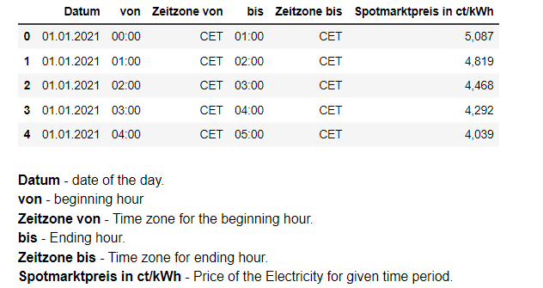
ELECTRICITY DATASET

Slide 10
CLEANING REQUIRED IN ELECTRICITY DATASET
We can very clearly observe that few changes need to be made in our electricity dataset, so that we can efficiently and correctly do the analysis.
Hence, we will be performing the following tasks-
Convert the 'Datum' column to datetime
Clean 'Spotmarktpreis in ct/kWh' by removing commas and converting to float
Calculate the average weekly value of Spotmarktpreis since waste dataset is given in week basis
Extract the week from the 'Datum' column
Calculate average weekly Spotmarktpreis
Add Index for merging.

Slide 11
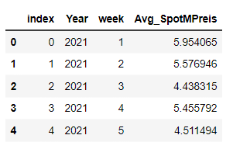
ELECTRICITY DATASET AFTER CLEANING

Slide 12
CLEANING REQUIRED IN WASTE DATASET
Extracting Data from January 1, 2021 from Waste price dataset.

Slide 13
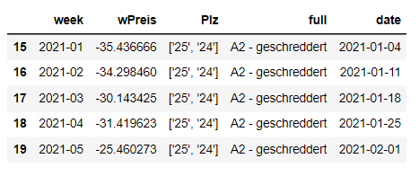
WASTE DATASET AFTER CLEANING

Slide 14
PROCESS FOLLOWED
IMPORT LIBRARIES
ACCESS THE DATASETS
PREPROCESSING AND CLEANING THE DATASETS

Slide 15
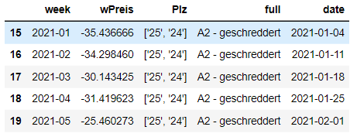
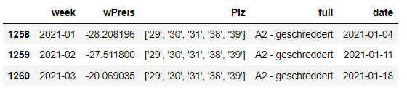
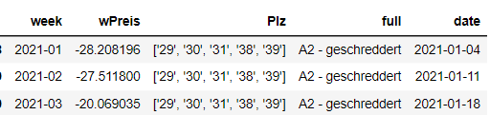
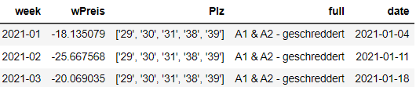
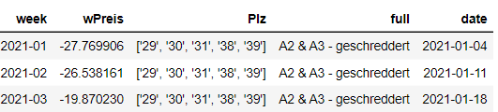
PROCESS FOLLOWED FOR EACH CLUSTER
MAIN WASTE DATASET
A2
EXTRACT CLUSTER DATASET
A1 & A2
A2 & A3
EXTRACT EACH WASTE TYPE DATATSET FROM THE CLUSTER DATASET

Slide 16
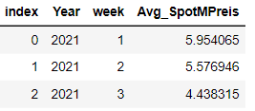
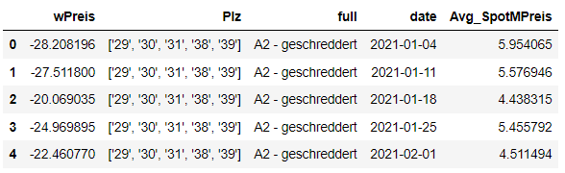
PROCESS FOLLOWED FOR EACH CLUSTER
MERGING THE WASTE AND ELECTRICITY DATASETS

Slide 17
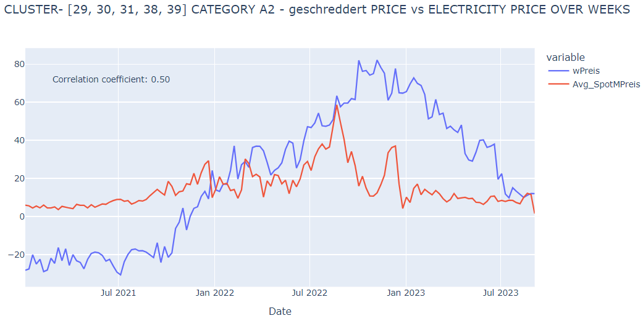
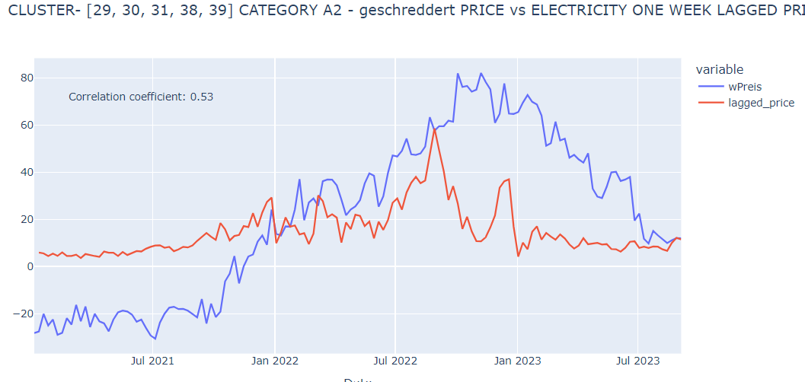
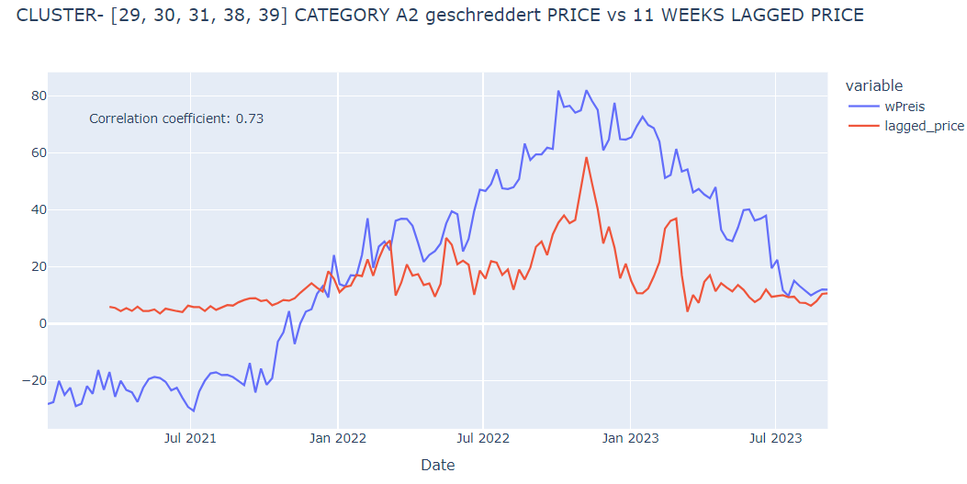
PROCESS FOLLOWED FOR EACH CLUSTER
EXPLORATORY DATA ANALYSIS
Merged Dataset Of Category Type Price Vs Electricity Price
OVER WEEKS
ONE WEEK LAG
MULTIPLE WEEK LAGS

Slide 18
CLUSTER 1

Slide 19
CLUSTER -['29', '30', '31', '38', '39’]
TYPE A2
TYPE A1 & A2
TYPE A2 & A3

Slide 20
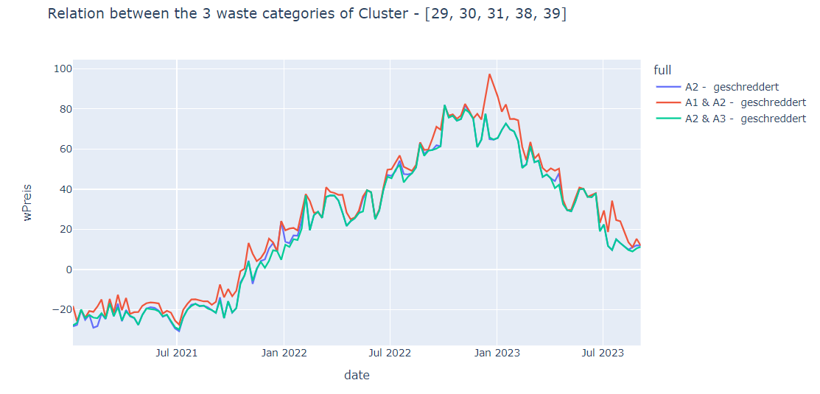
CLUSTER -['29', '30', '31', '38', '39’]

Slide 21
CLUSTER -['29', '30', '31', '38', '39’]
TYPE A2
TYPE A1 & A2
TYPE A2 & A3

Slide 22
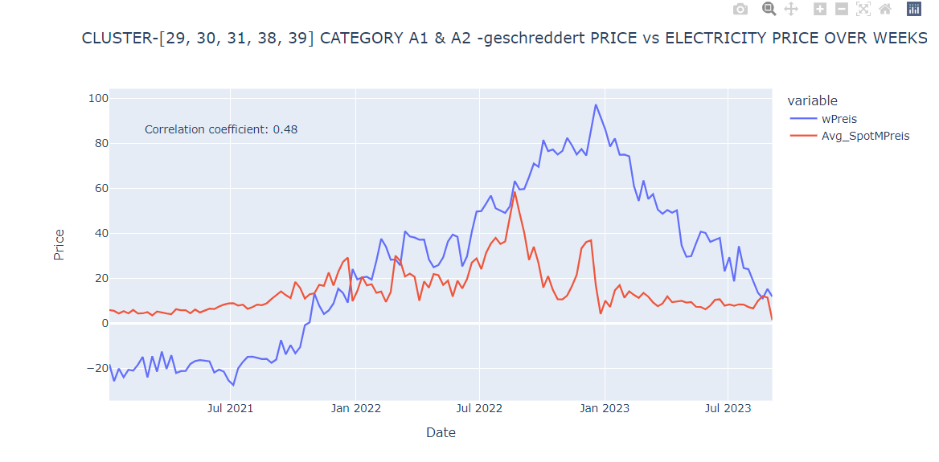
CLUSTER -['29', '30', '31', '38', '39’] Category - A1 & A2 geschreddert

Slide 23
CLUSTER -['29', '30', '31', '38', '39’] Category - A1 & A2 geschreddert

Slide 24
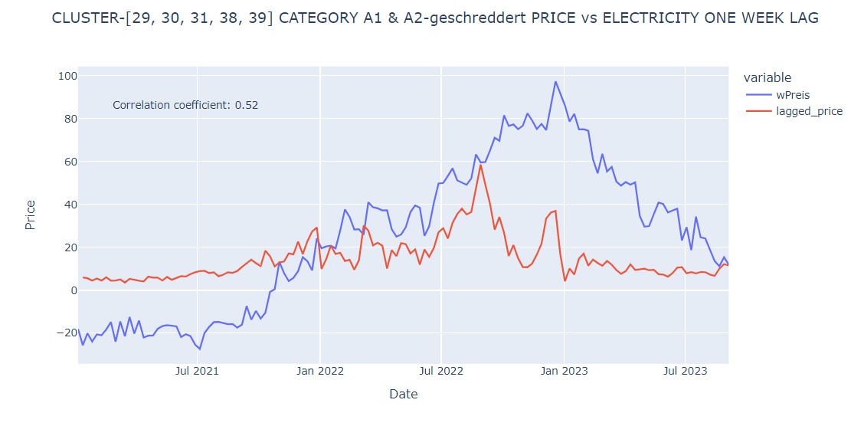
ONE WEEK LAG

Slide 25
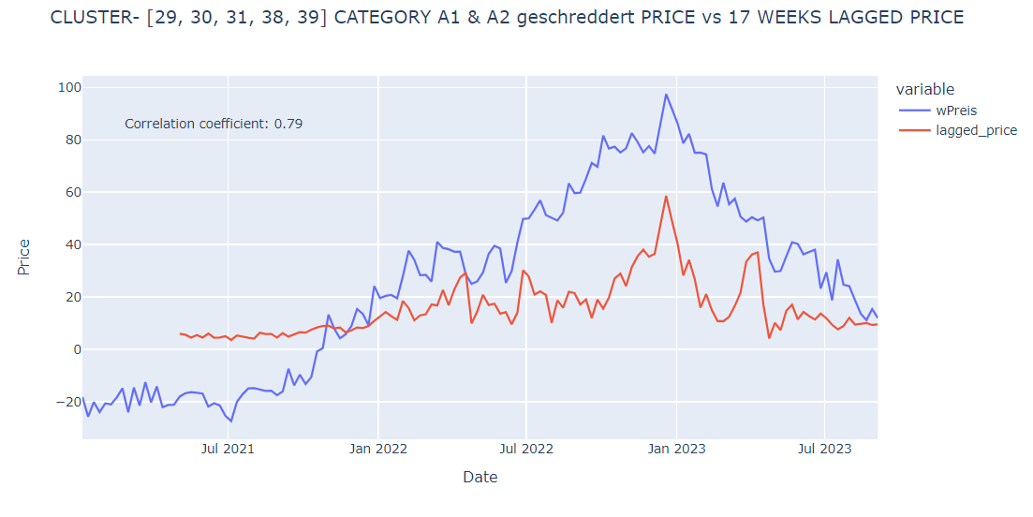
17 WEEKS LAG

Slide 26
17 WEEKS LAG

Slide 27
CLUSTER 2

Slide 28
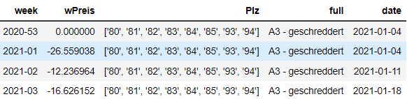
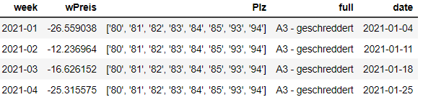
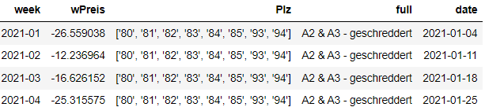
CLUSTER -['80', '81', '82', '83', '84', '85', '93', '94’]
TYPE A3
TYPE A2 & A3

Slide 29
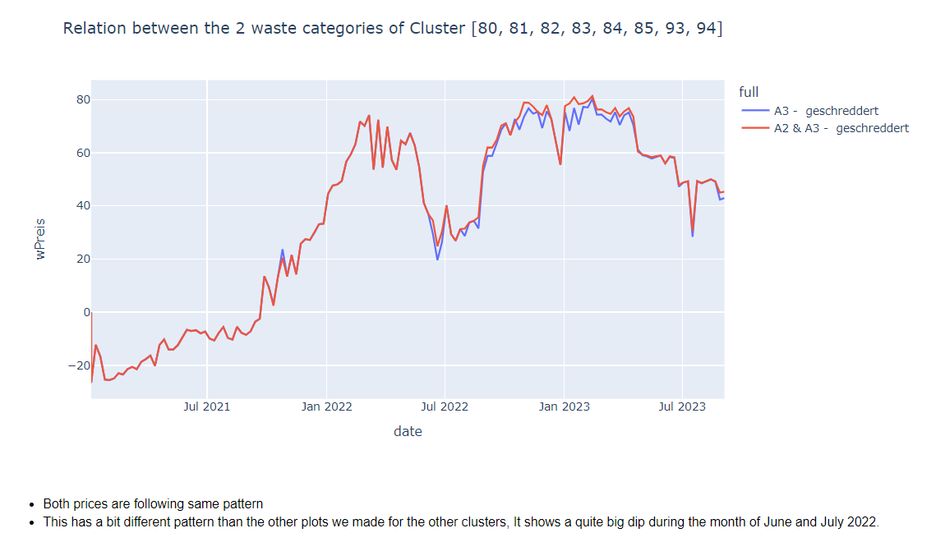
CLUSTER -['80', '81', '82', '83', '84', '85', '93', '94’]

Slide 30
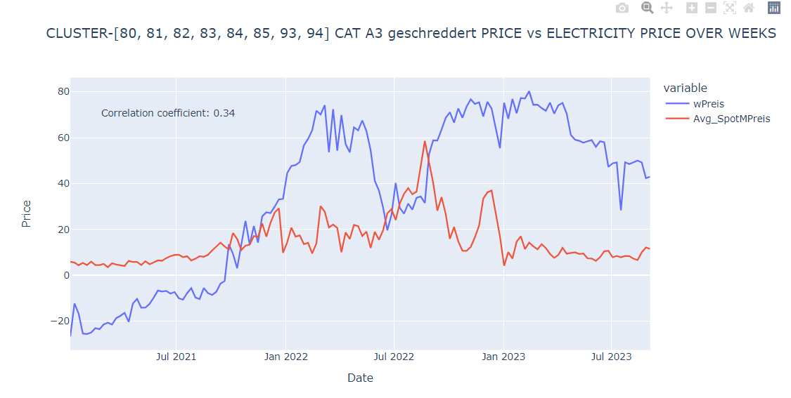
CLUSTER -['80', '81', '82', '83', '84', '85', '93', '94’] Category - A3 - geschreddert

Slide 31
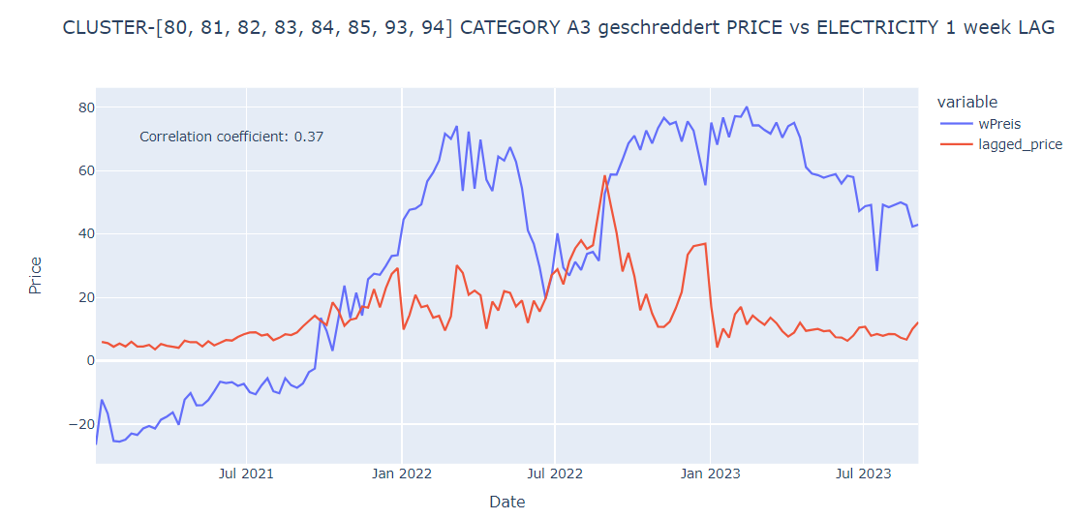
ONE WEEK LAG

Slide 32
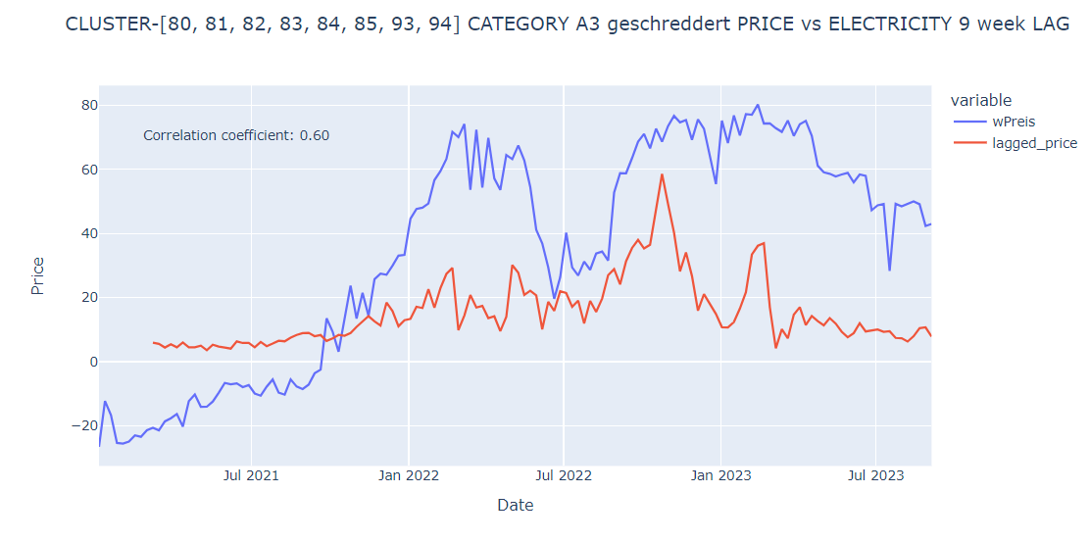
9 WEEKS LAG

Slide 33
9 WEEKS LAG

Slide 34
CONCLUSION
A very similar pattern and trend has been observed throughout the project for each of the categories of different clusters.
Also it was quite evident that creating one week LAG did not show much difference than the original one but higher LAGS were showing more correlation for each of them.
I had real fun exploring with real data and observing if or not energy prices are affecting the waste price as we do agree managing and disposing waste properly is extremely important and if something beneficial can be extracted from it then that is for best.

Slide 35
PRICE DETERMINANT - WEATHER
NILOUFAR SHOKRI

