Slide 1

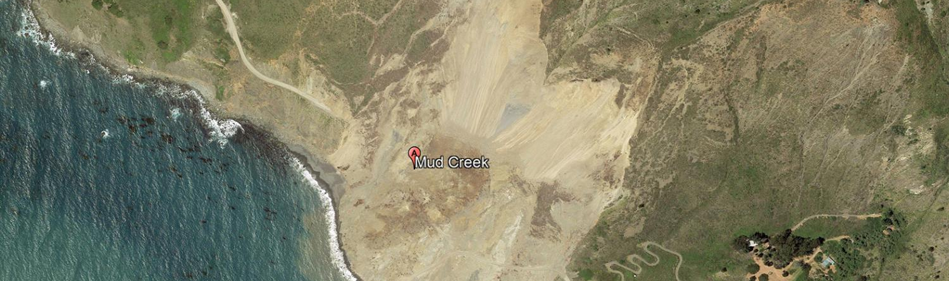
AI-POWERED LANDSLIDE REGION MAPPING USING SEMANTIC SEGMENTATION
Suraj Karki
25.08.2025
Dr.-Ing. Constanze Schwan
Notes:
HAW

Slide 2
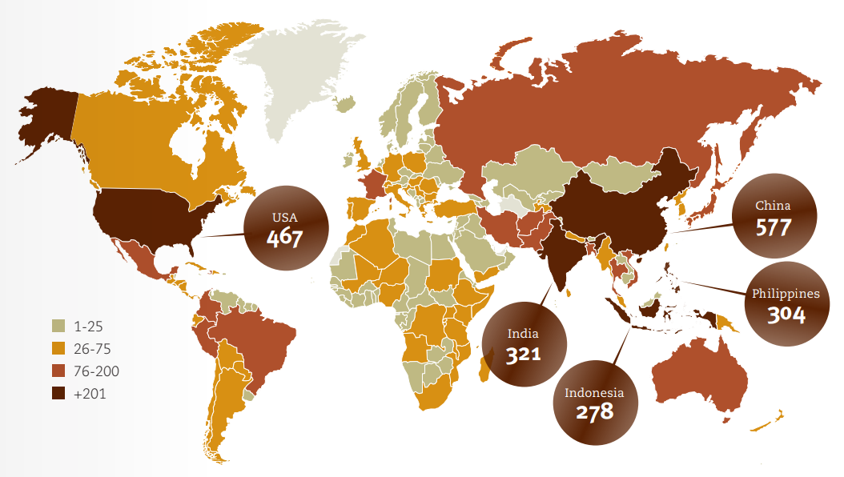
Introduction
Landslides are one of the most common and dangerous natural disasters globally
It causes significant damage to infrastructure, agriculture, and human life
According to the UNDRR, over 4,000 people die each year globally due to landslides ¹
Rapid post-disaster mapping is vital for guiding rescue efforts and risk assessment
1. UNDRR, Human Cost of Disasters: An Overview of the Last 20 Years (2000–2019), United Nations Office for Disaster Risk Reduction, 2020. [Online]. Available: https://www.undrr.org/publication/human-cost-disasters-overview-last-20-years-2000-2019
AI-Powered Landslide Region Mapping using Semantic Segmentation | Hochschule Bielefeld | 25.08.2025 | Page 2
Notes:
HAW

Slide 3
Problem statement
Manual mapping of landslide areas in post landslide assessment is slow, inconsistent, and risky.
Precise, up-to-date landslide masks are needed for:
Damage assessment
Recovery planning
Updating geohazards maps
A system is required to automatically generate post-landslide maps
AI-Powered Landslide Region Mapping using Semantic Segmentation | Hochschule Bielefeld | 25.08.2025 | Page 2
Notes:
HAW

Slide 4
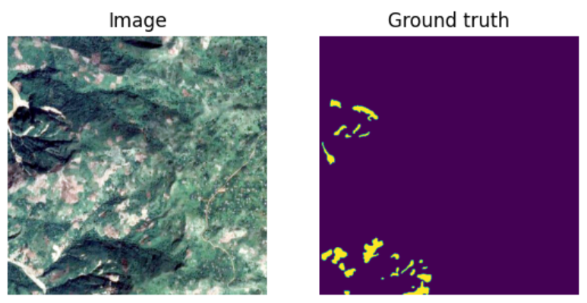
objective
To develop a deep learning model for precise landslide mapping
To obtain high performance in segmenting landslide regions from satellite and UAV imagery
To enable real-time monitoring and support disaster management efforts
Figure Source: Zhao et al. (2023), A global dataset of landslide inventories compiled from satellite imagery. Scientific Data. https://doi.org/10.1038/s41597-023-02847-z
AI-Powered Landslide Region Mapping using Semantic Segmentation | Hochschule Bielefeld | 25.08.2025 | Page 2
Notes:
HAW

Slide 5
State of the art
Points
Sub-points
AI-Powered Landslide Region Mapping using Semantic Segmentation | Hochschule Bielefeld | 25.08.2025 | Page 2
Notes:
HAW

Slide 6
Data acquisition
Points
Sub-points
AI-Powered Landslide Region Mapping using Semantic Segmentation | Hochschule Bielefeld | 25.08.2025 | Page 2
Notes:
HAW

Slide 7
Data structure
Points
Sub-points
AI-Powered Landslide Region Mapping using Semantic Segmentation | Hochschule Bielefeld | 25.08.2025 | Page 2
Notes:
HAW

Slide 8
ML models
Points
Sub-points
AI-Powered Landslide Region Mapping using Semantic Segmentation | Hochschule Bielefeld | 25.08.2025 | Page 2
Notes:
HAW

Slide 9
fine-tuning
Points
Sub-points
AI-Powered Landslide Region Mapping using Semantic Segmentation | Hochschule Bielefeld | 25.08.2025 | Page 2
Notes:
HAW

Slide 10
results
Points
Sub-points
AI-Powered Landslide Region Mapping using Semantic Segmentation | Hochschule Bielefeld | 25.08.2025 | Page 2
Notes:
HAW

Slide 11
discussion
Points
Sub-points
AI-Powered Landslide Region Mapping using Semantic Segmentation | Hochschule Bielefeld | 25.08.2025 | Page 2
Notes:
HAW

Slide 12
conclusion
Points
Sub-points
AI-Powered Landslide Region Mapping using Semantic Segmentation | Hochschule Bielefeld | 25.08.2025 | Page 2
Notes:
HAW

Slide 13

AI-Powered Landslide Region Mapping using Semantic Segmentation | Hochschule Bielefeld | 25.08.2025 | Page 2
Notes:
HAW

Slide 14

AI-Powered Landslide Region Mapping using Semantic Segmentation | Hochschule Bielefeld | 25.08.2025 | Page 2
Notes:
HAW

