Slide 1


ROBOTINO PROJECT
Suraj Karki
19.09.2025
Prof. Dr.-Ing. Christian Schwede; M.Sc. Philip Maurice Scheidig; B.Sc Roman Sliwinski
Notes:
HAW

Slide 2
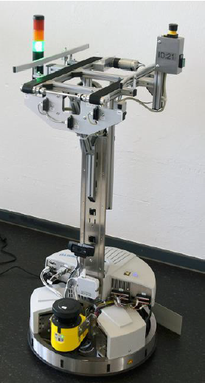
Introduction
Robotino AGV → mobile robot for education & research
Equipped with sensors (SICK LMS100, optical encoders,
infrared sensor and camera) for autonomous navigation.
It has omnidirectional movement for flexible navigation.
Robotino Project | Hochschule Bielefeld | 19.09.2025 | Page 2
Notes:
HAW

Slide 3

Problem statement
Currently, generation of path network for Robotino is manual and slow
It relies heavily on expert knowledge
Changing paths for new factory layouts takes a lot of time and effort.
Robotino Project | Hochschule Bielefeld | 19.09.2025 | Page 3
Notes:
HAW

Slide 4

objective
To generate a map of the environment including the stations of the IoT factory
To generate an optimized path network based on recordings
Robotino Project | Hochschule Bielefeld | 19.09.2025 | Page 4
Notes:
HAW

Slide 5
Methods & implementations
SLAM (Simultaneous Localization and Mapping)
It is the process by which a mobile robot build a map of the environment and, at the same time use this map to compute its location simultaneously. ¹
1. Bailey, Tim, and Hugh Durrant-Whyte. "Simultaneous localization and mapping (SLAM): Part II." IEEE robotics & automation magazine 13.3 (2006): 108-117.
Robotino Project | Hochschule Bielefeld | 19.09.2025 | Page 5
Notes:
HAW

Slide 6
Methods & implementations
Types of SLAM:
Filtering
State is estimated “on the go” with latest measurements
For example, Kalman Filter, EKF, Particle Filtering, etc.
Smoothing
Full trajectories are estimated using complete set of measurements
For example, Graph-based SLAM with Pose Graph Optimization, etc.
Robotino Project | Hochschule Bielefeld | 19.09.2025 | Page 6
Notes:
HAW

Slide 7
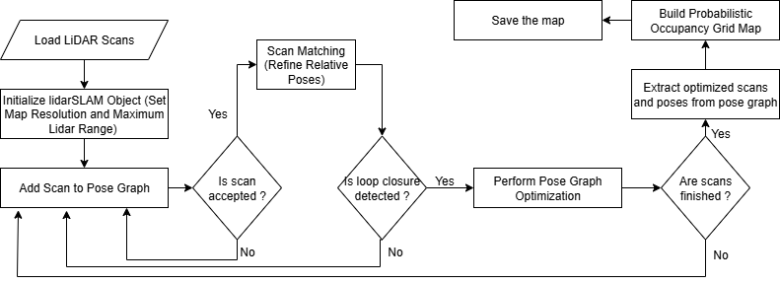
Methods & implementations
Workflow for Map Generation (Graph-based SLAM)
Robotino Project | Hochschule Bielefeld | 19.09.2025 | Page 7
Notes:
HAW

Slide 8
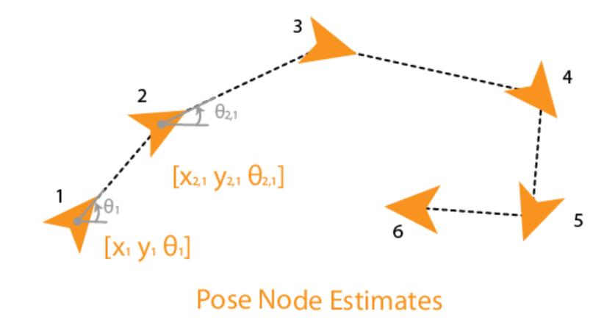
Methods & implementations
Pose Graph
A pose graph contains nodes connected by edges.
Nodes → robot poses (position + orientation) at different times
Edges → constraints between poses (odometry constraint,
loop closures)
These edge constraints also represent the uncertainty
associated with that measurement.
Robotino Project | Hochschule Bielefeld | 19.09.2025 | Page 8
Notes:
HAW

Slide 9
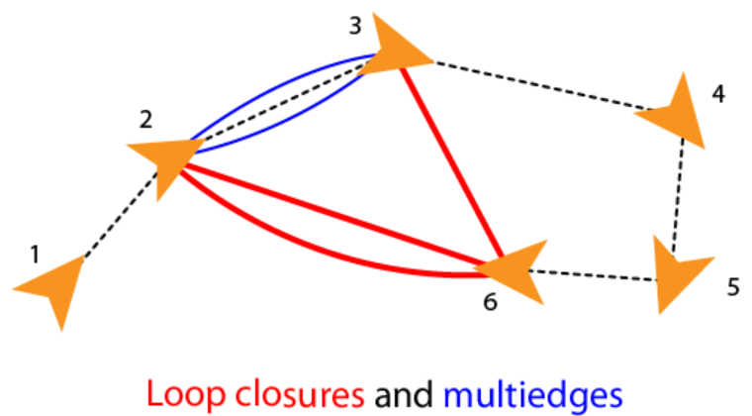
Methods & implementations
Loop Closure
It tells the SLAM system that the robot has returned to a
previously visited area.
It helps to correct errors (drift in trajectory) in the map.
Connecting two nodes that are not next to each other
(non-sequential), creates a loop closure.
Robotino Project | Hochschule Bielefeld | 19.09.2025 | Page 9
Notes:
HAW

Slide 10
Methods & implementations
Pose Graph Optimization
It is a technique to improve the estimated poses (positions and orientations) of a robot as it moves through an environment.
Goal: to minimize the errors in the estimated poses by considering the relationships and constraints between them.
This is typically achieved by minimizing a global error function.
This function measures the difference between the observed constraints and the predicted constraints based on the current pose estimates.
The optimization process adjusts the poses to reduce this error, resulting in a more accurate and consistent set of poses.
Robotino Project | Hochschule Bielefeld | 19.09.2025 | Page 10
Notes:
HAW

Slide 11
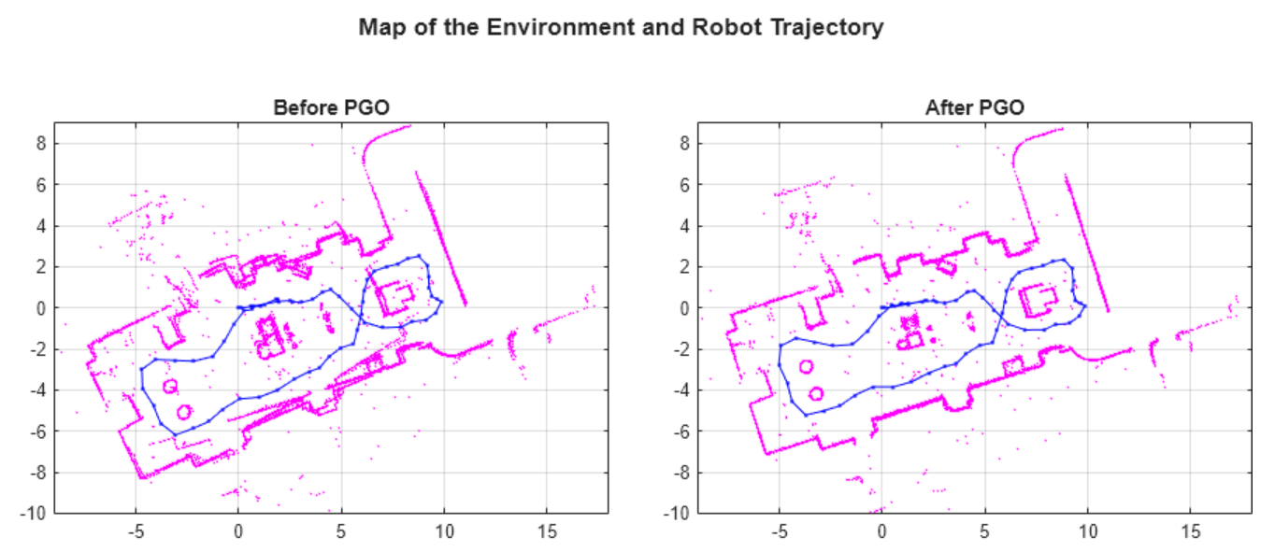
Methods & implementations
Pose Graph Optimization
Robotino Project | Hochschule Bielefeld | 19.09.2025 | Page 11
Notes:
HAW

Slide 12
Methods & implementations
Occupancy Grid Map
A way to represent the environment as a grid of cells.
Each cell in the occupancy grid has a value representing the probability of the occupancy of that cell
Value close to 1 → cell likely occupied (obstacle).
Value close to 0 → cell likely free (no obstacle).
Value = 0.5 → unknown
Robotino Project | Hochschule Bielefeld | 19.09.2025 | Page 12
Notes:
HAW

Slide 13
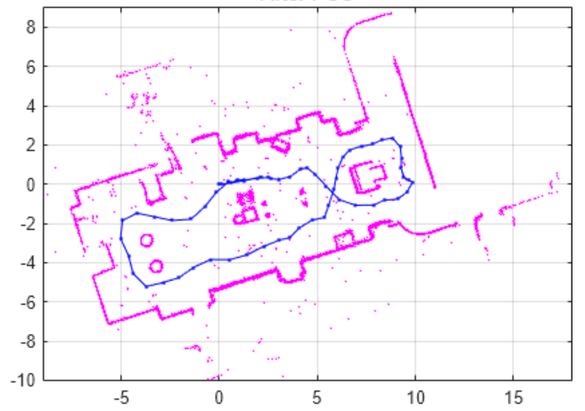
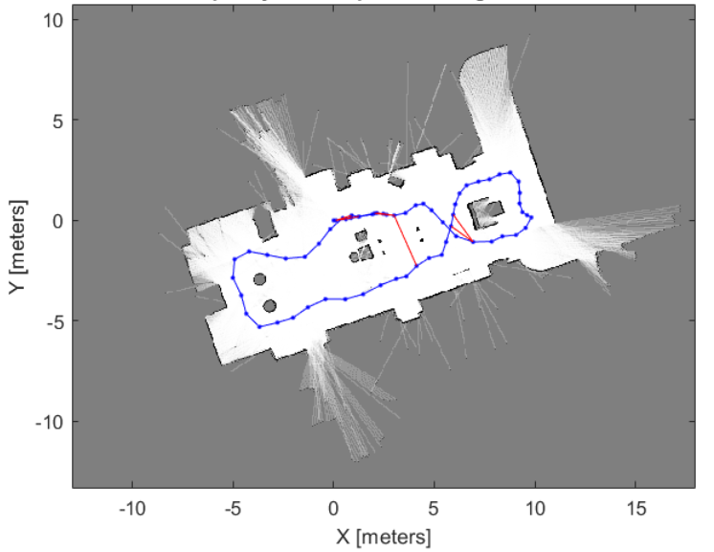
Methods & implementations
Occupancy Grid Map
Optimized Scans & Poses
2D Probability Occupancy Grid Map
Robotino Project | Hochschule Bielefeld | 19.09.2025 | Page 13
Notes:
HAW

Slide 14
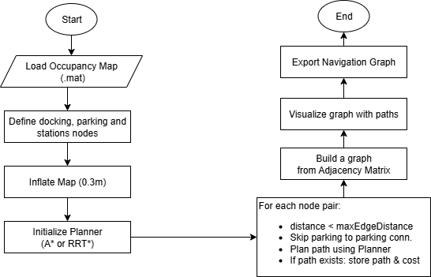
Methods & implementations
Workflow for Optimized Path-Network Generation
Robotino Project | Hochschule Bielefeld | 19.09.2025 | Page 14
Notes:
HAW

Slide 15
Methods & implementations
Path Planning
Finding a path from the current position to the goal position given a map of the environment.
Path Planning Algorithms
Search-based: A*
Sampling-based: RRT, RRT*
Robotino Project | Hochschule Bielefeld | 19.09.2025 | Page 15
Notes:
HAW

Slide 16
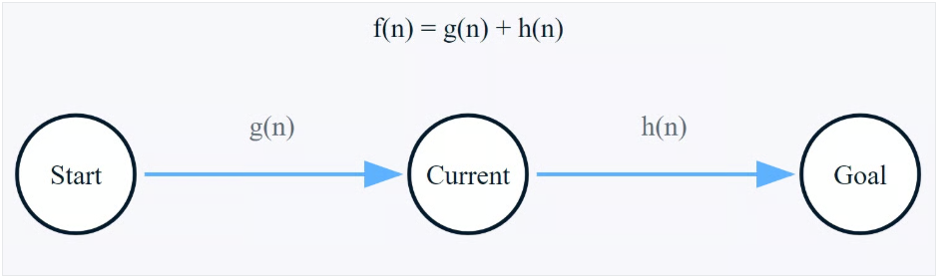
Methods & implementations
A*
A popular graph traversal path planning algorithm.
Heuristic-Based.
Evaluation function, f(n)=g(n)+h(n)
Where,f(n) is the estimated total cost of the path through node n.
g(n) is actual cost from the start node to n.
h(n) is estimated cost (heuristic) from n to the goal node.
Robotino Project | Hochschule Bielefeld | 19.09.2025 | Page 16
Notes:
HAW

Slide 17
Methods & implementations
A*
Optimality: Guarantees the shortest path if the heuristic is admissible (never overestimates).
Completeness: If a path exists, A* will always find it.
The performance of A* depends heavily on the heuristic function chosen.
Works with different heuristics like Manhattan distance, Euclidean distance, or custom heuristics depending on the problem.
Robotino Project | Hochschule Bielefeld | 19.09.2025 | Page 17
Notes:
HAW

Slide 18
Methods & implementations
Workings of A*
Initialization
Setting up two essential lists:
“open” list: initialize with starting node
“closed” list: begins empty
Each node stores 4 critical information:
g: The actual cost from the start node
h: The estimated cost to the goal
f: The sum of g and h
parent: Reference to the previous node (for path reconstruction)
Robotino Project | Hochschule Bielefeld | 19.09.2025 | Page 18
Notes:
HAW

Slide 19
Methods & implementations
Workings of A*
Main Loop:
The main loop will continues until either:
The goal is reached (success)
The open list becomes empty (failure - no path exists)
During each iteration, the algorithm:
Selects the most promising node (lowest f value) from the open list
Moves it to the closed list
Examines all neighboring nodes
Robotino Project | Hochschule Bielefeld | 19.09.2025 | Page 19
Notes:
HAW

Slide 20
Methods & implementations
Workings of A*
Neighbor Examination:
For each neighbor, the algorithm:
Skips nodes already in the closed list
Calculates a tentative g score
Updates node values if a better path is found
Adds new nodes to the open list
Robotino Project | Hochschule Bielefeld | 19.09.2025 | Page 20
Notes:
HAW

Slide 21
Methods & implementations
Workings of A*
Path Reconstruction:
Once the goal is reached, the algorithm works backward through the parent references to construct the optimal path from start to goal.
Robotino Project | Hochschule Bielefeld | 19.09.2025 | Page 21
Notes:
HAW

Slide 22
Methods & implementations
RRT (Rapidly Exploring Random Tree)
Sampling-based path planning algorithm
Grows a random tree by sampling points in the space
and connect them to the nearest existing node.
Efficiently explores large, high-dimensional, or obstacle-filled environments.
if a path exists, RRT will find it given enough time.
basic RRT does not ensure the shortest path
Robotino Project | Hochschule Bielefeld | 19.09.2025 | Page 22
Notes:
HAW

Slide 23
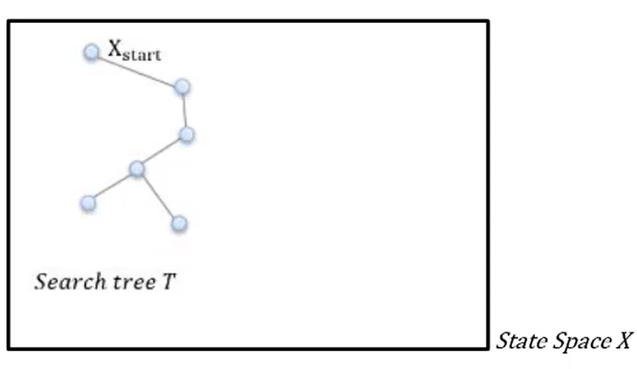
Methods & implementations
Workings of RRT
Define the State Space: Represent the environment (e.g., SE2 for 2D with orientation).
Initialize the Tree – Start with the root node at the robot’s initial position.
Robotino Project | Hochschule Bielefeld | 19.09.2025 | Page 23
Notes:
HAW

Slide 24
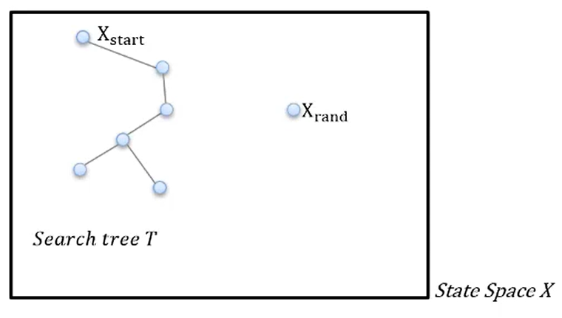
Methods & implementations
Workings of RRT
Random Sampling – Sample a random state Xrand​ within the state space.
Robotino Project | Hochschule Bielefeld | 19.09.2025 | Page 24
Notes:
HAW

Slide 25
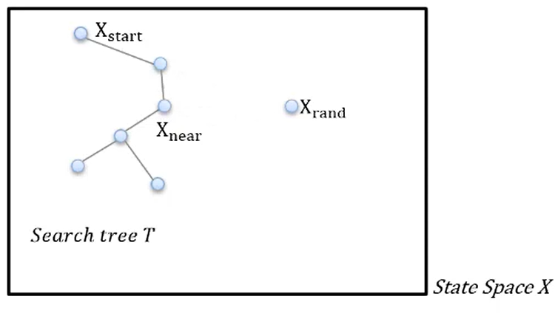
Methods & implementations
Workings of RRT
Find Nearest Node – Identify the tree node Xnear​ closest to Xrand​.
Robotino Project | Hochschule Bielefeld | 19.09.2025 | Page 25
Notes:
HAW

Slide 26
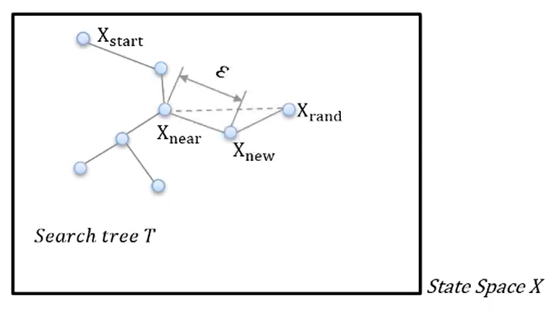
Methods & implementations
Workings of RRT
​Generate New Node – Extend from Xnear​ toward Xrand​ to create Xnew​, using feasible motion models.
Robotino Project | Hochschule Bielefeld | 19.09.2025 | Page 26
Notes:
HAW

Slide 27
Methods & implementations
Workings of RRT
​Collision Checking – Validate that the motion from Xnear​ to Xnew​ is collision-free.
Robotino Project | Hochschule Bielefeld | 19.09.2025 | Page 27
Notes:
HAW

Slide 28
Methods & implementations
Workings of RRT
​​ Add Node to Tree – If valid, add Xnew​ and connect it to Xnear.
Robotino Project | Hochschule Bielefeld | 19.09.2025 | Page 28
Notes:
HAW

Slide 29
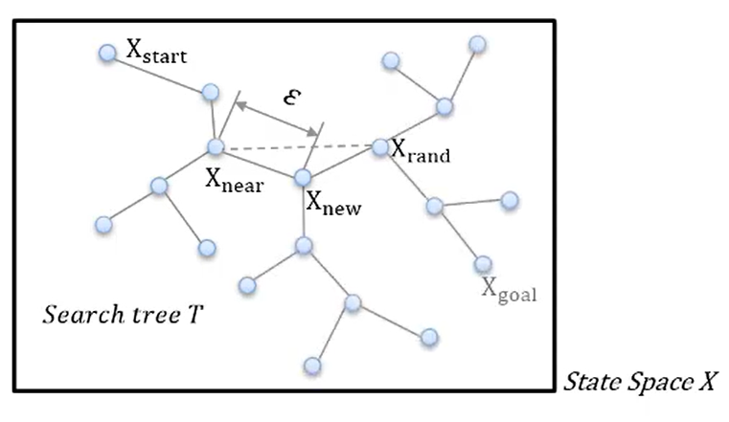
Methods & implementations
Workings of RRT
​​ Iterate – Repeat steps 3–7 until the goal is reached.
Robotino Project | Hochschule Bielefeld | 19.09.2025 | Page 29
Notes:
HAW

Slide 30
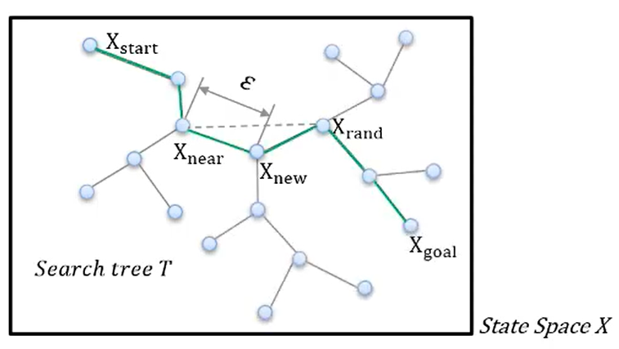
Methods & implementations
Workings of RRT
​​ Path Extraction – Trace back through parent nodes to extract the path.
Robotino Project | Hochschule Bielefeld | 19.09.2025 | Page 30
Notes:
HAW

Slide 31
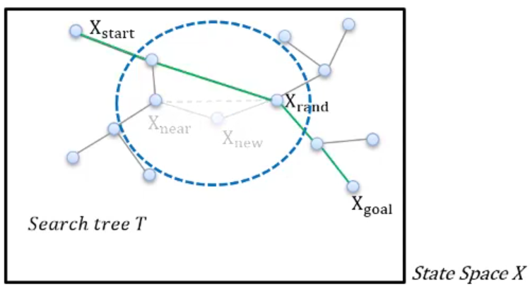
Methods & implementations
RRT*
​​ It expands the tree in a similar way like RRT.
It rewires the tree by looking at nearby nodes within a certain radius and tries to find a shorter path from the new node back to the start.
Robotino Project | Hochschule Bielefeld | 19.09.2025 | Page 31
Notes:
HAW

Slide 32
Experimental setup
Programming Language:
​​MATLAB R2025a: High-level programming language, widely used for numeric computing, data analysis, algorithm development, simulation and visualization.
Toolboxes:
Lidar Toolbox: MATLAB’s toolbox that provides algorithms, apps, and tools for working with LiDAR data.
Navigation Toolbox: Another MATLAB’s toolbox that provides algorithms and analysis tools for motion planning, SLAM, and inertial navigation.
Robotino Project | Hochschule Bielefeld | 19.09.2025 | Page 32
Notes:
HAW

Slide 33
results
Overview of Output Files From Map Generation Process:
.mat File: Contains the occupancy grid map data.
.yaml File: Stores image metadata for the occupancy grid map.
.pgm File: Grayscale image format of the occupancy grid map.
.png File: Grayscale image format of the occupancy grid map.
Robotino Project | Hochschule Bielefeld | 19.09.2025 | Page 33
Notes:
HAW

Slide 34
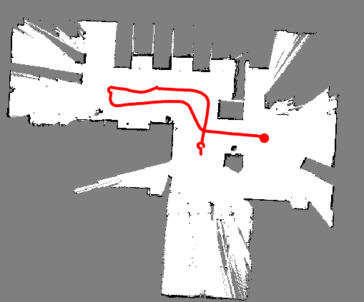
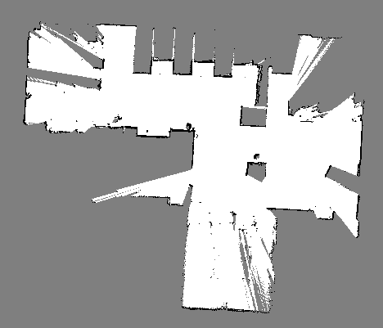
results
Generated Map of IOT Factory
Robotino Project | Hochschule Bielefeld | 19.09.2025 | Page 34
Notes:
HAW

Slide 35
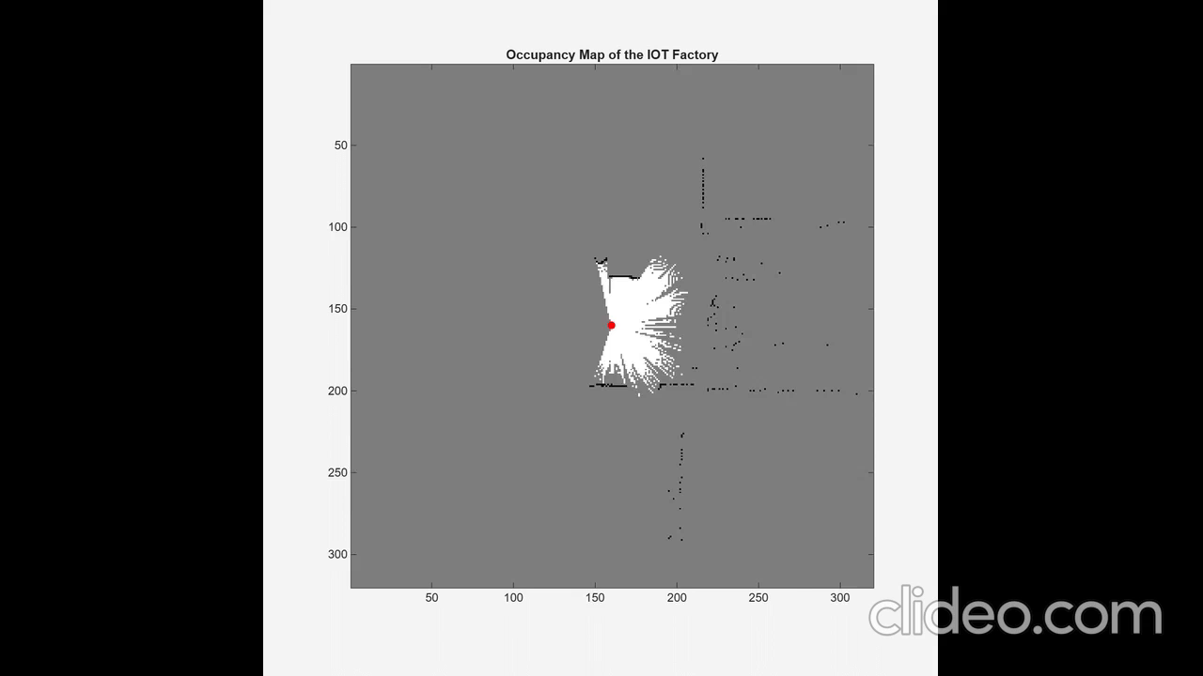
results
Video of Map Generation of IOT Factory
Robotino Project | Hochschule Bielefeld | 19.09.2025 | Page 35
Notes:
HAW

Slide 36
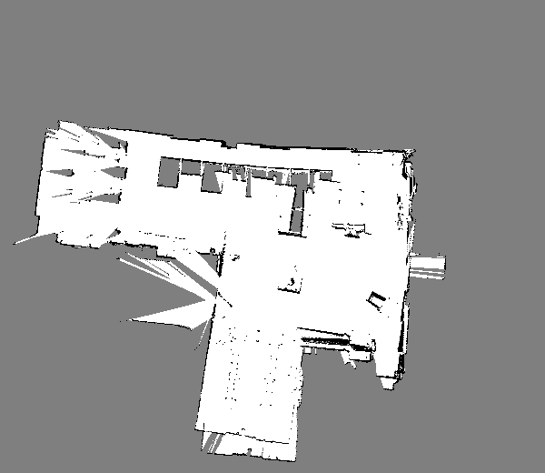
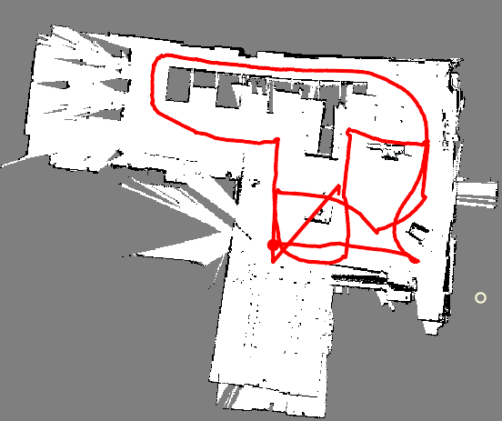
results
Generated Map of IOT Factory with Different Data
Robotino Project | Hochschule Bielefeld | 19.09.2025 | Page 36
Notes:
HAW

Slide 37
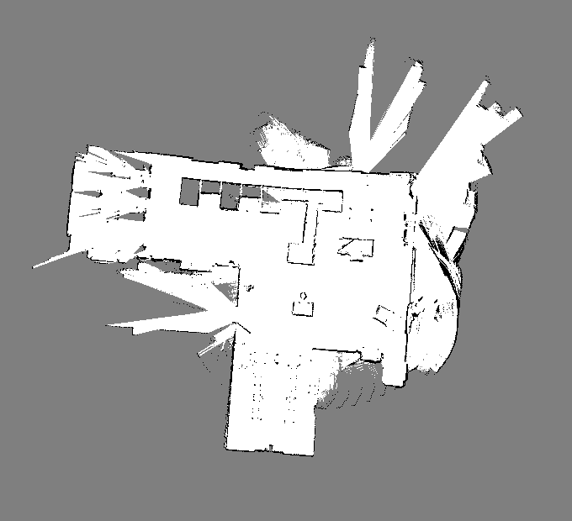
results
Generated Map of IOT Factory with Different Data
Robotino Project | Hochschule Bielefeld | 19.09.2025 | Page 37
Notes:
HAW

Slide 38
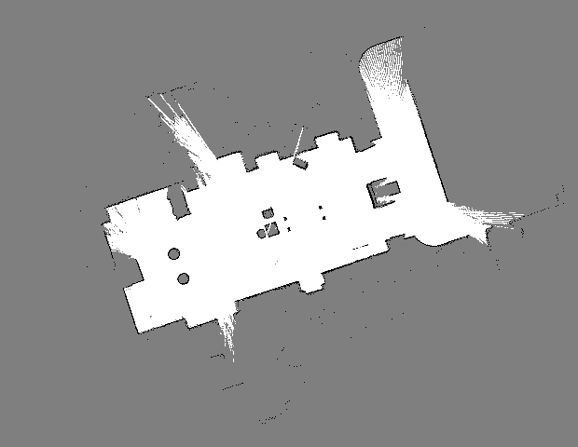
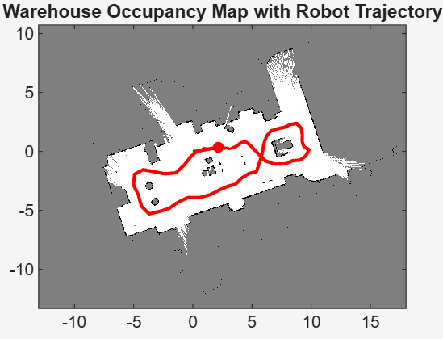
results
Generated Map of Warehouse
Robotino Project | Hochschule Bielefeld | 19.09.2025 | Page 38
Notes:
HAW

Slide 39
results
Overview of Output Files From Path Network Generation Process:
navigation-paths.xml: contains navigation paths between nodes (docking+parking).
positions.lisp: A LISP file listing the coordinates of all nodes.
stations.lisp: A LISP file containing station coordinates and their closest associated nodes.
Robotino Project | Hochschule Bielefeld | 19.09.2025 | Page 39
Notes:
HAW

Slide 40
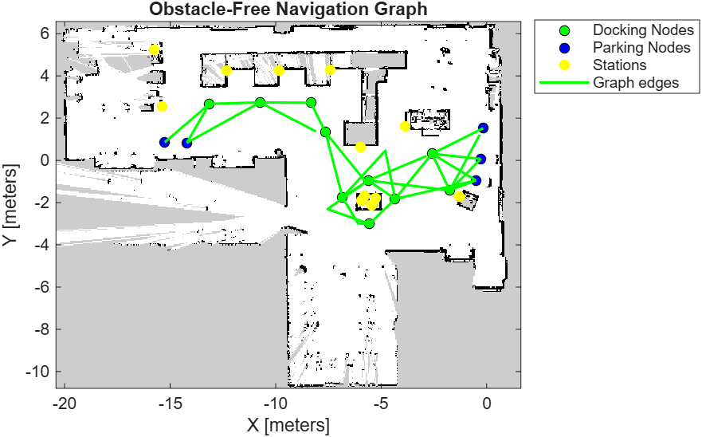
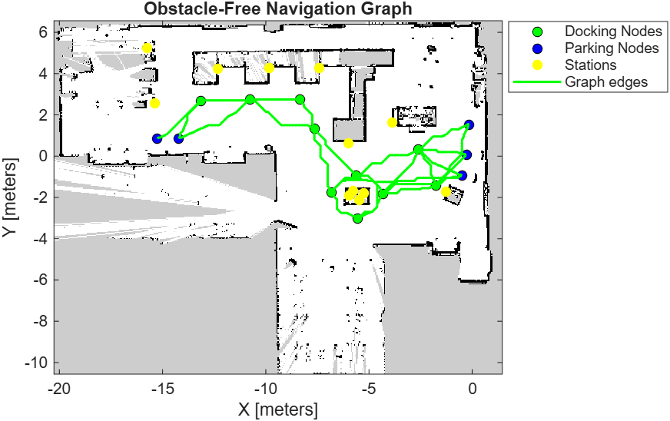
results
Path Network Generated by RRT* and A* on IOT Factory’s Map
Generated by RRT*
Generated by A*
Robotino Project | Hochschule Bielefeld | 19.09.2025 | Page 40
Notes:
HAW

Slide 41
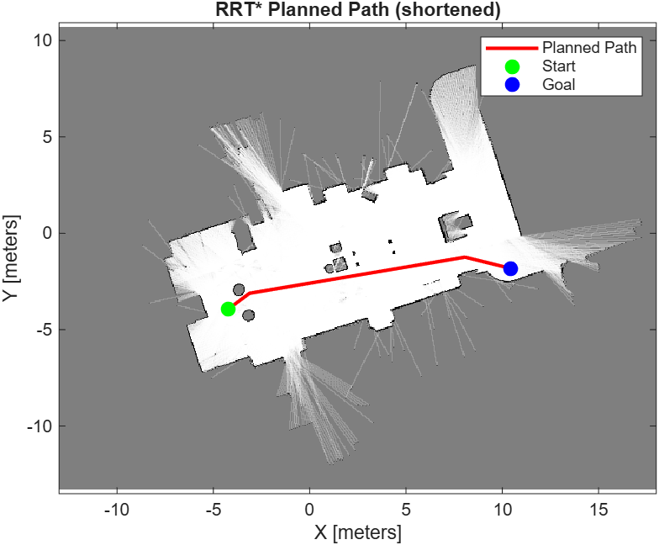
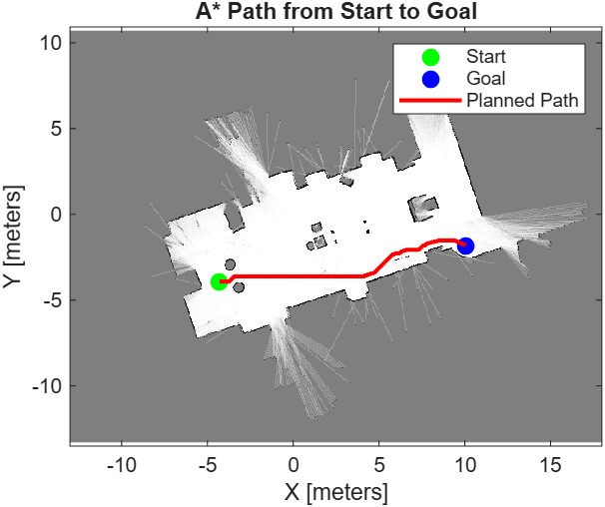
results
Path Generated by RRT* and A* on Warehouse Map
Robotino Project | Hochschule Bielefeld | 19.09.2025 | Page 41
Notes:
HAW

Slide 42
Critical reflection
Strengths of The Approach
The drift is mitigated through loop closure detection.
Pose graph optimization ensured globally consistent and robust map construction.
The A* algorithm produced optimal and shortest paths in the map.
The RRT* algorithm is also producing fairly optimal paths.
Robotino Project | Hochschule Bielefeld | 19.09.2025 | Page 42
Notes:
HAW

Slide 43
Critical reflection
Limitations
Generated map of IOT factory is not better because:
It is only using LiDAR data
Sensor noise
LiDAR data collection not in a proper way
Prebuilt map is using to generate optimized path network on the map.
Robotino Project | Hochschule Bielefeld | 19.09.2025 | Page 43
Notes:
HAW

Slide 44
Critical reflection
Challenges
Getting an optimized path network on map requires extensive work:
Need to set world co-ordinate origin properly for the map
So that, all nodes, stations, and docking points must align properly on the map
Sometimes, the generated maps are tilted or oriented, then transformation of them is required.
Converting the result of path network generation into Festo Software compatible format is difficult.
Performed custom mapping to get navigation-paths.xml, stations.lisp, and positions.lisp
Robotino Project | Hochschule Bielefeld | 19.09.2025 | Page 44
Notes:
HAW

Slide 45
Critical reflection
Future Work
Integrating odometry and IMU data to generate better occupancy map.
Using more sophisticated SLAM algorithms like Cartographer, LOAM, etc.
Working with different path planning algorithms.
Testing the generated path networks on Robotino’s Festo Software.
Robotino Project | Hochschule Bielefeld | 19.09.2025 | Page 45
Notes:
HAW

Slide 46

Robotino Project | Hochschule Bielefeld | 19.09.2025 | Page 46
Notes:
HAW

Slide 47

Robotino Project | Hochschule Bielefeld | 19.09.2025 | Page 47
Notes:
HAW

