Slide 1

Project Title - Seasonal Agriculture Performance Analysis
Student Name - Suraj GobariPrasad Kevat
College Name - BIRLA INSTIUTTE OF TECHNOLOGY AND SCIENCE PILANI
AICTE STU ID : STU6a61de09732191784798729

Slide 2

PROBLEM STATEMENT
Agricultural activities are influenced by seasonal variations in environmental conditions, farming practices, resource availability and market conditions. As a result, agricultural performance may differ from one season to another. However, raw agricultural data does not clearly explain how agricultural performance changes across seasons or what patterns can be observed in different seasonal conditions. The problem is to analyze the given agricultural dataset and investigate seasonal differences in agricultural performance by identifying meaningful patterns, trends, relationships and variations within the available data.

Slide 3
Project Description
This project analyses a dataset of 4,000 farm-level records that cover the Kharif season the Rabi season and the Zaid season. The goal is to find out how changes in seasons impact crop yield, production, profit and the way resources are used. The work includes cleaning the data, which means fixing missing values for rainfall, soil moisture and yield by using the median for each season. It also includes looking at statistics checking for unusual data points and creating visualizations like charts and graphs using Python. The main focus is on comparing yield and profit between seasons looking at patterns for crops during different seasons checking how well each state is doing and seeing how the use of resources like fertilizer and water is connected to how much money is made. The main aim is to get insights and suggestions to help plan agricultural activities, for different seasons. This is purely a data analysis project. Does not use machine learning or build any dashboards.

Slide 4

WHO ARE THE END USERS?
Farmers, planning crop and resource decisions by season to keep their fields healthy and productive.
Agricultural policy makers and state agriculture departments shaping rules and offering support, for farmers.
Agricultural researchers and extension officers investigating techniques and sharing knowledge with farmers.
Crop insurance and financial institutions assessing seasonal risk to help farmers manage uncertainty.
Agri‑business and supply chain planners, coordinating production and distribution so farmers get their products to market.

Slide 5

Technology Used
  Python- Pandas (data cleaning and aggregation)
  NumPy (numerical operations)
  Matplotlib and Seaborn (visualization)
  Google Colab (development environment)
  GitHub (version control and submission)

Slide 6
RESULTS
Kharif season has the performance: it gives the highest average yield at 5.63 tonnes per hectare the highest total profit of ₹318.3 million and the highest total production of 82,388 tonnes
Zaid season performs the worst: it has the lowest average yield at 4.64 tonnes per hectare and ends with a total profit loss of −₹14.7 million
In both Rabi and Zaid seasons the median profit is negative even though the mean profit remains positive. This means that the typical farm earns less than what the average suggests
The yield ranking from Kharif to Rabi to Zaid is consistent across all crops with no exceptions
Punjab and Maharashtra lead in average profit among states; Andhra Pradesh ranks last
Higher fertilizer use is linked to lower profit, not higher yield. The correlation, between fertilizer and yield is nearly zero
Disease and pest risk have only a weak and inconsistent connection to profit across different seasons

Slide 7
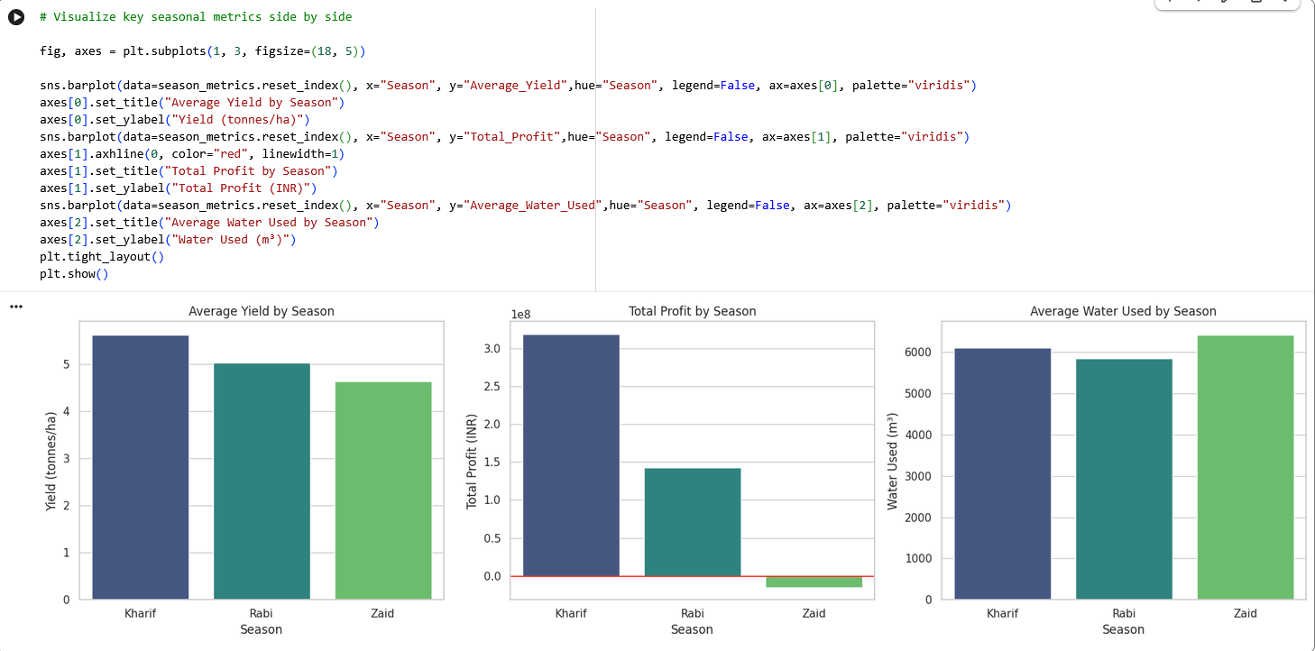
RESULTS

Slide 8
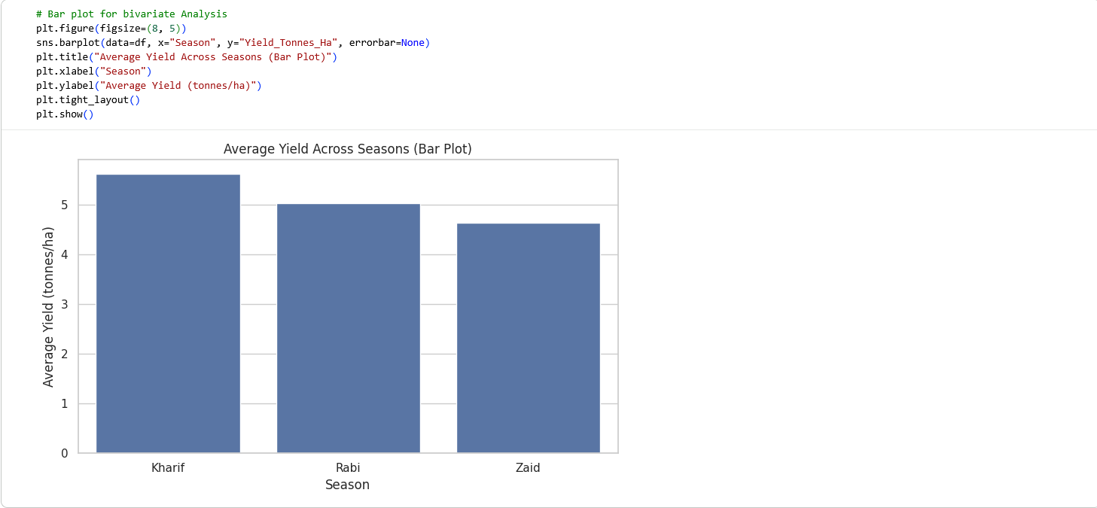
RESULTS

Slide 9
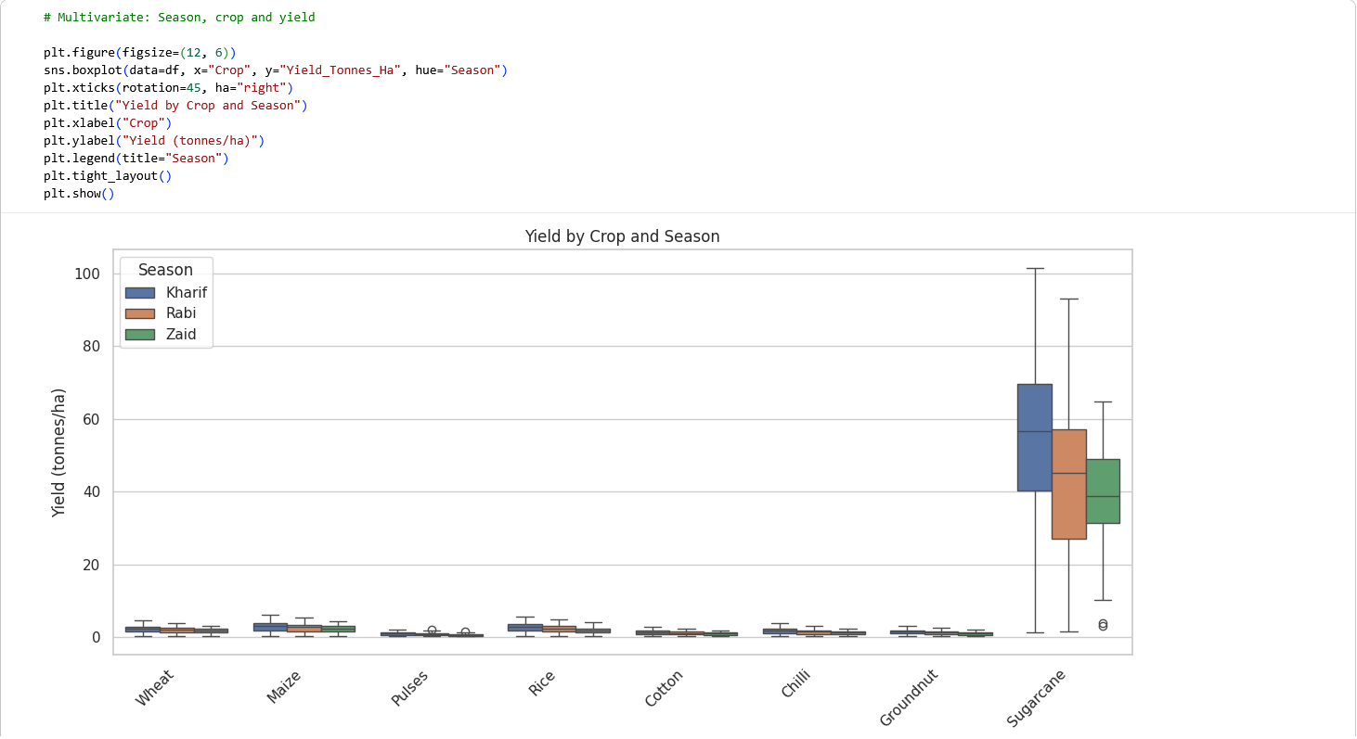
RESULTS

Slide 10
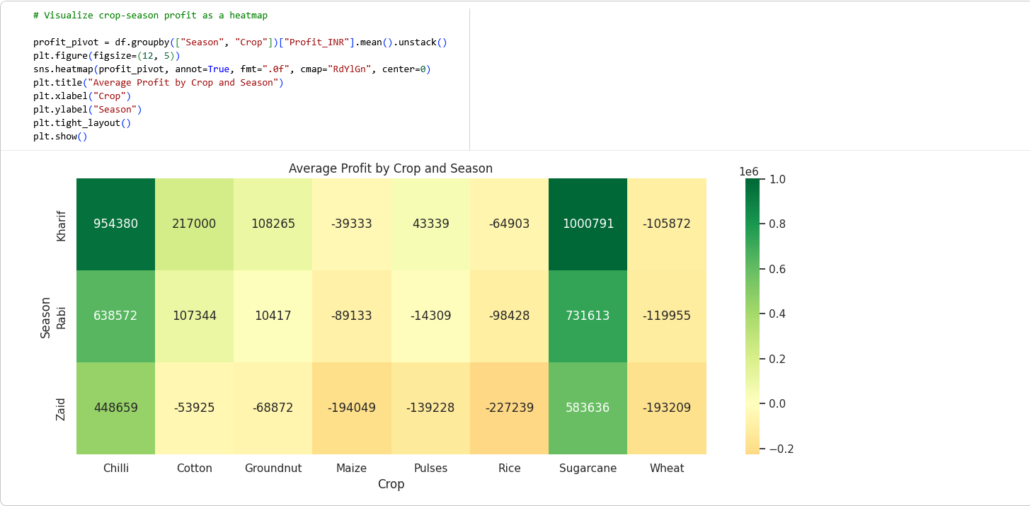
RESULTS

Slide 11
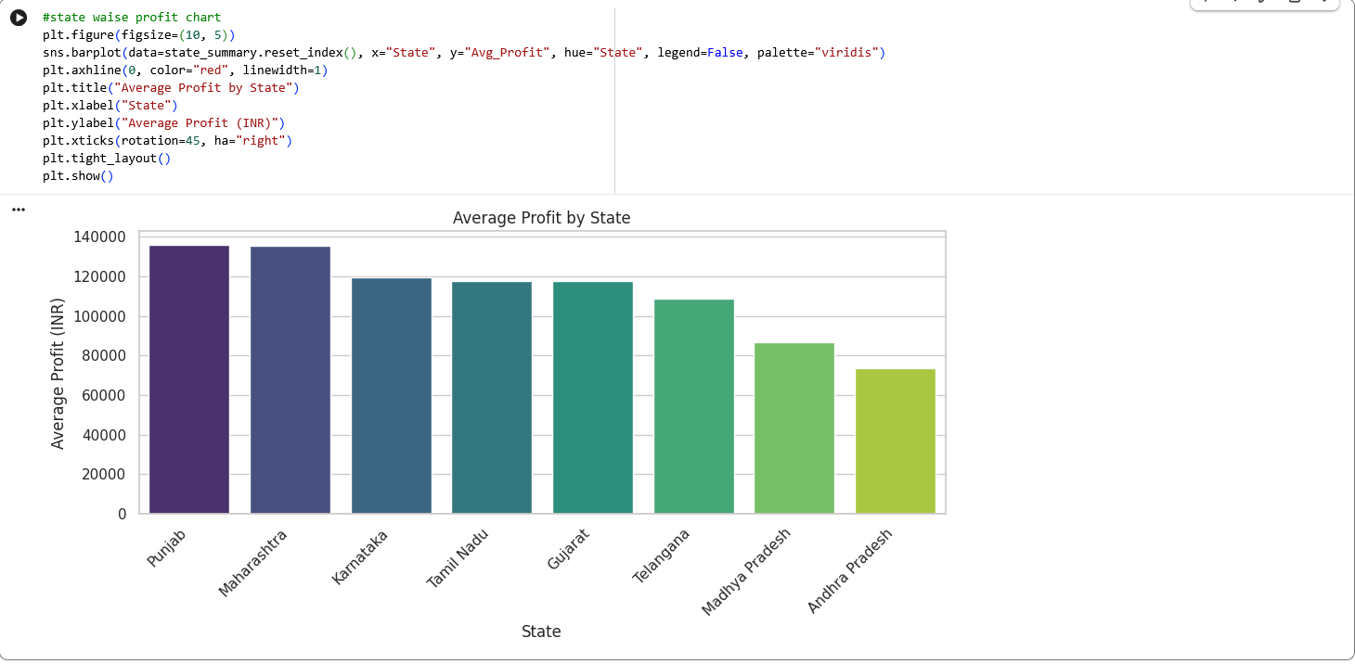
RESULTS

Slide 12
Future scope
Extend the analysis with a longer time series to observe year-over-year trends within each season
Investigate why high fertilizer usage correlates with profit. Possibly through a dedicated cost-efficiency study
Build a dashboard (e.g. using Streamlit) to let users interactively filter by season, state and crop
Apply machine learning models to predict yield or profit based on seasonal and resource variables
Incorporate additional data such as soil type, farmer demographics or market demand fluctuations
The Kharif > Rabi > Zaid yield ranking holds across every crop with no exceptions
Punjab and Maharashtra are the top-performing states by average profit; Andhra Pradesh is the lowest
Higher fertilizer usage is associated with lower profit (not higher yield). Correlation between fertilizer and yield is close to 0
Disease/pest risk shows only a weak inconsistent relationship with profit, across seasons

Slide 13
GitHub Link
https://github.com/AswiniKumar55/-Seasonal-Agriculture-Performance-Analysis-.git

Slide 14

VOIS Course completion certificate -
Course name- Data Visualization

Slide 15
Thank you
.
.

