Slide 1
JAVA Programming
Course Instructor: Dr. Suvojit Dhara
School of Computer Science
UPES Dehradun

Slide 2
TOPICs to be discussed
Concept of Inheritance
Inheritance in Java
Member Access in Inheritance
Constructors in Extended classes
‘super’ keyword and its uses
Method Overriding
Dynamic Method Dispatch

Slide 3

Let’s START …!!!

Slide 4
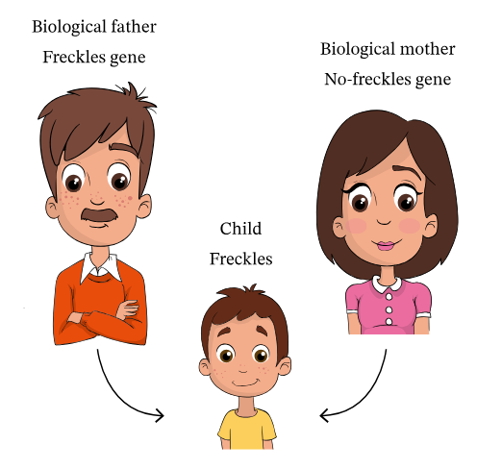
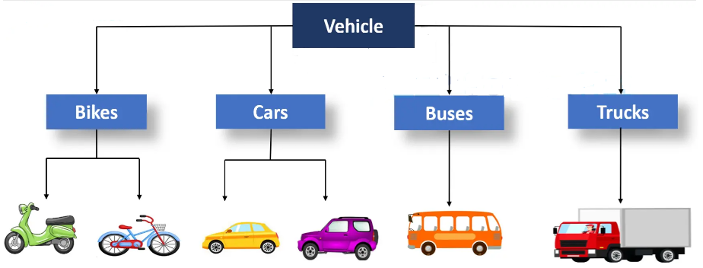
Concept of Inheritance
Inheritance is basically a biological term referring to the phenomena that a child possesses some attributes/features from his parent(s).
In general terms, the phenomena of acquiring some or all the features from a general object to a specific type of the object is known as Inheritance.

Slide 5
Inheritance in Java
Inheritance is an important pillar of OOP.
It is the mechanism in Java by which one class is allowed to inherit the features(fields and methods) of another class. In other words, Inheritance means creating new classes based on existing ones.
A class that inherits from another class can reuse the methods and fields of that class. The inherited class is termed Base class/parent class and the inheriting class is termed as the derived class/child class.
In addition, new fields and methods can be added to the derived class.
To inherit a class, we simply incorporate the definition of one class into another by using the extends keyword. The general form of a subclass (Derived class) declaration that inherits a superclass (Base class) is shown here:
class subclass-name extends superclass-name {
// body of class
}
Note: You can only specify one superclass for any subclass that you create. Java does
not support the inheritance of multiple superclasses into a single subclass.

Slide 6
Inheritance (Example)
class A {
int a = 10, b = 20;
}
class B {
int c = 30, d = 40;
}
class MainClass {
public static void main(String[] args) {
B obj = new B();
System.out.println(obj.a+" "+obj.b+
" "+obj.c+" "+obj.d);
}
}
class A {
int a = 10, b = 20;
}
class B extends A{
int c = 30, d = 40;
}
class MainClass {
public static void main(String[] args) {
B obj = new B();
System.out.println(obj.a+" "+obj.b+
" "+obj.c+" "+obj.d);
}
}
Output:
Error // fields a and b belong to objects of class A and obj is an instance of class B
Output:
10 20 30 40

Slide 7
Inheritance (Example)
class A {
int a, b;
void input(int x, int y) {
a = x; b = y;
}
}
class B extends A {
void show() {
System.out.println(a+" "+b);
}
}
class MainClass {
public static void main(String[] args) {
B obj = new B();
obj.input(10, 20);
obj.show();
}
}
class A {
int a, b;
void input(int x, int y) {
a = x; b = y;
}
}
class B extends A {
void show() {
System.out.println(a+" "+b);
}
}
class MainClass {
public static void main(String[] args) {
A obj = new A();
obj.input(10, 20);
obj.show();
}
}
Output:
Error // obj is of class A and show() is a method in class B
Output:
10 20

Slide 8
Member Access in Inheritance
Although a subclass includes all of the members of its superclass, it cannot access those members of the superclass that have been declared as private. (Inherit public, protected members only)
class A {
private int a = 10;
public int b = 20;
}
class B extends A {
void show() {
System.out.println(a+" "+b);
}
}
class MainClass {
public static void main(String[] args) {
B obj = new B();
obj.show();
}
}
class A {
protected int a = 10;
public int b = 20;
}
class B extends A {
void show() {
System.out.println(a+" "+b);
}
}
class MainClass {
public static void main(String[] args) {
B obj = new B();
obj.show();
}
}
Output:
Error: a has private access in A
Output:
10 20

Slide 9
Constructors in Inheritance
Subclasses do not inherit the constructors from the Base class.
class A {
}
class B extends A {
}
class MainClass {
public static void main(String[] args) {
B obj = (B)new A(); //Type Casting
} //Upcasting
}
class A {
}
class B extends A {
}
class MainClass {
public static void main(String[] args) {
B obj1 = new B(); //Allowed
B obj2 = new A(); //Not Allowed
}
}
Output:
java.lang.ClassCastException: class A cannot be cast to class B
class A {
}
class B extends A {
}
class MainClass {
public static void main(String[] args) {
A obj = new B(); //Works fine...!!!
} //Downcasting
}
Output:
Error: incompatible types: A cannot be converted to B
B obj2 = new A(); //Not Allowed
^

Slide 10
Constructors in Inheritance (Contd..)
For creating a subclass instance, the compiler will automatically call the no-argument constructor of the superclass, and then the constructor of the subclass. This is known as implicit constructor chaining.
class A {
A(){
System.out.println("I am in Class A");
}
}
class B extends A {
B(){
System.out.println("I am in Class B");
}
}
class MainClass {
public static void main(String[] args) {
B obj = new B();
}
}
Output: I am in Class A
I am in Class B

Slide 11
Constructors in Inheritance (Contd..)
Since the subclass has no access to private members of the superclass, the subclass constructor can not initialize that private member of the superclass.
class A {
private int x;
}
class B extends A {
int y;
B(int a, int b){
x = a; y = b;
System.out.println("I am in Class B");
}
}
class MainClass {
public static void main(String[] args) {
B obj = new B(2, 3);
}
}
Output:
Error: x has private access in A
x = a; y = b;
^

Slide 12
‘super’ keyword
Whenever a subclass needs to refer to its immediate superclass, it can do so by use of the keyword super.
To access a member of the superclass that has been hidden by a member of a subclass, that is when a subclass has its own member with the same name as a member in the superclass (overridden members), the super keyword can be used to refer to the members of the superclass.
To call the superclass constructor, the super() constructor should be called in as the first statement in the subclass constructor body.

Slide 13
super: to refer to superclass member
class A {
int a = 100, b = 200;
}
class B extends A {
int a = 10, b = 20;
void display() {
System.out.printf("%d %d %d %d", a, b, super.a, super.b);
}
}
class MainClass {
public static void main(String[] args) {
B obj = new B();
obj.display();
}
}
Output:
10 20 100 200

Slide 14
super: to call the superclass constructor
class A {
A(){
System.out.println("I am in Class A");
}
}
class B extends A {
B(){
super();
System.out.println("I am in Class B");
}
}
class MainClass {
public static void main(String[] args) {
B obj = new B();
}
}
class A {
private int a;
A(int x){
a = x;
System.out.println("a = "+ a);
}
}
class B extends A {
B(){
super(10);
System.out.println("I am in class B");
}
}
class MainClass {
public static void main(String[] args) {
B obj = new B();
}
}
Output: I am in Class A
I am in Class B
Output: a = 10
I am in Class B

Slide 15
Method Overriding
In a class hierarchy, when a method in a subclass has the same name and type signature as a method in its superclass, then the method in the subclass is said to override the method in the superclass.
When an overridden method is called within the subclass, it will always refer to the version of that method defined by the subclass.
class A {
void display(){
System.out.println("I am in Class A");
}
}
class B extends A {
void display(){
System.out.println("I am in Class B");
}
}
class MainClass {
public static void main(String[] args) {
B obj = new B();
obj.display();
}
}
Output:
I am in Class B

Slide 16
Method Overriding (Contd..)
super keyword can be use to access the superclass version of the overridden method.
class A {
void display(){
System.out.println("I am in Class A");
}
}
class B extends A {
void display(){
super.display();
System.out.println("I am in Class B");
}
}
class MainClass {
public static void main(String[] args) {
B obj = new B();
obj.display();
}
}
Output:
I am in Class A
I am in Class B

Slide 17
Method Overriding (Contd..)
static method of the superclass can not be overridden in the subclass.
class A {
static void display(){
System.out.println("I am in Class A");
}
}
class B extends A {
void display(){
System.out.println("I am in Class B");
}
}
class MainClass {
public static void main(String[] args) {
B obj = new B();
obj.display();
}
}
Output:
Error: display() in B cannot override display() in A
void display(){
^
overridden method is static
NO
Can we override the main() method?

Slide 18
Dynamic Method Dispatch
class A {
void display(){
System.out.println("I am in Class A");
}
}
class B extends A {
void display(){
System.out.println("I am in Class B");
}
}
class C extends A {
void display(){
System.out.println("I am in Class C");
}
}
class MainClass {
public static void main(String[] args) {
A obj1 = new A(); obj1.display();
A obj2 = new B(); obj2.display();
A obj3 = new C(); obj3.display();
}
}
Output:
I am in Class A
I am in Class B
I am in Class C

Slide 19
Dynamic Method Dispatch
In Java, Method overriding allows a subclass to provide a specific implementation of a method that is already defined in its superclass.
The primary purpose of dynamic method dispatch is to achieve runtime polymorphism, where the method to be executed is determined by the type of the object, not the reference variable.
Runtime Binding: The decision about which method to call is made at runtime based on the actual type of the object.
A obj1 = new A(); obj1.display(); // Call to display() of class A
A obj2 = new B(); obj2.display(); // Call to display() of class B
A obj3 = new C(); obj3.display(); // Call to display() of class C

Slide 20
Summary
Today, we learned about
Inheritance Concept with Examples
Member Access within Inheritance hierarchy
Constructors in Inheritance
super keyword and its uses
Method overriding and Dynamic Method Dispatch Concept

Slide 21


