Slide 1
JAVA Programming
Course Instructor: Dr. Suvojit Dhara
School of Computer Science
UPES Dehradun

Slide 2
TOPICs to be discussed
abstract methods and classes
‘final’ keyword
final methods and classes
Object class
Cloning objects
Types of Inheritance
Diamond Problem

Slide 3

Let’s START …!!!

Slide 4
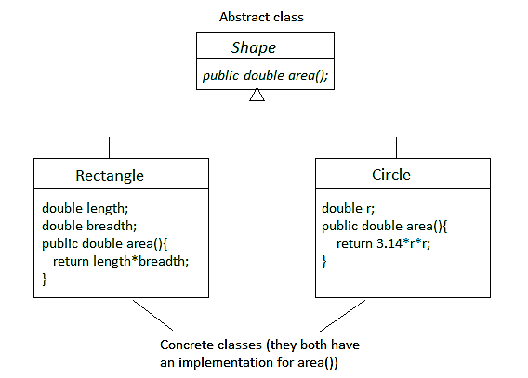
abstract classes and methods
There are situations in which we want to define a superclass that declares the structure of a given abstraction without providing a complete implementation of every method.
Sometimes we want to create a superclass that only defines a generalized form that will be shared by all of its subclasses, leaving it to each subclass to fill in the details.
Such a class determines the nature of the methods that the subclasses must implement.
One way this situation can occur is when a superclass is unable to create a meaningful implementation for a method.

Slide 5
abstract classes and methods
Certain methods can be overridden by subclasses by specifying the abstract type modifier. These methods are sometimes referred to as subclass’s responsibility because they have no implementation specified in the superclass and must be overridden in the subclass.
The declaration of these methods in the superclass is as follows:
abstract type method_name(parameter list);
Any class that contains one or more abstract methods must also be declared abstract.
To declare a class abstract, you simply use the abstract keyword in front of the class keyword at the beginning of the class declaration.

Slide 6
abstract class (Example)
abstract class Shape {
abstract double area();
}
class Rectangle extends Shape {
double l, b;
Rectangle(double x, double y) {
this.l = x; this.b = y;
}
double area() {
return l*b;
}
}
class Circle extends Shape {
double r;
Circle(double x) {
this.r = x;
}
double area() {
return 3.14*r*r;
}
}
class AbstractAreas {
public static void main(String[] args) {
Rectangle rect = new Rectangle(2.5, 3.7);
System.out.println("Area of the Rectangle: "+
rect.area());
Circle cir = new Circle(2.3);
System.out.println("Area of the Circle: "+
cir.area());
}
}
Output:
Area of the Rectangle: 9.25
Area of the Circle: 16.610599999999998

Slide 7
abstract classes (Contd..)
abstract class A {
abstract void callme(); //abstract method
void callmetoo() { //concrete method
System.out.println("concrete method is
fine.");
}
}
class B extends A {
void callme() {
System.out.println("B's implementation of
callme.");
}
}
class MainClass {
public static void main(String args[]) {
B b = new B();
b.callme(); b.callmetoo();
}
}
Important Points:
An abstract class cannot be directly instantiated with the ‘new’ operator.
abstract constructors and abstract static methods can not be declared.
Any subclass of an abstract class must either implement all of the abstract methods in the superclass, or be declared abstract itself.
An abstract class may have one or more concrete/non-abstract methods. This is perfectly fine.
Output:
B's implementation of callme.
concrete method is fine.

Slide 8
abstract classes (Contd..)
Although abstract classes cannot be used to instantiate objects, they can be used to create object references. That is, it is possible to create a reference to an abstract class so that it can be used to point to a subclass object.
abstract class Shape {
abstract void draw();
}
class Rectangle extends Shape {
void draw() {
System.out.println("Rectangle drawing in
process");
}
}
class Circle extends Shape {
void draw() {
System.out.println("Circle drawing in
process");
}
}
class MainClass {
public static void main(String args[]) {
Shape sh = new Shape(); // Error
Shape sh; //This is OK
Rectangle rect = new Rectangle();
Circle cir = new Circle();
sh = rect; sh.draw();
sh = cir; sh.draw();
}
}
Output:
Rectangle drawing in process
Circle drawing in process

Slide 9
final variable
final variables are nothing but constants. We cannot change the value of a final variable once it is initialized.
A final variable that is not initialized at the time of declaration is known as blank final variable. We must initialize the blank final variable in constructor of the class otherwise it will throw a compilation error.
class fin_var {
final int a = 10;
void change() {
a = 20;
}
}
class MainClass {
public static void main(String[] args) {
fin_var obj = new fin_var();
obj.change();
}
}
class blank {
final int a;
blank() { a = 10; }
void show() {
System.out.println(a);
}
public static void main(String[] args) {
blank obj = new blank();
obj.show();
}
}
Output:
Error: cannot assign a value to final variable a
a = 20;
^
Output: 10

Slide 10
Use of blank final variable
Let’s say we have a Student class which is having a field called Roll No. Since Roll No should not be changed once the student is registered, we can declare it as a final variable in a class but we cannot initialize roll no in advance for all the students (otherwise all students would be having same roll no). In such case we can declare roll no variable as blank final and we initialize this value during object creation like this:
class StudentData{
//Blank final variable
final int ROLL_NO;
StudentData(int rnum){
//It must be initialized in constructor
ROLL_NO = rnum;
}
void info(){
System.out.println("Roll no is: "+ROLL_NO);
}
public static void main(String args[]){
StudentData obj = new StudentData(1234);
obj.info();
}
}
Output:
Roll no is: 1234

Slide 11
static final variable
A static final variable that is not initialized during declaration can only be initialized in static block.
class StaticFinal{
static final int ROLL_NO;
static{
ROLL_NO=1230;
}
public static void main(String args[]){
System.out.println(("Roll no is: "+
StaticFinal.ROLL_NO);
}
}
class StaticFinal{
static final int ROLL_NO;
StaticFinal() {
ROLL_NO=1230;
}
public static void main(String args[]){
System.out.println(("Roll no is: "+
StaticFinal.ROLL_NO);
}
}
Output:
Roll no is: 1230
Output:
Error: cannot assign a value to final variable ROLL_NO
StaticFinal(){ ROLL_NO=1230; } ^

Slide 12
final method
To disallow a method from being overridden, specify final as a modifier at the start of its declaration. Methods declared as final cannot be overridden.
class A {
final void info() {
System.out.println("This is a final method."); } }
class B extends A {
void info() { // ERROR! Can't override.
System.out.println("Illegal!");
}
}
Note:
1. Because info() is declared as final, it cannot be overridden in B. If you attempt to do so, a compile-time error will result.
2. Normally, Java resolves calls to methods dynamically, at run time. This is called late binding. However, since final methods cannot be overridden, a call to one can be resolved at compile time. This is called early binding.

Slide 13
final class
Sometimes you will want to prevent a class from being inherited. To do this, precede the class declaration with final. Declaring a class as final implicitly declares all of its methods as final, too.
final class A {
//...
}
class B extends A {
//...
}
Output:
Error: cannot inherit from final A
class B extends A{
^
abstract final class A {
//...
}
As you might expect, it is illegal to declare a class as both abstract and final since an abstract class is incomplete by itself and relies upon its subclasses to provide complete implementations.
Output:
Error: illegal combination of modifiers: abstract and final
abstract final class StaticFinal{
^

Slide 14
Object class
The Object class is a fundamental class that serves as the root class for all other classes.
Every class in Java implicitly inherits from the Object class. If a class does not explicitly extend another class, it extends Object by default.
The Object class defines several important methods that can be used by all Java classes. Some of the commonly used methods from the Object class include:
equals(Object obj): Used to compare the content or state of two objects.
hashCode(): Returns a hash code value for the object, which is used in data structures like hash tables.
toString(): Returns a string representation of the object.
getClass(): Returns the runtime class of the object.
wait(), notify(), and notifyAll(): Methods used for inter-thread communication and synchronization.

Slide 15
Object class methods
The Object class provides default implementa-tions for the methods. However, the default implementations may not always be suitable for your specific class, so you can override them in your custom classes to provide custom behavior.
class A {
int a;
A(int x) { a = x; }
public boolean equals(Object ob) {
A ob1 = (A)ob;
return (ob1.a == a);
}
}
class Equals {
public static void main(String[] args) {
A a1 = new A(10);
A a2 = new A(20);
A a3 = new A(10);
System.out.print(a1.equals(a2));
System.out.print(a1.equals(a3));
}
}
class A {
int a;
A(int x) { a = x; }
}
class Equals {
public static void main(String[] args) {
A a1 = new A(10);
A a2 = new A(20);
A a3 = new A(10);
System.out.print(a1.equals(a2));
System.out.print(a1.equals(a3));
}
}
Output: false true
Output: false false

Slide 16
Object class methods (Contd..)
class GetClass {
public static void main(String[] args) {
Object obj = new String("Java");
Class a = obj.getClass();
System.out.println("Class of Object
obj is : " + a.getName());
}
}
Output:
Class of Object obj is : java.lang.String
class Student {
int Roll_no;
Student(int r) { Roll_no = r; }
public static void main(String[] args) {
Student obj = new Student(4002);
System.out.println(obj); //implicit
System.out.println(obj.toString()); //explicit
}
}
Output:
Student@379619aa
Student@379619aa
Note: Default behavior of toString() is to print class name, then @, then unsigned hexadecimal representation of the hash code of the object.

Slide 17
Cloning objects
The clone() method is defined in the Object class. Syntax of the clone() method is as follows:
protected Object clone() throws CloneNotSupportedException
The clone() method saves the extra processing task for creating the exact copy of an object. If we perform it by using the new keyword, it will take a lot of processing time to be performed that is why we use object cloning.
class Student implements Cloneable{
int id; String name;
Student(int i, String n){
id = i; name = n; }
public Object clone()throws CloneNotSupportedException{
return super.clone(); }
public static void main(String args[]){
try {Student s1 = new Student(101, "Suvojit");
Student s2 = (Student) s1.clone();
System.out.println(s1.id+" "+s1.name);
System.out.println(s2.id+" "+s2.name);
} catch(CloneNotSupportedException c) {} }
}
Output:
101 Suvojit
101 Suvojit

Slide 18
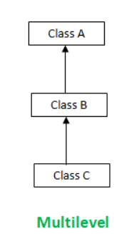
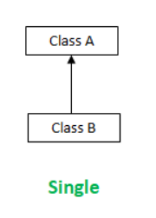
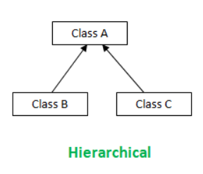
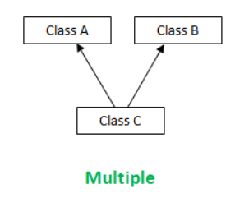
Types of Inheritance
Inheritance can be broadly classified into two types: Single Inheritance and Multiple Inheritance.
Single Inheritance: One or more subclasses inherit from a single superclass.
Multiple Inheritance: One subclass inherits from multiple superclasses.

Slide 19
Single Inheritance
class A {
int a;
A(int x) { a = x; }
}
class B extends A {
int b;
B(int x, int y) {
super(x);
b = y;
}
}
class MainClass {
public static void main(String[] args) {
B obj = new B(2, 3);
System.out.println(obj.a+" "+obj.b);
}
}
class A {
void fun() {
System.out.print("Hello "); }
}
class B extends A {
void fun(int x) {
System.out.print(x+ " PM "); }
}
class C extends A {
void fun() {
System.out.print("Bye"); }
}
class MainClass {
public static void main(String[] args) {
A obj1 = new A();
B obj2 = new B();
C obj3 = new C();
obj1.fun(); obj2.fun(8); obj3.fun();
}
}
Output:
2 3
Output:
Hello 8 PM Bye

Slide 20
Single Inheritance (Contd..)
class A {
A() {
System.out.println("I am in Class A.");
}
}
class B extends A {
B() {
System.out.println("I am in Class B.");
}
}
class C extends B {
C() {
System.out.println("I am in Class C.");
}
}
class MainClass {
public static void main(String[] args) {
C obj = new C();
}
}
Output:
I am in Class A.
I am in Class B.
I am in Class C.

Slide 21
Multiple Inheritance
Java does not support multiple inheritance to avoid the ambiguity caused by it.
class A {
A() {
System.out.println("I am in Class A.");
}
}
class B {
B() {
System.out.println("I am in Class B.");
}
}
class C extends A, B {
C() {
System.out.println("I am in Class C.");
}
}
class MainClass {
public static void main(String[] args) {
C obj = new C();
}
}
Output:
Compile time error
Error: '{' expected
class C extends A, B {
^

Slide 22
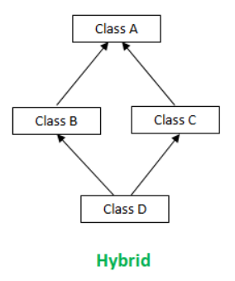
Hybrid Inheritance
We can have a situation where there is a mix of single and multiple inheritances in one inheritance hierarchy. This is referred to as Hybrid Inheritance.
Due to the presence of multiple inheritance in the structure, Java does not support hybrid inheritance.
Because of the resemblance to the diamond structure, this hybrid inheritance is sometimes termed as “Diamond Problem”.

Slide 23
Diamond Problem
class A {
A() {
System.out.println("I am in Class A.");
}
}
class B extends A {
B() {
System.out.println("I am in Class B.");
}
}
class C extends A {
C() {
System.out.println("I am in Class C.");
}
}
class D extends B, C {
D() {
System.out.println("I am in Class D.");
}
}
class MainClass {
public static void main(String[] args) {
D obj = new D();
}
}
Output:
Compile time error
Error: '{' expected
class D extends B, C {
^

Slide 24
Summary
Today, we learned about
abstract classes and methods
final variables, blank final variables and uses, final method, final class
Object class and methods
Cloning objects using clone() method
Types of Inheritance
Diamond Problem

Slide 25


