Slide 1
JAVA Programming
Course Instructor: Dr. Suvojit Dhara
School of Computer Science
UPES Dehradun

Slide 2
TOPICs to be discussed
Interface
Properties of an Interface
Implementing Interfaces
Accessing Implementations
through Interface References
Partial Implementations
Extending Interfaces
Extending and Implementing Simultaneously
Multiple Inheritance using Interface
Multiple Inheritance Issues

Slide 3

Let’s START …!!!

Slide 4
Interface
Java does not support Multiple Inheritance (through Classes). But, Java supports an alternate approach to this OOP feature known as Interface.
What is an Interface?
An Interface is basically a kind of class. Like classes, an interface contains members and methods. Unlike classes, in interface, all members are final and all methods are abstract.
An interface is a blueprint for a class. Declared using keyword “interface”.
interface Hello{
void fun();
}
An interface defines a protocol of behavior that can be implemented by any class anywhere in the class hierarchy.

Slide 5
Properties of an Interface
interface A {
int a = 10; //implicitly public, static, final
void func(); //implicitly public, abstract
}
class B implements A {
public void func() {
System.out.println("B's implementation of
func of interface A");
}
}
class MainClass {
public static void main(String[] args) {
// A obj = new A(); //Error
// A.a = 20; //Error, as a is Final
B obj = new B();
obj.func();
System.out.println("A.a = "+A.a);
}
}
Like abstract classes, we can not create an object of an interface.
Interfaces can contain only method declaration, these methods are implicitly public and abstract.
Interfaces can have constants (fields), which are implicitly public, static, and final. These constants can be accessed using the interface name.
Output: B’s implementation of func of interface A
A.a = 10

Slide 6
Properties of an Interface
Interface can have default method (using keyword “default”).
Interface can have static method.
interface A {
default void func() {
System.out.println("This is a default
method of interface A");
}
}
class B implements A {}
class MainClass {
public static void main(String[] args) {
B obj = new B();
obj.func();
}
}
interface A {
static void func() {
System.out.println("This is a static
method of interface A");
}
}
class MainClass {
public static void main(String[] args) {
A.func();
}
}
Output:
This is a static method of interface A
Output:
This is a default method of interface A

Slide 7
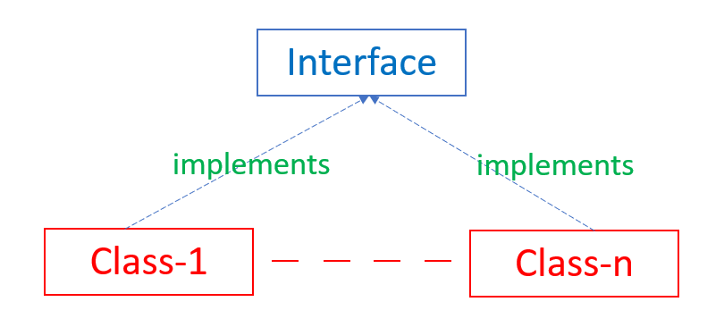
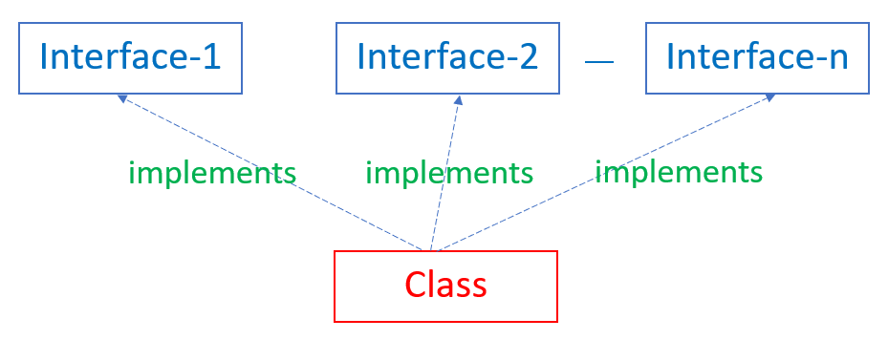
Implementing Interfaces
Once an Interface is defined, a class can implement the interface (define the implementation of the interface methods) using the keyword “implements”.
class class_name implements interface_name {}
Once an Interface is defined, one or more number of classes can implement the interface.
We can implement any number of interfaces using a class.

Slide 8
Implementing Interfaces (Example)
interface A {
void func();
}
class B implements A {
public void func() {
System.out.println("Class B
implements interface A"); }
}
class C implements A {
public void func() {
System.out.println("Class C
implements interface A"); }
}
class MainClass {
public static void main(String[] args) {
B obj1 = new B(); obj1.func();
C obj2 = new C(); obj2.func();
}
}
interface A {
void func1();
}
interface B {
void func2();
}
class C implements A, B {
public void func1() {
System.out.println("Class C
implements interface A"); }
public void func2() {
System.out.println("Class C
implements interface B"); }
}
class MainClass {
public static void main(String[] args) {
C obj = new C();
obj.func1(); obj.func2();
}
}
Output: Class B implements interface A
Class C implements interface A
Output: Class C implements interface A
Class C implements interface B

Slide 9
Accessing Implementations through Interface References
interface A {
void display();
}
class B implements A {
public void display() {
System.out.println("Class B
implements interface A"); }
}
class C implements A {
public void display() {
System.out.println("Class C
implements interface A"); }
}
class MainClass {
public static void main(String[] args) {
A obj1 = new B(); obj1.display();
A obj2 = new C(); obj2.display();
}
}
You can declare variables as object references that use an interface rather than a class type. Any instance of any class that implements the declared interface can be referred to by such a variable.
When you call a method through one of these references, the correct version will be called based on the actual instance of the interface being referred to. (Runtime polymorphism)
Output: Class B implements interface A
Class C implements interface A

Slide 10
Accessing Implementations through Interface References
interface A {
void display();
}
class B implements A {
public void display() {
System.out.println("Class B
implements interface A"); }
}
class C implements A {
public void display() {
System.out.println("Class C
implements interface A"); }
void show() {
System.out.println("This method is
only of Class C"); }
}
class MainClass {
public static void main(String[] args) {
A obj1 = new B();
obj1.display();
A obj2 = new C();
obj2.display();
obj2.show();
}
}
Output:
Error: cannot find symbol
obj2.show();
^
Note: obj2 is of type A and show() method is defined in class C, but not declared in interface A. Hence obj2 can not use the method show()

Slide 11
Partial Implementations
A class that implements an interface must provide concrete implementations for all of the interface's methods.
If a class implements an interface but does not define all the methods required by that interface, then that class must be declared as abstract.
interface A {
void func1();
void func2();
}
class B implements A {
public void func1() {
System.out.println("Class B implements func1
of interface A"); }
}
class MainClass {
public static void main(String[] args) {
B obj = new B();
obj.func1();
}
}
Output:
error: B is not abstract and does not override abstract method func2() in A
class B implements A {
^

Slide 12
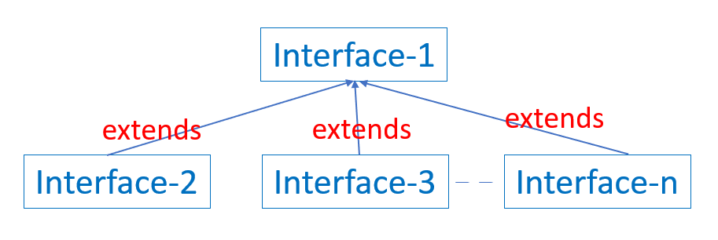
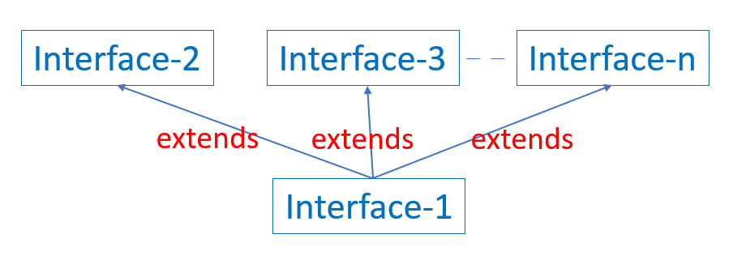
Extending Interfaces
One interface can inherit another interface by using the keyword extends. The syntax is the same as for inheriting classes.
interface derived_interface extends base_interface_1, base_interface_2, ...{}
Multiple interfaces can inherit from one interface and one interface can inherit from multiple interfaces.

Slide 13
Extending Interfaces (Contd..)
When a class implements an interface that inherits another interface, it must provide implementations for all methods required by the interface inheritance chain.
interface A {
void meth1(); void meth2();
}
interface B extends A {
void meth3();
}
class MyClass implements B {
public void meth1() {
System.out.println("Implement meth1().");
}
public void meth2() {
System.out.println("Implement meth2().");
}
public void meth3() {
System.out.println("Implement meth3().");
}
}
class MainClass {
public static void main(String arg[]) {
MyClass obj = new MyClass();
obj.meth1();
obj.meth2();
obj.meth3();
}
}
Output:
Implement meth1().
Implement meth2().
Implement meth3().

Slide 14
Extending and Implementing simultaneously
In Java, a class can extend another class and implement any number of interfaces simultaneously.
class subclass_name extends superclass_name implements interface_1, interface_2, ...{}
interface intf_A1 {
void func1(); }
interface intf_A2 {
void func2(); }
class cls_A {
int fun(int x) {
return x%24; }
}
class B extends cls_A implements intf_A1, intf_A2 {
public void func1() {
System.out.println("Hello world...!!!"); }
public void func2() {
System.out.println("We're in India"); }
}
class MainClass {
public static void main(String arg[]) {
B obj = new B();
obj.func1();
obj.func2();
System.out.println("The time is : "
+obj.fun(8)+" AM"); }
}
Output:
Hello world...!!!
We’re in India
The time is : 8 AM

Slide 15
Multiple Inheritance using Interface
Java supports multiple inheritance through interfaces.
interface Printable {
void print();
}
interface Drawable {
void draw();
}
class Image implements Printable, Drawable {
public void print() {
System.out.println("Printing Image"); }
public void draw() {
System.out.println("Drawing Image"); }
}
class MainClass {
public static void main(String[] args) {
Image img = new Image();
img.print(); img.draw();
}
}
Output:
Printing Image
Drawing Image

Slide 16
Diamond Problem Solved…!!!
interface Shape {
void display(); }
interface Parallelogram extends Shape {
void prop_P(); }
interface Rhombus extends Shape {
void prop_R(); }
class Square implements Parallelogram, Rhombus {
public void display(){
System.out.println("Let's learn Geometry..."); }
public void prop_P(){
System.out.println("Opposite sides are parallel"); }
public void prop_R(){
System.out.println("All four sides are equal"); }
void prop_S() {
System.out.println("All four angles are 90 degree"); }
}
class Geometry {
public static void main(String[] args) {
Square sq = new Square();
sq.display(); sq.prop_P();
sq.prop_R(); sq.prop_S();
}
}
Output:
Let’s learn Geometry...
Opposite sides are parallel
All four sides are equal
All four angles are 90 degree

Slide 17
Issues with Multiple Inheritance
Consider the following code:
interface Alpha {
default void info(){
System.out.println("I am in Alpha interface");
}
}
interface Beta {
default void info(){
System.out.println("I am in Beta interface");
}
}
class MyClass implements Alpha, Beta {
}
class MainClass {
public static void main(String[] args) {
MyClass obj = new MyClass();
obj.info();
}
}
Which version of the info() method will be used by MyClass object?
Output:
Error: types Alpha and Beta are incompatible;
class MyClass implements Alpha, Beta {
^
class MyClass inherits unrelated defaults for info() from types Alpha and Beta

Slide 18
Issues with Multiple Inheritance
Consider the following code:
interface Alpha {
default void info(){
System.out.println("I am in Alpha interface");
}
}
interface Beta {
default void info(){
System.out.println("I am in Beta interface");
}
}
class MyClass implements Alpha, Beta {
public void info(){
System.out.println("I am in MyClass");
}
}
class MainClass {
public static void main(String[] args) {
MyClass obj = new MyClass();
obj.info();
}
}
Which version of the info() method will be used by MyClass object?
Output:
I am in MyClass

Slide 19
Issues with Multiple Inheritance
Consider the following codes:
interface Alpha {
default void info(){
System.out.println("I am in Alpha interface");
}
}
interface Beta extends Alpha {
default void info(){
System.out.println("I am in Beta interface");
}
}
class MyClass implements Alpha, Beta {
public void info(){
System.out.println("I am in MyClass");
}
}
class MainClass {
public static void main(String[] args) {
MyClass obj = new MyClass();
obj.info();
}
}
interface Alpha {
default void info(){
System.out.println("I am in Alpha
interface");
}
}
interface Beta extends Alpha {
default void info(){
System.out.println("I am in Beta
interface");
}
}
class MyClass implements Alpha, Beta { }
class MainClass {
public static void main(String[] args) {
MyClass obj = new MyClass();
obj.info();
}
}
Output:
I am in Beta interface
Output:
I am in MyClass

Slide 20
Rules with Multiple Inheritance
Rules:
First, in all cases, a class implementation takes priority over any default interface implementation.
Thus, when MyClass provides an implementation of the info() method, then that is used only.
Even when MyClass implements both the interfaces Alpha and Beta, the default interface implementations of the info() method are overridden by the class implementation.
Second, in cases where a class (in our case, MyClass) implements two or more interfaces (in our example, Alpha and Beta) that have a same default method, but the class does not override the method, then error will occur.

Slide 21
Rules with Multiple Inheritance
Rules:
If one interface inherits another, with both defining a common default method, then the implementation of the default method in the inheriting interface takes precedence.
In our case, Beta inherited from the Alpha interface and both had the same default method info(). Hence, the version of the info() method defined in the Beta interface was used when the class MyClass did not have its own implementation of the method.

Slide 22
Rules with Multiple Inheritance
It is possible to explicitly refer to the default implementation in the inherited interface by using a new form of the super keyword.
Inherited_interface_name.super.method_name();
interface Alpha {
default void info(){
System.out.println("I am in Alpha interface");
}
}
interface Beta extends Alpha {
default void info(){
Alpha.super.info();
System.out.println("I am in Beta interface");
}
}
class MyClass implements Alpha, Beta { }
class MainClass {
public static void main(String[] args) {
MyClass obj = new MyClass();
obj.info();
}
}
Output:
I am in Alpha interface
I am in Beta interface

Slide 23
Summary
Today, we learned about
Interface (Definition and Properties)
Implementation of Interfaces (Accessing implementations through references, Partial implementation)
Extending Interfaces
Multiple Inheritance using Interfaces, Diamond Problem
Issues and Solutions (Rules) with Multiple Inheritance

Slide 24


