Slide 1
JAVA Programming
Course Instructor: Dr. Suvojit Dhara
School of Computer Science
UPES Dehradun

Slide 2
TOPICs to be discussed
Packages In Java
Use of Packages
Package Naming
Package Contents
Type Imports
Access Protection for Packages
Built-in Packages in Java
Runtime Input in Java

Slide 3

Let’s START …!!!

Slide 4
Packages in Java
In Java, a package is a way to organize and group related classes, interfaces, and sub-packages (package within packages).
Example:
You can organize all sorting-related java classes in one package.
package myPackage;
class MyClass {
\\class Members and methods. . .
}
It provides a hierarchical structure for your code, making it more organized and easier to manage, especially in larger projects.

Slide 5
Use of Packages
Packages provide code reusability, because a package contains group of classes, interfaces, etc.
Packages help resolving naming collision, when multiple packages contain classes, interfaces with same name.
Packages also provides abstraction (hiding of classes, interfaces, etc.), Thus, other programs cannot use the classes, interfaces from hidden package.
Access limitation can be applied with the help of Packages.
Nesting of Packages, i.e., one package can be defined inside another package in hierarchical fashion to enhance code maintainability.

Slide 6
Package Naming
When naming packages, you should follow some conventions:
Hierarchical Style: Packages are usually defined using a hierarchical naming pattern, with levels in the hierarchy separated by periods(.)
All lowercase: Package names should be in all lowercase to follow Java naming conventions. However, using capital letters in package names is allowed.
Avoid Confusing Names: Choose meaningful and descriptive names for your packages that reflect the content of the classes they contain.
Use of Whitespace and Hyphens: Avoid using whitespace ( ) or hyphens (-) in package names; these are not allowed.
Use of digits: Package names can contain digits but must not start with a digit.

Slide 7
Package Contents
Packages in Java contain classes, interfaces, subpackages, etc.
package myPackage;
class MyClass {
\\class Members and methods. . .
}
package myPackage;
interface MyInterface {
\\interface Members and methods. . .
}
package Package1;
package Package1.Package2;
\\Package contents. . .

Slide 8
Type Imports
Type imports allow you to use classes, interfaces, and static members from other package without needing to specify their fully qualified names every time.
They make the code cleaner and easier to read.
class MainClass {
public static void main(String[] args) {
java.util.Date Today = new java.util.Date();
System.out.println(Today);
}
}
import java.util.Date;
class MainClass {
public static void main(String[] args) {
Date Today = new Date();
System.out.println(Today);
}
}

Slide 9
Type Imports
Single Type Import: Import a single type (class or interface or other content) from another package.
import java.util.Date;
Import All Types from a Package: Import all types from a specific package.
import java.util.*;
Static Imports: You can also import static members (variables or methods) of a class to use them without specifying the class name.
import static java.lang.Math.PI;

Slide 10
Access Protection for Packages
Because of the interplay between classes (or interfaces) and packages, Java addresses four categories of visibility for class (or interface) members.
Child classes (interfaces) in the same package
Non-child classes (interfaces) in the same package
Child classes (interfaces) in the different packages
Classes (interfaces) that are neither in the same package nor child classes (interfaces).
The three different access specifiers: public, protected, and private (also default, i.e., no access specifier) provide a variety of ways to produce the many levels of access required by these different categories.

Slide 11
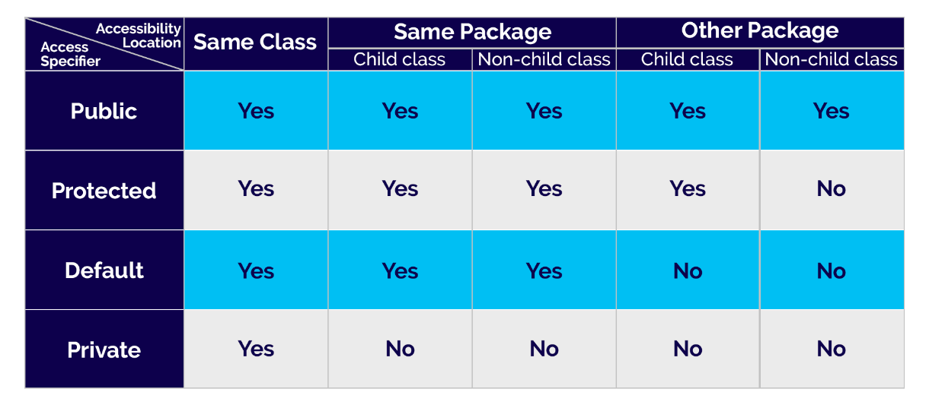
Access Protection for Packages

Slide 12
Access Protection in same Package (Example)
package myPackage1;
class A {
int n = 1; public int p = 2;
protected int q = 3; private int r = 4;
public A() {
System.out.println("In constructor A");
System.out.println("n = "+n);
System.out.println("p = "+p);
System.out.println("q = "+q);
System.out.println("r = "+r);
}
}
class MainClass {
public static void main(String[] args) {
A obj1 = new A();
}
}
Output:
In constructor A
n = 1
p = 2
q = 3
r = 4

Slide 13
Access Protection in same Package (Example)
package myPackage1;
class A {
int n = 1; public int p = 2;
protected int q = 3; private int r = 4;
public A() {
System.out.println("In constructor A");
System.out.println("n = "+n);
System.out.println("p = "+p);
System.out.println("q = "+q);
System.out.println("r = "+r);
}
}
class B extends A {
public B() {
System.out.println("In constructor B");
System.out.println("n = "+n);
System.out.println("p = "+p);
System.out.println("q = "+q);
System.out.println("r = "+r);
}
}
class MainClass {
public static void main(String[] args) {
B obj = new B();
}
}
Output:
Error: r has private access in A System.out.println("r = "+r);
^

Slide 14
Access Protection in same Package (Example)
package myPackage1;
class A {
int n = 1; public int p = 2;
protected int q = 3; private int r = 4;
public A() {
System.out.println("In constructor A");
System.out.println("n = "+n);
System.out.println("p = "+p);
System.out.println("q = "+q);
System.out.println("r = "+r);
}
}
class C {
A a = new A();
public C() {
System.out.println("In constructor C");
System.out.println("n = "+a.n);
System.out.println("p = "+a.p);
System.out.println("q = "+a.q);
System.out.println("r = "+a.r);
}
}
class MainClass {
public static void main(String[] args) {
C obj = new C();
}
}
Output:
Error: r has private access in A System.out.println("r = "+a.r);
^

Slide 15
Access Protection in different Package (Example)
package myPackage2;
import myPackage1.*;
class X extends myPackage1.A {
public X() {
System.out.println("In constructor X");
System.out.println("n = "+n);
System.out.println("p = "+p);
System.out.println("q = "+q);
System.out.println("r = "+r);
}
}
class MainClass {
public static void main(String[] args) {
X obj = new X();
}
}
Output:
Error: n is not public in A; cannot be accessed from outside package System.out.println("n = "+a.n);
^
Error: r has private access in A System.out.println("r = "+a.r);
^

Slide 16
Access Protection in different Package (Example)
package myPackage2;
import myPackage1.*;
class Y {
public Y() {
A a = new A();
System.out.println("In constructor Y");
System.out.println("n = "+a.n);
System.out.println("p = "+a.p);
System.out.println("q = "+a.q);
System.out.println("r = "+a.r);
}
}
class MainClass {
public static void main(String[] args) {
Y obj = new Y();
}
}
Output:
Error: n is not public in A; cannot be accessed from outside package System.out.println("n = "+a.n);
^
Error: q has protected access in A System.out.println("q = "+a.q);
^
Error: r has private access in A System.out.println("r = "+a.r);
^

Slide 17
Built-in Packages in Java
Java has many built-in packages that consist of a large number of classes which are a part of Java API. Some of the commonly used built-in packages are:
java.lang: Contains language support classes(e.g., classes which defines primitive data types, math operations). This package is automatically imported.
java.io: Contains classes for supporting input / output operations.
java.util: Contains utility classes which implement data structures like Linked List, Dictionary and support classes for Date / Time operations.
java.applet: Contains classes for creating Applets.
java.awt: Contain classes for implementing the components for graphical user interfaces (like button , menus, etc.).
java.net: Contain classes for supporting networking operations.
java.sql: Provides the classes for accessing and processing data stored in a database.

Slide 18
Runtime input in Java
In Java, you can read input from the user at runtime using the ‘Scanner’ class, which is part of the java.util package.
Here’s how you can use ‘Scanner’ to read input from the console during program execution:
Import the Scanner class: import java.util.Scanner;
Create a Scanner object:
Scanner scanner = new Scanner(System.in);
You can now use the ‘Scanner’ object to read various types of input, such as
integers, doubles, strings, etc.
Read input from the user. Use methods like next(), nextInt(), nextDouble(),
etc., to read input from the user.

Slide 19
Runtime input (Example)
import java.util.Scanner;
class InputExample {
public static void main(String[] args) {
Scanner scanner = new Scanner(System.in);
System.out.print("Enter a string: ");
String s = scanner.next();
System.out.print("Enter an integer: ");
int n = scanner.nextInt();
System.out.print("Enter a double: ");
double d = scanner.nextDouble();
scanner.close();
System.out.println("You entered...: ");
System.out.println("String: "+s);
System.out.println("Integer: "+n);
System.out.println("Double: "+d);
}
}
Output:
Enter a string: Java
Enter an integer: 4003
Enter a double: 23.45
You entered…:
String: Java
Integer: 4003
Double: 23.45

Slide 20
next() vs nextLine() for String input
import java.util.Scanner;
class StringInput1 {
public static void main(String[] args) {
Scanner scanner = new Scanner(System.in);
System.out.print("Enter a string: ");
String s = scanner.next();
scanner.close();
System.out.println("You entered: "+s);
}
}
import java.util.Scanner;
class StringInput2 {
public static void main(String[] args) {
Scanner scanner = new Scanner(System.in);
System.out.print("Enter a string: ");
String s = scanner.nextLine();
scanner.close();
System.out.println("You entered: "+s);
}
}
Output:
Enter a string: Hello UPES
You entered: Hello
Output:
Enter a string: Hello UPES
You entered: Hello UPES
next() reads the input string up to the first whitespace.
nextLine() reads the input string up to the enter key.

Slide 21
Single Character input
To input a single character, you can use the charAt() method, present in the java.lang.String class.
It takes only the first character present in a string. Hence, even if mistakenly more than one characters are entered, only the first character is taken as input.
import java.util.Scanner;
class CharInput {
public static void main(String[] args) {
Scanner scanner = new Scanner(System.in);
System.out.print("Enter a character: ");
char ch= scanner.next().charAt(0);
scanner.close();
System.out.println("You entered: "+ch);
}
}
Output:
Enter a character: j
You entered: j
Enter a character: java
You entered: j

Slide 22
Summary
Today, we learned about
Package definition, use in Java
Package naming conventions
Type imports (Single type, All type, Static import)
Access protection for Packages
Java Built-in Packages
Runtime user input in Java
next() vs nextLine() method
Single character input

Slide 23


