Slide 1
MINOR PROJECT Spam Detection

Slide 2

Team Members
-> Devendra Singh
-> Suraj Kumar
-> Kishan Kumar
-> Raju kumar
2

Slide 3
ABSTRACT
The popularity of mobile devices is increasing day by day as they
provide a large variety of services by reducing the cost of services. Short
Message Service (SMS) is considered one of the widely used communication
service. However, this has led to an increase in mobile devices attacks like SMS
Spam. In this paper, we present a novel approach that can detect and filter the
spam messages using machine learning classification algorithms. We study the
characteristics of spam messages in depth and then found ten features, which can
efficiently filter SMS spam messages from ham messages. Our proposed
approach achieved 96.5% true positive rate and 1.02% false positive rate for
Random Forest classification algorithm.
Keywords: SMS spam Mobile devices Machine learning Feature selection
3

Slide 4
1. Introduction
Short Message Service (SMS) is one of the popular communication services in which a
message is sent electronically. The reduction in the cost of SMS services by telecom
companies has led to the increased use of SMS. This rise attracted attackers which have
resulted in SMS Spam problem. A spam message is generally any unwanted message
that is sent to user’s mobile phone. Spam messages include advertisements, free services,
promotions, awards, etc. People are using SMS messages to communicate rather
than emails because while sending SMS message there is no need of internet connection
and it is simple and efficient .
The SMS Spam problem is increasing day by day with the increase in the use of
text messaging. There are various security measures available to control SMS Spam
problem but they are not so mature. Many android apps are also on play store to
block spam messages but people are not aware of these apps due to lack of knowledge.
Other than apps the filtering techniques available mainly focuses on email spam as
email spam is one of the oldest problem [5] but with the popularity of mobile devices,
SMS spam is the one of the major issue these days.
SMS is one of the cheapest ways to communicate and can be considered as the
simplest way to perform phishing attacks as mobile devices contain sensitive and personal
information like card details, username, password, etc. Attackers are finding
different ways to steal this information from mobile devices and SMS is one of the
easiest ways. Smishing i.e. SMS based Phishing is more popular these days in which
4

Slide 5
Introduction
user sends malicious link via SMS and asks user to visit that link and steals sensitive
information from user’s mobile device. There are various detection approaches available
for detecting mobile phishing like QR code, machine learning based, biometric based,
matrix code reader based, knowledge based and authentication based [9].
SMS spammers can purchase any mobile number with any area code to send spam
messages so that it becomes difficult to identify the attacker. US tatango learning center
provided the list of top 25 SMS Spam area codes used by spammers .
5

Slide 6
Problem Formulation
In SMS, there are a set of k text messages 𝑇𝑀 = {𝑡𝑚1 , … ,𝑡𝑚𝑘}. Each
message is limited to 160 characters consisting of words, number, etc. Messages can be
about any topic (see samples messages in Figure 1.). The tasks of SMS spam detection is to
predict whether 𝑡𝑚𝑖 is a spam (A) or non-spam (B) by using a classifier 𝑐. The problem is
formulated below: 𝑐:𝑡𝑚𝑖 → {𝑠𝑝𝑎𝑚, 𝑛𝑜𝑛 − 𝑠𝑝𝑎𝑚} To support the classification, we need to first
extract a set of 𝑛 features 𝐹 = {𝑓1 , … , 𝑓𝑛} from 𝑇𝑀.
6

Slide 7
Proposed Methodolgy
The main objective of our approach is to classify the spam SMS messages as soon as it
received on the mobile phone, regardless of newly created spam message (zero-hour
attack). In this, we firstly collected dataset and finalized the features for our experiment.
After finalizing features, we extracted the features from the messages (ham and spam)
to create a feature vector. These feature vectors are used for training and testing
purposes. Our proposed system takes the decision based on ten features. In the training phase, a binary classifier is generated by applying the feature vectors of spam and ham messages. In the testing phase, the classifier determines whether a new message is a spam or not. At the end we get classification results for different machine learning algorithms and performance is evaluated for each machine learning algorithm such that we can get the
best algorithm for our proposed approach.
7

Slide 8
System Architecture
Feature
Selection
Feature
Extraction
Spam
Count
Vectorizer
SMS
DB
Preprocessing
Training
Collection
Classification
Tfidf
Vectorizer
Non-
Spam
Test
Collection

Slide 9
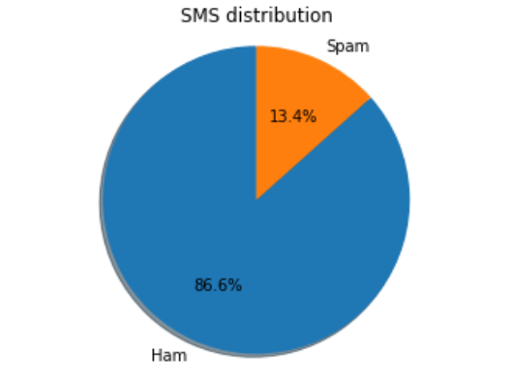
About Dataset
Dataset Size (5572 , 2)
Spam: A collection of 747 SMS spam messages.
Non-Spam (Ham): A Collection of 4,825 non-spam messages
9

Slide 10
Feature Extraction
CountVectorizer
The CountVectorizer provides a simple way to both tokenize a collection of text documents and build a vocabulary of known words, but also to encode new documents using that vocabulary
TfidfVectorizer
Transforms text to feature vectors that can be used as input to estimator.
10
10

Slide 11
Machine Learning Algorithms
Logistic Regression – It is the appropriate regression analysis to conduct when the dependent variable is dichotomous (binary).
Naive Bayes -It is a classification technique based on Bayes’ Theorem with an assumption of independence among predictors. In simple terms, a Naive Bayes classifier assumes that the presence of a particular feature in a class is unrelated to the presence of any other feature.
11

Slide 12
Machine Learning Algorithms
k- NEAREST NEIGHBOURS (KNN) –k-nearest neighbour can be applied to the classification problems as a simple instance-based learning algorithm. In this method, the label for a test sample is predicted based on the majority vote of its k nearest neighbours. K nearest neighbours is a simple algorithm that stores all available cases and classifies new cases based on a similarity measure (e.g., distance functions). KNN has been used in statistical estimation and pattern recognition already in the beginning of 1970’s as a non-parametric technique.
12

Slide 13
Machine Learning Algorithms
RANDOM FOREST –Random forests is an averaging ensemble method for classification. The ensemble is a combination of decision trees built from a bootstrap sample from training set. Additionally, in building the decision tree, the split which is chosen when splitting a node is the best split only among a random set of features. This will increase the bias of a single model, but the averaging reduces the variance and can compensate for increase in bias too. Consequently, a better model is built. In this work, the implementation of random forests in scikitlearn python library is used, which averages the probabilistic predictions. Two number of estimators are simulated for this method. With 10 estimators, the overall error is 2.16%, SC is 87.7 %, and BH is 0.73%. Using 100 estimators will result in overall error of 1.41 %, SC of 92.2 %, and BH of 0.51 %. We observe that comparing to the naive Bayes algorithm, although the complexity of the model is increased, yet the performance does not show any improvement.
13

Slide 14
Machine Learning Algorithms
SUPPORT VECTOR MACHINES –Linear kernel gains better performance compared to other mappings. Using the polynomial kernel and increasing the degree of the polynomial from two to three shows improvement in error rates, however the error rate does not improve when the degree is increased further. Finally, applying the sigmoid kernel results in all messages being classified as hams.While the overall training set error of the model is far less than error rate for naive Bayes, the test set error is well above that rate. This characteristic shows the model might be suffering from high variance or overfitting on the data. One option we can explore in this case is reducing the number of features. However, the simulation results show degradation in performance after this reduction. For instance, choosing 800 best features based on MI with the labels and training SVM with linear kernel on the result yields to 1.53% overall error, 91.5% SC, and 0.53% BH. While applying SVM with different kernels increases the complexity of the model and subsequently the running time of training the model on data, the results show no benefit compared to the multinomial naive Bayes algorithm in terms of accuracy..
14

Slide 15
Machine Learning Algorithms
ADABOOST –Adaboost is a boosting ensemble method which sequentially builds classifiers that are modified in favor of misclassified instances by previous classifiers . The classifiers it uses can be as weak as only slightly better than random guessing, and they will still improve the final model. This method can be used in conjunction with other methods to improve the final ensemble model. In each iteration of Adaboost, certain weights are applied to training samples. These weights are distributed uniformly before first iteration. Then after each iteration, weights for misclassified labels by current model are increased, and weights for correctly classified samples are decreased. This means the new predictor focuses on weaknesses of previous classifier. We tried the implementation of Adaboost with decision trees using scikit-learn library. Like Random Forests, although the complexity is much higher, naive Bayes algorithm still beats Aadaboost with decision trees in terms of performance.
15

Slide 16
Evaluation Metrics
In order to evaluate the effectiveness of our proposed approach, we will consider eight possible outcomes i.e. true positive rate, false positive rate, true negative rate, false negative rate, f1 score, accuracy, precision, and recall. These are the standard metrics to judge any spam detection system. These evaluation metrics are described in brief as follows:-
16

Slide 17
Evaluation Metrics
True Positive Rate (TP) - It denotes the percentage of spam messages that were
accurately classified by the machine learning algorithm. If we denote spam messages
as S and spam messages that were accurately categorized as P, then
TP =P/S
True Negative Rate (TN) - It denotes the percentage of ham messages that were
accurately categorized as ham messages by the machine learning algorithm. If we
denote ham message as H and ham messages that were accurately categorized as
ham by Q, then
TN =Q/H
17

Slide 18
Results and Discussion
Various experiments are performed to evaluate the performance of our proposed SMS
Spam detection system. Initially we have selected features on the basis of behavior of
spam and ham messages and then extracted these features from the dataset to get the
feature vector. After extracting features from the dataset, various classification algorithms
like Naïve Bayes, Logistic Regression, Decision Tree ,MLP ,Random Forest and Support Vector
Machine (SVM) is being applied to get the performance metrics.
18

Slide 19
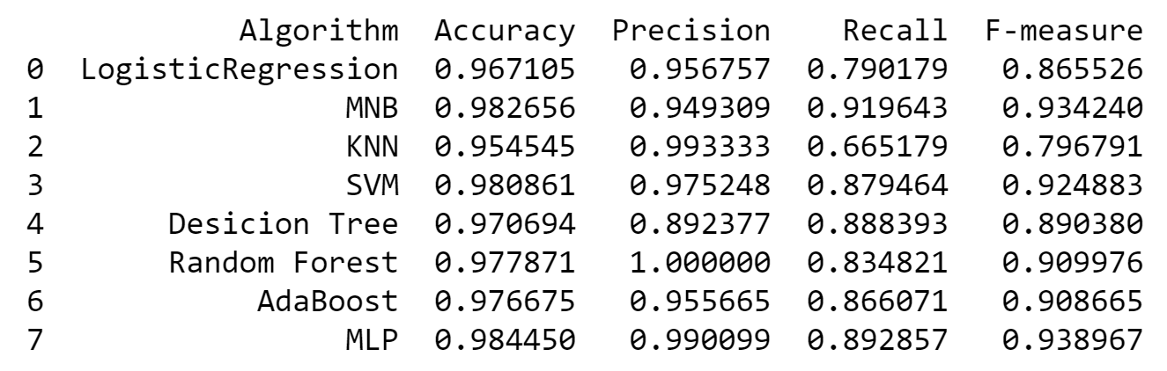
Results of proposed approach on various machine learning algorithms
19

Slide 20
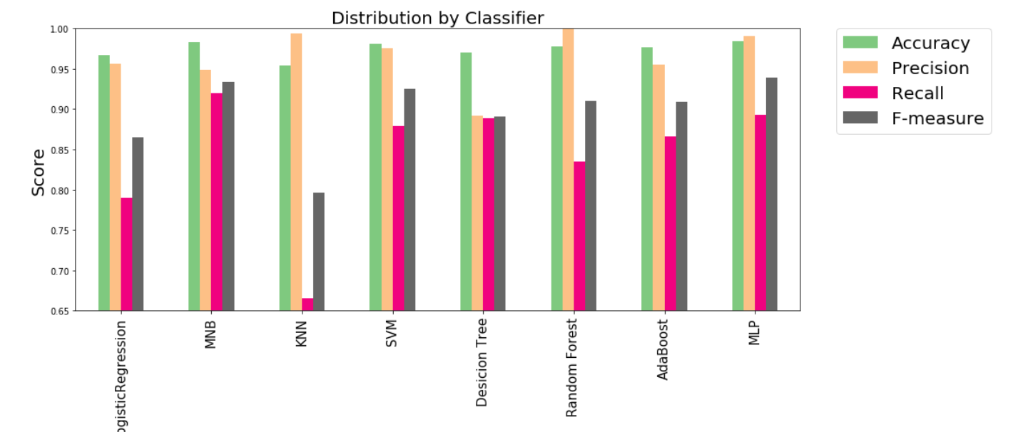
Results of proposed approach on various machine learning algorithms
20

Slide 21
Conclusion
The SMS Spam problem is increasing nowadays with the increase in the use of text
messaging. SMS Spam filtering is the big challenge these days. In this paper, we
propose a technique for SMS Spam filtering based on 10 feature using eight machine
learning algorithms namely Logistic Regression, Naïve Bayes, K means , SVM , Decision Tree ,
Random Forest. , AdaBoost and MLP. The dataset that we have used in our work consists of 5572 messages. Out of all classification algorithms,Random Forest Classification Algorithm gives best results.
21

