Slide 1
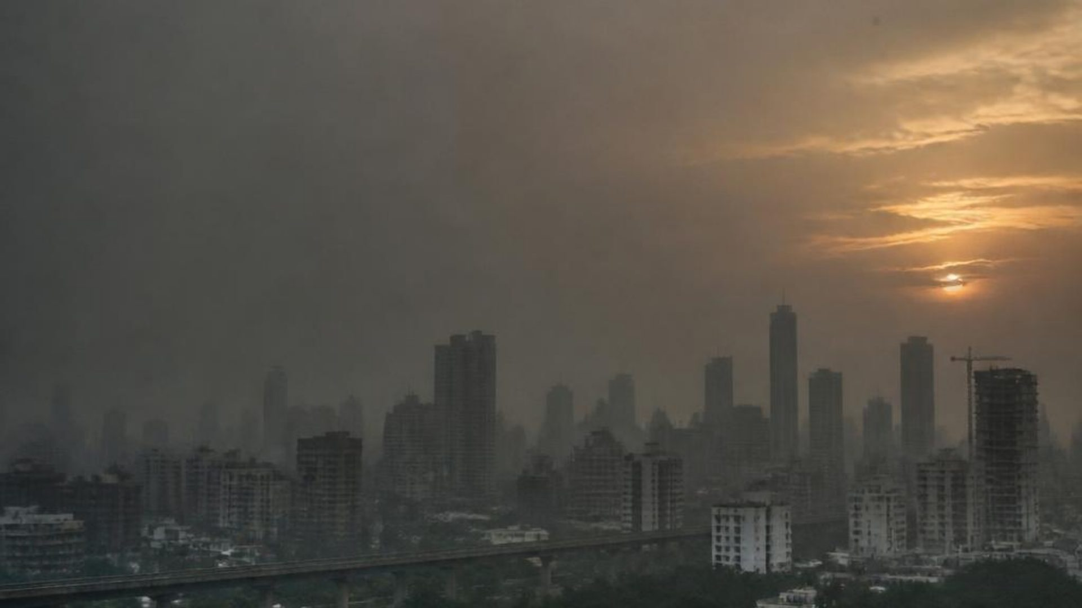


TRACK 2 — CLEAN AIR & CLIMATE RESILIENCE
NorAQI
AI-Powered Hyperlocal Air Quality
Reporting & Advisory
Google Developer Hackathon 2026
TEAM NAME
TEAM MEMBER
NorAQI
Suraj Maharana

Slide 2

02 / CONTEXT
Air quality is local. Guidance should be too.
The Problem
01
02
03
04
Limited
Citizens have
Official AQI
People receive
hyperlocal
no simple
updates may
little
pollution
platform to
not always
personalized
monitoring.
report
reflect
environmental
pollution
real-time local
guidance.
incidents.
conditions.
There is a need for an intelligent, citizen-driven air quality monitoring
platform powered by AI.

Slide 3
Our Solution
03 / PRODUCT LOGIC
Citizen
FROM CITIZEN SIGNAL TO ACTIONABLE GUIDANCE
NorAQI Dashboard
↓
CORE CAPABILITIES
↓
Google Gemini AI
Live Weather
Live Weather + Official AQI
↓
Official AQI Monitoring
↓
AI-generated Advisory
Citizen Pollution
Reporting
↓
Citizens & Authorities
AI-powered Report
Analysis
↓
AI-generated Air Quality
Advisory

Slide 4
04 / BUILD
Built for a fast, transparent prototype
Technology Stack
GOOGLE TECHNOLOGIES
FRONTEND
BACKEND
Gemini API
Streamlit
Python
Google AI Studio
HTML / CSS
Application logic
LIBRARIES
EXTERNAL DATA SOURCES
Pandas
Open-Meteo API
OSPCB
Requests
Live weather signals
Official AQI reference
Generative AI is used to analyze pollution reports, classify incidents, and generate contextual
advisories.

Slide 5
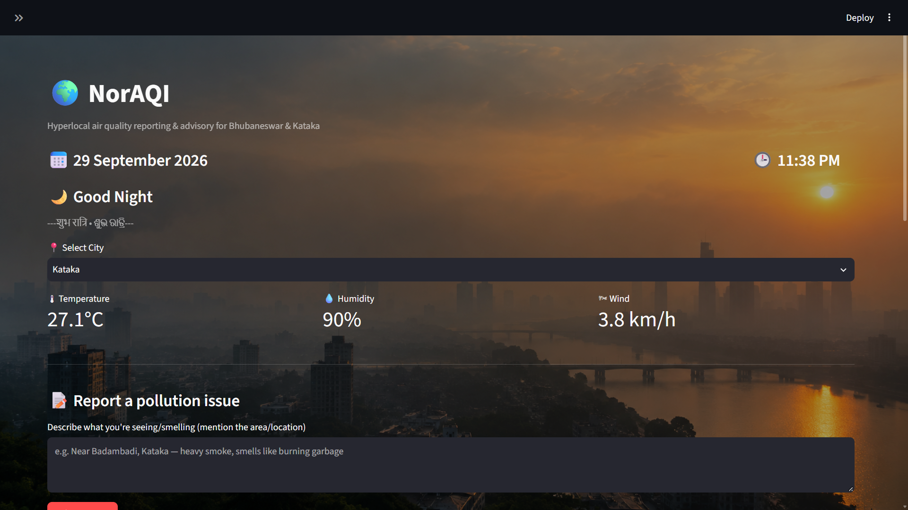
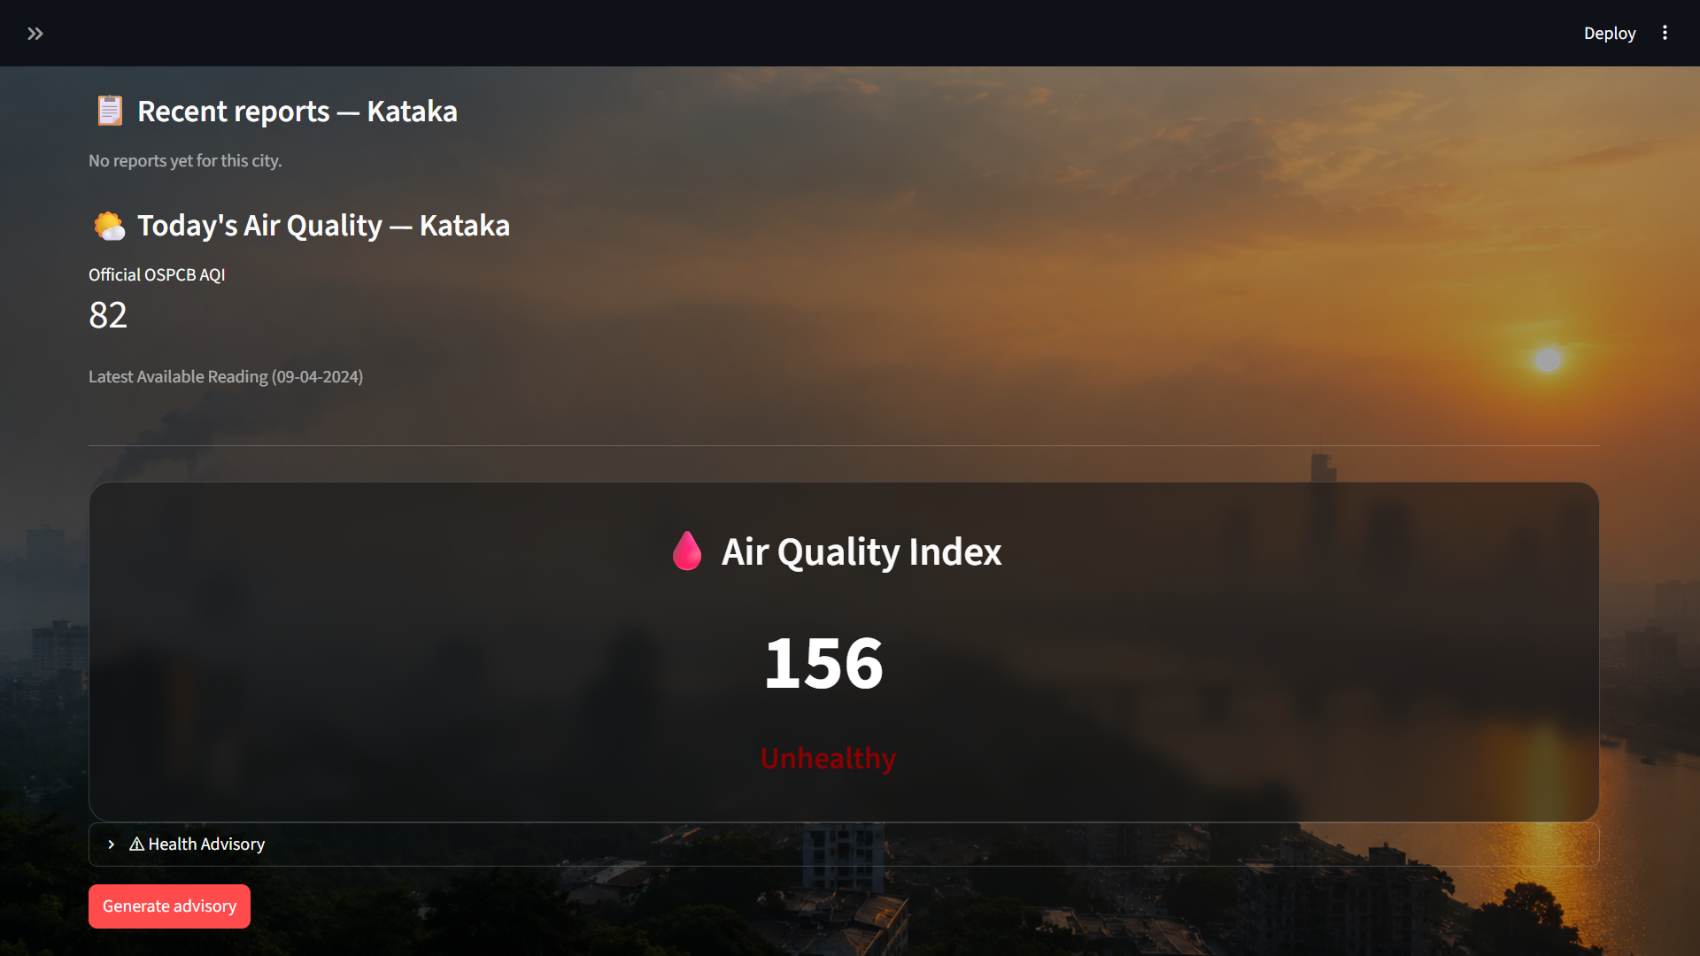
05 / DEMONSTRATION
A two-minute path from observation to action
Prototype Walkthrough
SIX-STEP FLOW
APPLICATION SCREENS
1
Select City
↓
2
View Live Weather
↓
3
Check Official AQI
↓
Submit Pollution
Report
4
Advisory preview
↓
placeholder
5
Gemini AI Analysis
↓
Generate AI
Advisory
City dashboard
Weather + AQI
Citizen report
AI advisory
6

Slide 6
06 / NEXT
Impact & Future Scope
Impact
Future Scope
Encourages citizen participation
Android application
Faster pollution reporting
Google Maps integration
Hyperlocal environmental
awareness
IoT air quality sensors
Predictive AQI forecasting
AI-assisted decision support
Government monitoring dashboard
Supports cleaner and healthier
communities
“Empowering communities with AI for cleaner air.”

