Slide 1
INTRODUCTION
The system is developed through ARM microprocessor. The two techniques we are taking in to consideration are facial recognition and speech recognition. The system aims to implement a face recognition software code and to successfully implement this code on Raspberry Pi platform for real time recognition. Raspberry Pi is a credit card size computer supporting an ARM 11 processor, developed in UK by Raspberry Pi foundation. Raspberry Pi model functions as a regular desktop computer when it is connected to the keyboard or monitor. Raspberry Pi is very cheap and most reliable to make a Raspberry Pi super computer. The Raspberry Pi use Linux kernel-based operating systems, Raspbian. This project is very useful in real time situations for providing instant access to one’s personal information and it can also be used as a search engine.

Slide 2
Features of our system
Face Recognition
Speech Recognition
Auto-Login Mechanism
Personal Assistant

Slide 3
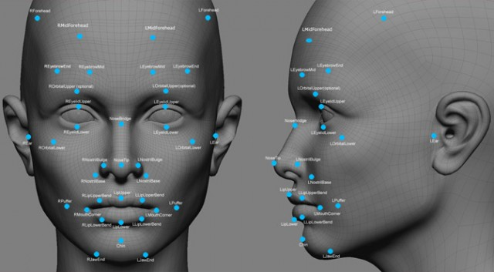
Face Recognition:
In face recognition there are two types of comparisons:-
Verification- The system compares the given individual with who they say they are and gives a yes or no decision
Identification- The system compares the given individual to all the other individuals in the database and gives a ranked list of matches

Slide 4

Speech Recognition:
Speech recognition (SR) is the inter-disciplinary sub-field of computational linguistics which incorporates knowledge and research in the linguistics, computer science, and electrical engineering fields to develop methodologies and technologies that enables the recognition and translation of spoken language into text by computers and computerized devices such as those categorized as smart technologies and robotics. It is also known as "automatic speech recognition" (ASR), "computer speech recognition", or just "speech to text" (STT).

Slide 5

Auto-Login Mechanism:
In this we are concentrating on cloud computing. Cloud computing is a type of internet based computing that provide shared computer processing resources and data to computer and other devices on demand. After the recognition part system logs in to the respective social media as per the details previously stored in the cloud.

Slide 6
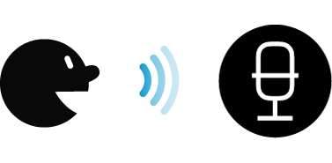
Personal Assistant
It can also be used as our personal assistant like ‘Ok Google’ , ’Siri’, etc.
We are using the jasper text recognition in this system.
We in addition to the voice recognition to navigate to a particular web page ,
It also serves as an excellent Personal Assistant.
It will search for a required item on the web as per the requirements of the user.

